Slide 1

Flange Leak Upstream of
C-127 Debut Column
Jason Grant
Arlene Lee

Slide 2
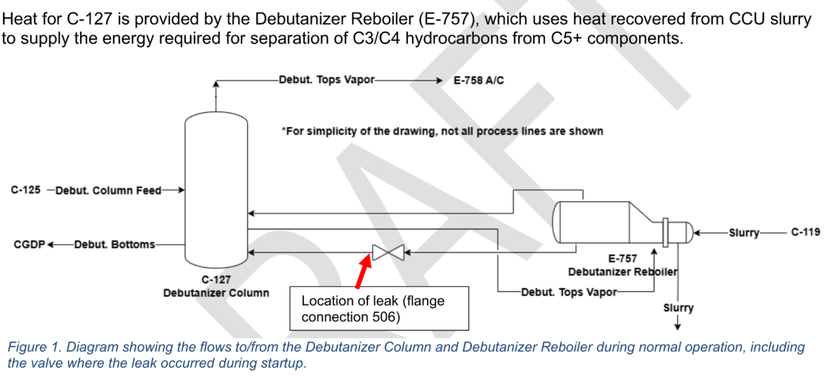
Fact:

Slide 3
Fact:
On 5/3/2026, a leak was discovered on flange connection #506 upstream of C-127 in the Catalytic Gas Plant (CGP) during unit startup.
Approximately 1,917 lbs of Naphtha-range liquid leaked and ~454 lbs of Naphtha-range vapor were released.
It is found that the leak was caused by a plastic flange cover left in the pipe flange connection.
When the flow temperature reached the melting point of the plastic cover, the plastic flange cover melted, causing the studs to lose tension, allowing hydrocarbon to be released at flange connection #506.
A continuous gas monitoring device approximately 35 ft. away from the leak location alarmed on LEL registering at 14%. A unit evacuation was initiated, and the Basic Fire Crew (BFC) responded.
Operations then de-pressured and de-inventoried the column for repair. Contra Costa County (the County) issued a Community Warning System Level 1 notification for flaring.
The incident did not cause physical harm to any onsite personnel.

Slide 4
Impact
Uncontrolled release of light thermal cracked Naphtha.
Delay in Cracked Products (CP) startup activities .
Potential for fire at CGP.

Slide 5
Root Causes
1. No company standard against flange protectors that only cover the raised face with the same diameter as the raised face.
2. Requirements for flange tags are not strict enough.

Slide 6
Recommendations
1. Add requirements of flange protectors to standards, policies, and/or procedures.
1.1 Make it standard practice to replace flange protectors with ones that go through or cover the bolt holes if incorrect protector is found.
1.2 Add this requirement to standards, policies, and procedures. This could include GMP-13 and/or GMP-30. Ensure associated training is updated.
1.3 Remove flange protectors that do not go through or cover the bolts holes from all flanges being stored on site and replace with flange protectors that go through the bolt holes.
1.4 Check for stored flange protectors that do not go through or cover the bolt holes and dispose of any flange protectors found that do not go through or cover the bolt holes.

Slide 7
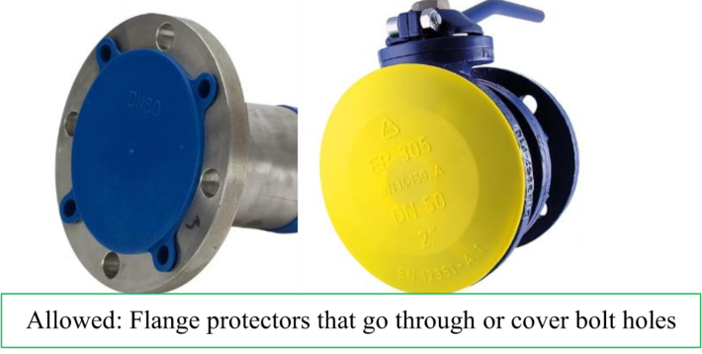
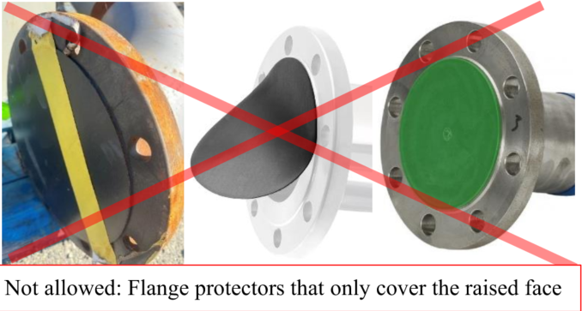
Recommendations

Slide 8
Recommendations
2. Make the flange tags a mandatory requirement
2.1 Update wording in GMP-30 to state that flange tags are required for all bolted joint assemblies. Ensure associated training is updated.
2.2 Disseminate information that flange tags are required for all bolted flange joint assemblies to TA, Non-routine Maintenance, and project construction group.

Slide 9

Q & A

