Slide 1
Wildland and Process Unit Fires
CAER Safety Summit, April 22, 2026
Notes:
background

Slide 2
Topics
Published Studies and Key Points
Public Exposure References
Cal/OSHA Wildfire Smoke Standard
Refinery Process Unit fire
Other

Slide 3
Published Studies
J Geo Research, Kuwaiti oil fires: Compositions of source smoke. 1992.
Oil Spill Conf, Advantages and disadvantages of burning spilled oil. 1993
Atm Envir, Geometric/aerodynamic equivalent diameter rations of ash aggregate aerosols collected in burning Kuwaiti well fields. 1994
AIHA Journal, Air emissions from petroleum hydrocarbon fires during controlled burning. 1997
A J of Epid, Are gulf war veterans experiencing illness due to exposure to smoke from Kuwaiti oil well fires? Examination of Department of Defense hospitalization data. 2002
Thorax, Respiratory health status of Australian veterans of the 1991 Gulf Wat and the effects of exposure to oil fire smoke and dust storms. 2003
J Geo Research, Emissions of trace gases and particles from savanna fires in southern Africa. 2003
Observations of the plume generated by the December 2005 oil depot explosions and prolonged fire at Buncefield and associated atmospheric changes. 2006
Atm Environ, Modelling pollutants dispersion and plume rise from large hydrocarbon tank fires in neutrally stratified atmosphere. 2010
CTEH, Petroleum smoke incident support, the composition and adverse health effects of petroleum fire smoke. 2015
NIST, Polycyclic aromatic hydrocarbons and select inorganics in smoke from various WUI fire fuels. 2025
AIHA, Post-fire Assessment and Sampling Plan. Draft (in peer review) 2025

Slide 4
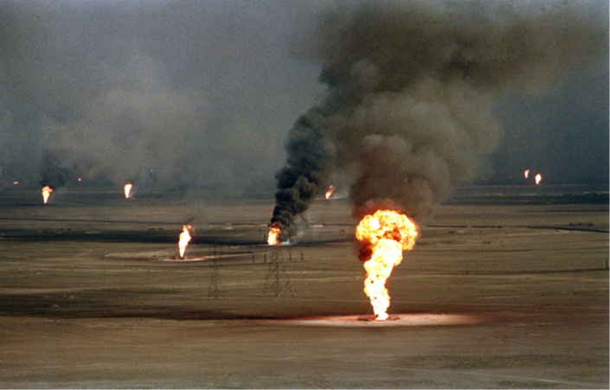
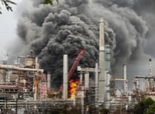
Study Key Points
Ground-level exposures and thermal rise
Gulf War Veterans dose-response
Wildfire smoke organics created
Petroleum fire combustion
Wildfire and petroleum smoke similarity
SO2 in petroleum smoke
WUI fire chronic toxins

Slide 5
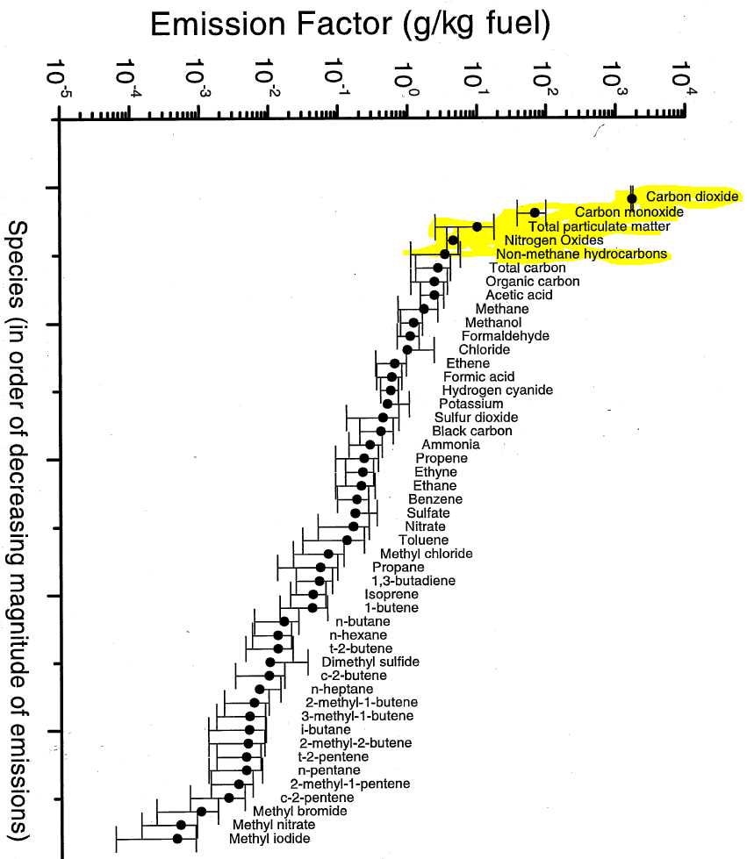
Wildfire Smoke
Decreasing percentage (wt):
CO2: 90 - 94
CO: 1 - 3
Total Particulate 2 - 3
NOx: <1
Non-methane hydrocarbons: <1
Other compounds <1
WUI Smoke – additional toxins

Slide 6
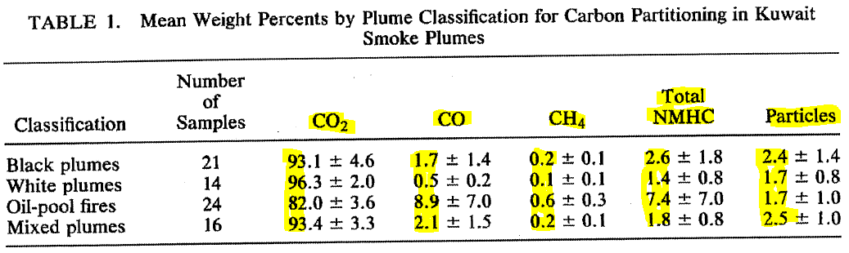
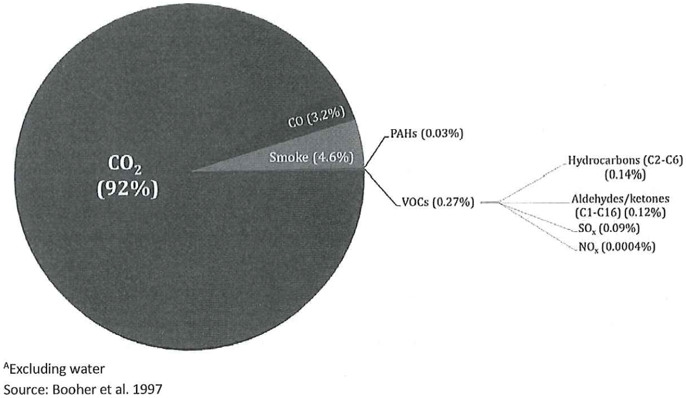
Petroleum Smoke
Decreasing percentage (wt):
CO2: 82 - 97
CO: 1 - 9
“smoke” i.e. Particulate: 2 – 5
“VOCs”: <1 - 7
  Hydrocarbons (C2-C6)
  aldehydes/ketones
  PAHs
  SO2
  NOx

Slide 7
Public Exposure References
EPA
  CO: 9 ppm (8 hr avg.) or 35 ppm (1 hr avg.)
  SO2: 0.075 ppm (1 hr avg.)
  AQI >100: “unhealthy for sensitive individuals”
    Particulate <2.5 µm: 35 µg/M3 (24 hr avg.)
    Particulate <10 µm: 150 µg/M3 (24 hr avg.)
OEHHA
  CO: 20 ppm (1 hr avg.)
  SO2: 0.25 ppm (1 hr avg.)
  H2S: 0.03 ppm (1 hr avg.)

Slide 8
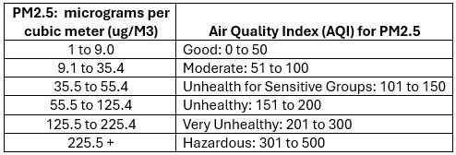
Cal/OSHA Wildfire Smoke Standard
Based upon PM2.5 (respirable fraction)
Training on hazards of smoke inhalation
Identification of harmful exposures
  start of shift and periodically re-check
PM2.5 concentration and AQI for PM2.5 – not 1:1
Control of harmful exposures
  shelter with PM2.5 AQI of 151 (if feasible), or
  admin controls, or
  Masks / Respirators:
    PM2.5 AQI 151 to 500 – N95 masks (e.g. COVID use)
    PM2.5 AQI >500 – respirator that results in AQI <151

Slide 9
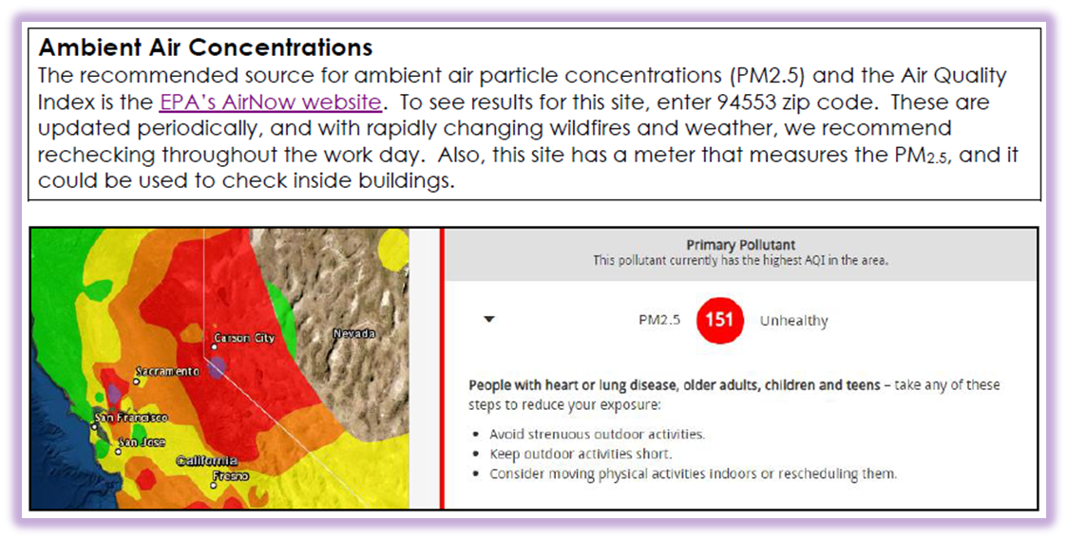
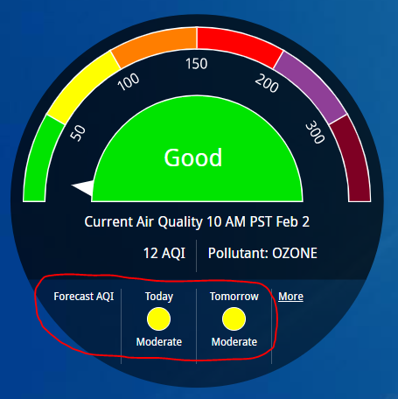
Wildfire Smoke Program
Example
AirNow checks
e-mail AQI with controls
N-95 respirator stock
HVAC MERV 13
DRI PM 2.5

Slide 10
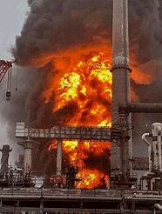
Process Fire Sampling & Testing
Sampling with Real-time Detectors on/off-site
  Particulate PM 2.5 and 10
  CO (<=2 ppm)
  SO2
  VOC on PID
  Benzene
  H2S
Analytical Testing Done
  Asbestos surfaces and bunker gear
  Surface wipes for PAHs
  Urinary phenol, s-PMA, or 1-HP

Slide 11
Incident Observations
Road access
Police respirator
Background particulates
Local meteorological conditions

Slide 12
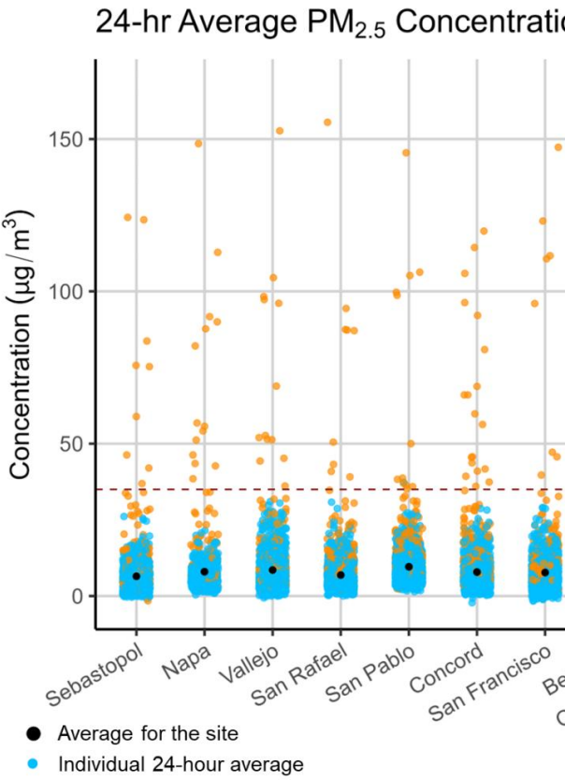
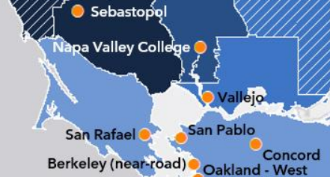
Other Information
BAAQMD – PM2.5 stations nearby
Two new stations to be added...
2025_five_year_network_assessment-pdf.pdf

Slide 13
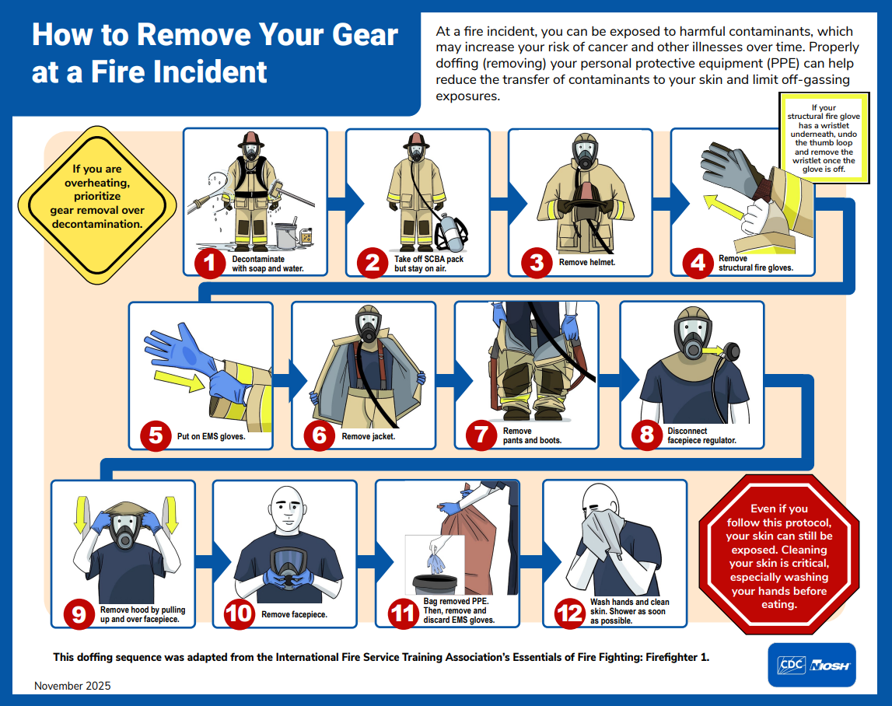
New NIOSH Guidance to Reduce Firefighter Exposure
Notes:
Published late 2025 by NIOSH.

Slide 14
Questions?
Corrections?
Clarifications?
Explanations?

