Slide 1
Making Life Safer
Eliminating Transportation Risk & Protecting Communities

Slide 2
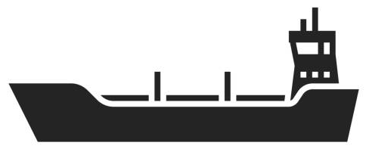
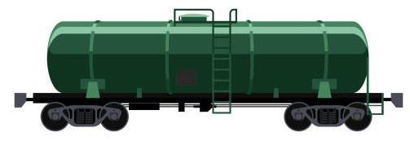
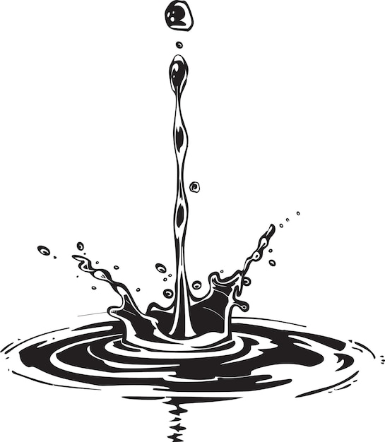
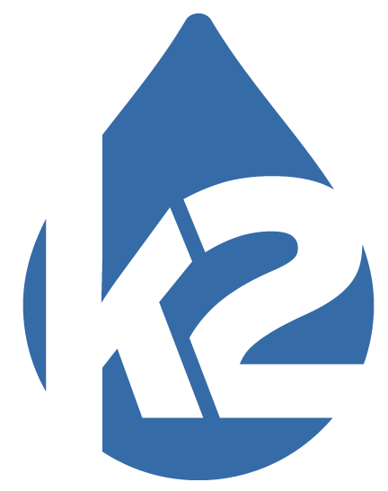
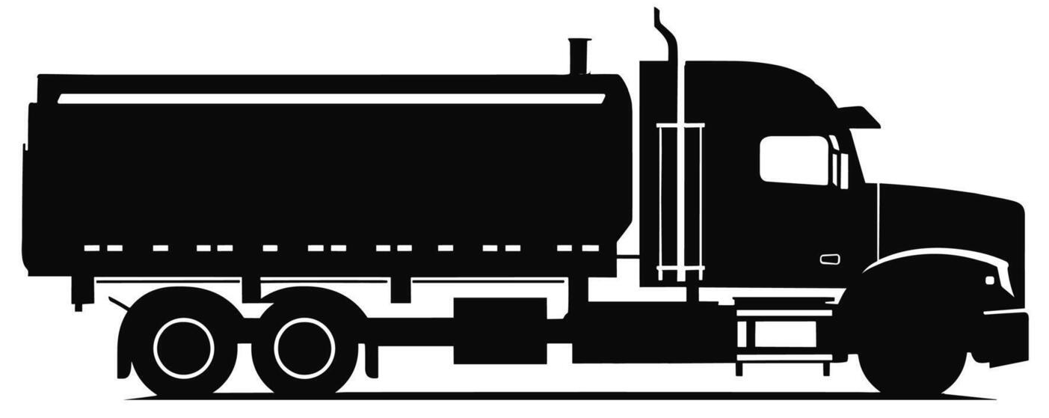
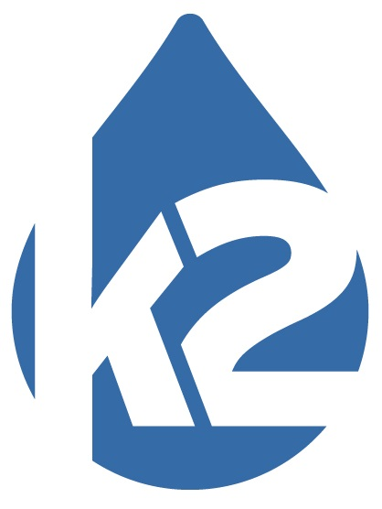
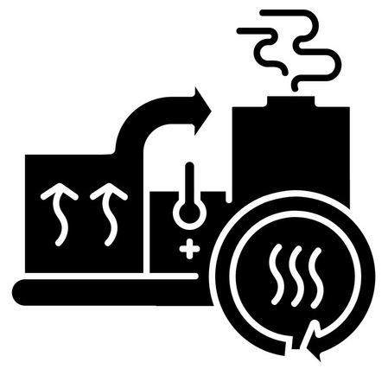
SODIUM
HYDROXIDE
SALT
HYDROCHLORIC
ACID
WATER
BLEACH
SODIUM
HYDROXIDE
HYDROCHLORIC
ACID
ELECTRICITY
1

Slide 3
Why K2 Was Built
Support Dow Chlorine Raw Material Need
Built to supply chlorine to Dow/Corteva (Pittsburg, CA) for their manufacturing process
Eliminated the need to transport liquid chlorine by rail from the Gulf Coast
Replaced ~1000+ chlorine railcar shipments annually eliminating the need for chlorine transportation
Supply Bleach for Clean Water Purposes
Globally, water is purified with chlorine or bleach
Traditionally, bleach is made by first producing chlorine and caustic, then shipping those to another facility that turns it into bleach. We perform this all onsite eliminating the need for chlorine transportation

Slide 4
Why Bleach Is Safer to Transport
 | Chlorine | Bleach
Transportation Method | Pressurized, liquefied gas requiring specialized railcars and strict controls | Liquid solution (non-pressurized) in easier and safer to handle trailers or railcars
Health Hazard | Potentially Fatal Toxic Vapor Cloud | Corrosive on contact
Potential Consequences of a transportation release | 2X IDLH* level up to 4.5miles away | Extremely localized corrosive hazards only.
*IDLH = Immediately Dangerous to Life and Health
Safety Advantage
Reduced potential for large-scale offsite impact
Safer for transport routes, communities, and emergency response
Lower hazard. Lower consequence. Safer for the communities we serve

Slide 5
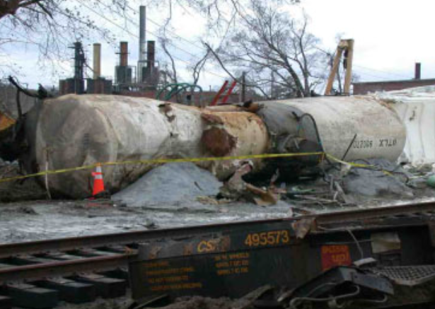
Real-World Incident – Graniteville, SC (2005)
Graniteville train crash Chlorine Release (South Caroline)
What Happened
Train collision led to a chlorine railcar breach
Large release of chlorine gas into the surrounding community
Impact
Multiple fatalities and serious injuries
Community evacuation and shelter-in-place orders
Long-term environmental and economic effects
Why It Matters
Demonstrates the high consequence of chlorine transport incidents
Offsite impact can occur rapidly and affect entire communities

Slide 6
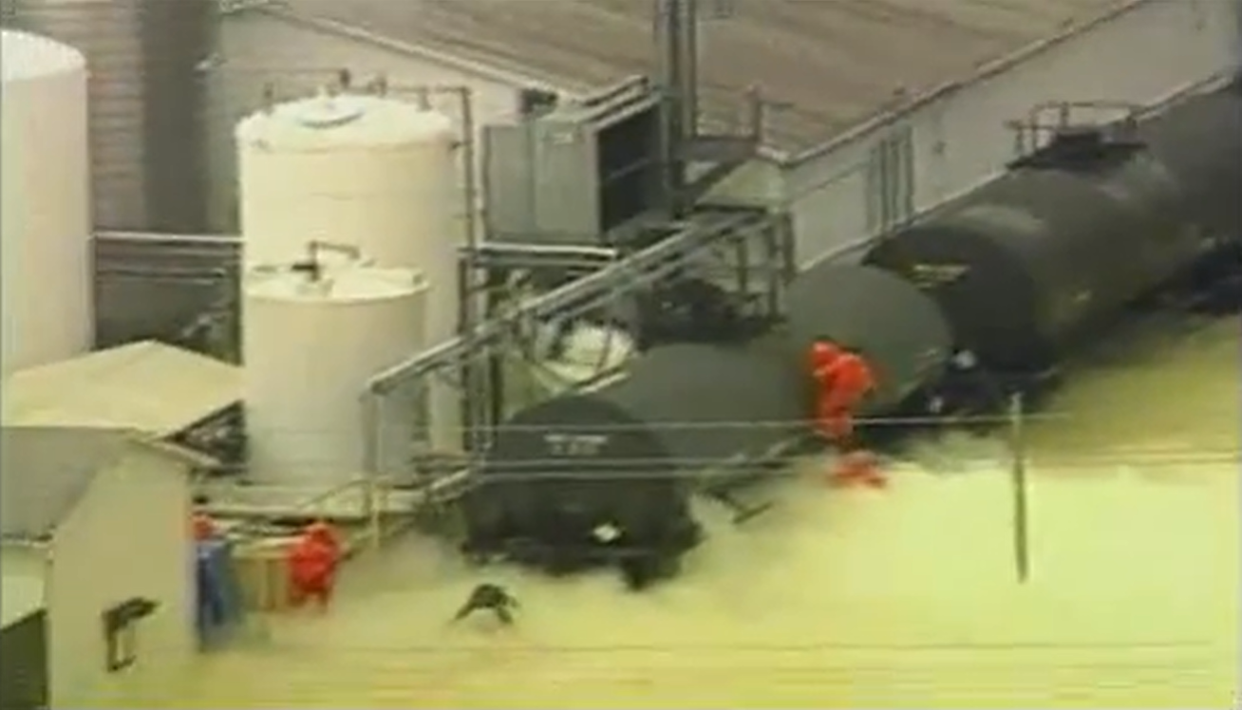
Real-World Incident – Festus, MO (2002)
DPC Enterprises Chlorine Release (Festus, Missouri)
What Happened
Failure during chlorine transfer (hose rupture)
Release occurred during unloading/handling operations
Impact
Worker exposure and injuries
Emergency response activation and area impact
Why It Matters
Risk isn’t just transport — handling and transfer are critical points
Even routine operations can lead to serious incidents

Slide 7
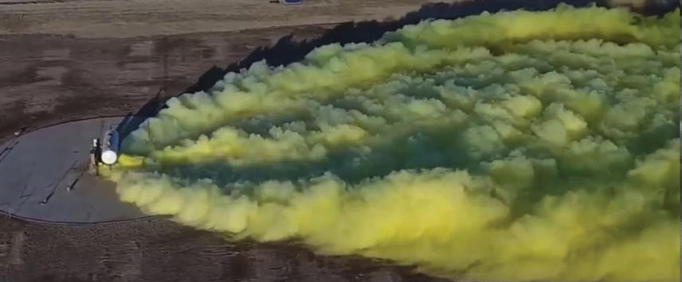



Jack Rabbit Testing Program
How We Know How Chlorine Travels

Slide 8
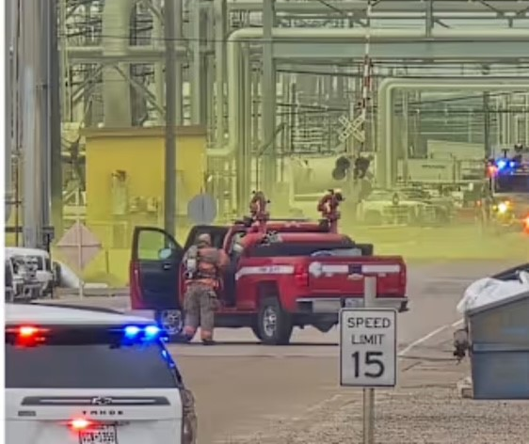
Our Impact – Reducing Risk, Protecting Communities
Eliminating Transportation Risk
Removed the need for ~1,000+ chlorine railcar shipments annually
Reduced hazardous material movement through surrounding communities
Safer Alternative
Transitioned to bleach (sodium hypochlorite) production
Lower risk during transport, storage, and handling
Reducing High-Risk Scenarios
Minimizes exposure to:
  Railcar derailments and releases
  Transfer and unloading incidents
Decreases potential for large-scale offsite impacts
Strengthening Emergency Preparedness
Active collaboration with HazMat teams and first responders
Ongoing drills, site access planning, and coordination

Slide 9
Building Partnerships & Emergency Preparedness
Collaboration with Contra Costa County Fire
Hosting plant tours with ConFire/HazMat to improve familiarity with the site
Enhancing communication and pre-incident understanding
PMAO Drill Participation
Recently led and participated in a coordinated emergency response walkthrough exercise
Included:
  Facility overview and walkthrough scenario
  Emergency vehicle access and gate entry points
  Identification of staging areas
  Pre-planning for potential incident response
  Key Findings
  Engine and attack vehicles are most effective for response
  Use of portable ground monitors identified as a critical tactic
  Improved clarity on response strategy and site access

Slide 10


Slide 11
Living our Motto: Making Life Safer
Producing chemicals essential for safe drinking water and wastewater treatment
Eliminating the need to transport bulk liquid chlorine
Managing remaining risk through world-class process safety programs

Slide 12
Our Safety Vision
Safety is our number one core value. We are uncompromising in our commitment to the health and safety of our employees, contractors, customers, and community.
Through this deep commitment, rooted in our ownership, driven by our management, and displayed in all levels of our organization, we have developed an incredible safety culture and management programs far exceeding regulatory requirements and even industry best practices.

Slide 13

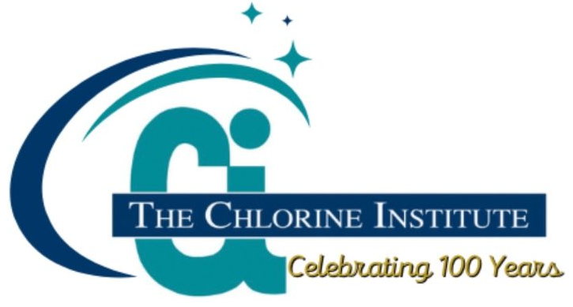
Process Safety & Risk Management
K2’s World Class Programs
K2’s philosophy is that in this industry of high hazard chemical manufacturing, World Class Process Safety & Risk Management programs are absolutely essential to meet the expectations of safety and reliability set by our leadership.
As such, we consider regulatory requirements to be merely the bare minimum and set our expectations far higher.
To achieve this, K2 layers additional systems, company specific expectations and redundant layers of protection on top of the required elements of each program.
PLATINUM PROCESS
SAFETY AWARD WINNER

Slide 14
WE’RE
HIRING

Slide 15
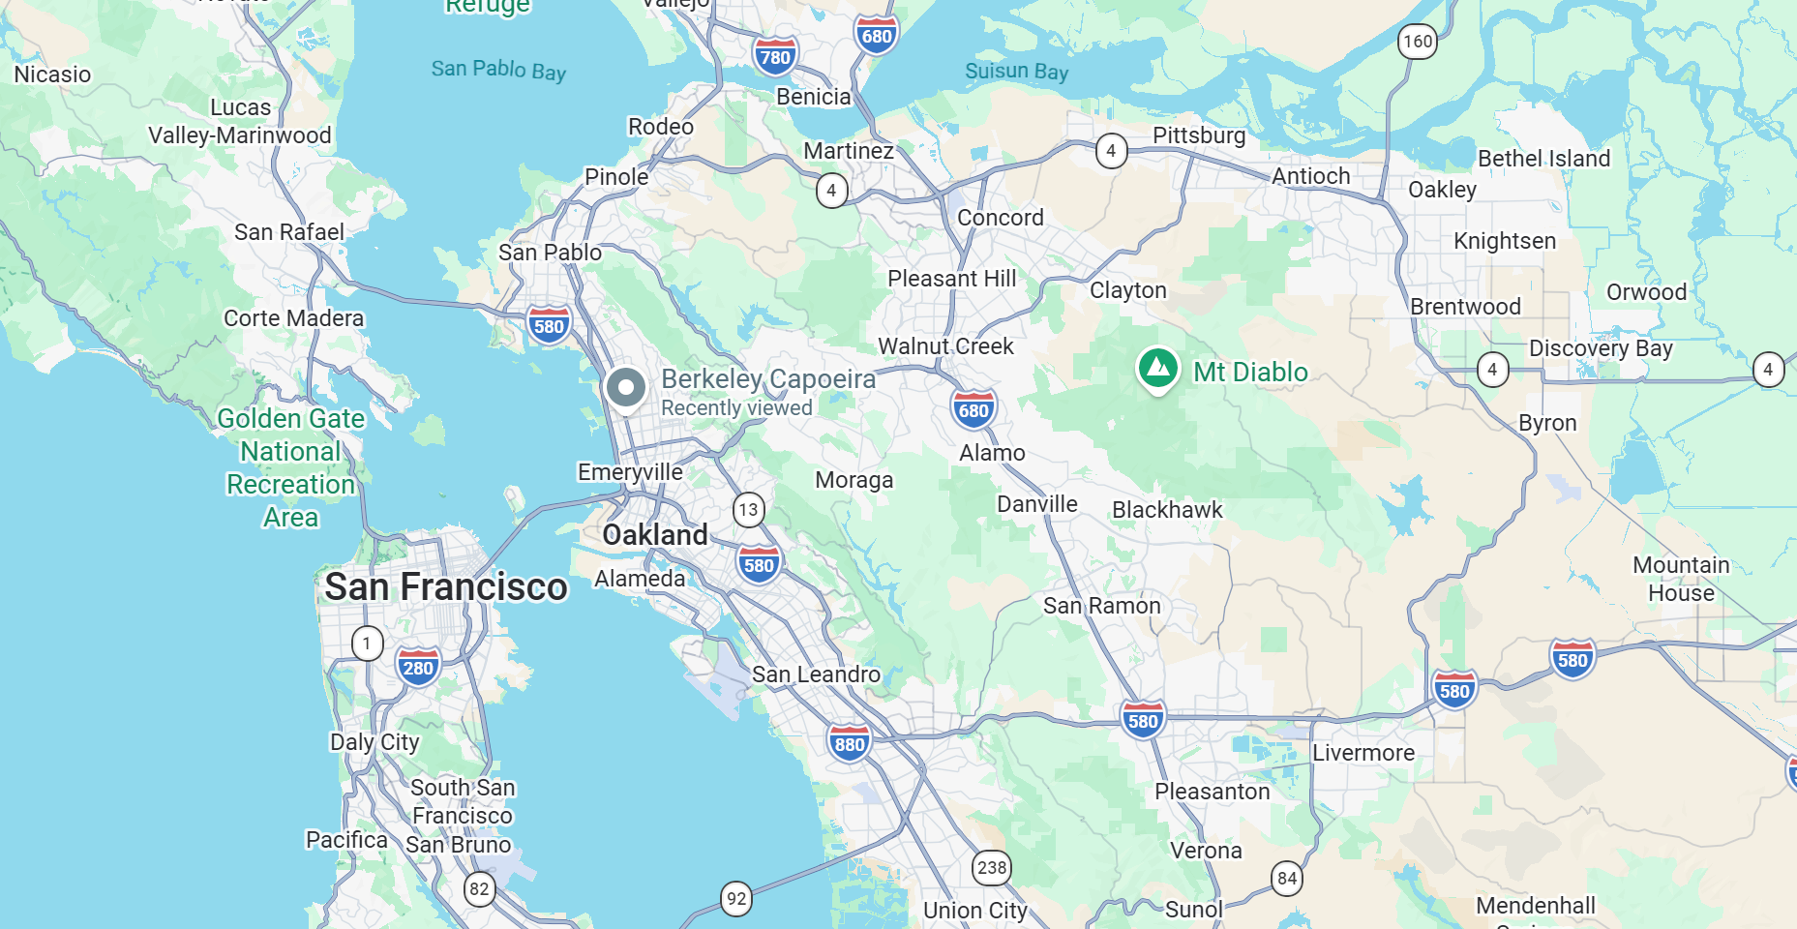
K2 Facility Overview
Who we Are:
K2 facility built to support critical chemical production needs
K2 produces chemicals used for drinking water and wastewater treatment
Designed with a focus on safety, reliability, and community impact
Our Beginning
Established to supply chlorine directly to Dow operations
Built to eliminate the need for long-distance chlorine transportation
Where We Started
Startup year: 2010
Initial workforce: 17 employees, 12.5 acres
Where We Are Today
Current workforce: 109 employees, 75 acres
Fully operational facility supporting essential chemical production

