Slide 1
CAER Safety Summit
2021 Valero Fatality – Lessons Learned
Presented by Nick Plurkowski, United Steelworkers Local 5

Slide 2
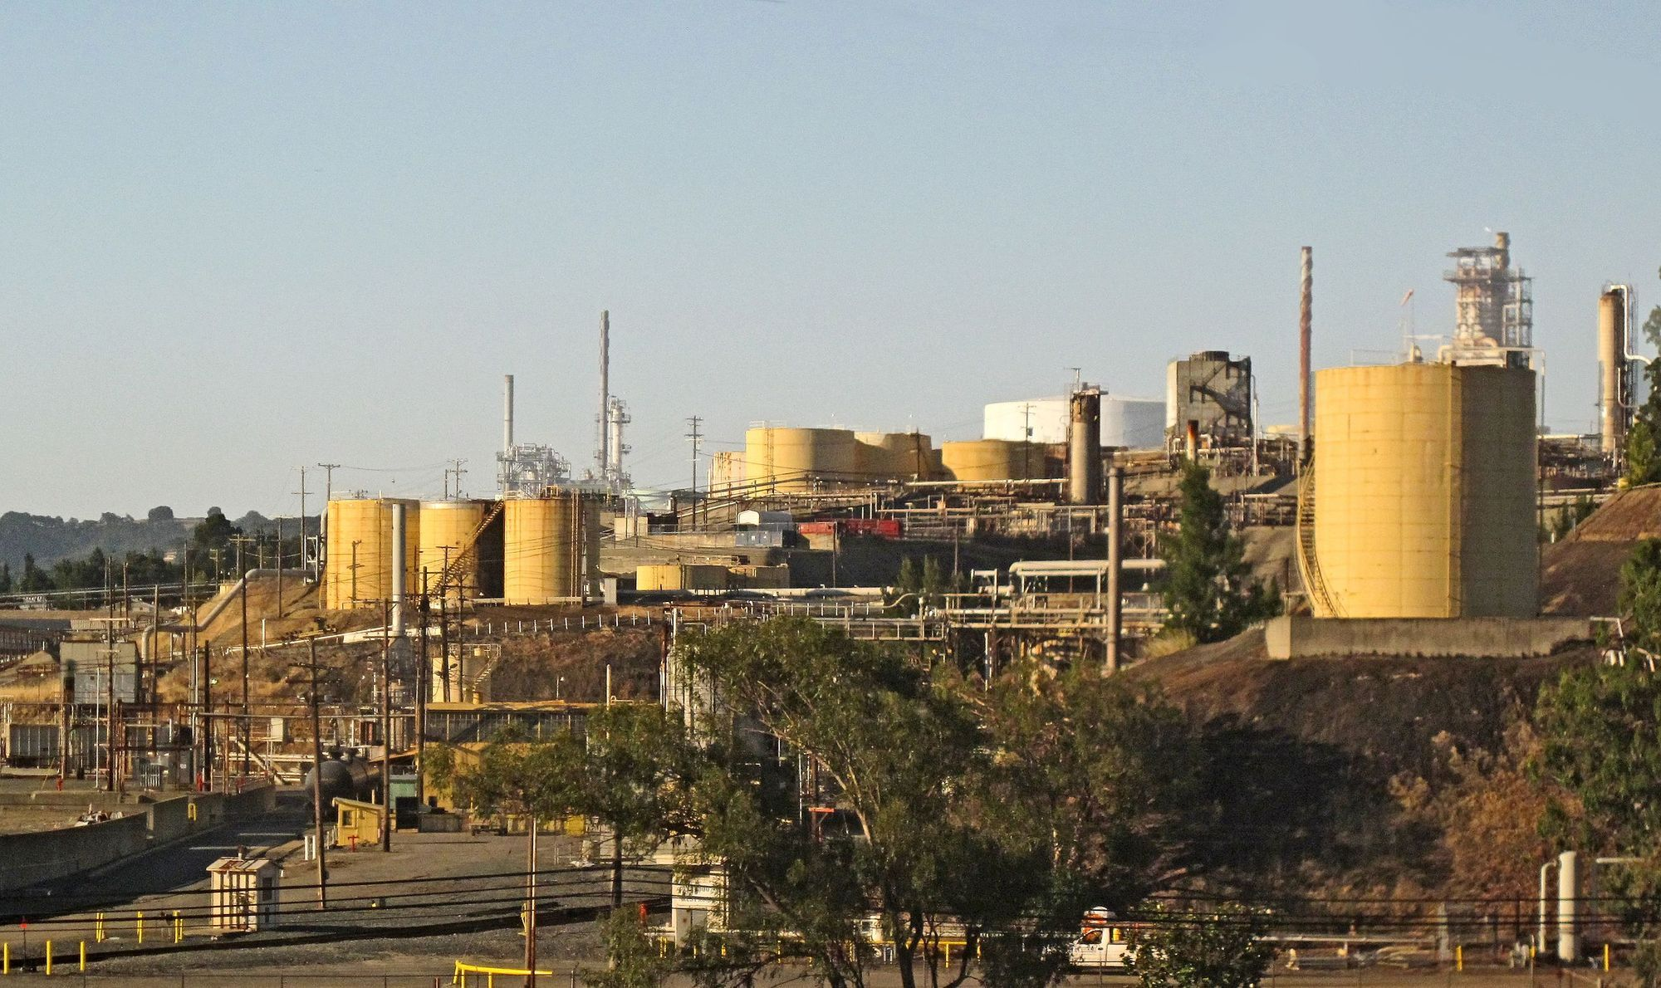
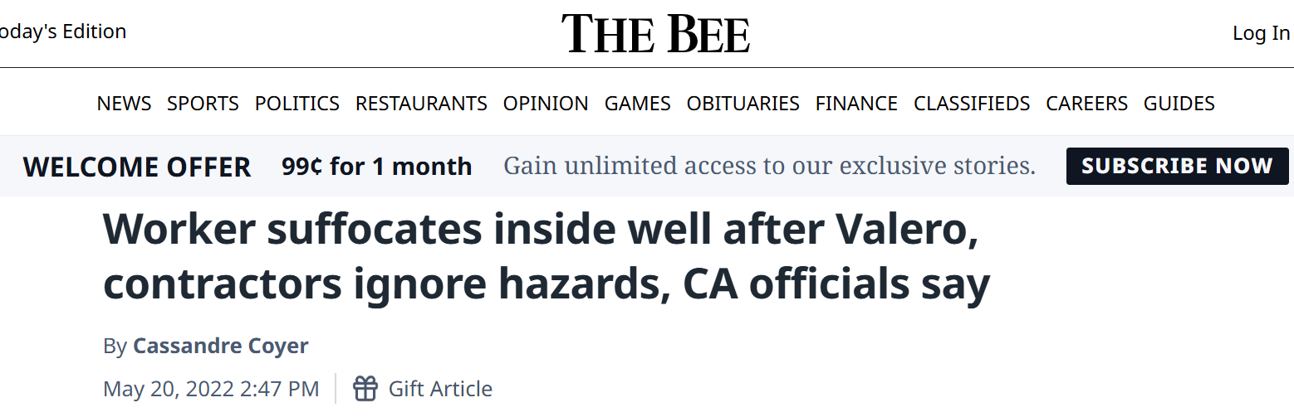
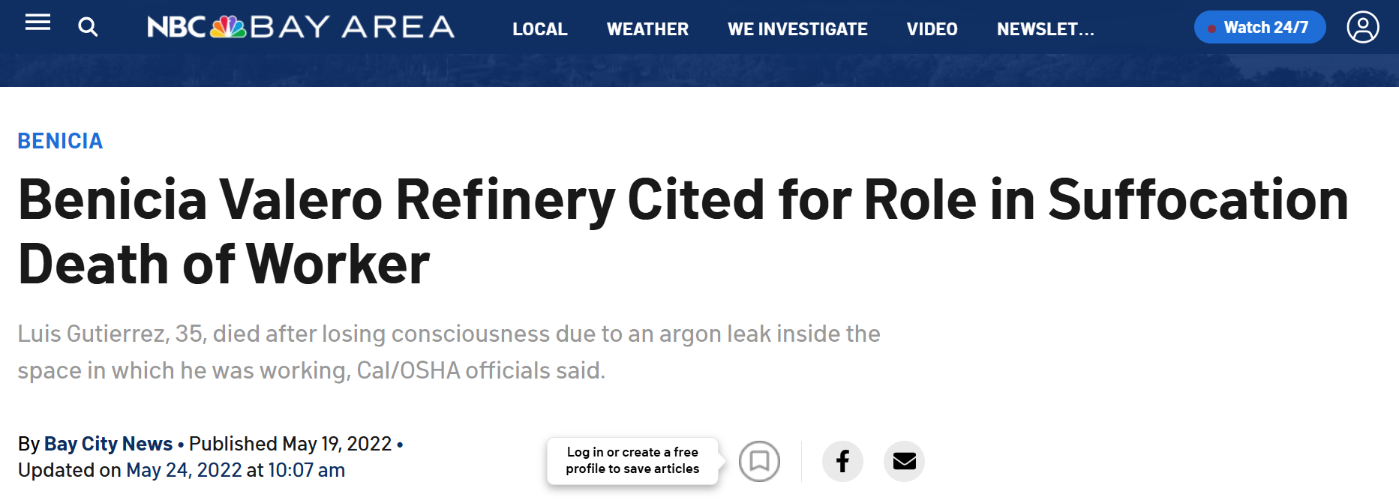
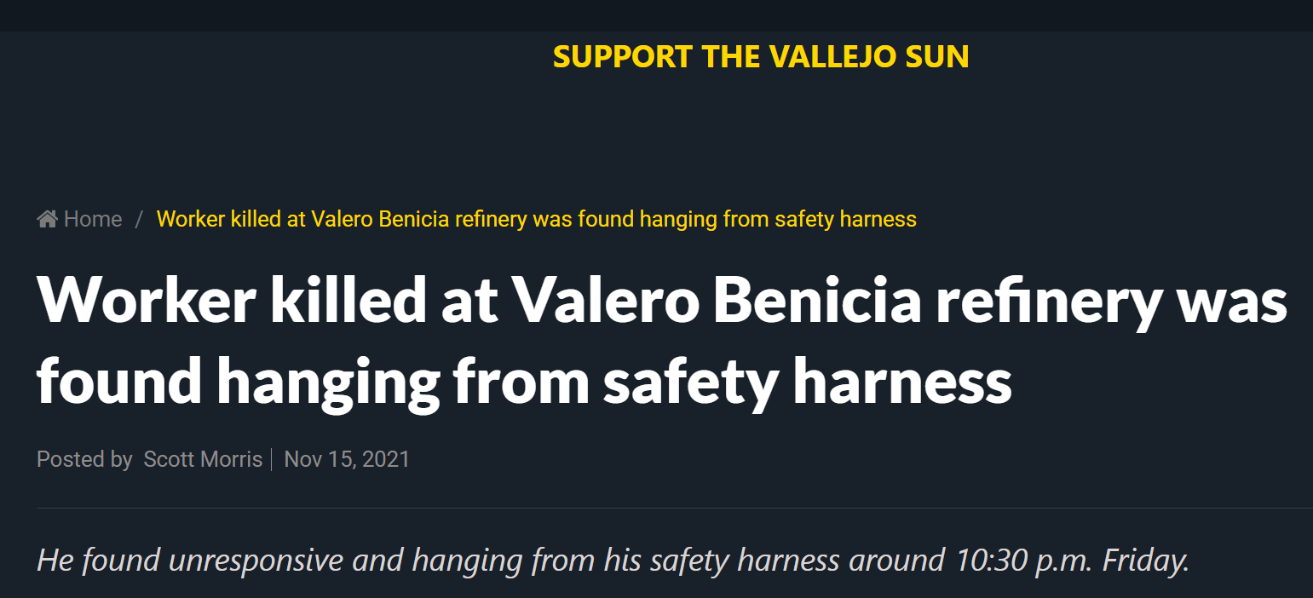

Slide 3
Was this incident preventable?

Slide 4
Here are some definitions for the following terms:
Confined Space / Permit Required Confined Space
Attendant or “Hole Watch”
Fall Protection / Fall Prevention / Fall Arrest
Hazardous Atmosphere / IDLH / Ventilation
Rescue
https://www.dir.ca.gov/title8/5157.html

Slide 5
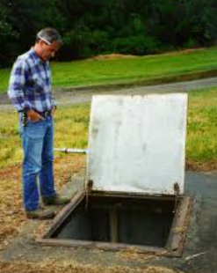
Confined Space
Confined space means a space that:
(1) Is large enough and so configured that an employee can bodily enter and perform assigned work; and
(2) Has limited or restricted means for entry or exit (for example, tanks, vessels, silos, storage bins, hoppers, vaults, and pits are spaces that may have limited means of entry.); and
(3) Is not designed for continuous employee occupancy.

Slide 6
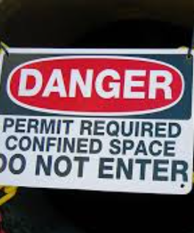
Permit Required Confined Space
Permit-required confined space (permit space) means a confined space that has one or more of the following characteristics:
(1) Contains or has a potential to contain a hazardous atmosphere;
(2) Contains a material that has the potential for engulfing an entrant;
(3) Has an internal configuration such that an entrant could be trapped or asphyxiated by inwardly converging walls or by a floor which slopes downward and tapers to a smaller cross-section; or
(4) Contains any other recognized serious safety or health hazard.

Slide 7
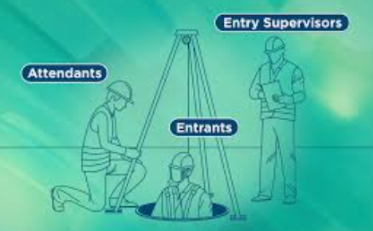
Attendant – “Hole Watch”
Attendant means an individual stationed outside one or more permit spaces who monitors the authorized entrants and who performs all attendant's duties assigned in the employer's permit space program.

Slide 8
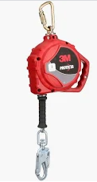
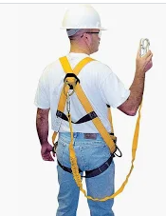
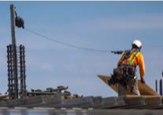
Fall Protection Systems
Fall Protection Systems There are 2 basic types of fall protection systems:
  Passive Systems - Fall Prevention - Guardrails, safety nets, floor covers, catch platforms, etc.
  Active Systems - Personal Fall Protection - Safety belts and body harnesses

Slide 9
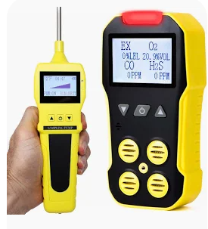
Hazardous Atmosphere
Hazardous atmosphere means an atmosphere that may expose employees to the risk of death, incapacitation, impairment of ability to self-rescue (that is, escape unaided from a permit space), injury, or acute illness from one or more of the following causes:
(1) Flammable gas, vapor, or mist in excess of 10 percent of its lower flammable limit (LFL);
(2) Airborne combustible dust at a concentration that meets or exceeds its LFL;
(3) Atmospheric oxygen concentration below 19.5 percent or above 23.5 percent;
(4) Atmospheric concentration of any substance for which a dose is published in Group 14 for Radiation and Radioactivity or a permissible exposure limit is published in section 5155 for Airborne contaminants and which could result in employee exposure in excess of its dose or permissible exposure limit;
(5) Any other atmospheric condition that is immediately dangerous to life or health.

Slide 10
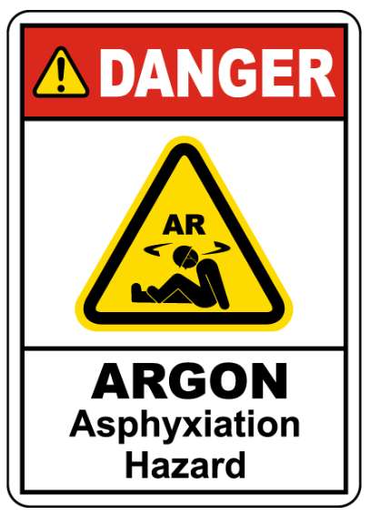
IDLH
Immediately Dangerous to Life or Health (IDLH) means any condition that poses an immediate or delayed threat to life or that would cause irreversible adverse health effects or that would interfere with an individual's ability to escape unaided from a permit space.

Slide 11
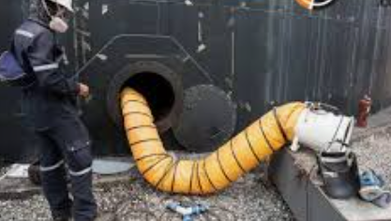
Ventilation
Continuous forced air ventilation shall be used, as follows:
  a. An employee may not enter the space until the forced air ventilation has eliminated any hazardous atmosphere;
  b. The forced air ventilation shall be so directed as to ventilate the immediate areas where an employee is or will be present within the space and shall continue until all employees have left the space;
  c. The air supply for the forced air ventilation shall be from a clean source and may not increase the hazards in the space.

Slide 12
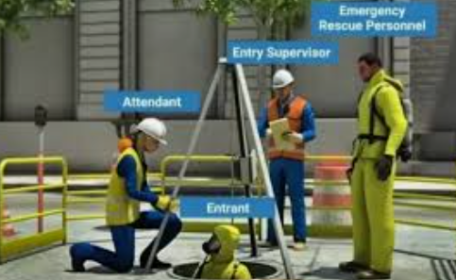
Rescue
Rescue service means the personnel designated to rescue employees from permit spaces.

Slide 13
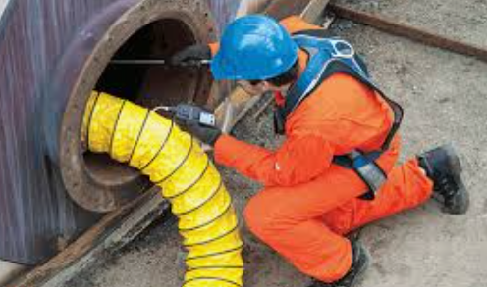

Slide 14
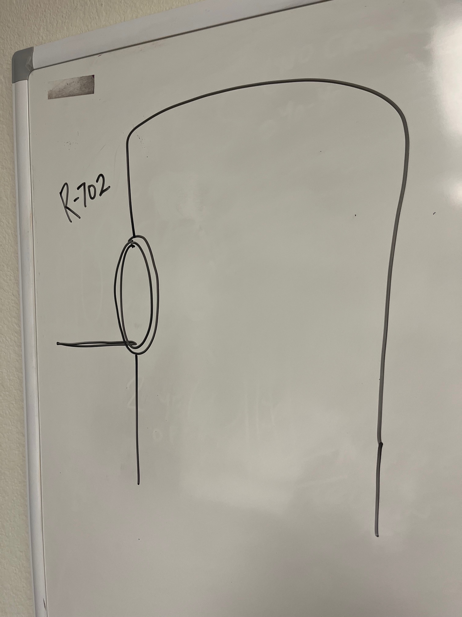
R-702

Slide 15
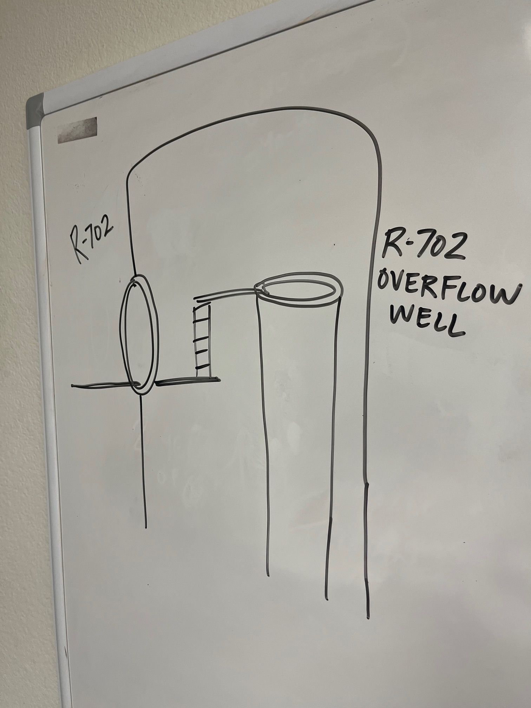
R-702
Overflow Well located inside
R-702

Slide 16
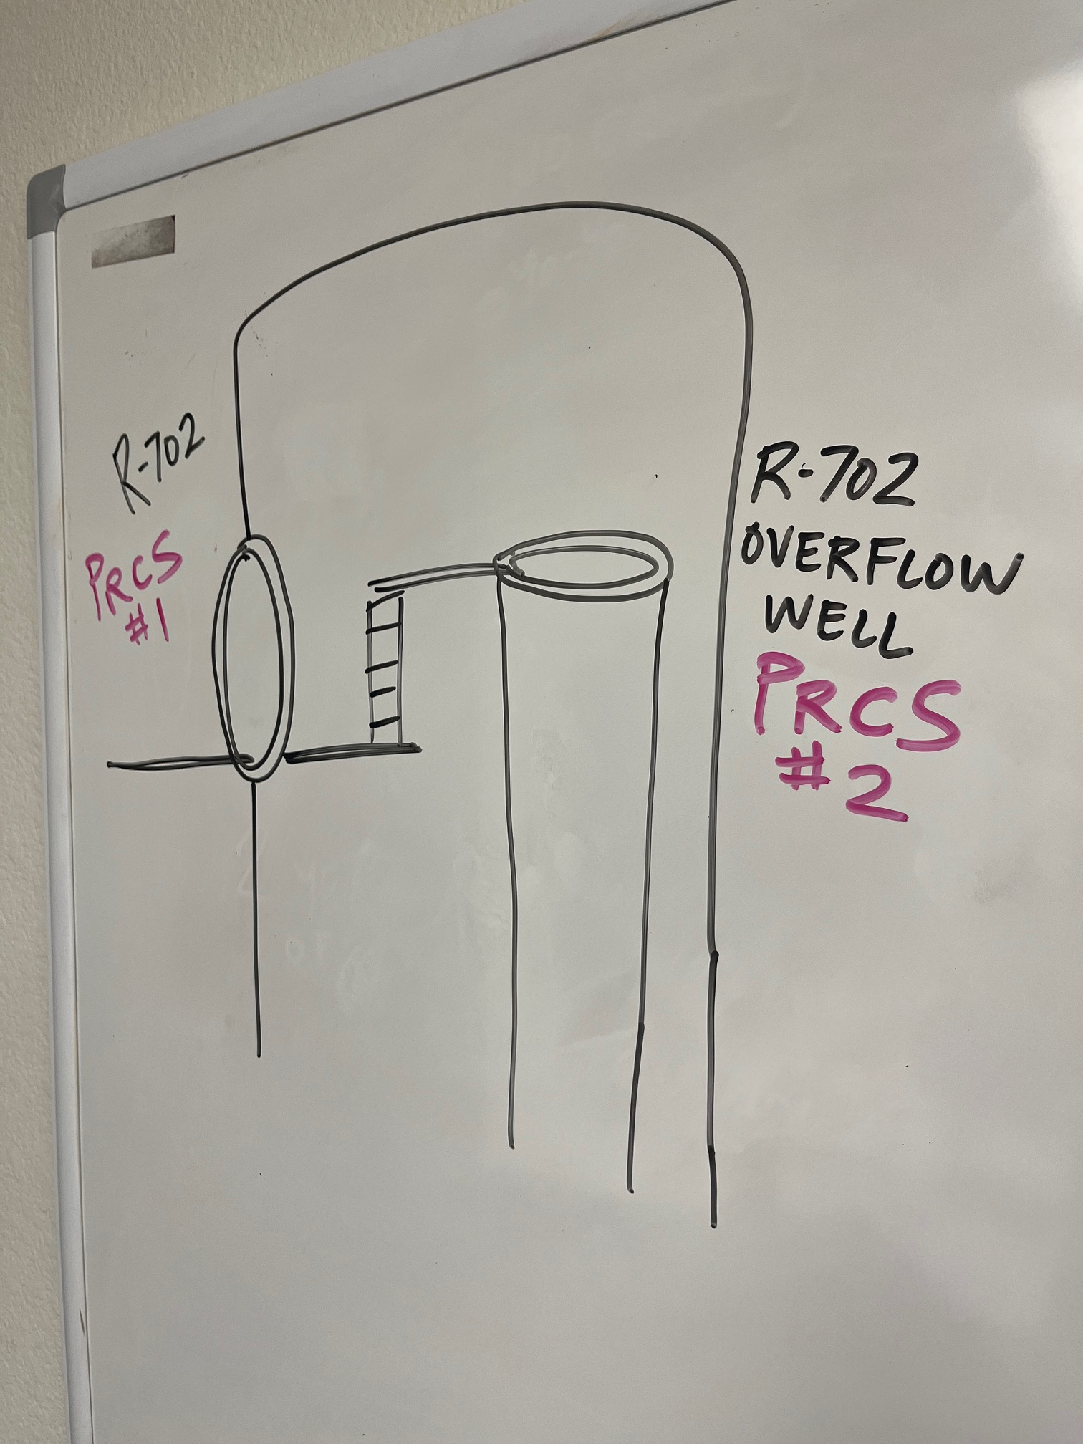
PRCS #1
R-702
PRCS #
R-702
Overflow
Well

Slide 17
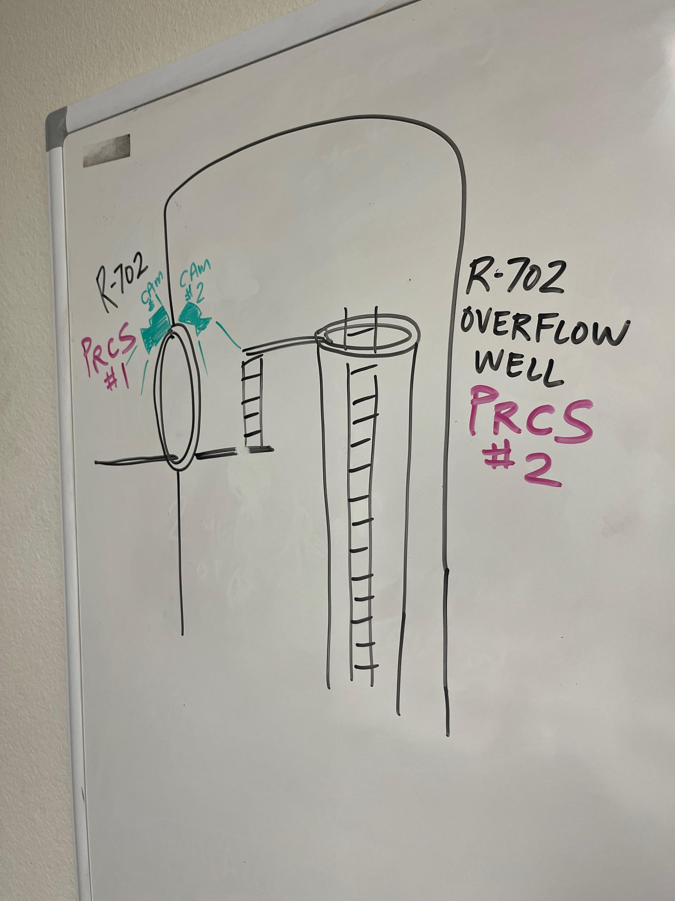
Camera
1-outside to monitor Entrants & PPE
Camera
2-
inside to monitor Entrants working

Slide 18
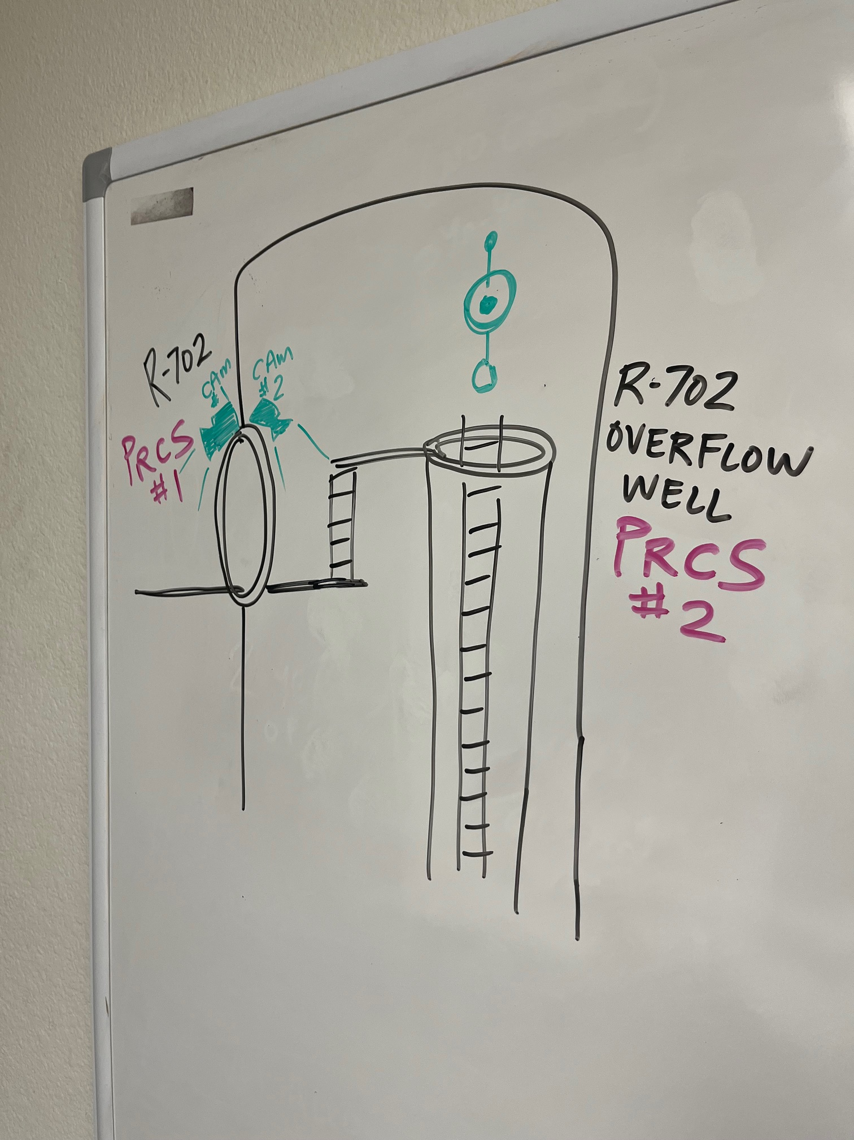
Fall Protection above ladder
(~50 ft to bottom)

Slide 19
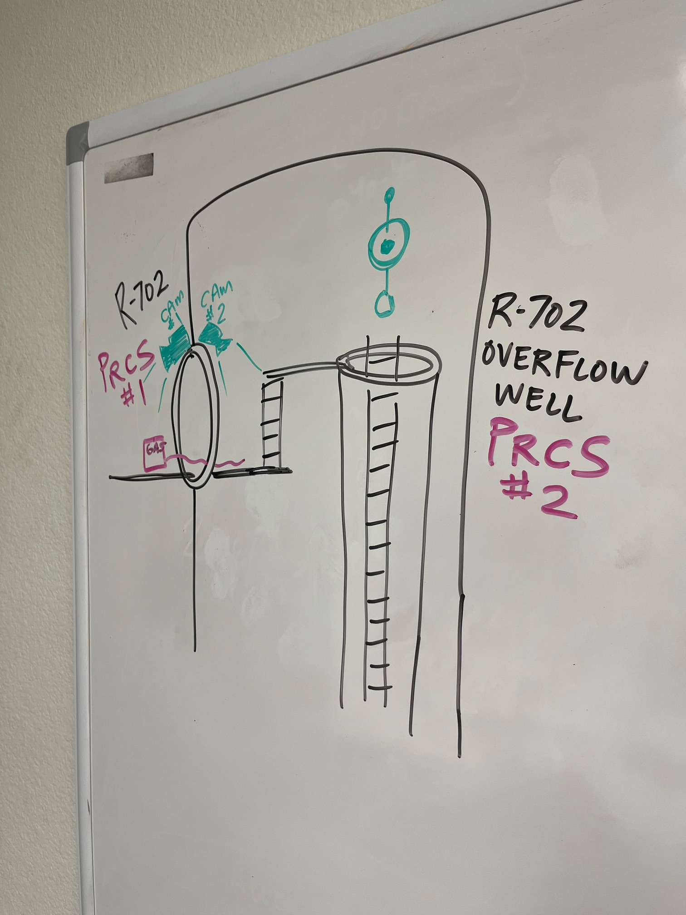
Gas Monitor
(only setup to monitor R-702 entrance)

Slide 20
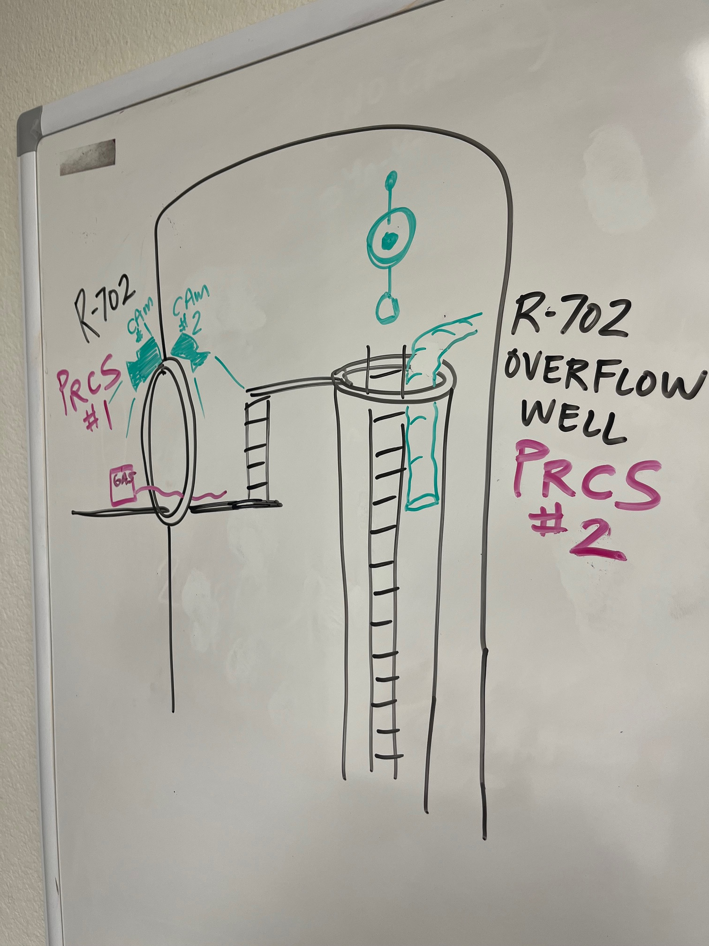
Ventilation
Ventilation
(not reaching the bottom, low flow)

Slide 21
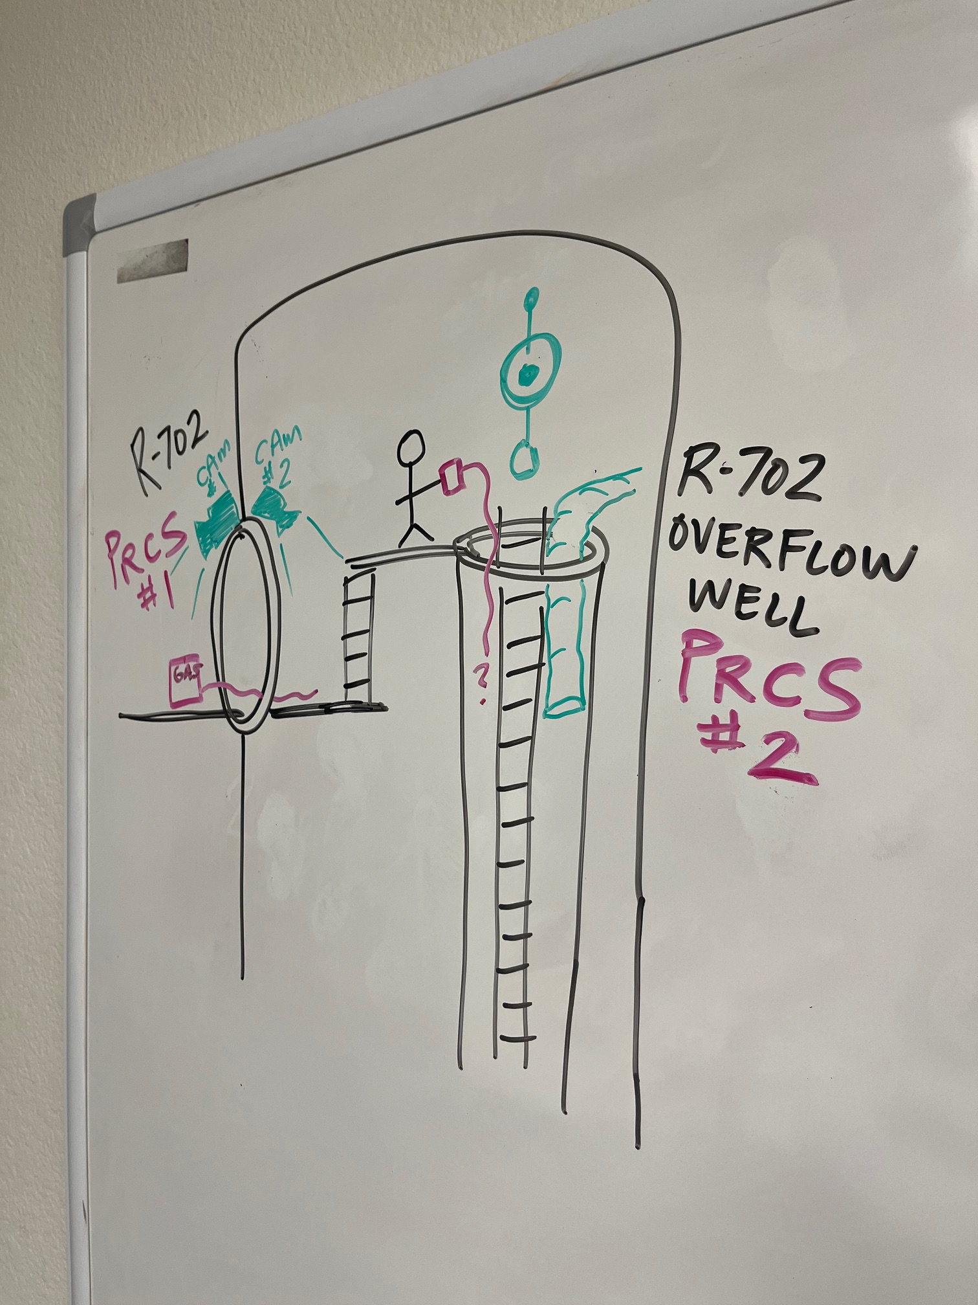
Gas Testing
(representative sample?)
(ongoing???)

Slide 22
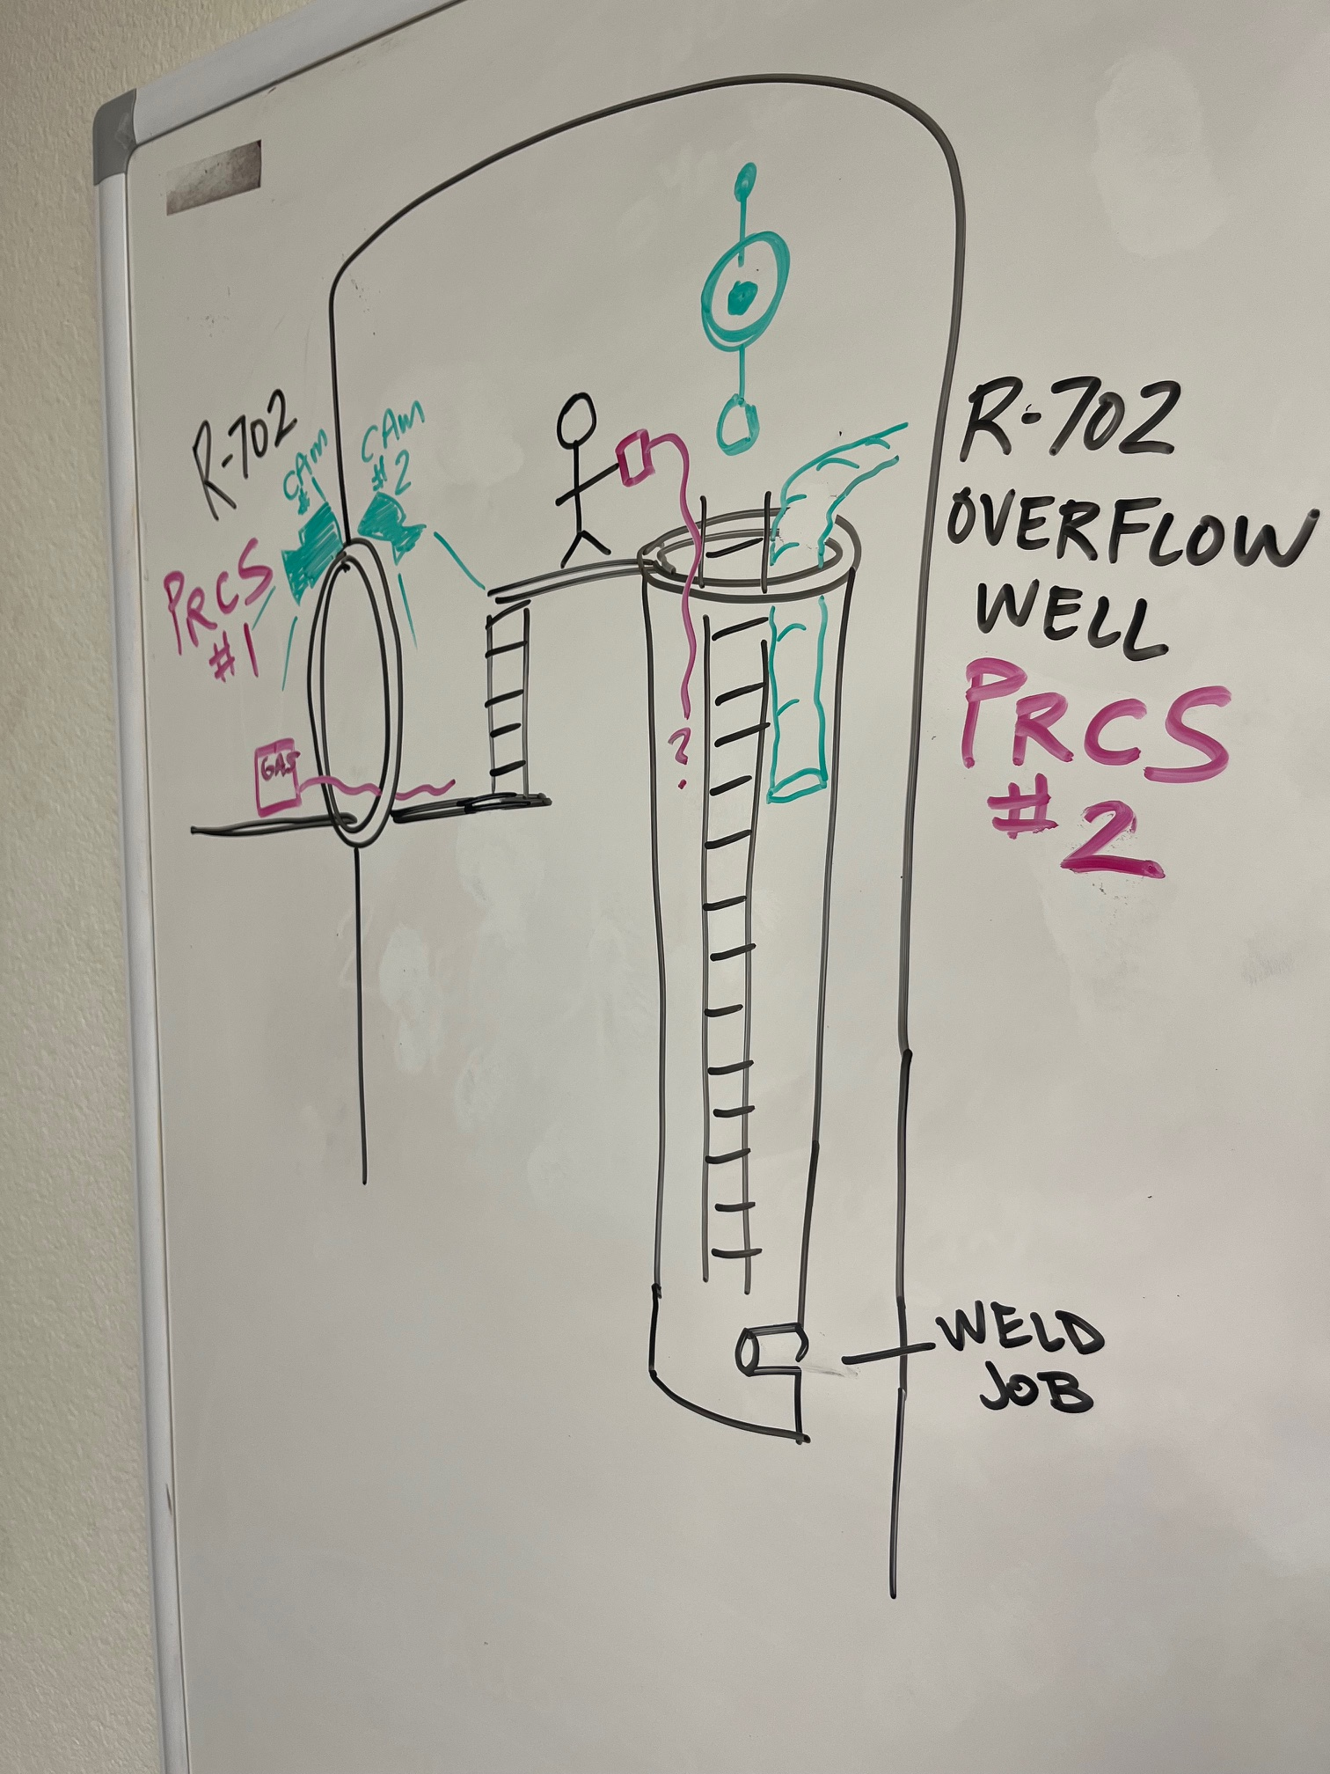
Weld job was to happen at the bottom of the Overflow Well on a nozzle…

Slide 23
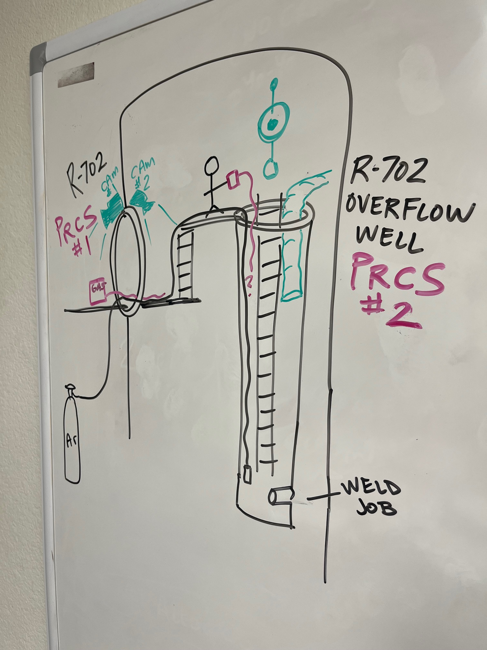
Argon hose ran to job as part of Weld equipment

Slide 24
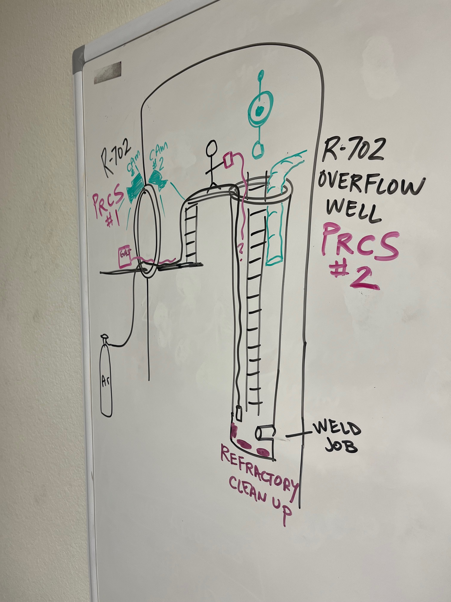
Weld job couldn’t happen until excess refractory was cleaned up at bottom

Slide 25
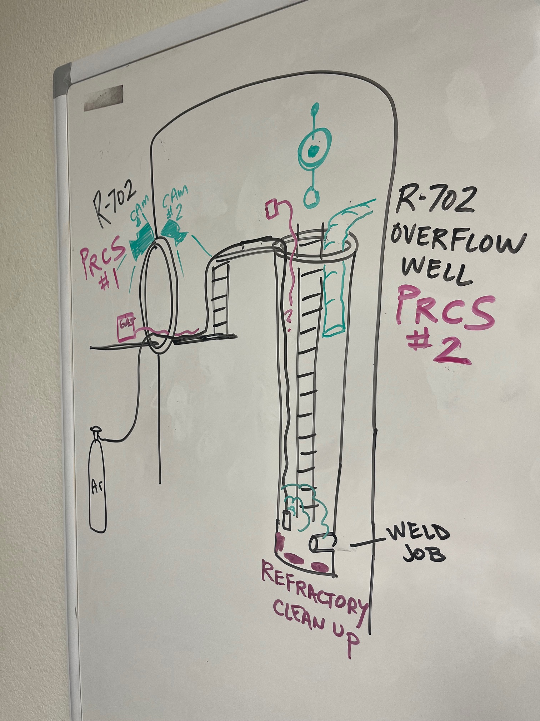
Argon leaking

Slide 26
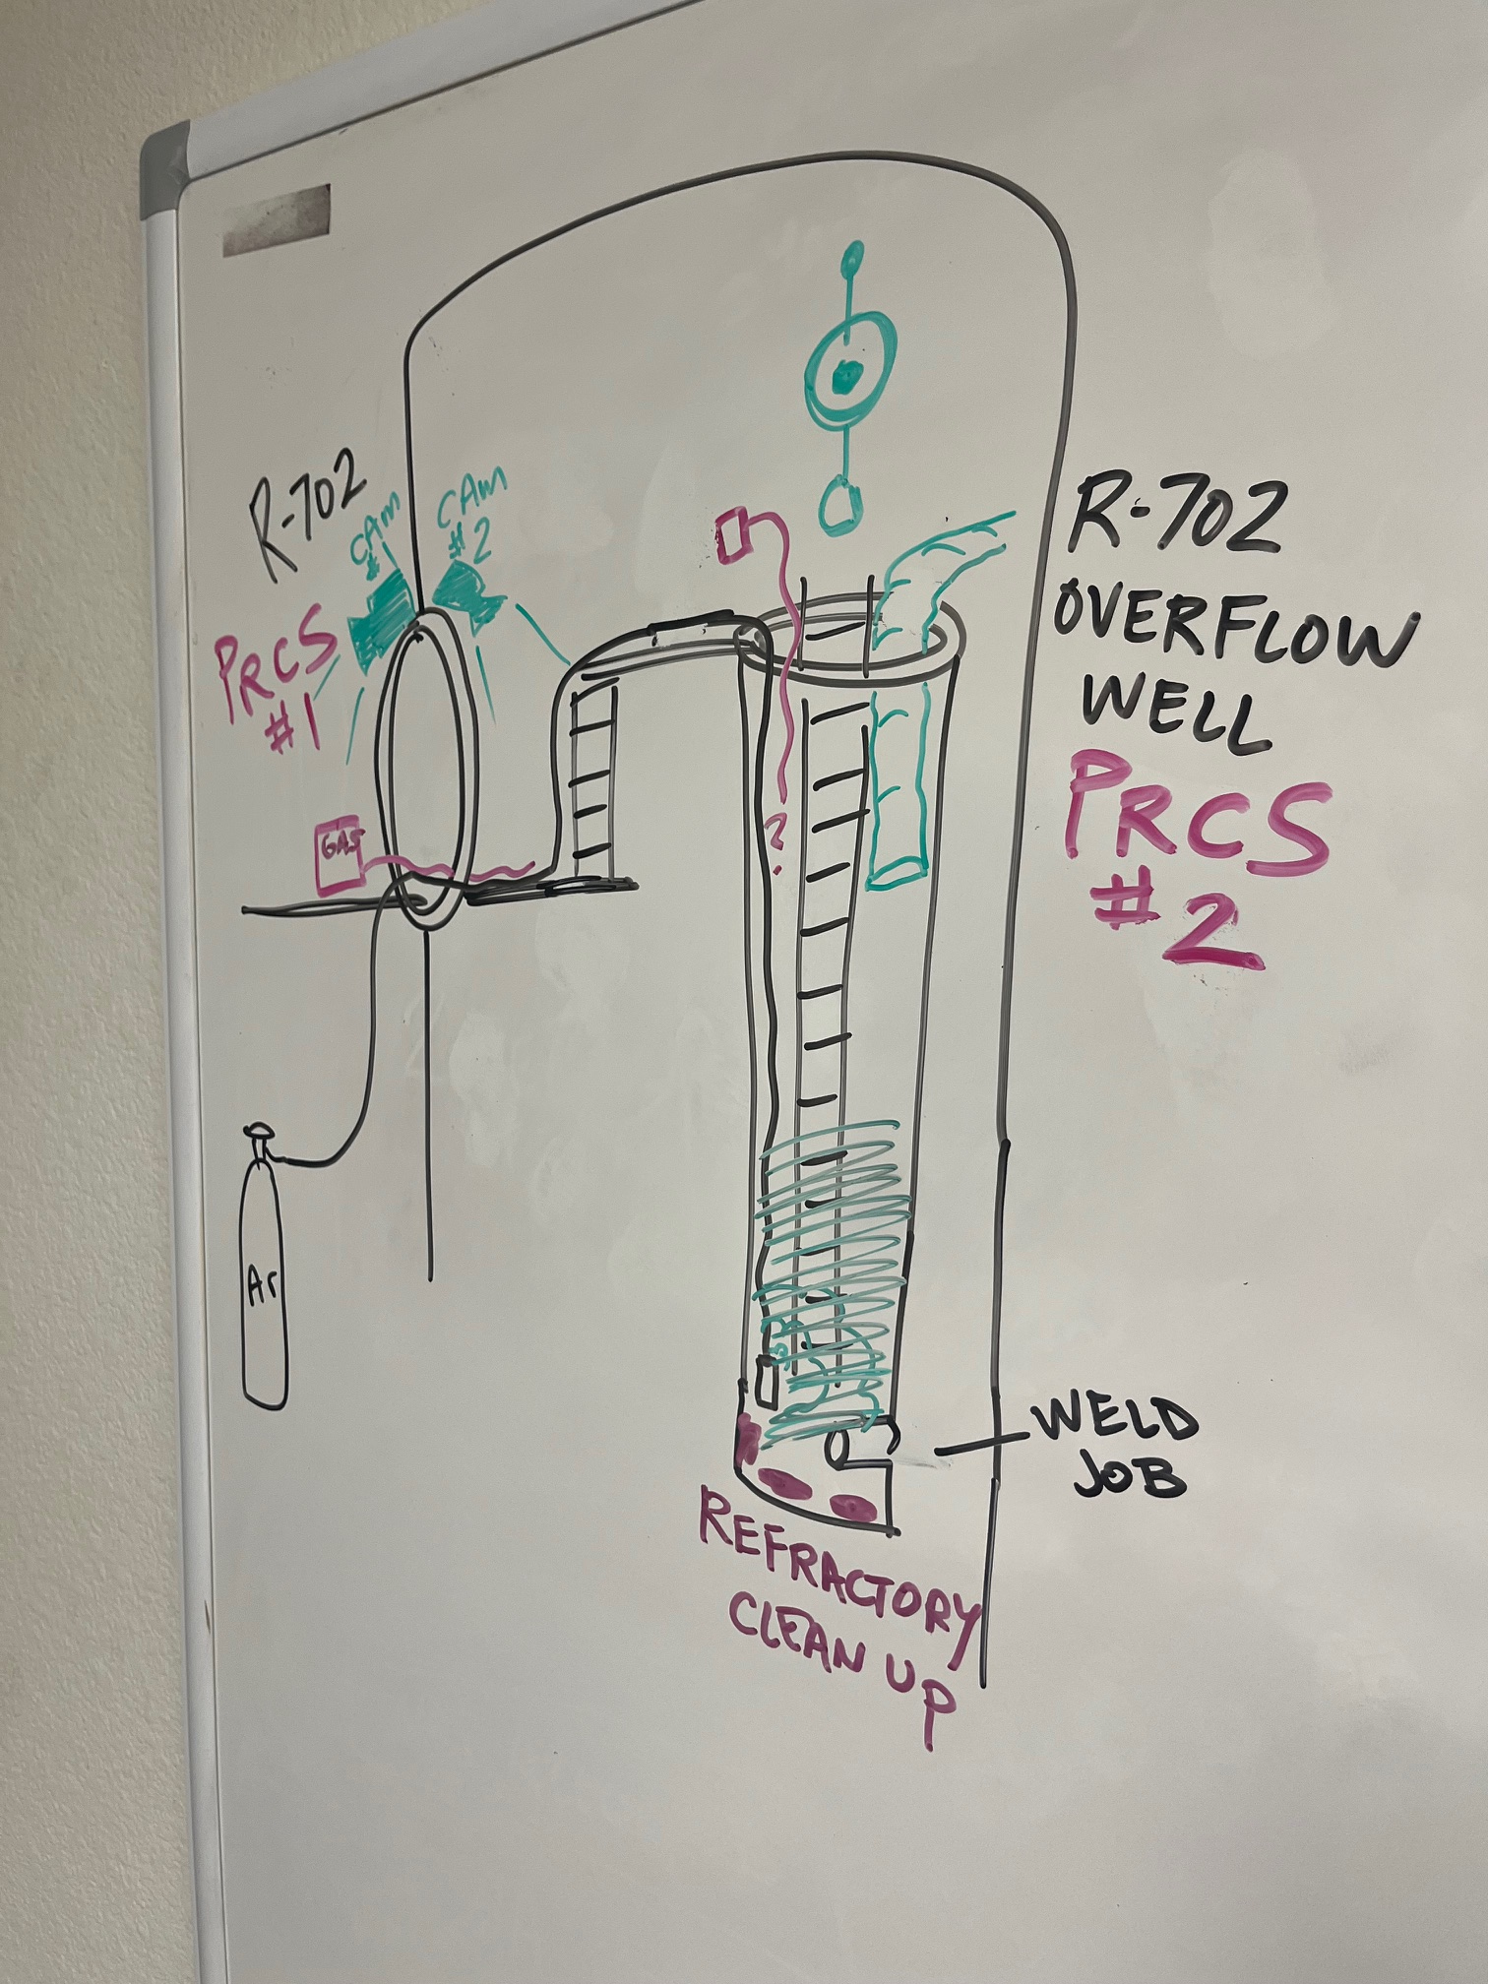
Argon accumulating
(IDLH)

Slide 27
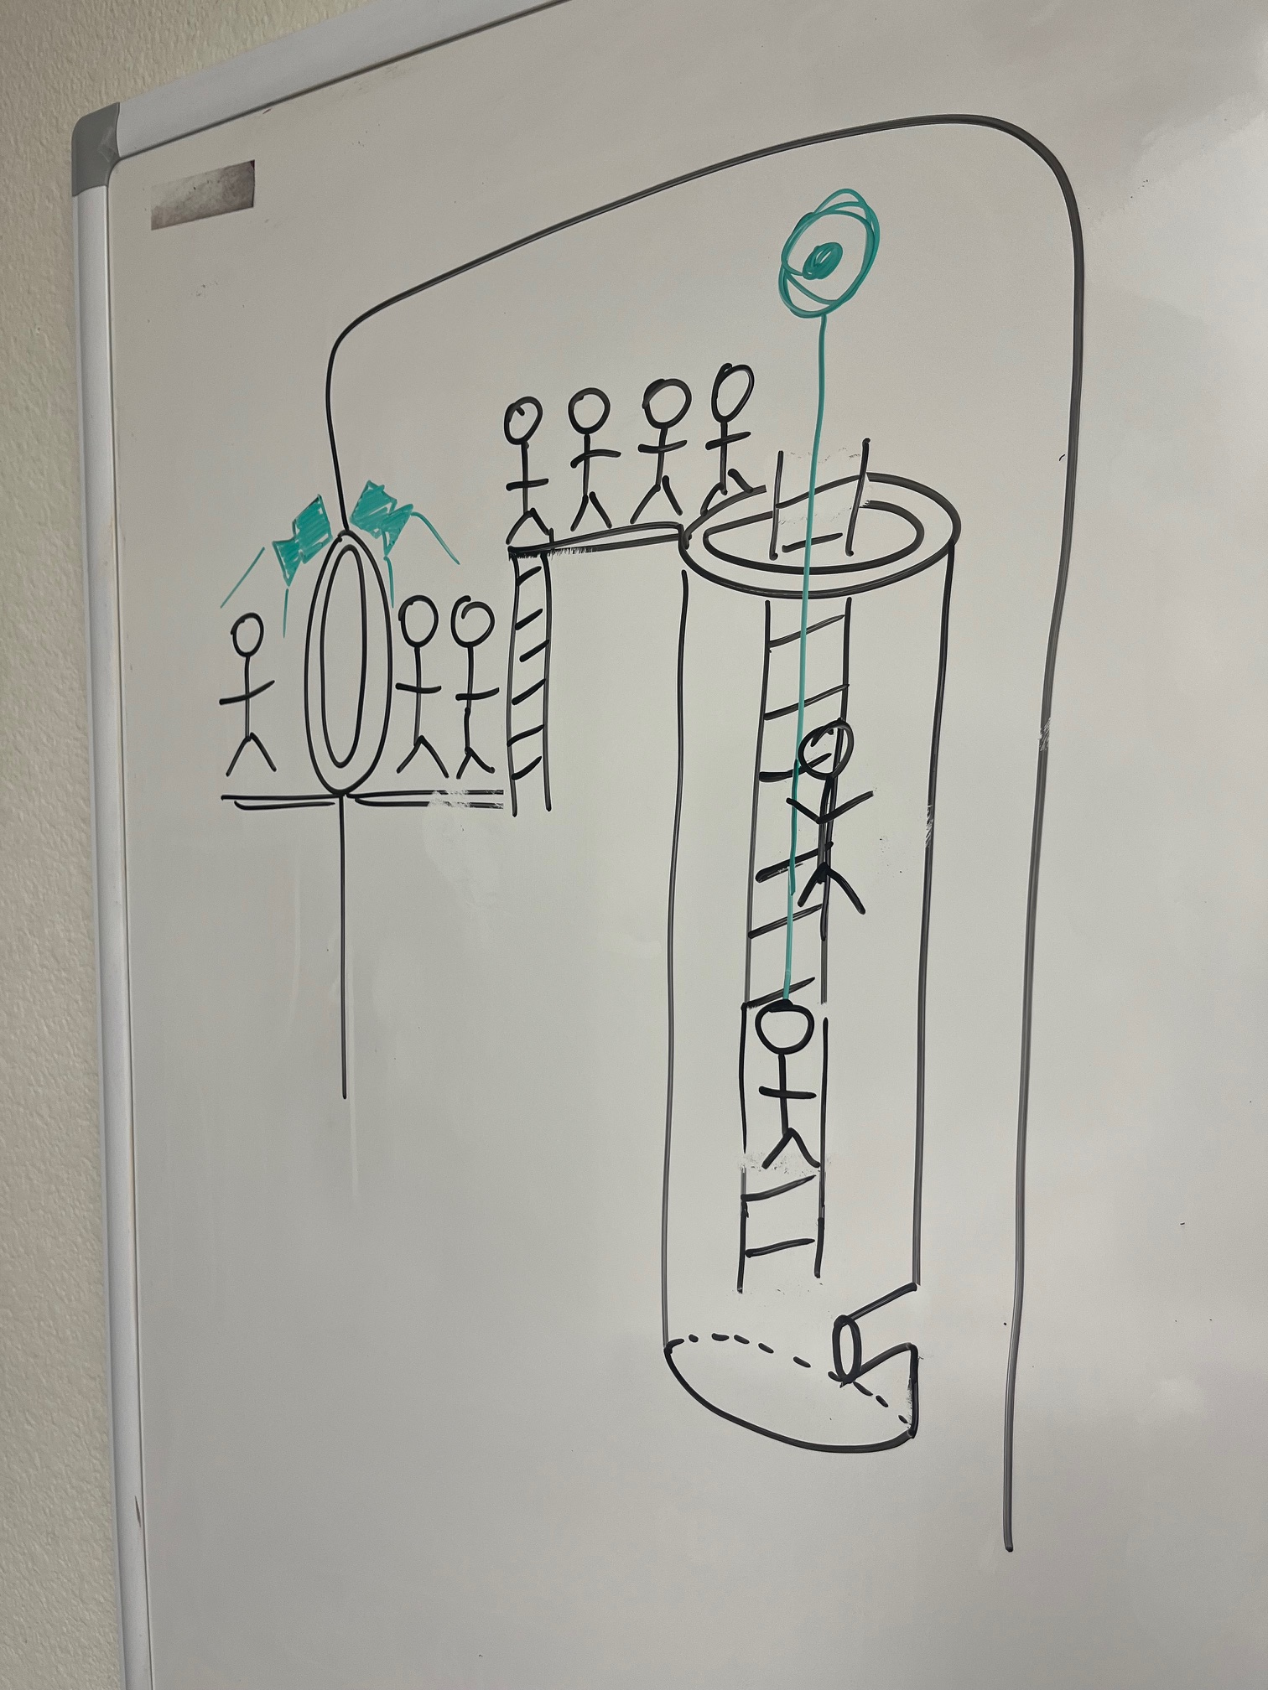
Rescue Efforts
~20min response
No Badge-In for ~10 rescue personnel
No PRCS (#2) identified
No Gas Test (=IDLH)
No Respiratory Protection (SCBA)
Used Fall Protection
No Rescue Team

Slide 28
Was this incident preventable?

Slide 29
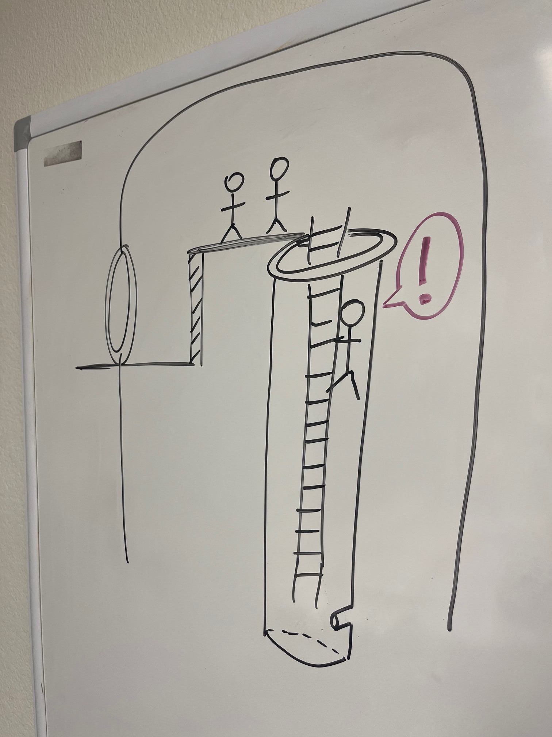
A worker gets dizzy in the R-702 Overflow Well
Nov. 19th 2021

Slide 30
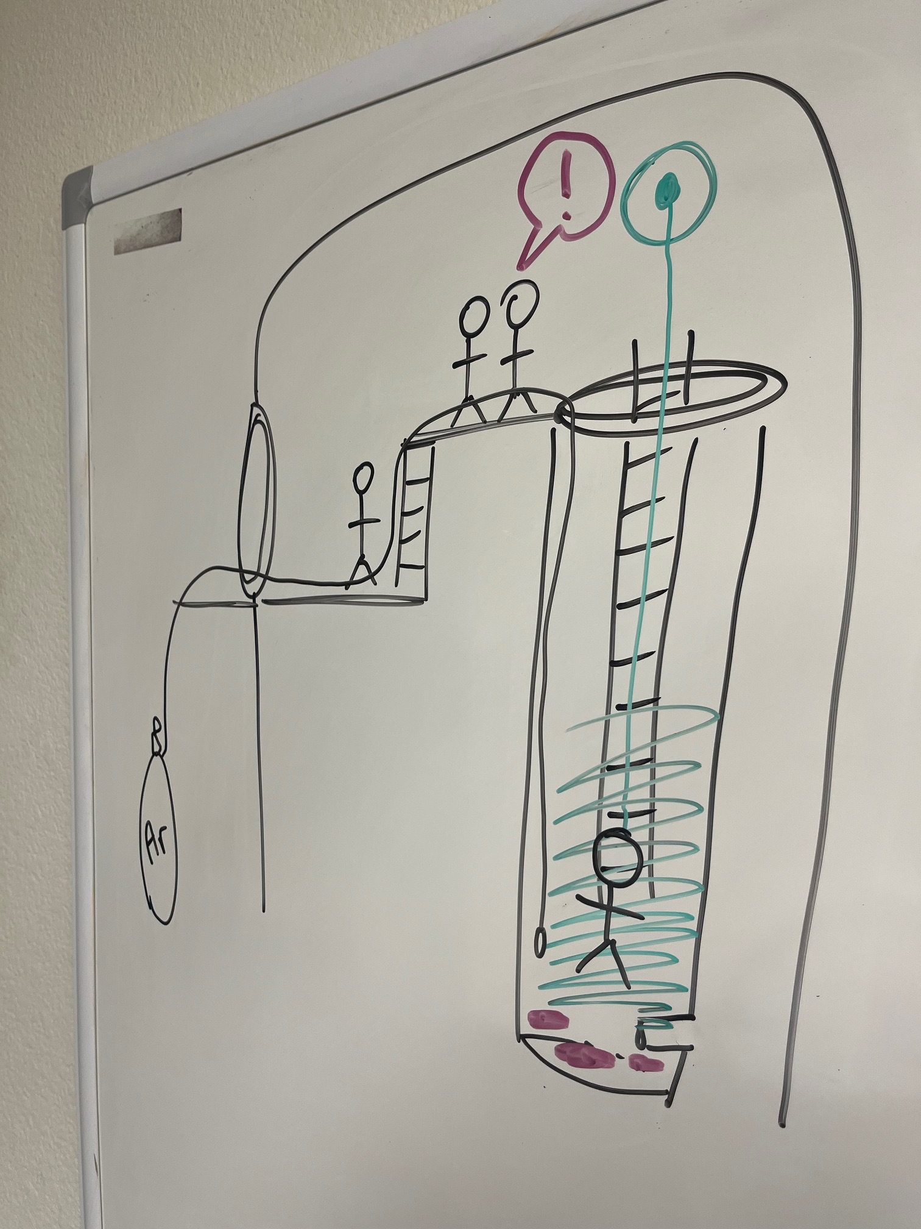
Luis Gutierrez is overcome by an IDLH atmosphere
Nov. 12th 2021
(Nightshift)

Slide 31
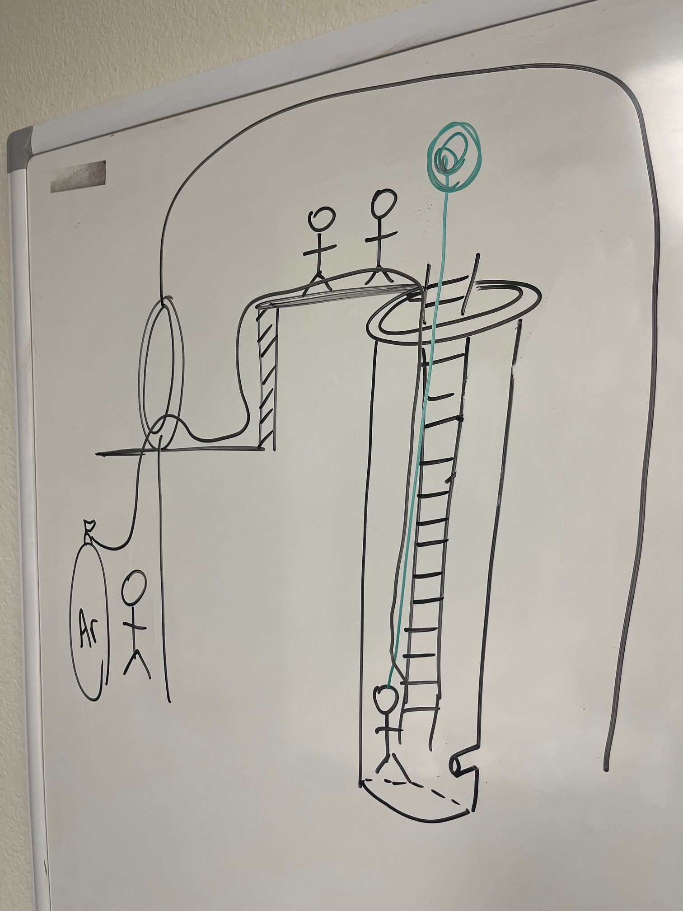
A worker gets dizzy in the R-702 Overflow Well
Nov. 12th 2021
(Dayshift)

Slide 32
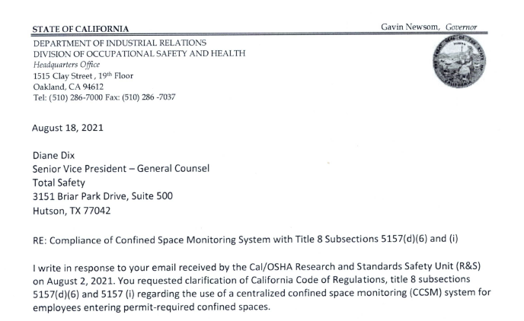
CalOSHA responds to Total Safety’s inquiry about their system being CA compliant…
August 18th 2021

Slide 33

United Steelworkers at the Chevron Richmond Refinery participate in a MOC to allow Total Safety’s program
They pushed back
April / May 2021

Slide 34
Timeline:
April / May 2021 – USW pushes back against Total Safety at Chevron Richmond
August 18, 2021 – CalOSHA issues a memo to Total Safety saying the program doesn’t meet Regulation
November 12, 2021 – Near Miss of a worker getting dizzy in the R-702 Overflow Well (Dayshift)
November 12, 2021 – Luis Gutierrez is overcome by an IDLH atmosphere in the R-702 Overflow Well (Nightshift)
November 19, 2021 – Near Miss of a worker getting dizzy in the R-702 Overflow Well

Slide 35
Was this incident preventable?

Slide 36
Learnings
Employee Participation
Stop Work Authority
Near Misses reported, investigated and mitigated immediately
Proper Attendant / “Hole Watch” program
Leaking hoses (any equipment) be destroyed (not re-used)
Rescue Plans be written out & verified by those to be rescued
Rescue equipment with a crank
Proper gas testing
Proper gas monitoring
Proper Ventilation
Proper PRCS identification
Safety Culture

Slide 37
CAER Safety Summit
2021 Valero Fatality – Lessons Learned
Presented by Nick Plurkowski
United Steelworkers Local 5
(925) 451-5564
nplurkowski@usw5.org

