Slide 1
CAER Process Safety Action Team Update
Michael Dossey
Supervising Accidental Release Prevention Engineer, Hazardous Materials Programs
April 22, 2026

Slide 2
What Is CAER?
Mission Statement:
The mission of CAER is to foster a collaborative community of industry, agencies, municipalities, and the public dedicated to actively educate, promote awareness and prepare for emergencies within Contra Costa County.
CAER’s core objectives are:
Build and maintain a trust-based relationship with the community
Enhance safety awareness and knowledge in our communities
Facilitate effective sharing of safety best practices
Support comprehensive emergency preparedness initiatives
Notes:
https://www.crhmro.org/CAER/about/

Slide 3
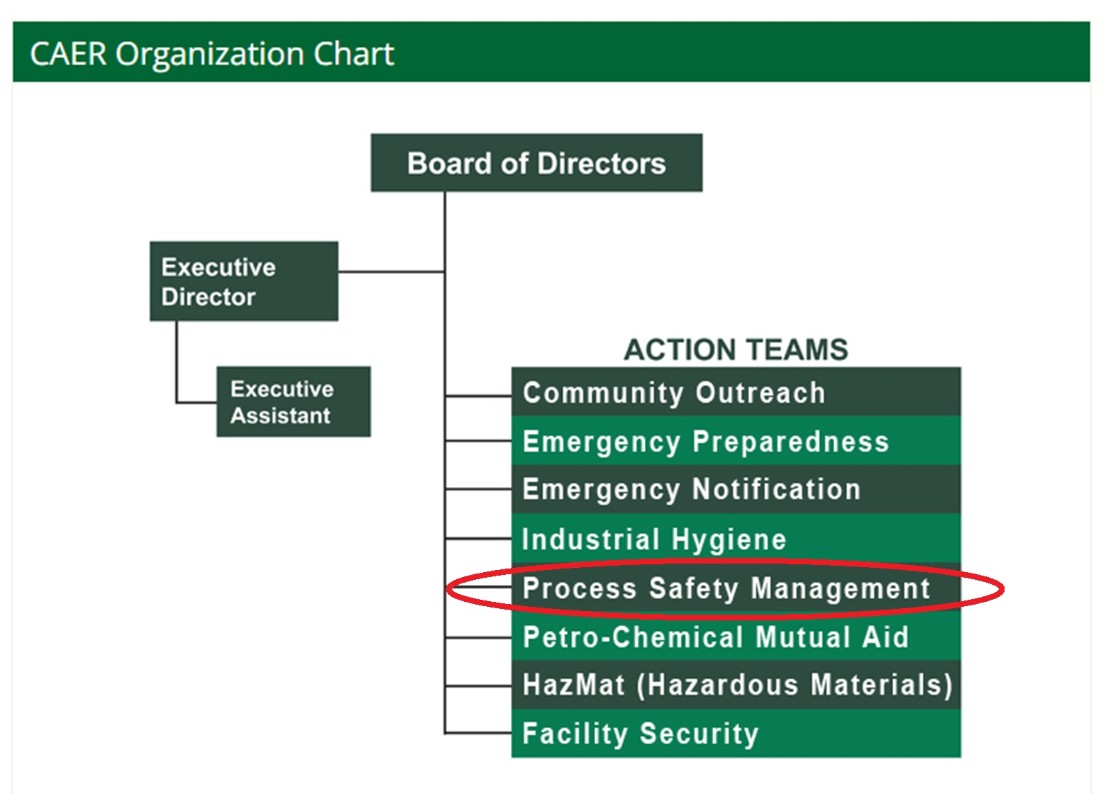
Notes:
https://www.crhmro.org/CAER/about/organization-chart/

Slide 4
CAER Process Safety Action Team
Who We Are
Industry, Hazmat, Cal/OSHA
Meet Quarterly
  Last 2/18/26
  Next 5/27/26
Hazmat Offices
Notes:
Our group unites industrial facilities, regulators, and agency partners across the county to share what matters most: lessons learned the hard way
Industry - Refineries, renewable fuels facilities, specialty chemical manufacturers
Focus is on Process Safety

Slide 5
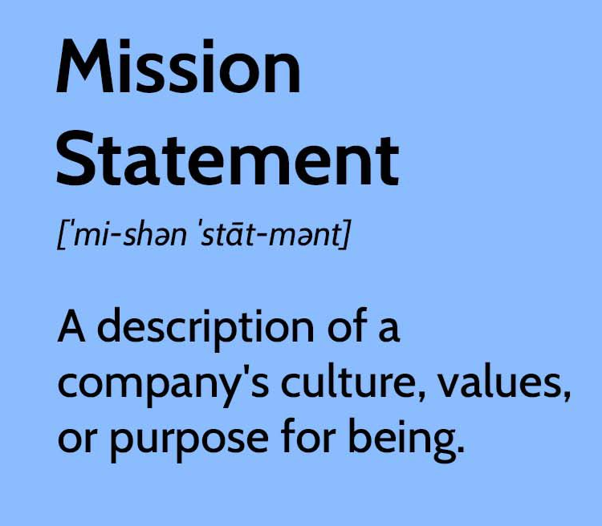
Group Mission
Improve safety through training and sharing information gained from incident investigations and regulatory compliance

Slide 6
CAER Process Safety Action Team
Primary Topics Covered
Sharing and Discussion of:
  Incidents and Lessons Learned
  Proposed New Process Safety Regulations
  Best Practices Related to Process Safety
Notes:
Share real process safety incidents, near misses, near-disasters, and the occasional “how did that happen”
Use an educational forum – a safe space to ask questions, discuss ideas, and debate what good process safety actually looks like
Stay current on CalARP/ISO, EPA RMP, and Cal/OSHA changes before they show up in your audit

Slide 7
Why share Incidents and Lessons Learned?
“Organisations have no memory. Only people have memory and they move on”.
“Accidents are not due to lack of knowledge, but failure to use the knowledge we have”.
--Trevor Kletz
Notes:
Although it is great to see so many new faces, it is with mixed emotion to continually see so much experience moving on. We continually share lessons learned hoping some part of it will stick to those even if they have not experienced it themselves. Many of us recognize not everyone will absorb every lesson learned, but the more you do it, the more likely something will resonate.

Slide 8

Sharing Lessons Learned
Site-specific incident sharing
Sister site issues
National & International headlines
Updates provided on local incidents
Notes:
Local issues discussed: Railcar releases, line opening events, PPE donning and doffing failures, near misses
National issues: CSB updates, regulatory enforcement, cyber threat attacks (nations largest steel mill)
International: global incidents discussed (e.g., fuel depot fires, port explosions, refinery closures)

Slide 9
Sharing Proposed New Regulations
ISO/RISO updated for Tank Terminals
Department drafting guidance for Tank Terminals
Discussion of other cities evaluating ISO adoption
Proposed changes to CalARP rule
Cal/OSHA rule making expanding covered facilities for 5189.1
Updated ISO guidance

Slide 10


Sharing Office Updates
County Hazmat being absorbed by County Fire 7/1/26
County Hazmat moved Feb 2026

Slide 11
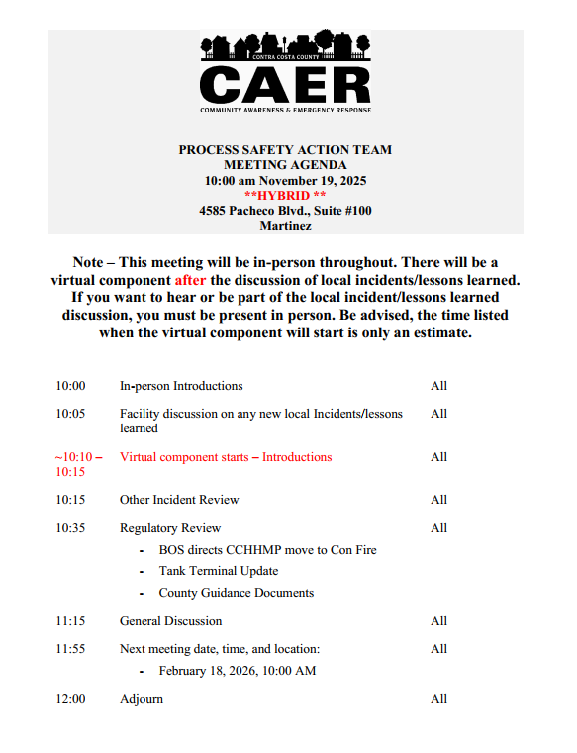
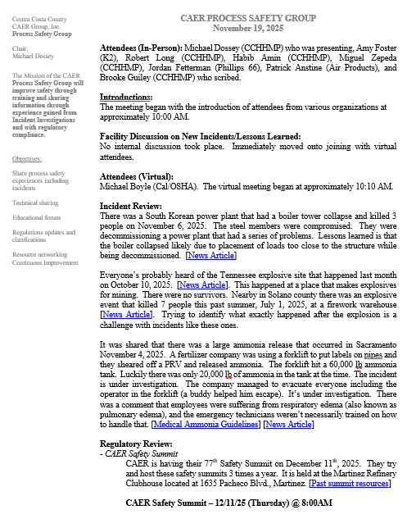
Agendas and Minutes

Slide 12
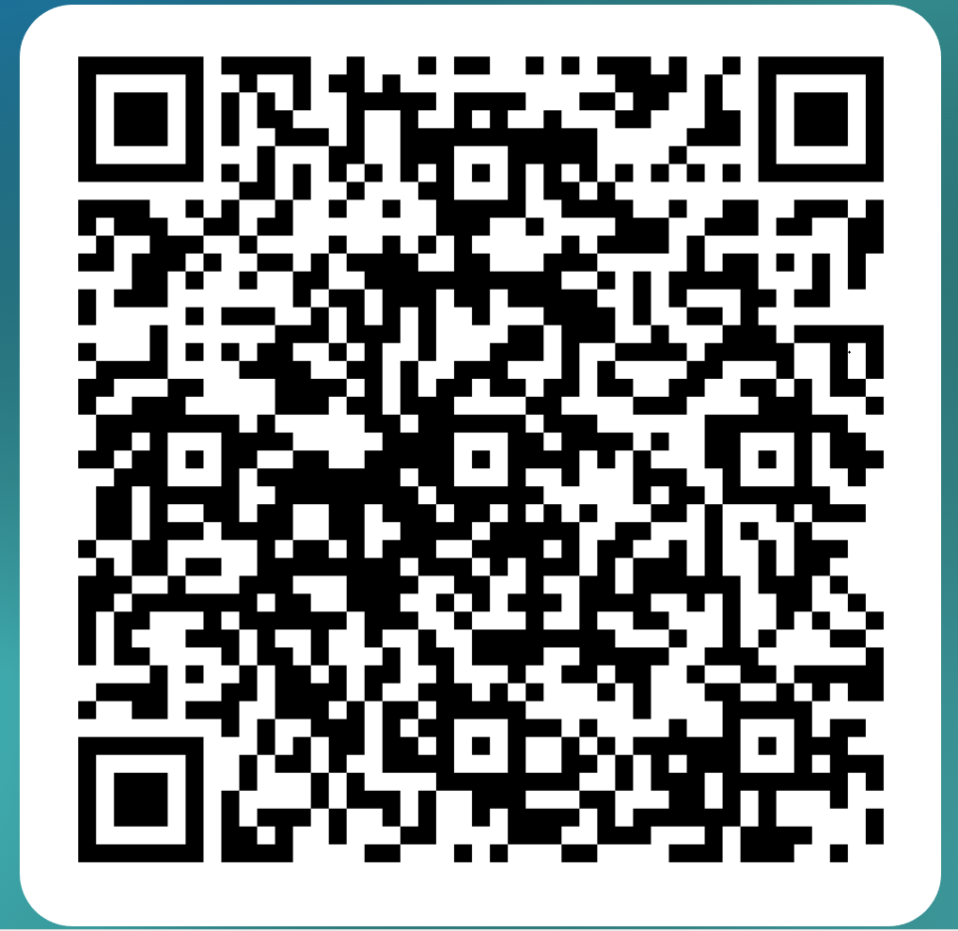
If Interested, Sign Up to Receive CAER Process Safety Action Team Quarterly Meeting Agendas and Minutes

