Slide 1
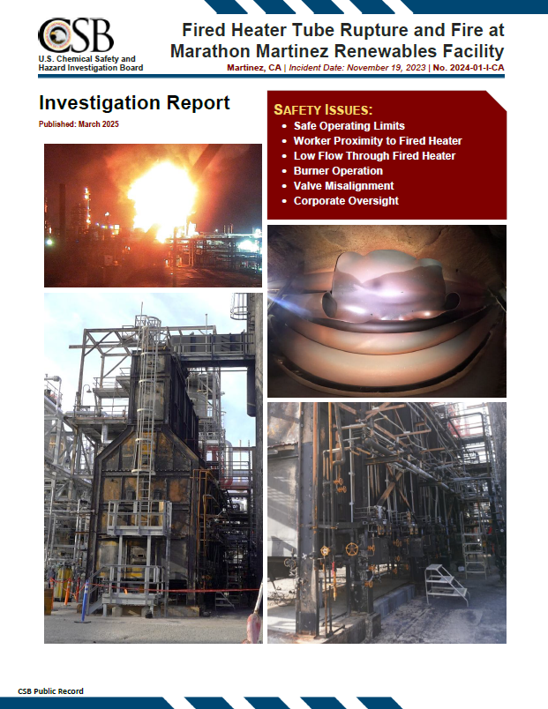
Fired Heater Tube Rupture and Fire at Marathon Martinez Renewables Facility
CAER Safety Summit
Melike Yersiz
September 11, 2025
Notes:
Chemical incident investigator
Public report; published March

Slide 2
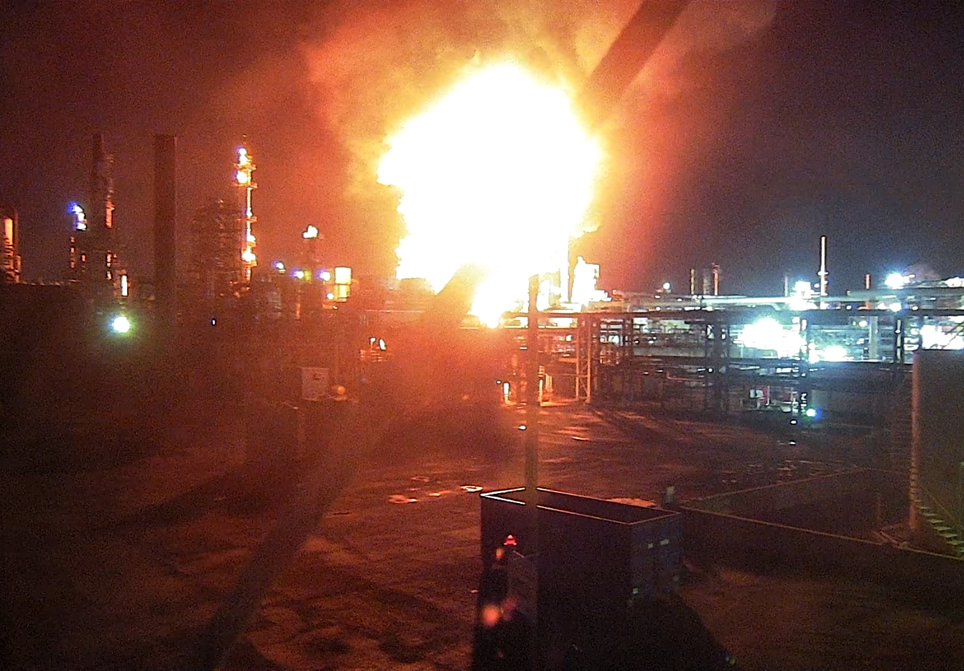
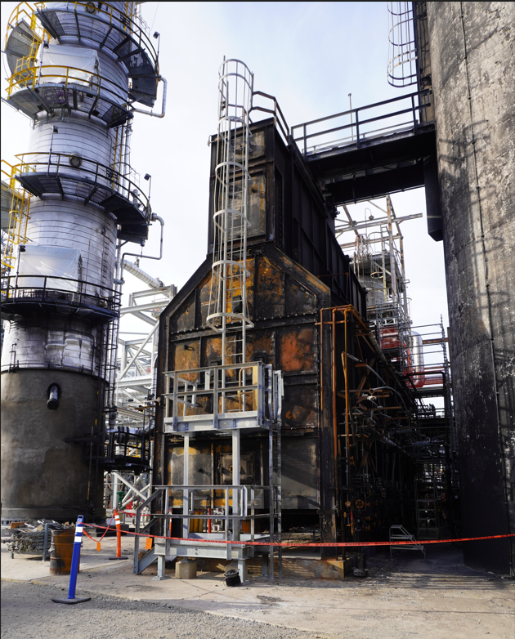
Incident Overview
November 19, 2023, 12:21 a.m.
Initial startup of a renewable diesel process unit, converted from refinery diesel hydrotreater
Fired heater tube ruptured and fire erupted while field operator was next to heater
One serious injury: third-degree burns
Notes:
Petroleum diesel hydrotreater since 1970s
Initial startup, had been attempting to get feed in for 2 weeks
Show location where the operator was
Facility remained down for approx 1 year

Slide 3
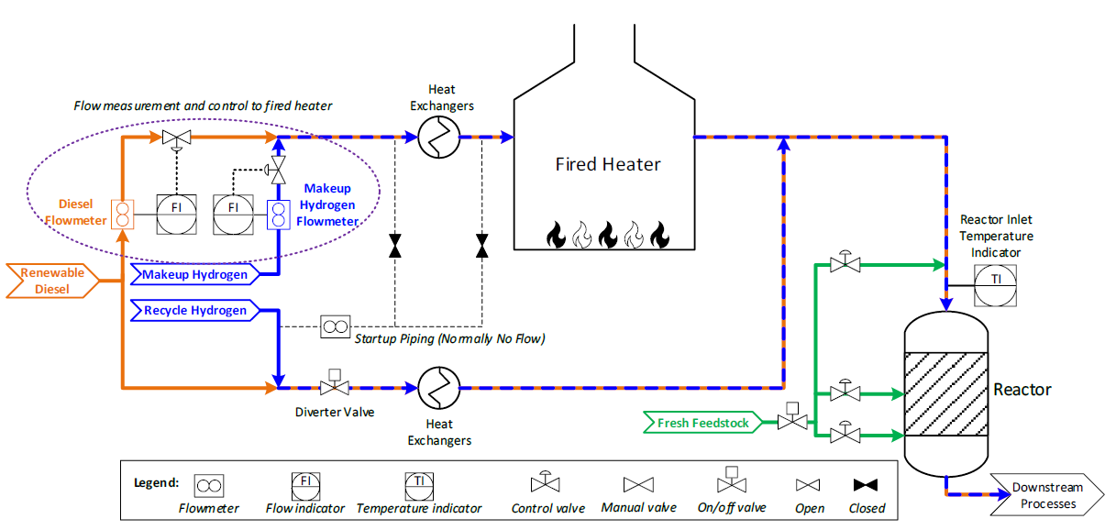
Process Overview (Normal Operation)

Slide 4
Process Flow Diversion (Heater Bypass)
Misaligned (Open) Valve
Safety Instrumented System
Flow Meter
Notes:
Fired heater two-phase flow
Show diesel and hydrogen
Some of the process bypassed the heater
On startup, all recycle hydrogen was routed to the heater to warm up the system via the startup line
Valve left open, backflow occurred when diesel introduced
SIS configured to trip on low flow, but it continued to read adequate flow to the heater

Slide 5
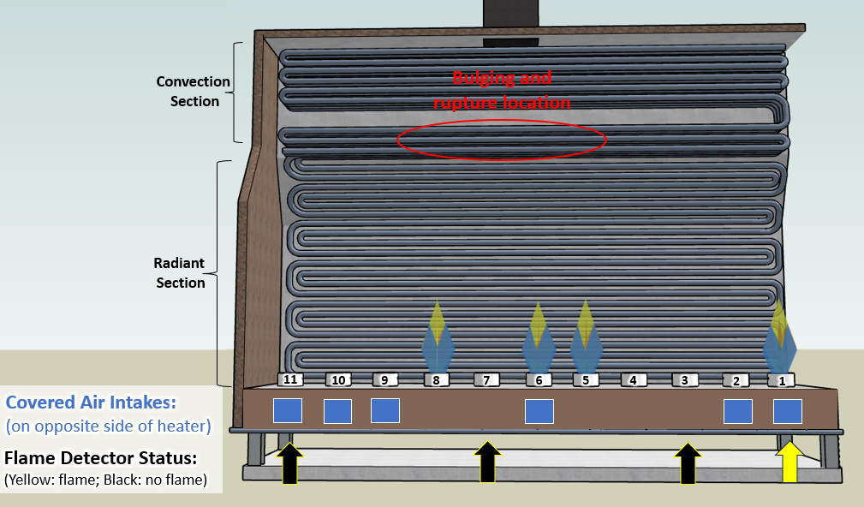
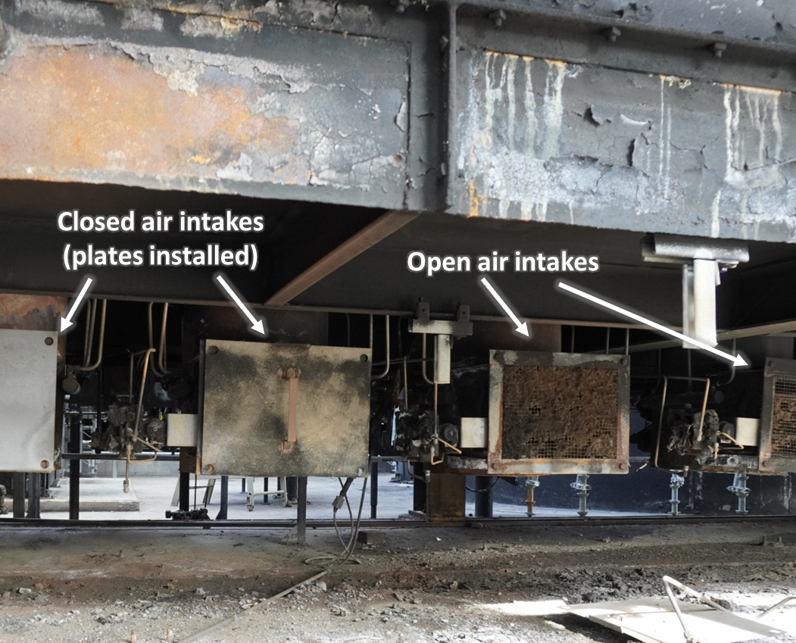
Burner Configuration Prior to Incident
Notes:
- Once diesel introduced, added burners
Heater tripped while adding burners
When re-lit burners, two out of four burners had their air intakes covered
11 burners, 4 flame detectors, status of these burners was unknown at the time of the incident
Likely flameout, air/fuel mixing, afterburning

Slide 6
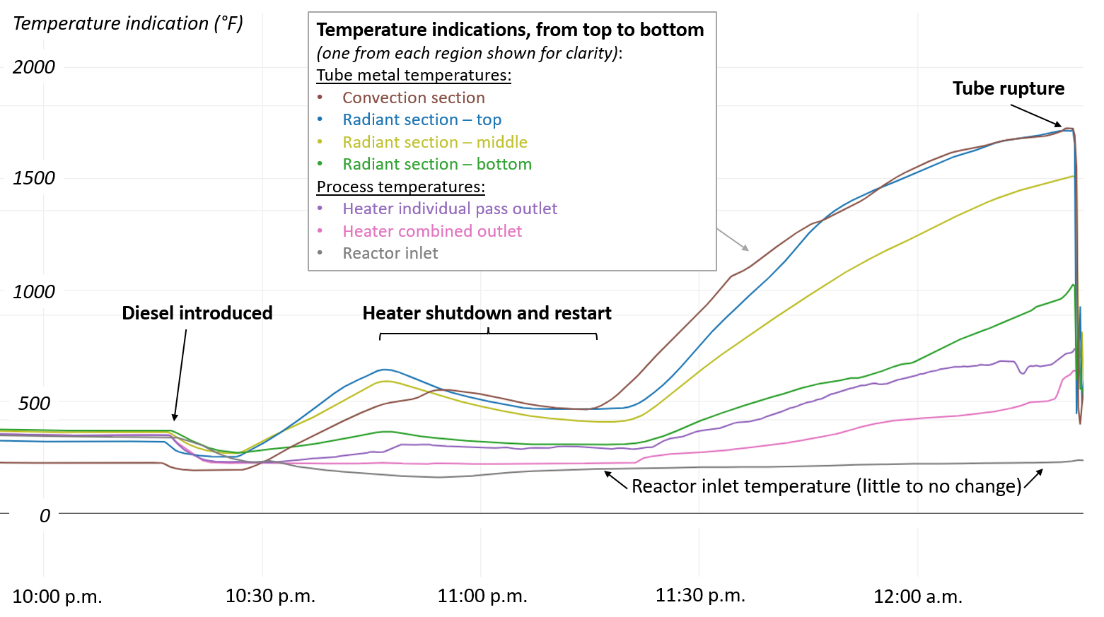
Temperature Trends – 2 hours until incident
Notes:
Stable temperatures before diesel introduced
Design temperature tubes 1120F
In about an hour, temps exceeded 1700F
High-temperature alarms inside heater; no change in reactor inlet temp
Troubleshooting: changes to draft, process flows, nothing made sense
Board operators asked field operator to shut down two burners

Slide 7
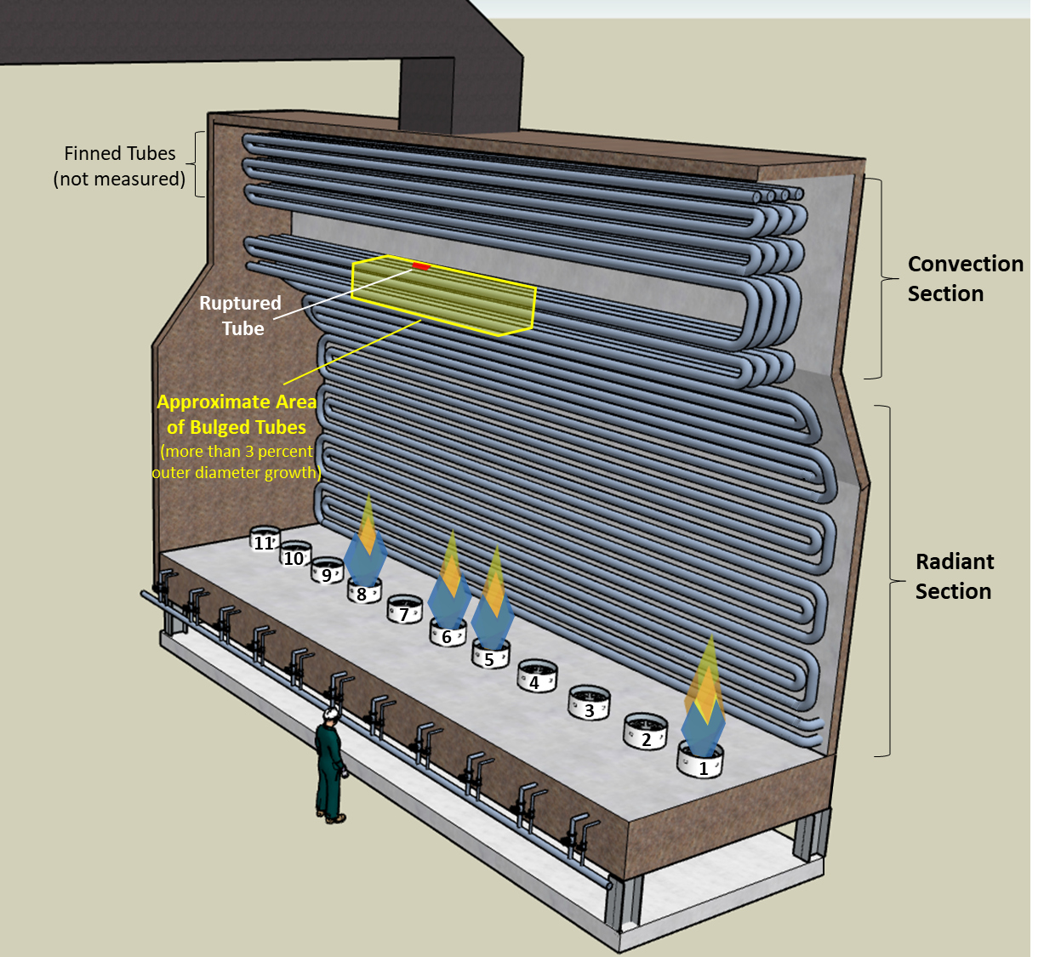
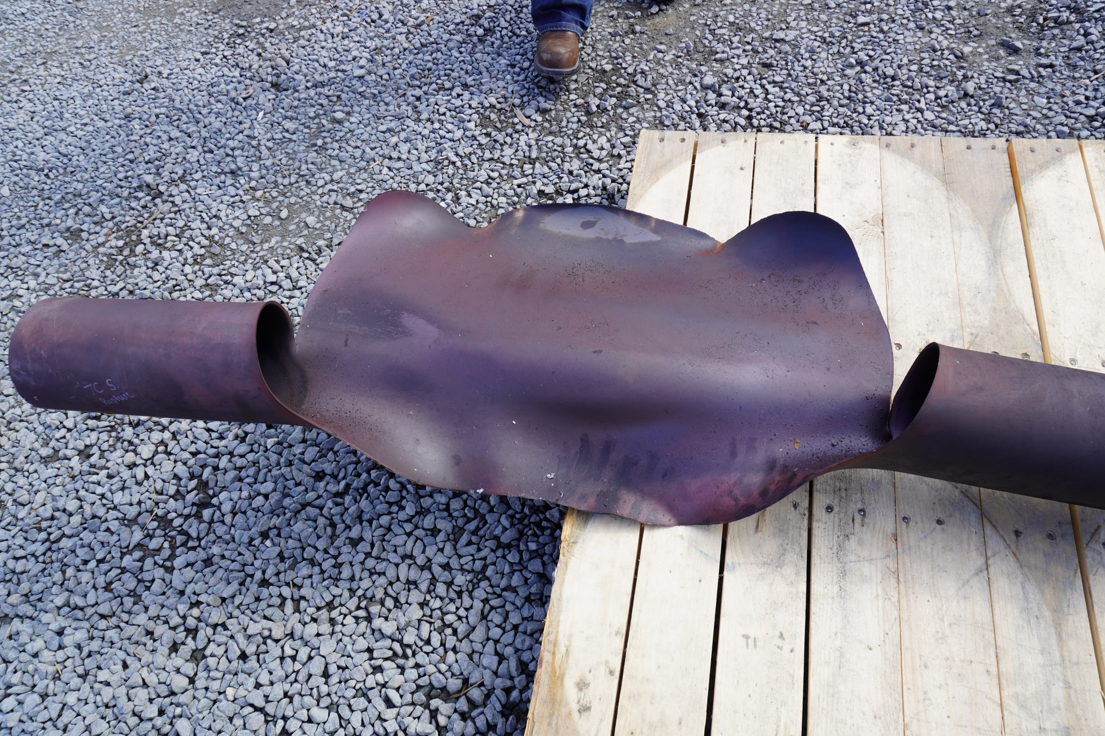
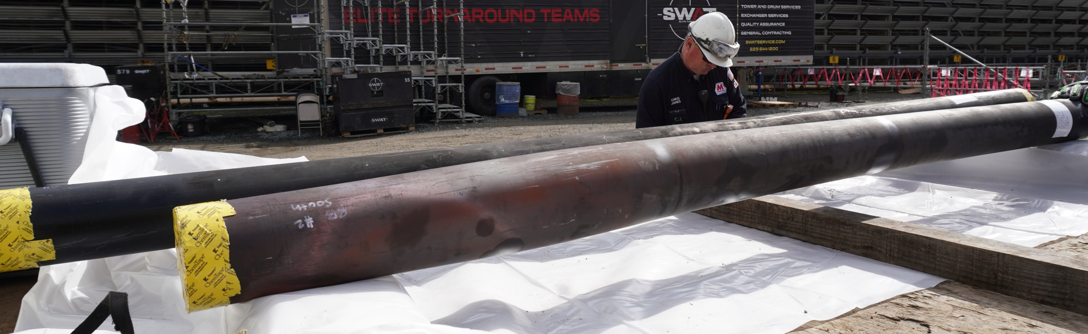
Short-term overheating tube failure

Slide 8
Safety Issues
Safe Operating Limits
Worker Proximity to Fired Heater
Low Flow through Fired Heater
Burner Operation
Valve Misalignment
Corporate Oversight
Link to CSB report (at csb.gov)

Slide 9
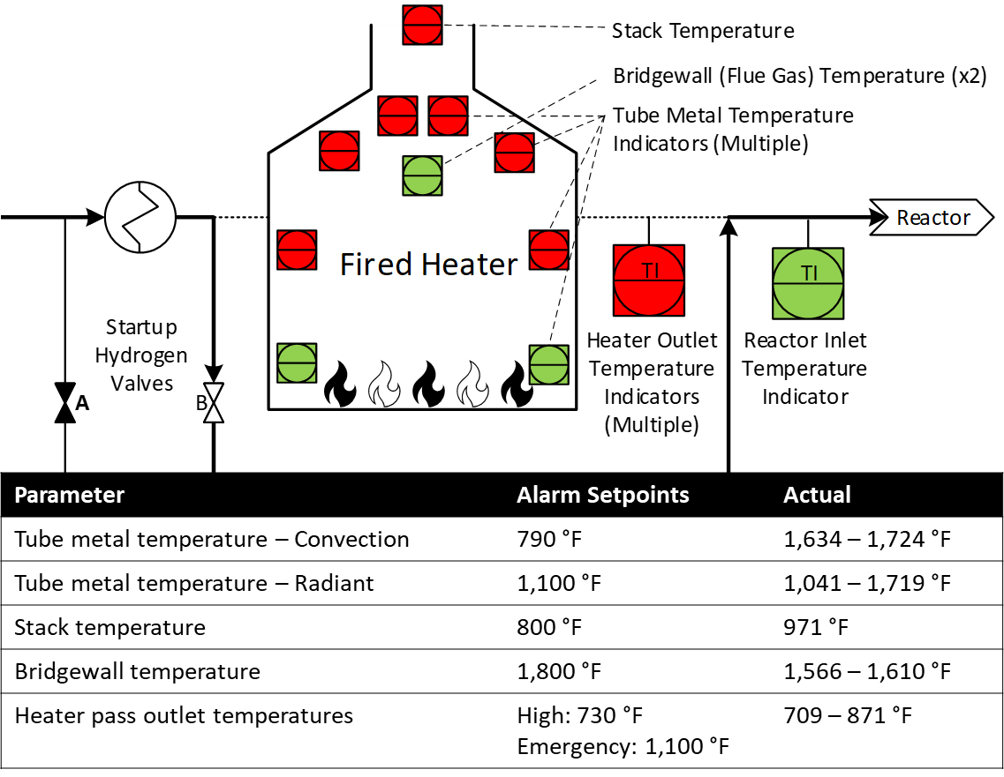
#1 – Safe Operating Limits
Marathon did not require Not-to-Exceed limits on tube metal temperatures that would prompt operators to stop troubleshooting and remotely shut down the heater
Notes:
Alarms
Safe operating limits – stop troubleshooting
Only NTE on outlet

Slide 10
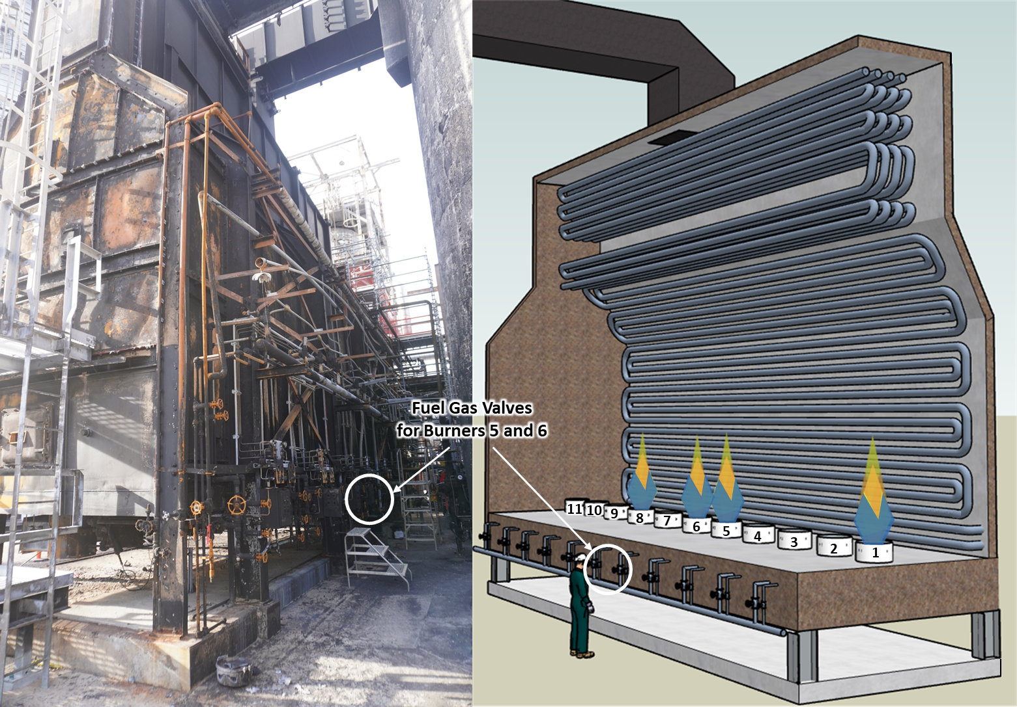
#2 – Worker Proximity to Fired Heater
Marathon did not prevent workers from being in close proximity to a fired heater during unsafe conditions
Insufficient industry guidance for removing personnel from the area during unsafe fired heater conditions
The CSB identified at least eight fired heater tube rupture incidents during 2020-2024
(see Appendix E in report)
Notes:
Need to remove people from the area under certain conditions (high tube metal temperature)
Not a rare occurrence
IR packet

Slide 11
Safe Operating Limits / Worker Proximity
Key Lesson:
Companies should ensure the safety of their workers by preventing workers from being in close proximity to a fired heater when tube temperatures are high or the fired heater is otherwise in an unsafe condition. Companies should create clear requirements for when troubleshooting in close proximity to fired heaters should be stopped and other actions, such as shutting down a fired heater remotely, should be taken.
Recommendations:
API RP 556: Instrumentation, Control, and Protective Systems for Gas Fired Heaters
Requirements for proper response to high tube metal temperatures, including guidance to alert operators when safe operating limits are exceeded and to specify predetermined response actions, such as shutting down the fired heater remotely.
The predetermined response actions must include actions that specify when to stop troubleshooting and remove personnel from the vicinity of the fired heater.
Notes:
API subcommittee meetings
RP being broken down into standards
3 topics CSB rec

Slide 12
#3 – Low Flow Through Fired Heater
PHA team did not anticipate reverse flow through Valve B and flow bypassing the fired heater
Hydraulic analysis did not exist (typically not required in a PHA)
Startup piping not considered a “bypass”
Company-wide survey following a similar 2018 Detroit fired heater incident did not identify this piping as a potential bypass or flow diversion
Notes:
PHA team evaluated this scenario
NC valves
No safety consequence of having either valve open
No design purpose of having two branches of startup hydrogen line
Post-incident changes

Slide 13
#3 – Low Flow Through Fired Heater
Marathon’s post-incident modifications:

Slide 14
#3 – Low Flow Through Fired Heater
Key Lesson:
Companies should ensure that fired heaters are adequately protected from operating with low flow by evaluating all process connections between flow meters associated with the safety instrumented system and the heaters they are intended to protect, including considerations for reverse and misdirected flow.
Recommendations:
API RP 556: Instrumentation, Control, and Protective Systems for Gas Fired Heaters
Design requirements (“shall” rather than “should” language) for protecting fired heaters from low process flow where process piping diverges downstream of a flow meter. Requirements may include achieving proof of flow to the heater through valve position indicators and interlocks on branch connections downstream of flow meters to prevent backflow, reverse flow, or other diverted flow scenarios that could defeat the safety instrumented system.

Slide 15
#4 – Burner Operation
Insufficient operator training and operating procedures on safe burner operation
Flame detection system ineffective
Insufficient engineering controls
(flameout detection and combustibles measurements)
Insufficient industry guidance in API recommended practices

Slide 16
Marathon’s post-incident actions:
Brought in existing combustibles analyzer readings to the control room
Installed a TDL analyzer (bridgewall CO and methane)
Alarms on high and high-high (Not to Exceed) TDL CO and methane, with predetermined actions to reduce fuel gas or shut down the heater
Alarms on fuel gas H₂ content
Future plans to tie in the TDL analyzer to the heater SIS

Slide 17
#4 – Burner Operation
Key Lessons:
Operating procedures and operator training should include verification that air intake covers (where used) are removed prior to lighting a burner.
Fired heaters should be equipped with continual combustibles monitoring at the bridgewall to detect the onset of incomplete combustion. The combustibles data should be viewable by the board operators in the control room and should be equipped with alarms at appropriate setpoints.
Recommendation (API RP 556):
Engineering safeguard requirements to detect and prevent afterburning in fired heaters. These requirements may include the use of instrumentation such as combustibles measurements, flame detectors, and/or thermocouples that measure tube metal, flue gas, and process fluid temperatures. The requirements shall address monitoring capability from the control room.

Slide 18
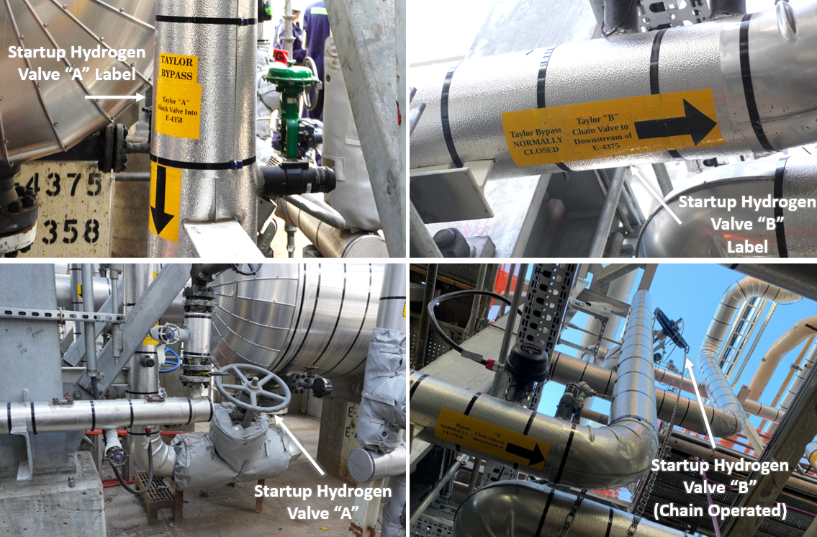
#5 – Valve Misalignment
Equipment labeling did not match operating procedure
Valve B and associated piping did not have a design purpose
Marathon did not check valve line-ups prior to second startup attempt
Marathon did not provide adequate operator training and allowed non-operators to manipulate valves – counter to “Walk the Line” philosophy

Slide 19
#5 – Valve Misalignment
Key Lesson:
Companies should implement Walk the Line practices to minimize equipment lineup errors. Walk the Line activities include verifying valve positions before starting up a unit, understanding operating procedures and equipment routings, and properly communicating and documenting shift turnover information.
Recommendation to the Marathon Martinez Renewables facility:
Implement changes to improve Walk the Line performance at the Martinez facility:
Operator field walkdowns to ensure that valves are correctly aligned before all unit startup activities from planned or unplanned shutdowns
Communications among and between shifts
Expectation for only trained operators to control valve line-ups at their units

Slide 20
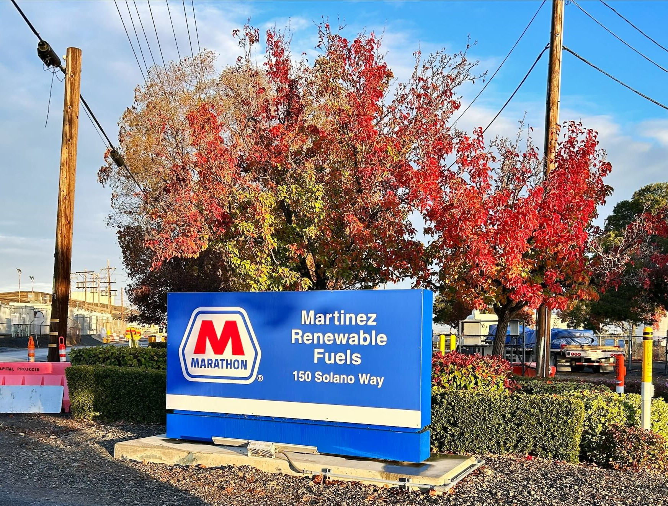
#6 – Corporate Oversight
Martinez facility:
  Acquired in 2018
  Idled in 2020
  Operated as a terminal
  Started up as a renewable diesel facility in 2023
Martinez facility did not conform to corporate refinery standards at the time of the 2023 incident
Key Lesson:
Companies should have effective oversight to ensure that processes are safe, equipment meets or exceeds local, state, federal, industry, and internal company safety standards, and workers are adequately trained and prepared before startup of a new or revamped process.

Slide 21
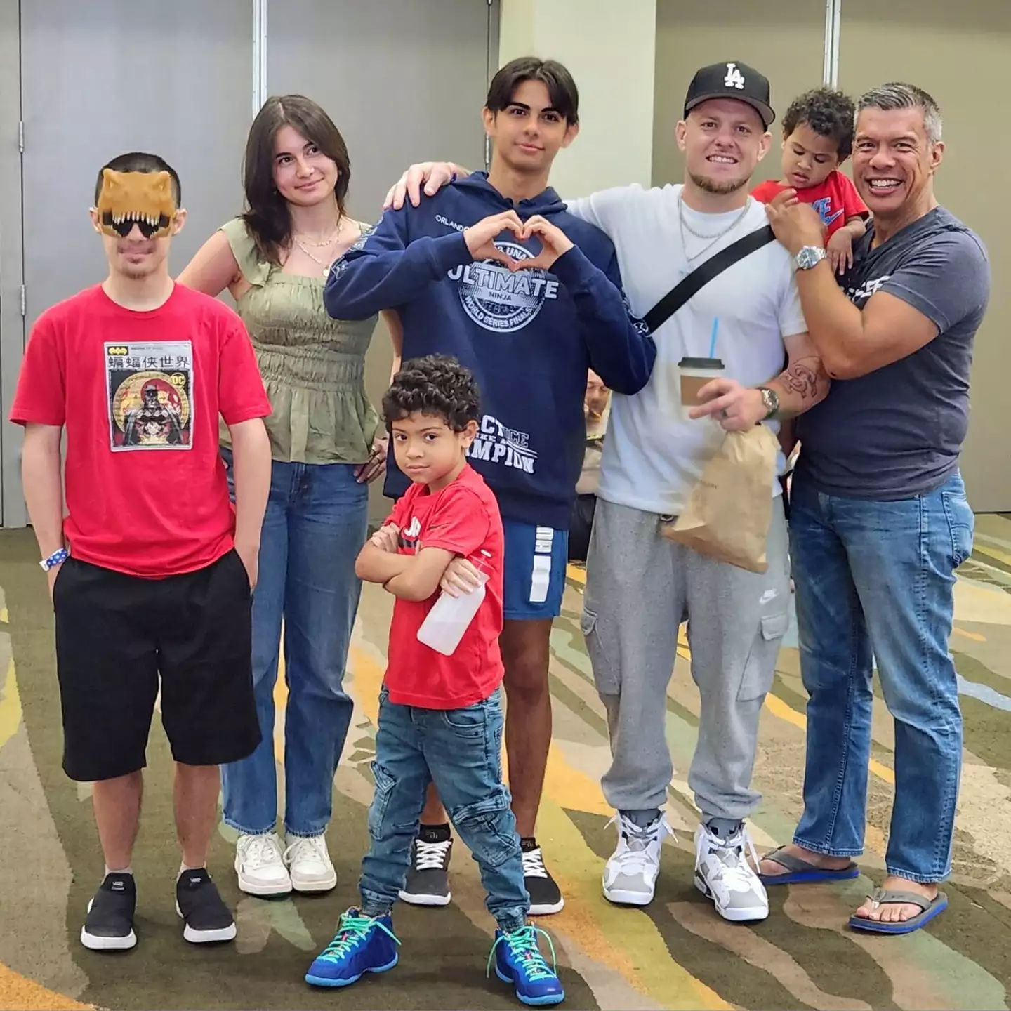

Jerome Serrano
San Francisco Chronicle Article:
A faulty furnace. A blast of fire. And a man’s life, shattered
(12/10/2024)

Slide 22
Thank You
Melike Yersiz
Chemical Incident Investigator
Melike.Yersiz@csb.gov

