Slide 1
Lithium-Ion Battery Emergencies
Cody Clem
Captain Paramedic
Hazardous Materials Specialist
Contra Costa County Fire Protection District

Slide 2
Meeting Objectives
This presentation is designed to inform you about the growing risks linked to lithium-ion fire emergencies. We will explore different battery types and their applications, discuss their chemical makeup, and identify the toxic and explosive gases that could impact our operations as first responders and citizens at large. Furthermore, we will analyze case studies from incidents in Surprise, Arizona to Alcorcon, Spain. I will present videos demonstrating the dynamics and reactions of lithium-ion batteries during thermal runaway and introduce the Take CHARGE campaign.

Slide 3
“Lithium-ion batteries have emerged as the power source of choice for a vast array of modern tools and mobility devices. From toothbrushes to smartphones, construction tools to medical devices, scooters to cars, these rechargeable power sources have transformed the way we power our homes, cities and everything in between.”
U.S. Fire Administration

Slide 4

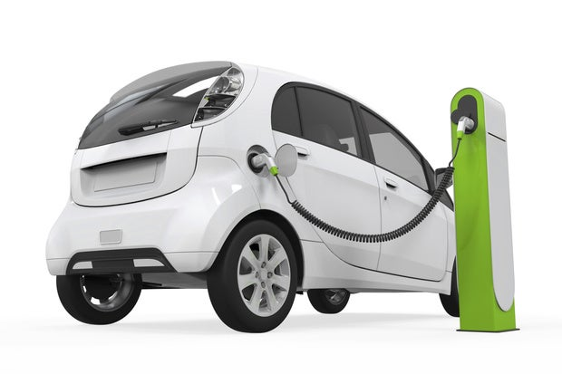
Everyday Lithium-Ion Battery Use
This Photo by Unknown Author is licensed under CC BY-SA
This Photo by Unknown Author is licensed under CC BY-SA-NC

Slide 5


Everyday Lithium-Ion Battery Use
This Photo by Unknown Author is licensed under CC BY

Slide 6
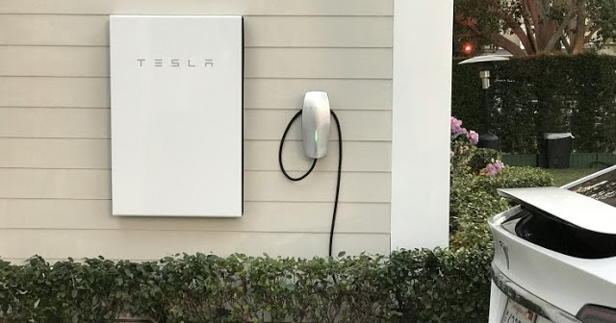

Everyday Lithium-Ion Battery Use
This Photo by Unknown Author is licensed under CC BY
This Photo by Unknown Author is licensed under CC BY-NC-ND

Slide 7
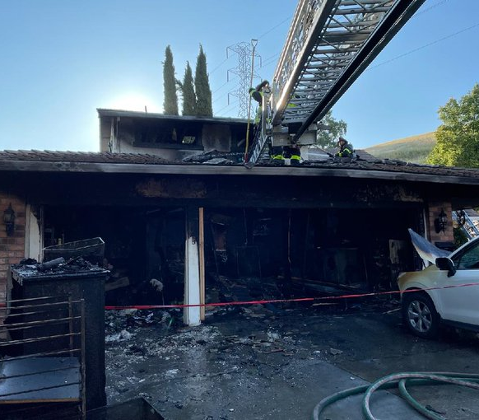
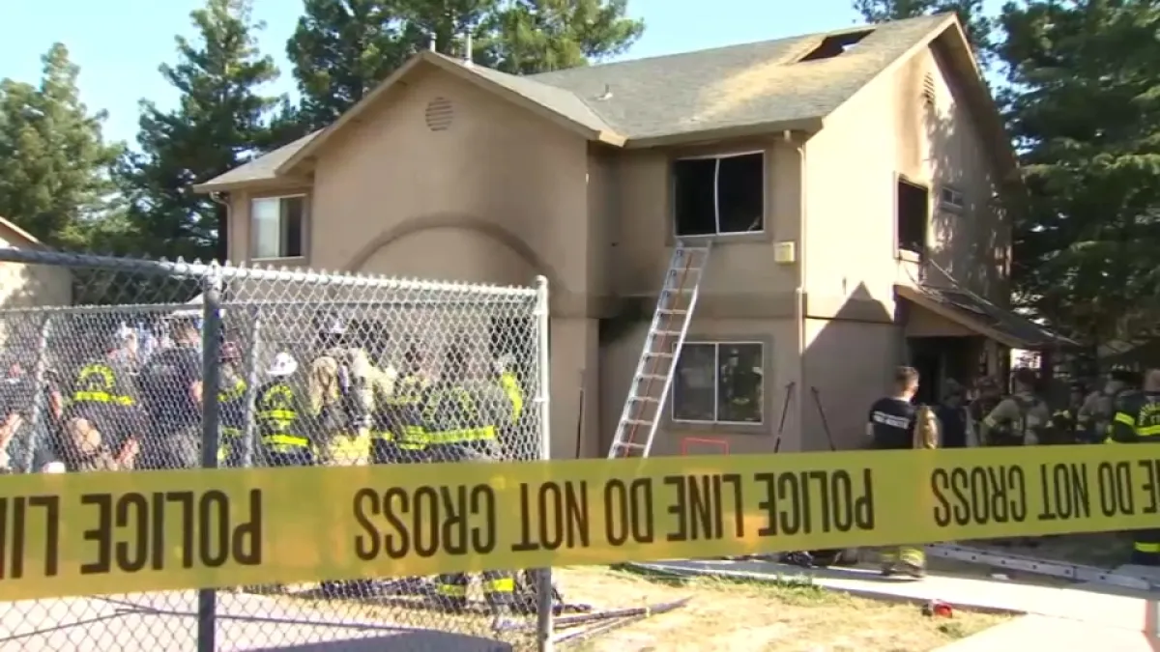
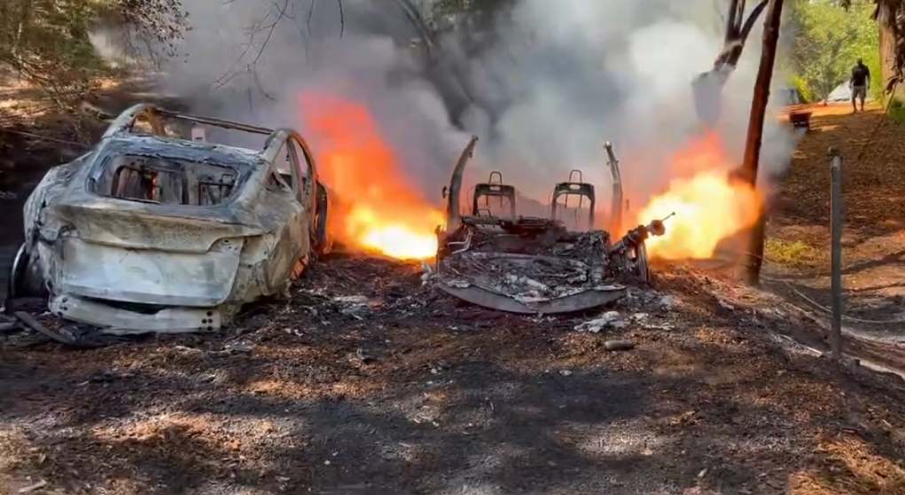
Everyday Use = Everyday Problems
Tesla Fire Hunsaker Canyon
2 critically injured in two-alarm Pittsburg apartment fire
“Contra Costa Fire officials warn of lithium ion battery dangers after series of related fires.”

Slide 8
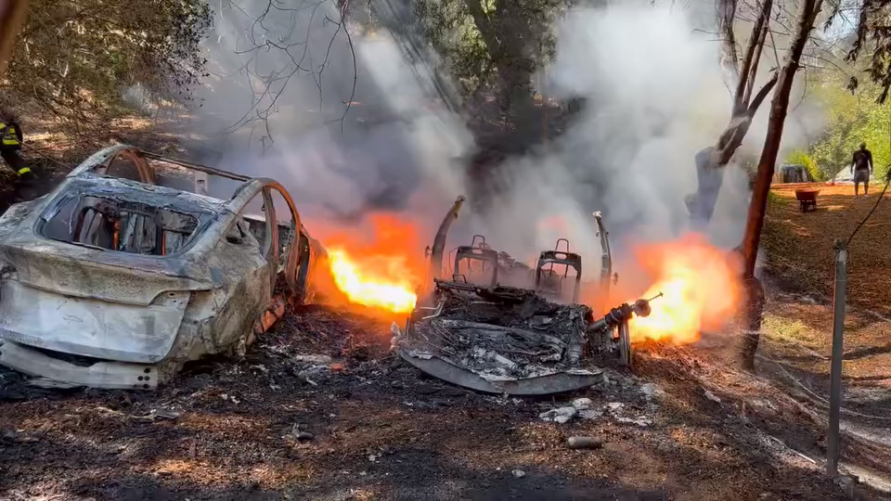

Slide 9
Lithium-Ion Battery Design
Prismatic - Lithium prismatic cells are commonly found in telecommunication and portable electronic devices.
Pouch – also known as a flexible or flat-cell battery. Used in some military applications
Cylindrical – cylindrical metal casing that encloses the positive and negative electrodes, separator, and electrolyte. Widespread applications.

Slide 10
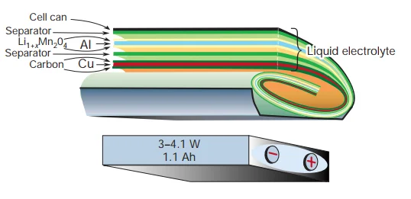
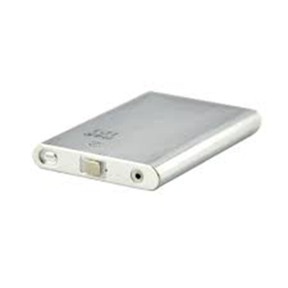
Prismatic Cell
Prismatic cells are produced with capacities that vary from a few ampere-hours suitable for laptops and cell phones to several hundred ampere-hours intended for electric vehicle applications. The manufacturing costs for prismatic cells can be higher than other designs.

Slide 11
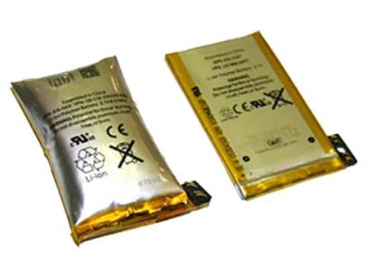
Pouch Cells
Pouch cells lack a hard casing and utilize a flexible foil that is sealed to contain the cell. This packaging method is relatively straightforward; it minimizes weight and results in adaptable cells that can conform to the space available in a product.

Slide 12
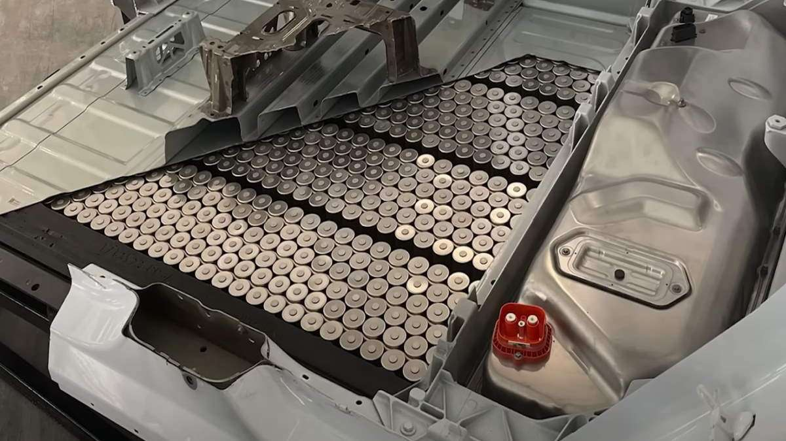
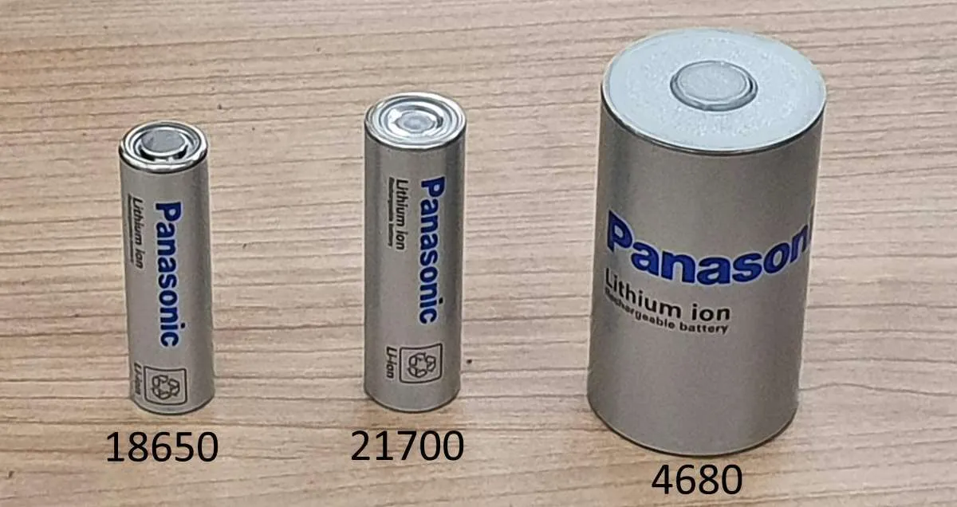
Cylindrical Cells
Cylindrical cells are commonly used in everything from vape pens, micro mobility devices like scooters and bikes, to commercial busses, trucks, and storage systems. One 18650 lithium-ion battery can produce eight liters of toxic/flammable gas. Many devices use several 18650 cells to work. In the case of a typical electric bike/scooter, the battery may contain between 50 and 130 cells. Some Tesla models have more than 7,000 cells.

Slide 13
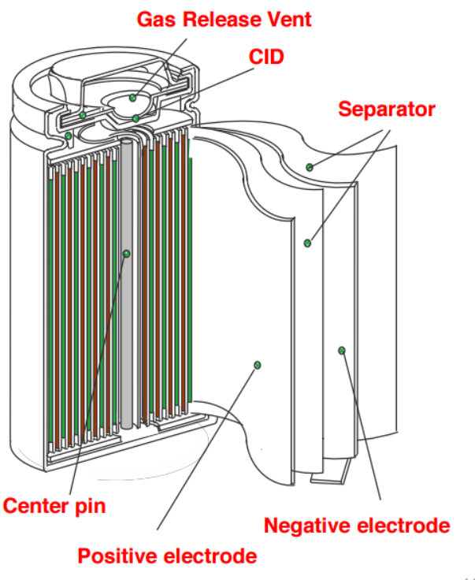
Chemical Composition
The chemistry for lithium-ion batteries are numerous but the design is mostly the same. The most common ones in use are nickel manganese cobalt (NMC), nickel cobalt aluminum (NCA), and lithium iron phosphate (LFP) or (LiFePO4). Each chemistry has a specific strength of application.

Slide 14
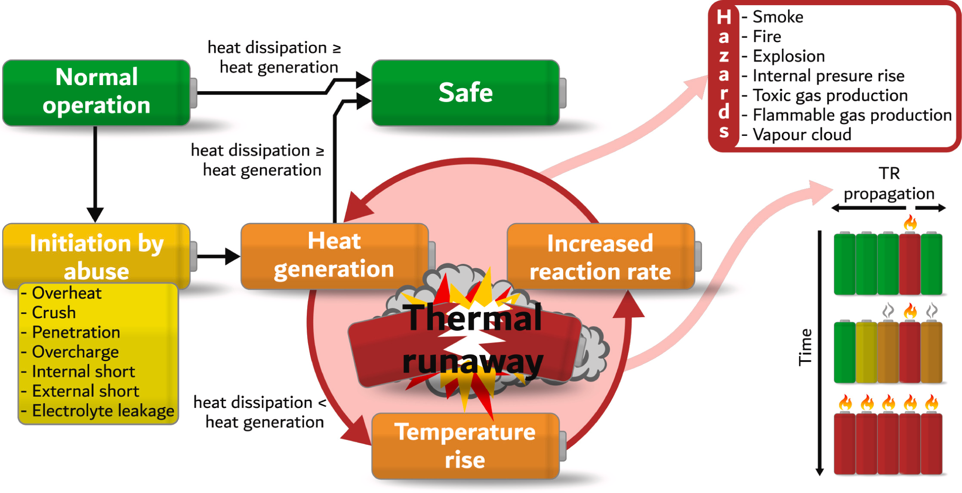
Process of Thermal Runaway

Slide 15
What Type of Gasses?
Flammable
Carbon Monoxide
Hydrogen
Various Hydrocarbons
Methane
Ethane
Ethylene
Etc..
Toxic
Carbon Dioxide
Hydrogen Fluoride
Hydrogen Cyanide
Hydrogen Chloride
Nitrogen Dioxide
Sulfur Dioxide
Carbonyl Fluoride
Phosphoryl Fluoride

Slide 16
Metal Particulate Matter
12,000 – 17,000 times the EPA ambient standard for particulate matter
Lithium
Nickel
Cobalt
Manganese
Copper

Slide 17
Chemical Composition & Hazards
NMC currently stands out as the dominant chemistry in the battery industry, capturing a substantial market share. It is cost-effective, provides a satisfactory cycle life, and is recognized as a reliable battery choice. You will commonly encounter it in most E-bikes, power tools, and certain electric vehicles.
Common Hazards:
Reignition Flammable & Toxic Gasses
Toxic Heavy Metals Off-brand / Counterfeit Construction

Slide 18
Chemical Composition & Hazards
NCA is most noted for its superior power density and low passive discharge rate (a term used to describe a battery cell’s propensity to lose power while not in use). This battery chemistry has been a staple for Tesla vehicles, although they are now using limited amounts of Lithium Iron Phosphate (LFP) and Nickle Manganese Cobalt in their vehicles.
Common Hazards:
Reignition Flammable & Toxic Gasses
Toxic Heavy Metals Off-brand / Counterfeit Construction

Slide 19
Chemical Composition & Hazards
LiFePO4 is considered the most thermally stable of the three chemistries; however, it has a lower energy density by volume, which means more cells may be needed to achieve the same energy density as an NCA. With stationary battery energy storage systems (BESS) facilities, where space is not necessarily an issue, this chemistry has become quite popular.
Common Hazards:
Flammable & Toxic Gasses Off-brand / Counterfeit Construction
“The Safe Lithium-ion Battery”

Slide 20
Chemical Composition & Hazards
NMC LIBs generate larger specific off-gas volumes than other chemistries;
Prismatic cells tend to generate larger specific off-gas volumes than offer cell forms;
Generally, a higher SOC leads to greater specific gas volume generation;
LFP batteries show greater toxicity than NMC;
LFP is more toxic at lower SOC, while NMC is more toxic at higher SOC (respective to themselves); and
LFP off-gas has a greater flammability hazard.
“Review of gas emissions from lithium-ion battery thermal runaway failure — Considering toxic and flammable compounds” Journal of Energy Storage, Volume 87, 15 May 2024

Slide 21
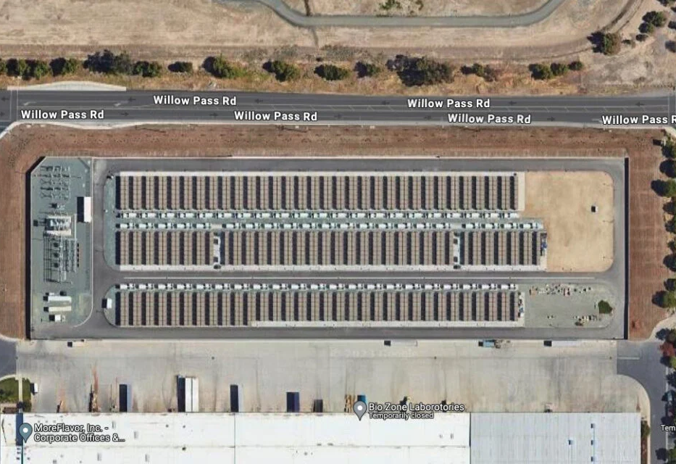
Battery Energy Storage Systems
Diablo Energy Storage 200Mw of energy.
1Megawatt = 1,000 Kilowatts
Average home uses 800-1000Kw a month.
Multiple smaller systems have been installed in the county.

Slide 22
Surprise Arizona April 19th, 2019
Cascading thermal runaway within a 2.16 MWh Li-ion battery ESS.
9 First responders sent to the hospital with injuries 4 members of the fire department sustain serious injuries.
HazMat Crews detected concentrations of Hydrogen Cyanide (HCN) and Carbon Monoxide (CO) above lethal levels
When crews opened the door of the battery enclosure the preceding thermal runaway resulted in an explosion.
One firefighter was thrown over 75 feet and a second over 30 feet.

Slide 23
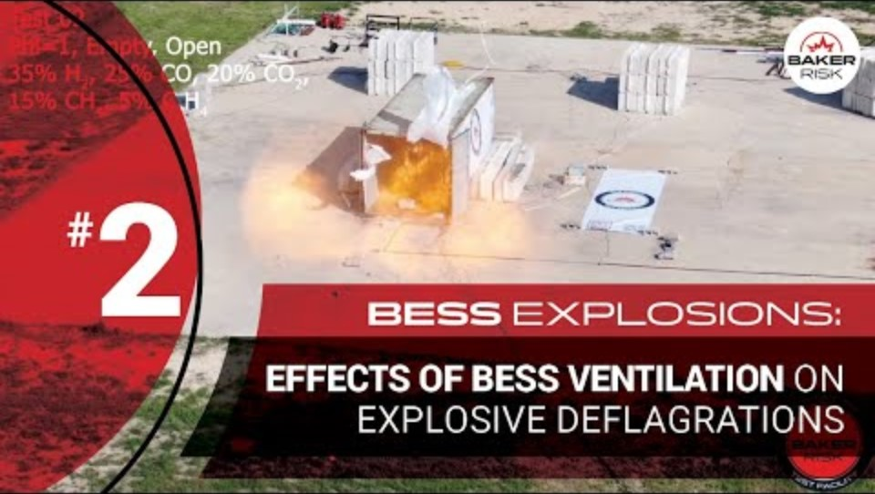

Slide 24
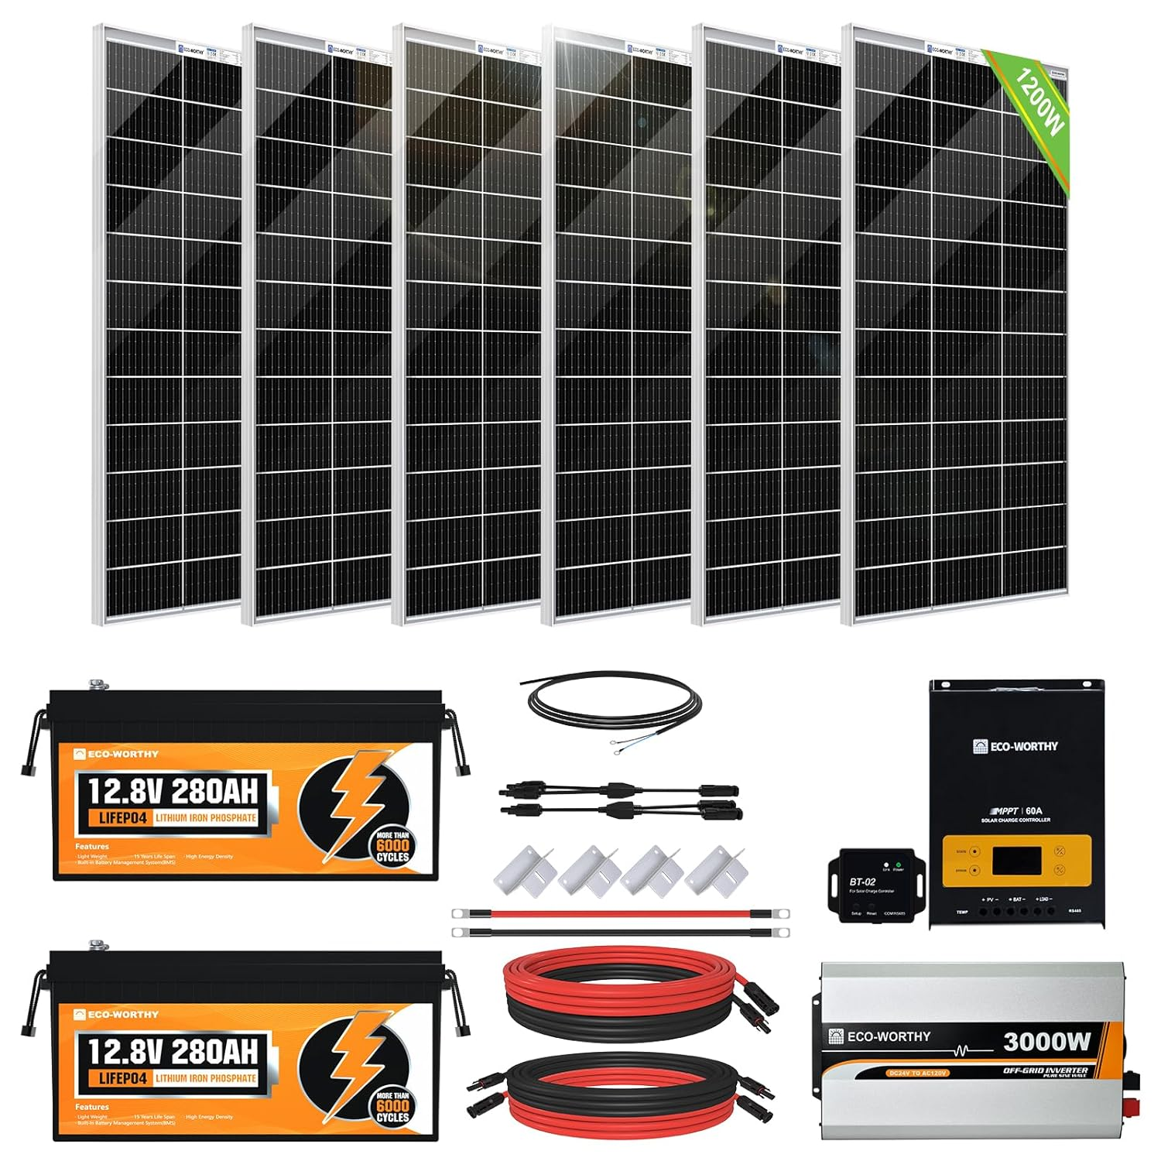
Home Built Energy Storage Systems
Recent incidents throughout the county have highlighted issues related to home-assembled (DIY) Battery Energy Storage System (BESS).
As technology advances and becomes more available, we can expect to encounter more such instances.
DIY Power Walls are gaining traction in the market. Complete packages are available on multiple websites.

Slide 25
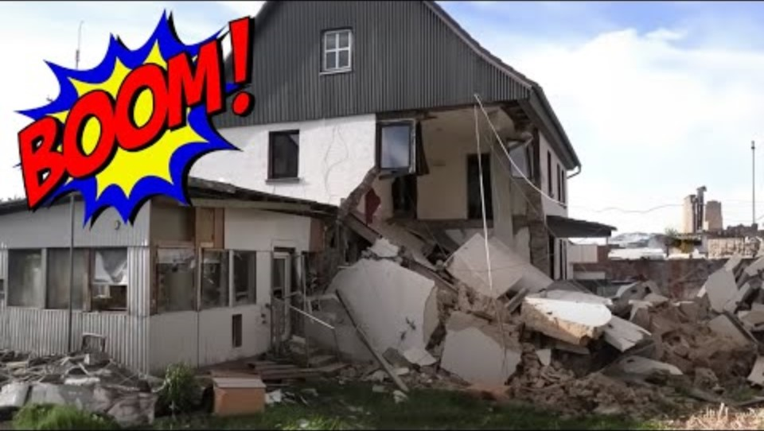

Slide 26
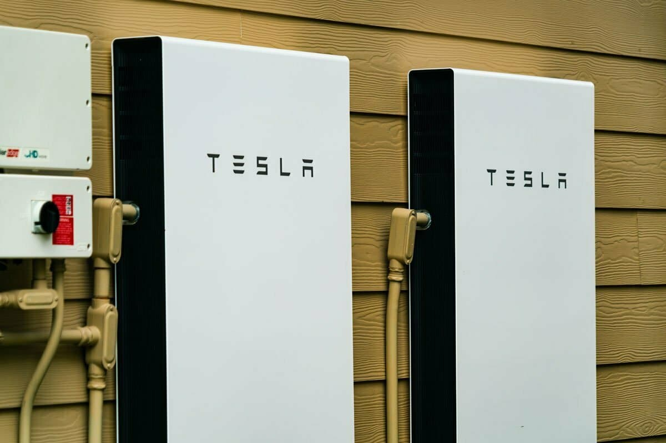
Residential Energy Storage Systems
UL approved power walls have built in battery management systems
2022 California became the first state to require builders install solar and battery storage on new commercial and high-rise multifamily buildings.
New residential must be energy storage ready.

Slide 27


Slide 28
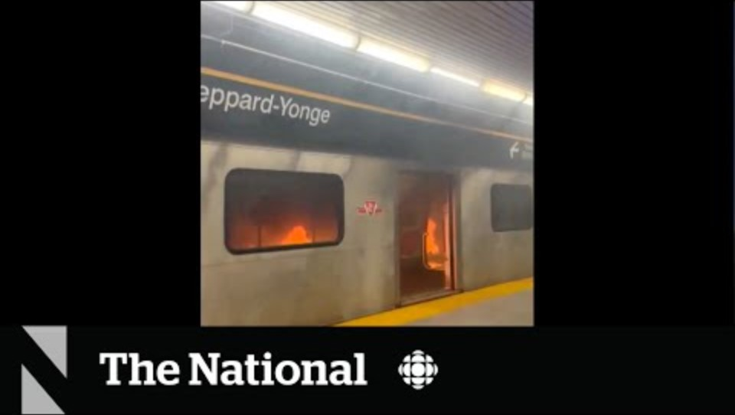

Slide 29
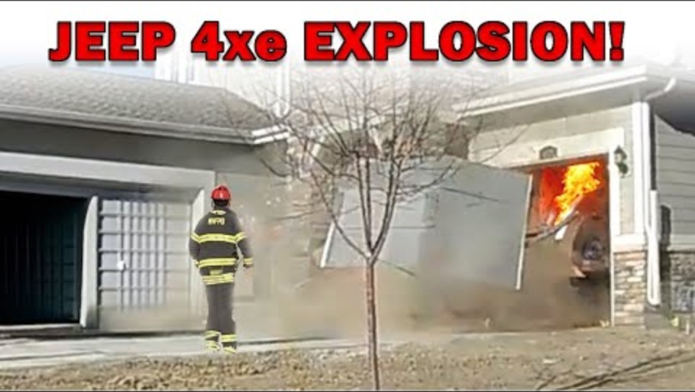

Slide 30
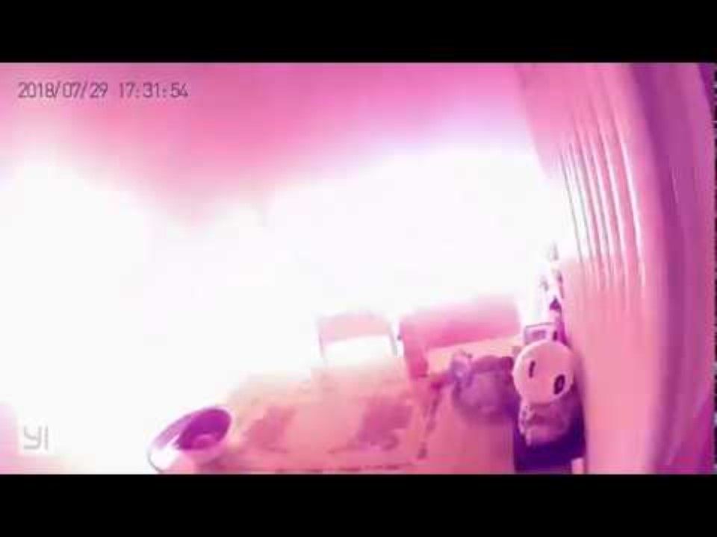

Slide 31


Slide 32
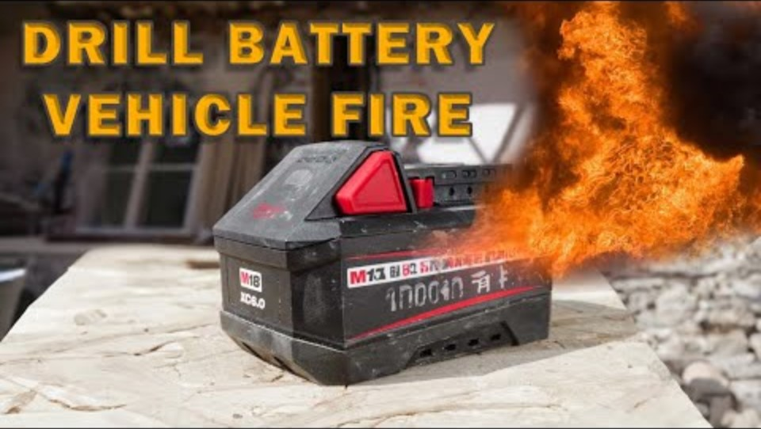

Slide 33
Fires Involving Lithium-Ion Batteries
These are not normal fires.
Treat as Hazardous Materials incidents
The Emergency Response Guide (ERG) #147 (Lithium-Ion Batteries) described as containing flammable liquid electrolytes that can ignite at 302 degrees Fahrenheit.
If batteries are involved in fire, Guide #147 tells us to go to Guide #125 (Gases – Toxic and /or Corrosive). Guide #125 indicates that burning batteries may produce hydrogen fluoride gas, which could be fatal. Hydrogen fluoride (HF) levels were present in every test performed by UL/NFPA.

Slide 34
Fires Involving Lithium-Ion Batteries
Con Fire’s Response –
Incidents will develop and expand according to their severity and the information obtained from 911 callers as well as the fire units that arrive at the scene.
Con Fire’s Hazardous Materials Response Team will be deployed to handle fires involving lithium-ion batteries. Providing hazard neutralization and gas detection capabilities
The methods of suppression will differ based on risk assessment, the potential for effective suppression, and the level of qualitative energy present.

Slide 35
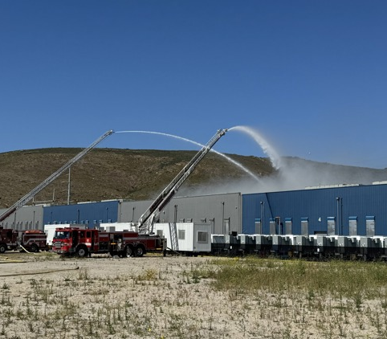
Otay Mesa Incident (San Diego co.)
Fire occurred in May of 2024
Burned for over a week.
Clean up is still on going at the site. Expected completion late 2025
EPA utilized for air monitoring surveillance and water monitoring operations

Slide 36
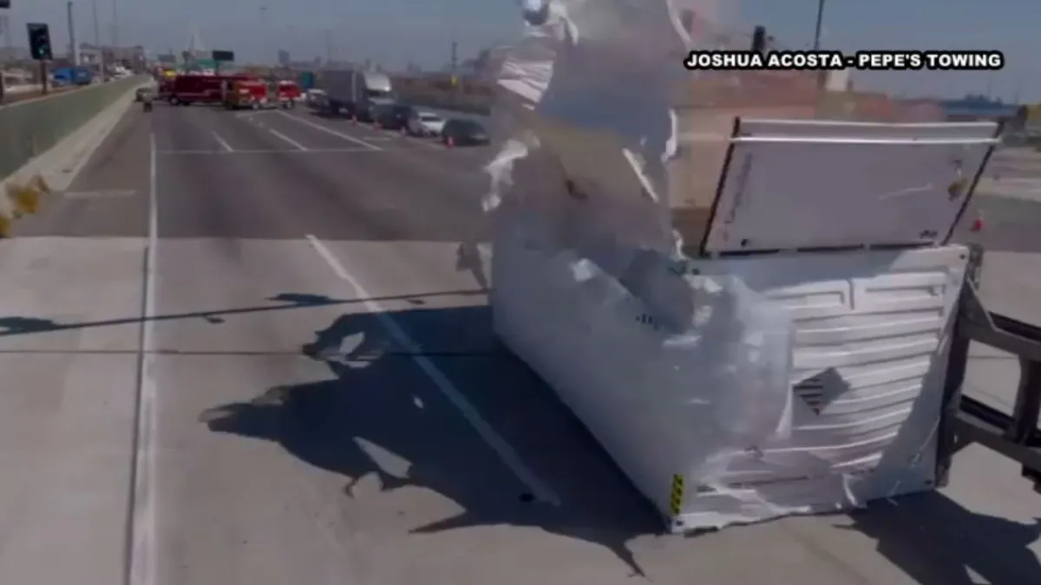
Seaside Incident (Los Angeles)
BESS during transport fell off truck.
Mechanical / Physical Damage cause Thermal Runaway.
Shut down major freeway for nearly 48 hours.
Projected $900,000,000 in Port revenue loss
6 Firefighters injured
EPA utilized for air monitoring surveillance

Slide 37
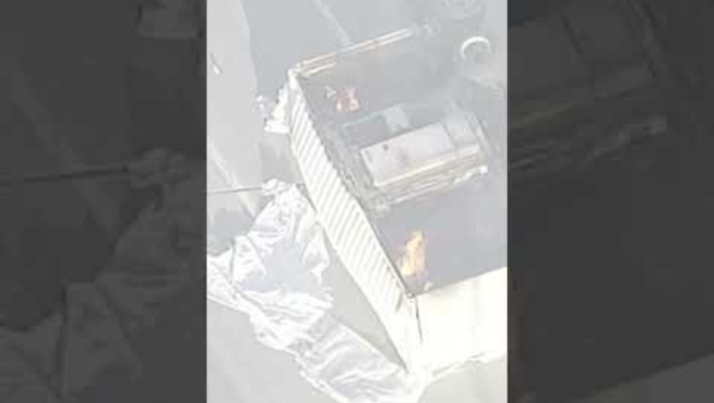

Slide 38
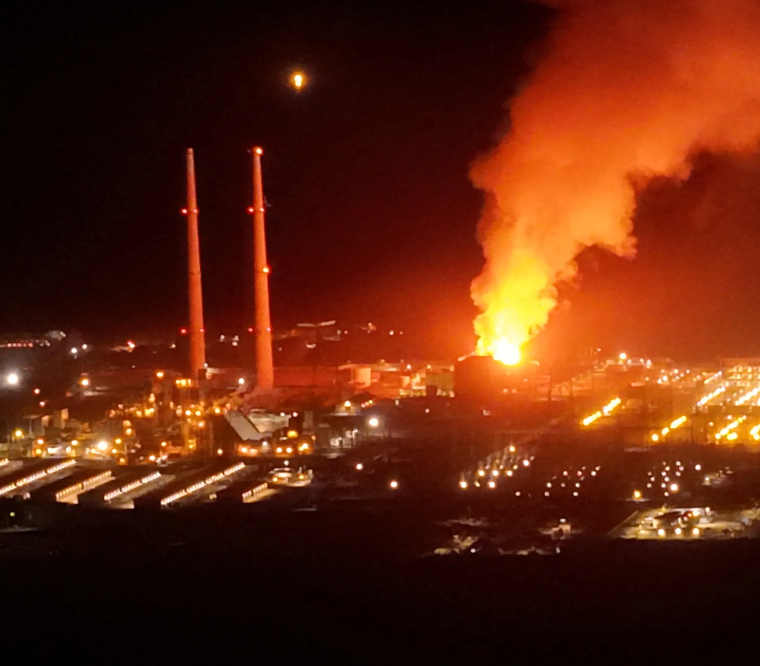
Moss Landing (Monterey co)
PG&E Energy Storage Facility
Was not the first fire at this location (2021 & 2022)
Evacuations of 1,700 people
EPA utilized for air monitoring surveillance
Initial concern is of HF but has evolved into long term effects of heavy metals

Slide 39

Alcorcon, Spain 2025
Two firefighters killed in an underground parking garage fire
7 others were transported with injuries
Electric Porsche caught fire after an accident inside the garage
Explosion resulted in partial roof collapse

Slide 40
TEEX – Lithium-ion Battery Study
Texas A&M Engineering Extension Service (TEEX)
The tests measured 24 heavy metals and 75 semi-volatile organic compounds (SVOCs) resulting from the battery fires
High concentrations of lithium, nickel, cobalt, manganese and copper
SVOCs remained in the gear after water-based cleaning, with cleaning efficiencies ranging from 21 percent to 92 percent
12,000 to 17,000 times more than the United States Environmental Protection Agency (EPA) ambient standard. Emissions were dominated by metallic particles

Slide 41
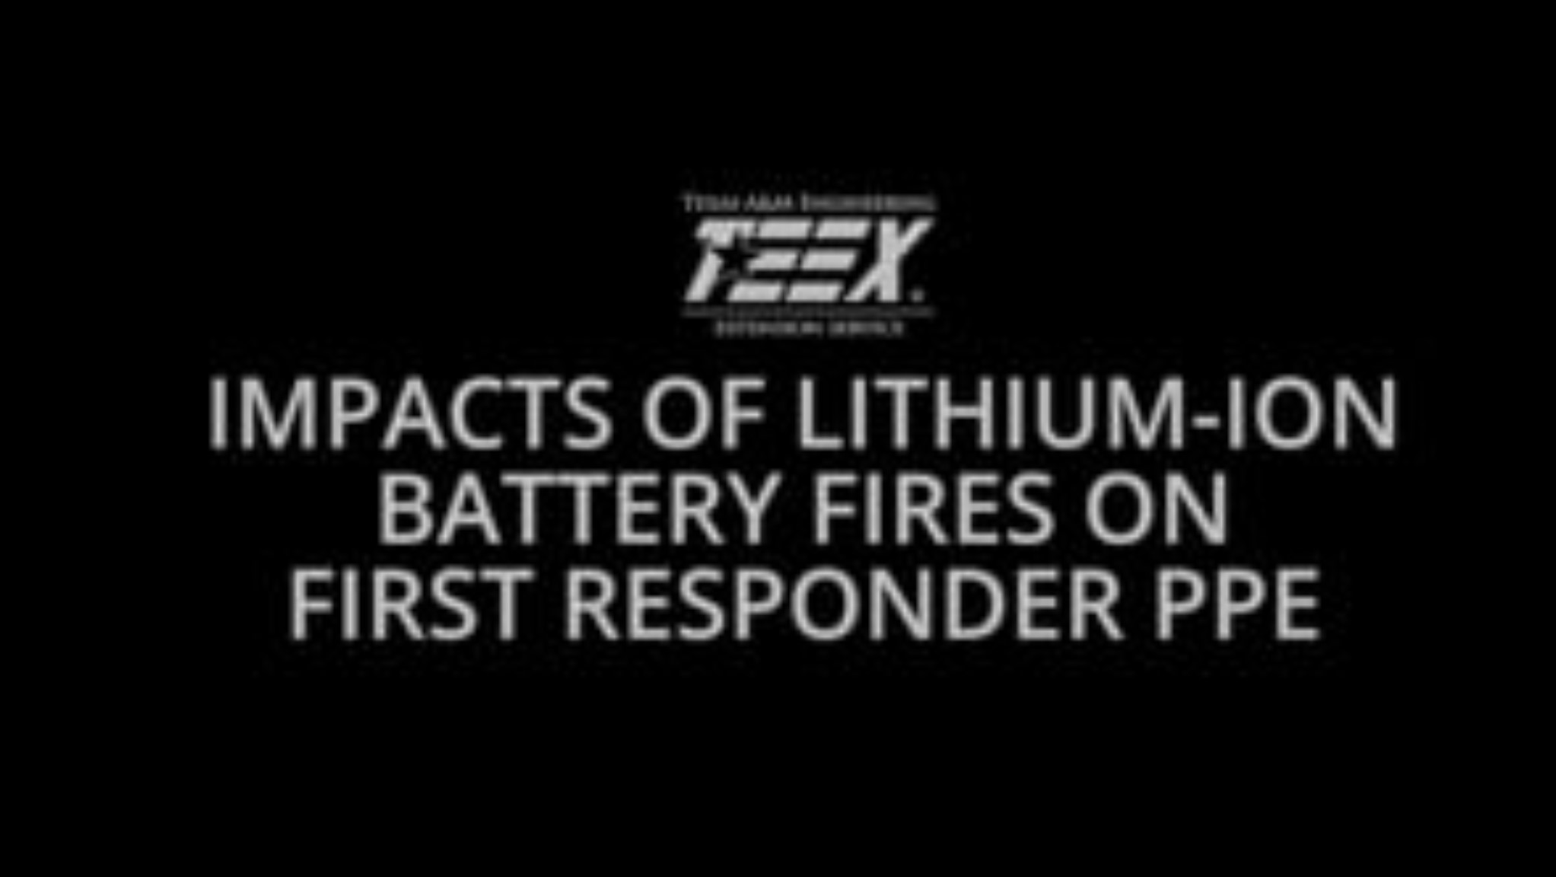

Slide 42


Slide 43


C – Choose certified products
H – Handle with care
A – Always stay alert for warning signs
R – Recycle batteries and devices properly
G – Get out quickly if there’s a fire
E – Educate others about battery safety

Slide 44
Conclusion
This was an introduction into the hazards and types of emergencies we face with lithium-ion technologies.
Our Policies are evolving as well as .
The Fire Service is still very much in the research and development phase, when it comes to Lithium-ion Batteries (Lori Moore-Merrell, the U.S. Fire Administrator 2024)
We are attempting to get out in front of these emerging threats.
Any Questions?

