Slide 1
CAER
Contra Costa Health HazMat Presentation
May 1, 2025

Slide 2
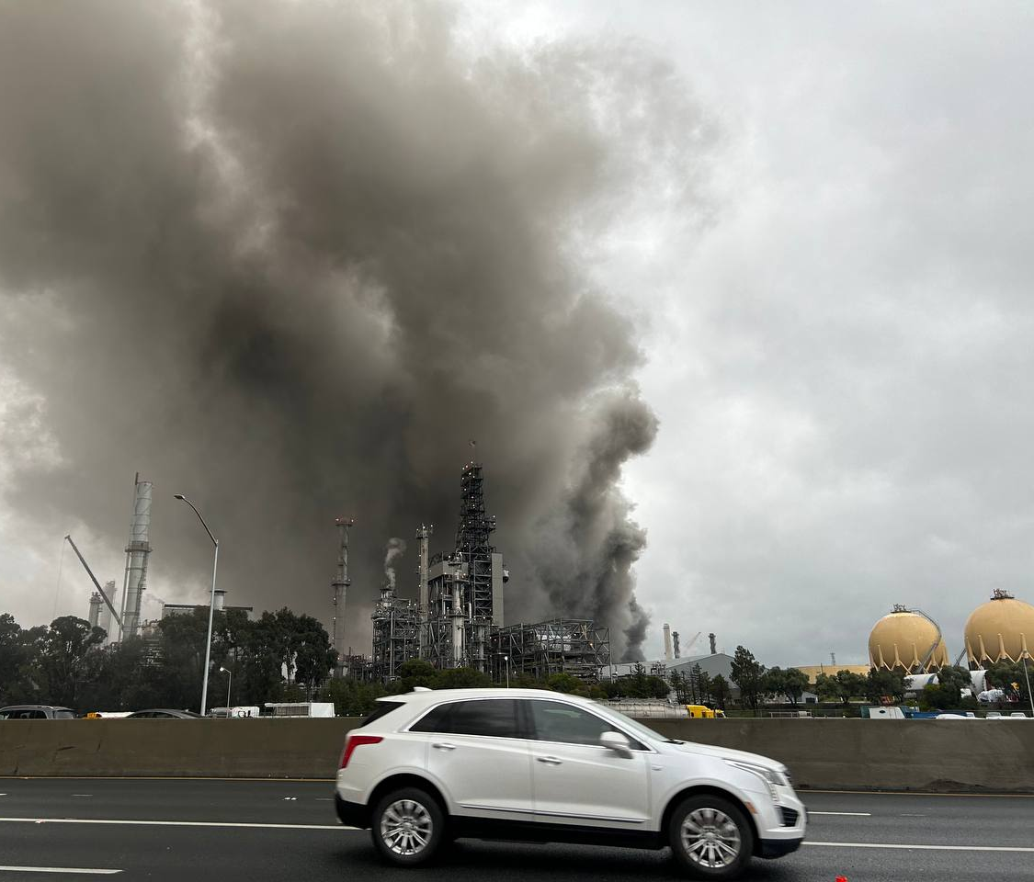
Description of Event
1:35 p.m. on February 1, 2025, when two contract workers were opening a flange in preparation for planned maintenance on one of the refinery’s process units.
1:35 p.m. on February 1, 2025, when two contract workers were opening a flange in preparation for planned maintenance on one of the refinery’s process units.
While opening the flange, hydrocarbon material started to leak.
The two contract workers upon observing the leak evacuated the area,
and within seconds the material caught fire.
While opening the flange, hydrocarbon material started to leak.
The two contract workers upon observing the leak evacuated the area,
and within seconds the material caught fire.
1:49 p.m. a Level 2 CWS notification was received by CCH.
CCH expanded the initial health advisory, ultimately issuing a Shelter In Pace for parts of Martinez for ~ 5 hours
1:49 p.m. a Level 2 CWS notification was received by CCH.
CCH expanded the initial health advisory, ultimately issuing a Shelter In Pace for parts of Martinez for ~ 5 hours
Crews continued to suppress the fire until Tuesday, February 4, 2025
when the fire was extinguished and the health advisory was lifted.
Crews continued to suppress the fire until Tuesday, February 4, 2025
when the fire was extinguished and the health advisory was lifted.
A total of six workers were evaluated by medical personnel and released.
None were admitted to the hospital.
A total of six workers were evaluated by medical personnel and released.
None were admitted to the hospital.

Slide 3
Hazmat Notification
Incident Occurs; Facility Activates CWS
LEVEL 0
LEVEL 1
LEVEL 2
LEVEL 3
Off-site impact is not expected
Flaring not included in any other level
Not expected to cause public concern
Off-site Health impact is not expected
Odor or Audible impact
Flaring lasting longer than 20 minutes
Plumes visible off-site
Off-site consequences expected, may impact health of sensitive populations
Off-site consequences may impact health of general public
Notification
Only
Community
Awareness Messaging
Public Health Advisory
Public Protective Actions Issued
CCH Notified; Contact with Facility and Response (if necessary) Occurs
Verification of Incident Level done by CCH
Reclassification of Level Occurs when Necessary

Slide 4

CCH Response Timeline
Certified Unified Programs
2/1/2025 1:49 p.m.
Certified Unified Programs
Level 2 Alert Issued by MRC
2/1/2025 4:48 p.m.
CWS Level 3 issued North of the Refinery due to changing smoke conditions
2/4/2025 3:00 p.m.
Health advisory for the sounding areas lifted
2/1/2025 - 2/4/2025 INCIDENT RESPONSE TO ASSESS COMMUITY IMPACT BY VISUAL AND REAL TIME AIR MONITORING
2/1/2025 4:07 p.m.
2/1/25 9:12 p.m.
Initial field Reports of Smoke impacts North of Refinery
Air quality improved event reclassified back to CWS Level 2 Health Advisory
.
.
2/1/2025 2:32 p.m.
CCH expanded the Health Advisory due to field observations
4
Notes:
*update timeline with other facts which could include (media releases, when the incident ends, when all clear is issued) Verbally need to discuss what will come in future (risk assessment, etc)

Slide 5
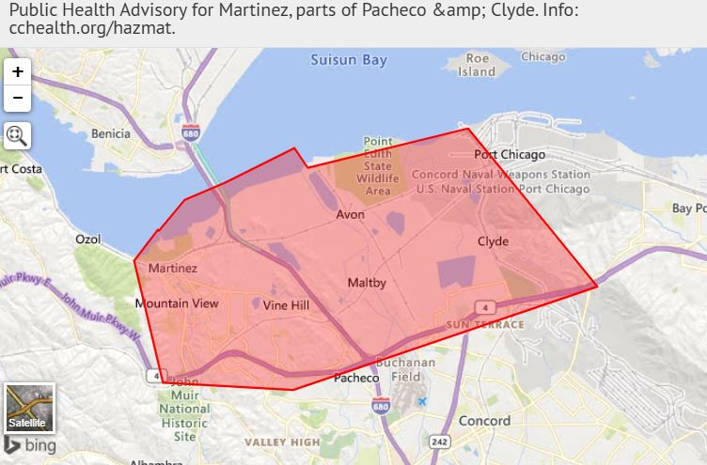
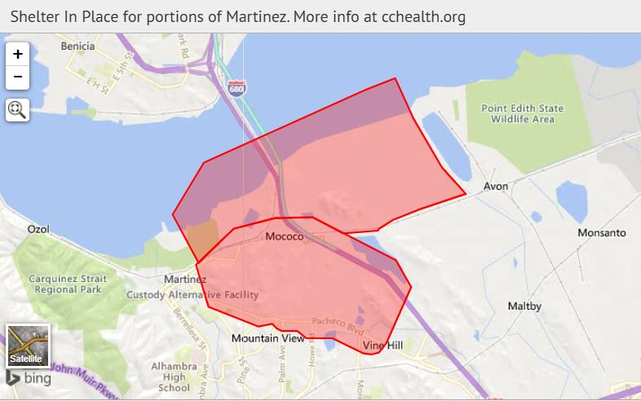
Health Advisory and Shelter in Place
This is a public health advisory for all of Martinez, parts of Pacheco, and Clyde. An incident at the Martinez Refining Company could affect individuals with respiratory sensitivities. Most people will not be affected. Eye, skin, nose, or throat irritation may be possible for some people in the affected area.
This is a message from Contra Costa Health Services. There is an emergency at the Martinez Refining Company. Residents in portions of Martinez, north of the refinery should shelter in place due to impacts from smoke.

Slide 6
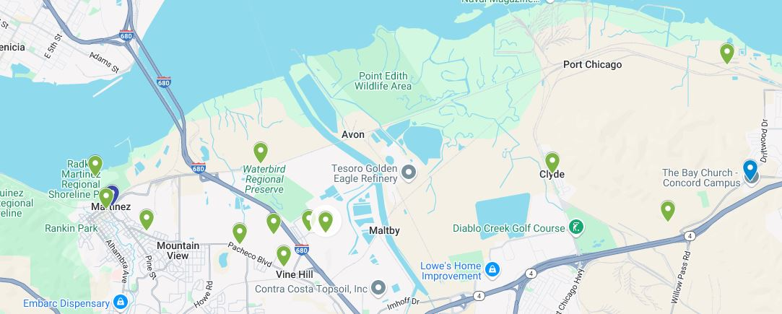
Health Advisory Assessment

Slide 7
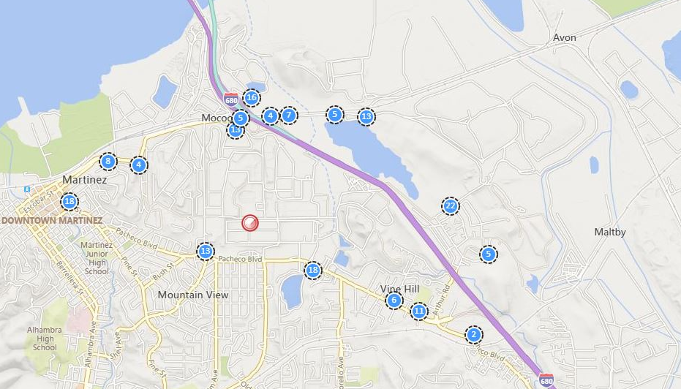
Air Monitoring Map for Long-Term Incident
Analyte including but not limited to:
Hydrogen Sulfide
Particulate PM 2.5/10
Carbon Monoxide
Sulfur Dioxide
VOC’s including Benzene
LEL

Slide 8
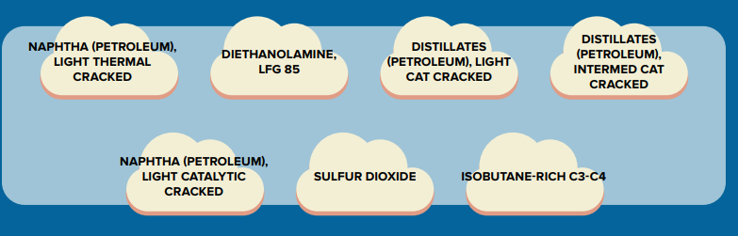
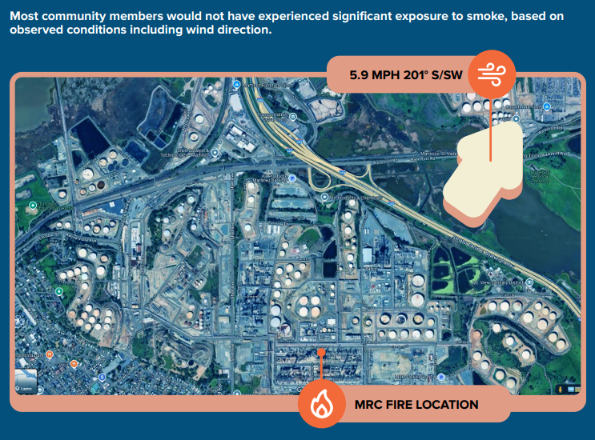
Overview of Chemicals
CCH determined chemicals of concern from fire
Air monitoring results showed low levels for most chemicals
CCH identified elevated levels for Particulate Matter in smoke

Slide 9
Timeline
Certified Unified Programs
2/28/2025
Certified Unified Programs
2/1/2025
2/21/2025
Level 2 Alert Received by CCH
Soil Sampling
30 Day Report Received
4/18/2025
2/5/2025
MRC Oversight Committee Received Draft Toxicologist Report
72 HR Report Received
2/1/2025 - 2/20/2025 INCIDENT RESPONSE
2/21/2025 - 3/21/2025 POST INCIDENT ACTIVITY
3/22/2025 - CONTINUED OVERSIGHT
2/1/2025
Media Release – Disclosure of Chemicals
3/1/2025
Final Pending
.
.
2/11/2025
Health Advisory Lifted
Safety Inspection
2/4/2025
2/25/2025
9
Notes:
*update timeline with other facts which could include (media releases, when the incident ends, when all clear is issued) Verbally need to discuss what will come in future (risk assessment, etc)

Slide 10
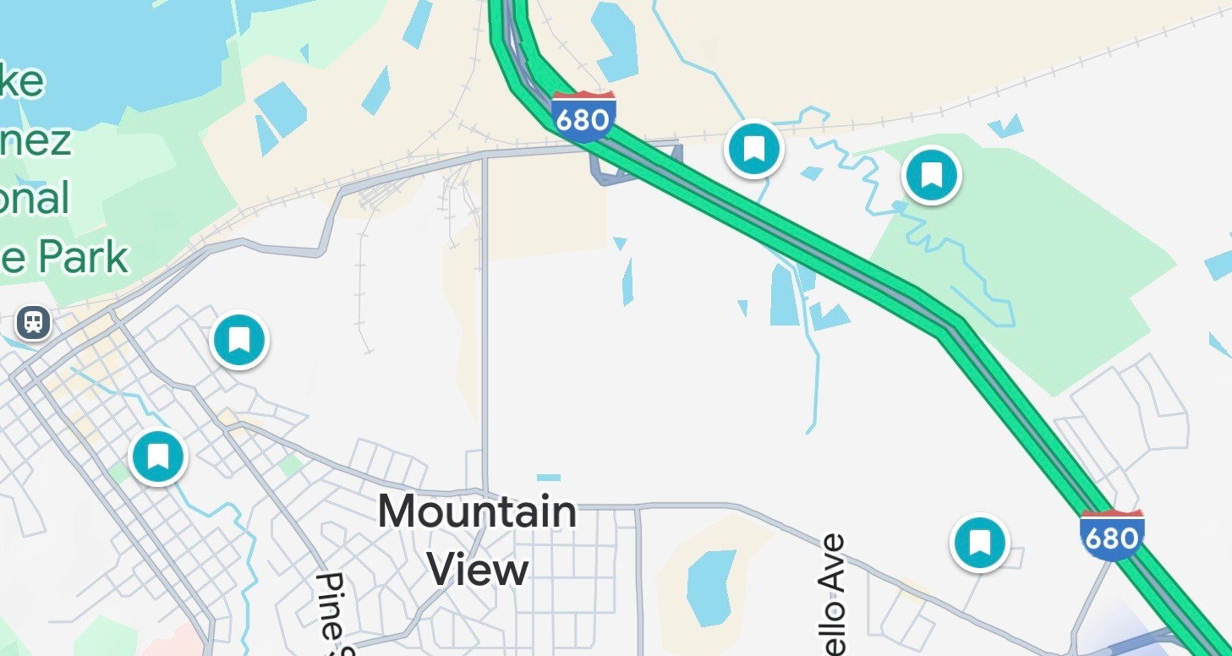
Soil Sampling

Slide 11
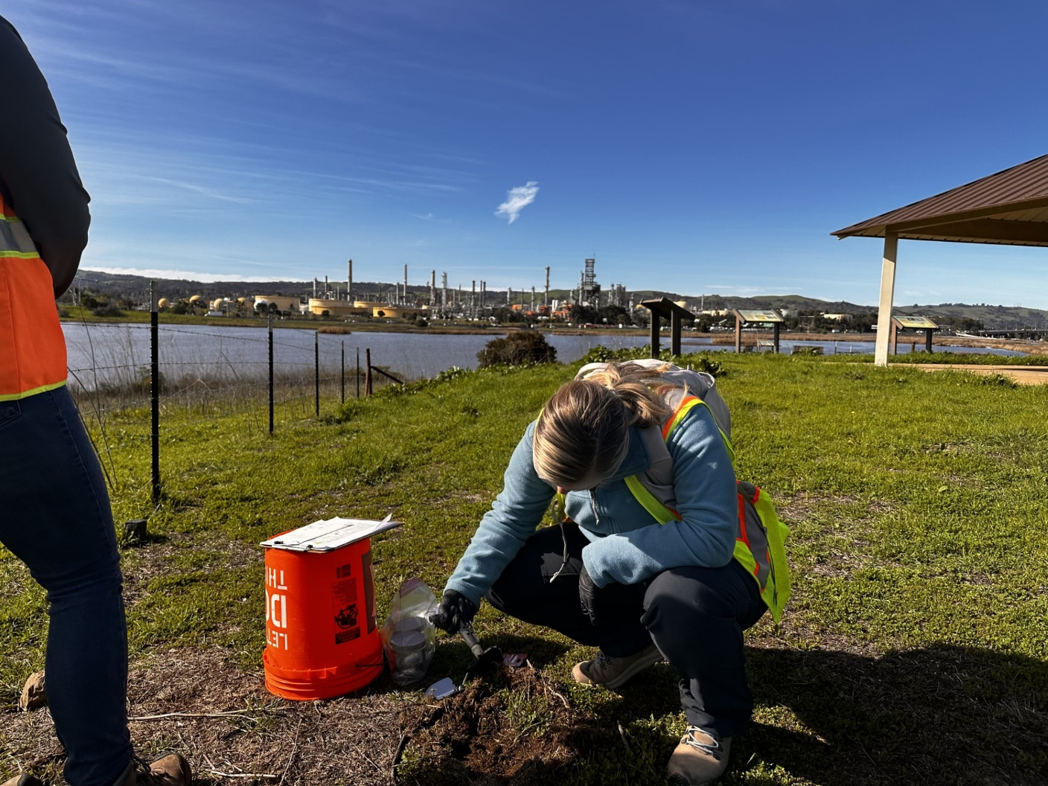
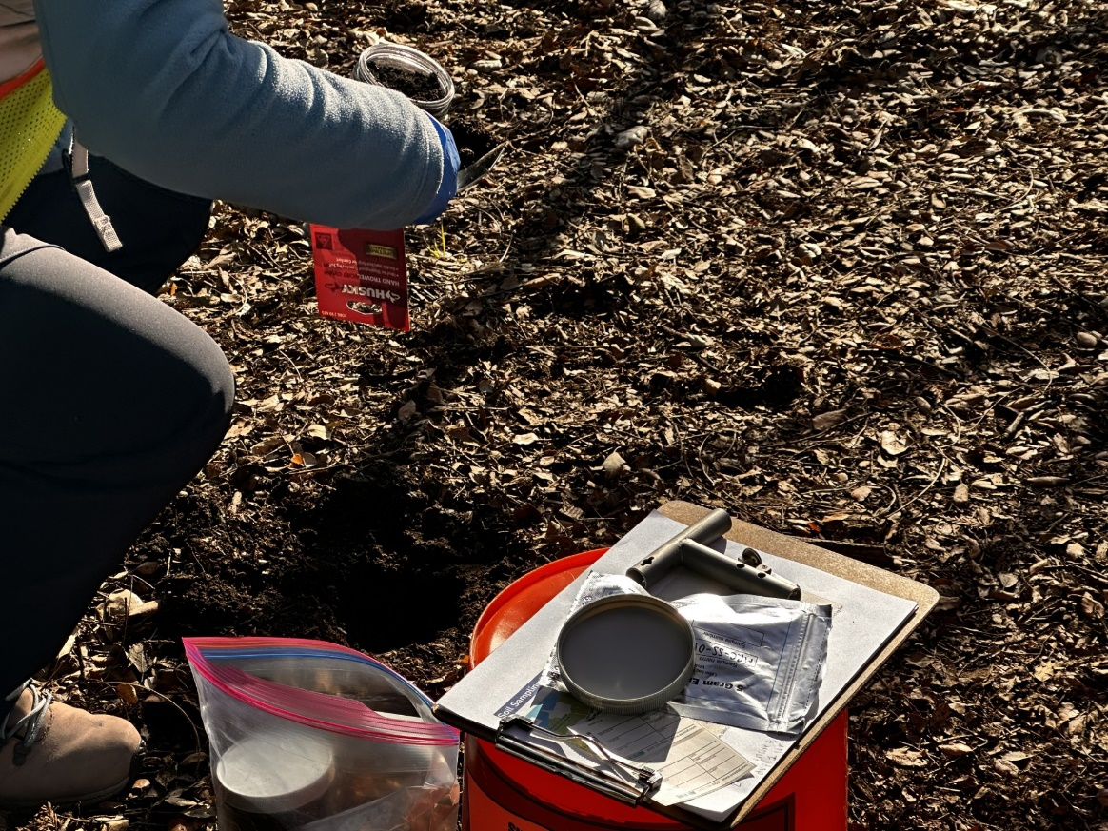
Soil Sampling
Chemical | Results
Benzene | Non Detect
Cumene | Non Detect
Cyclohexane | Non Detect
Diethanolamine (DEA) | Non Detect
Ethylbenzene | Non Detect
n-Hexane | Non Detect
Toluene | Non Detect
1,2,4-Trimethylbenzene | Non Detect
1,3,5-Trimethylbenzene | Non Detect
Xylenes | Non Detect
“Analytical results indicated that all analytes were either non detect or the detected concentrations were below risk based residential screening levels and/ or within the range of regional background concentrations.” - TRC

