Slide 1
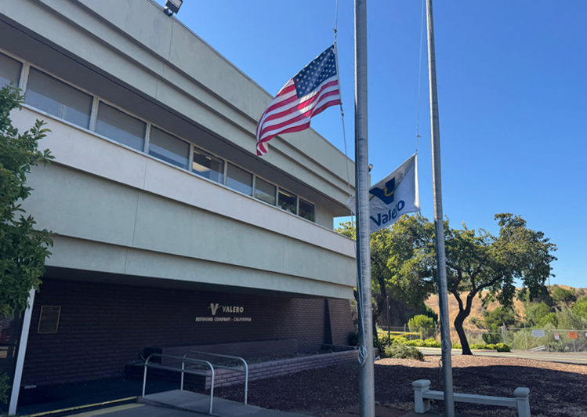


Valero Best Practices
Paul Modjesky
Manager Refinery Safety
Valero Refining Company
3400 East Second St.
Benicia Ca. 94510
Paul.Modjesky@Valero.com
O: (707) 745-7742
C: (707) 731-3318

Slide 2
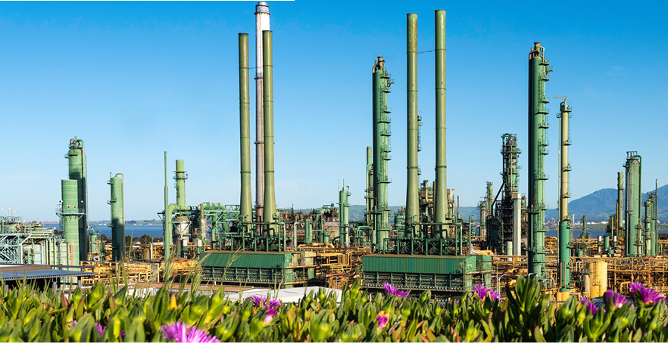

What is the Valero Short Service Worker Program?
It is a program that helps develop all new personnel to the Valero Benicia Refinery by providing additional resources and guidance on health and safety procedures, along with work practices, during initial entrance into the refinery.

Slide 3
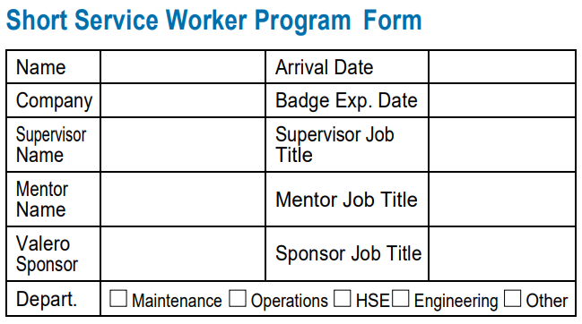
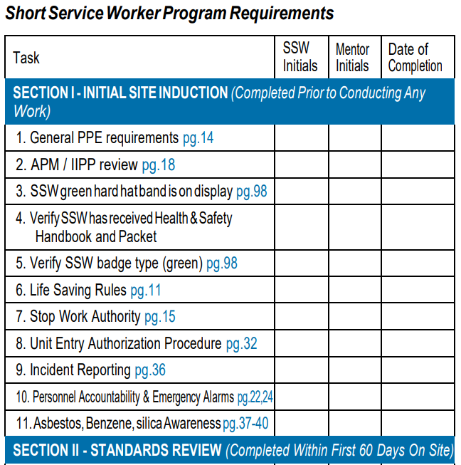
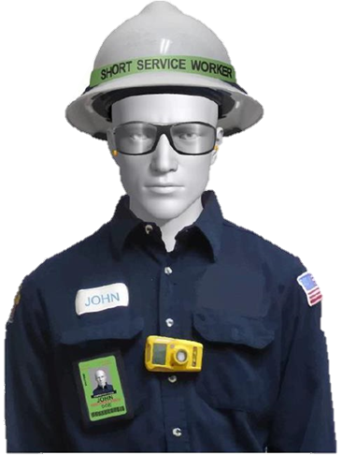
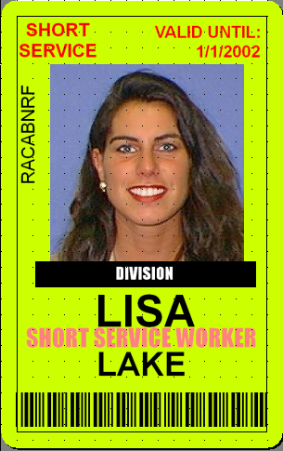


Slide 4


Slide 5
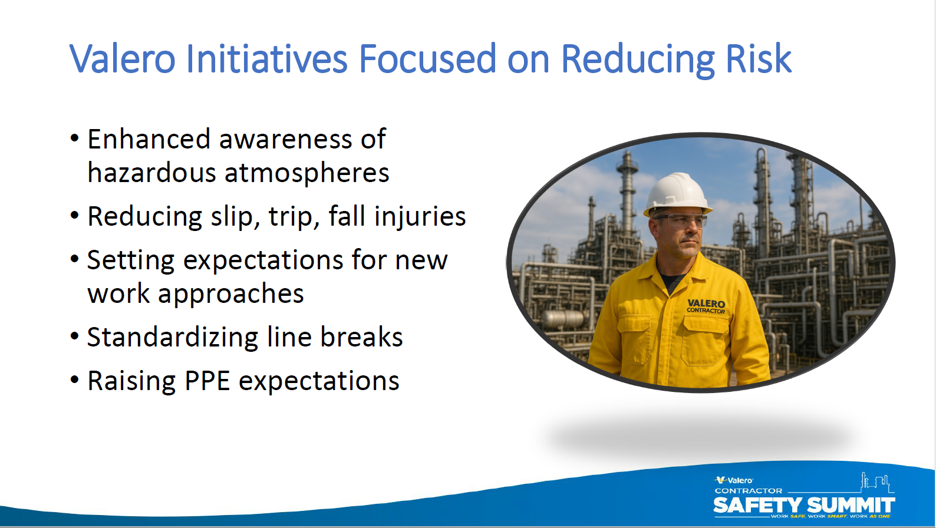

Slide 6
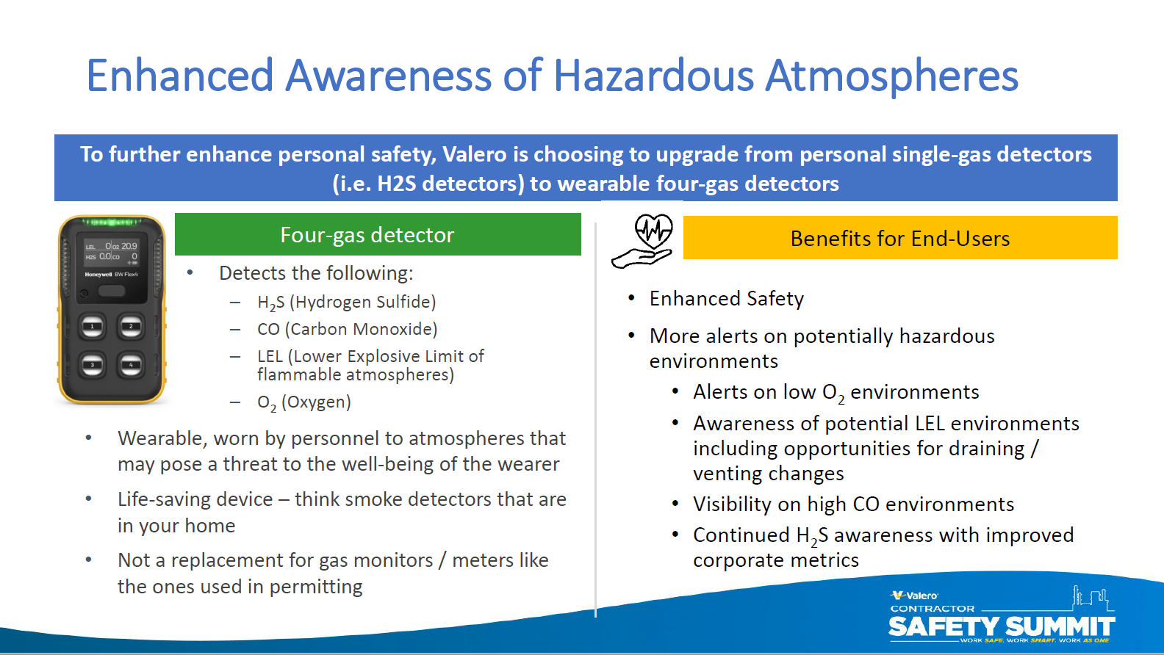

Slide 7
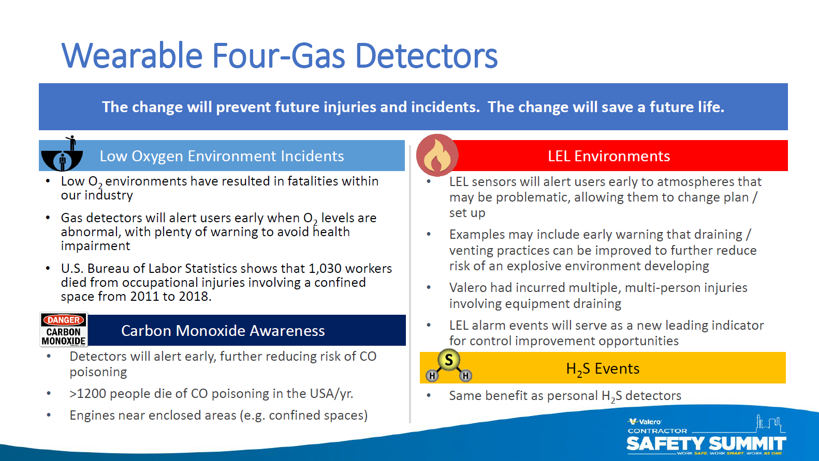

Slide 8
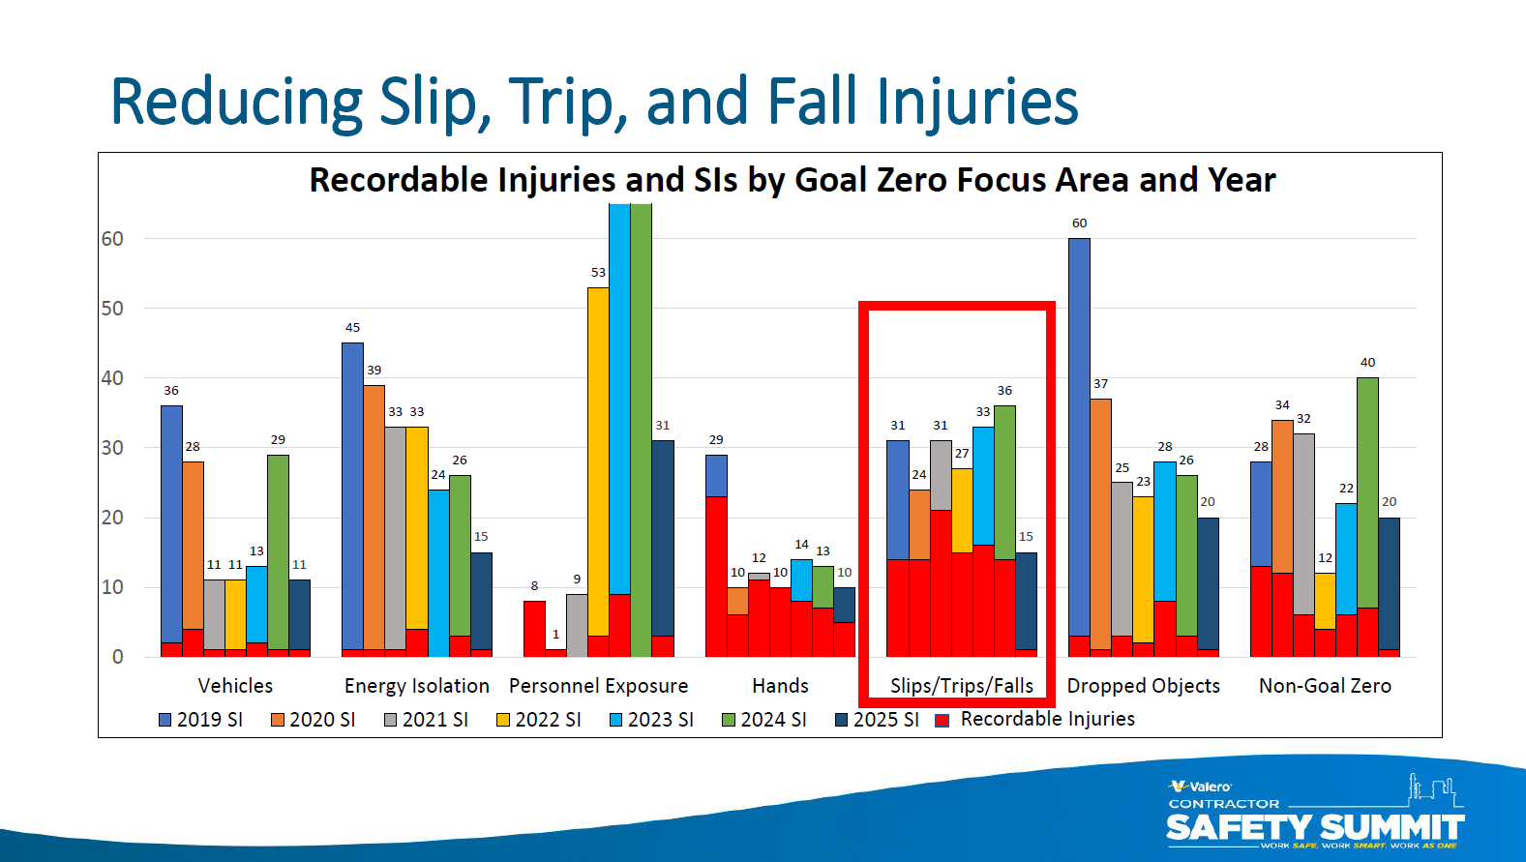

Slide 9
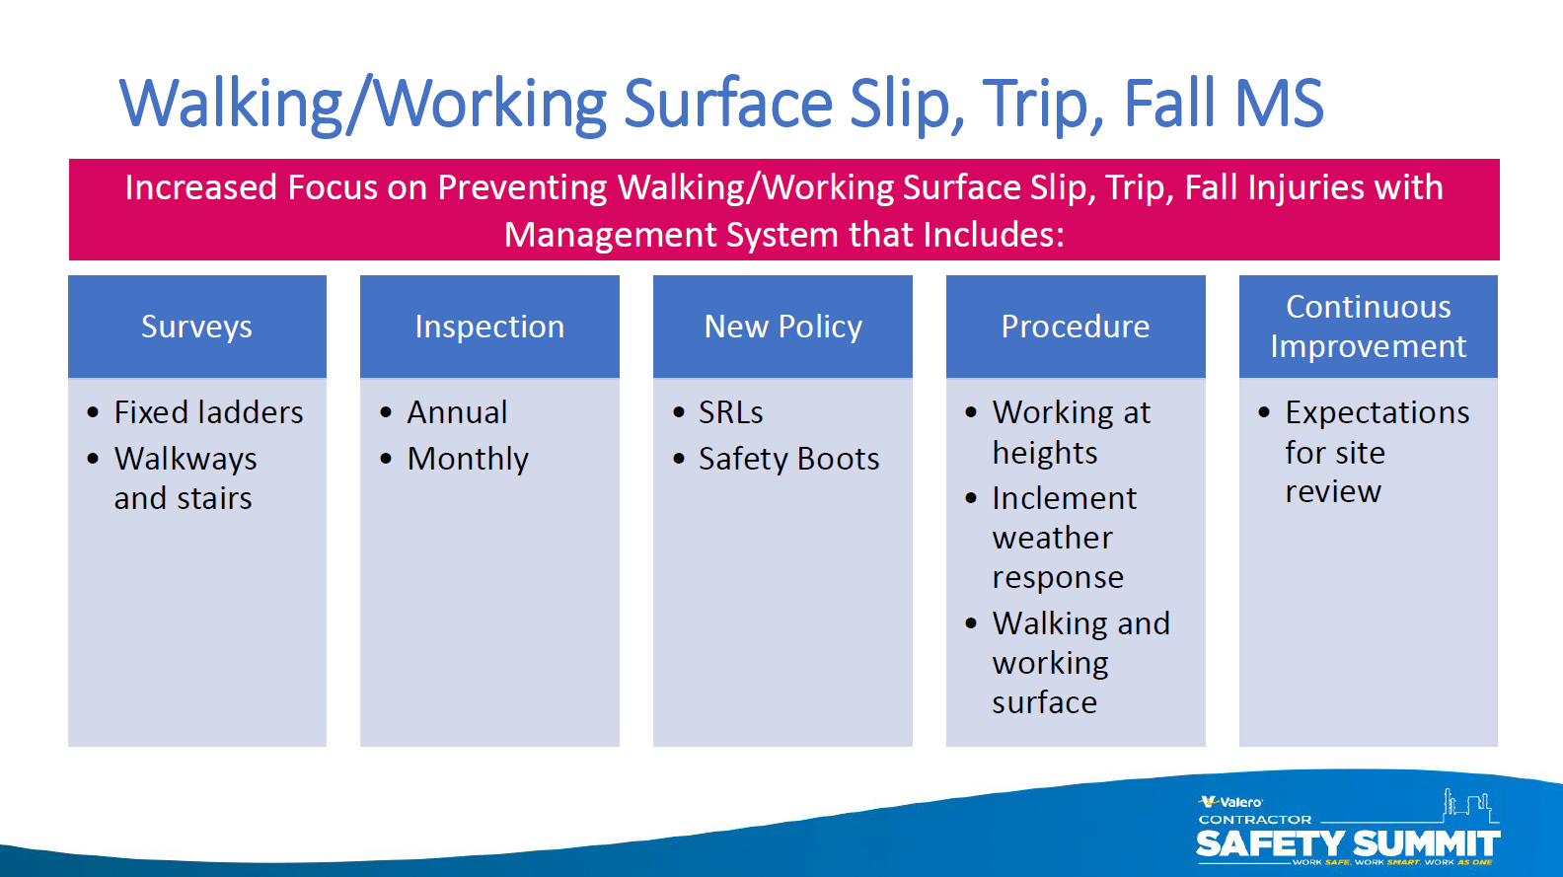

Slide 10
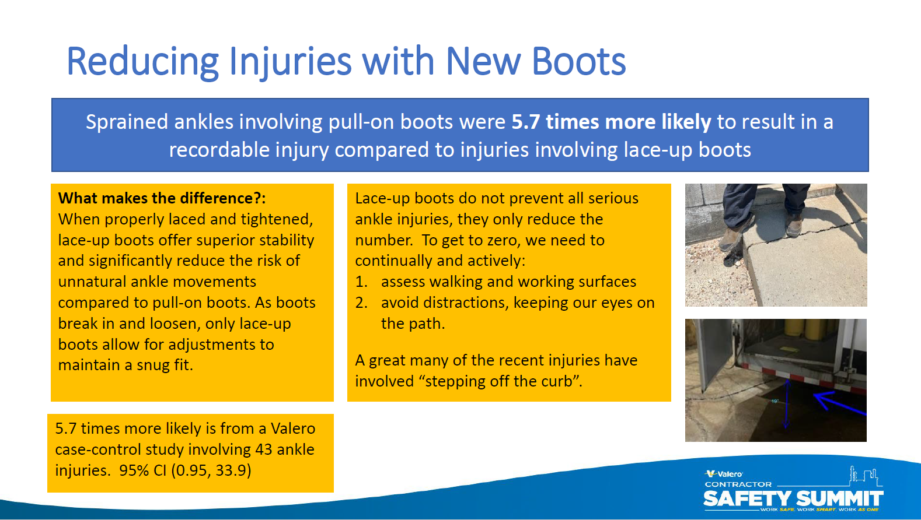

Slide 11
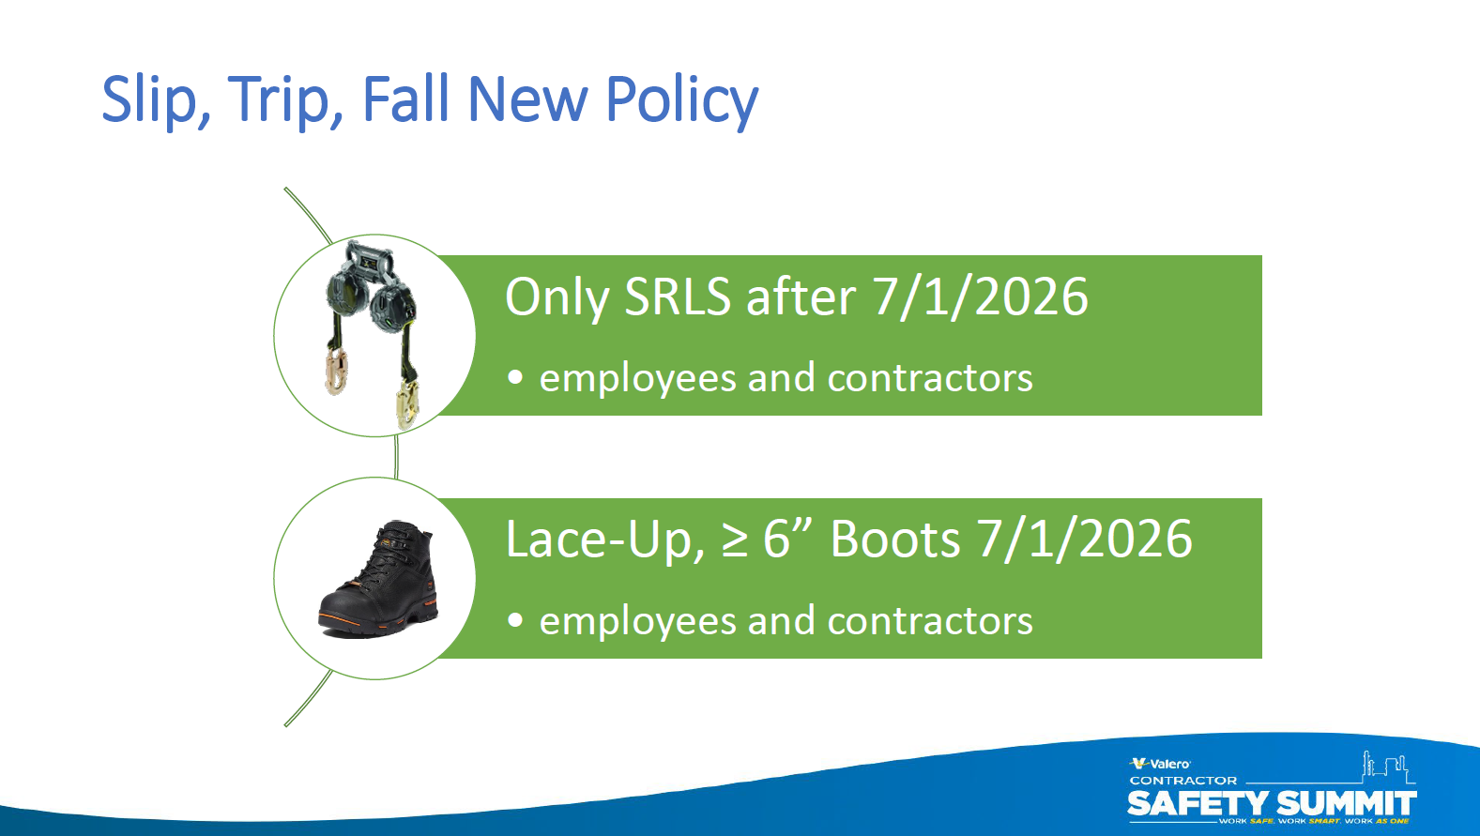

Slide 12
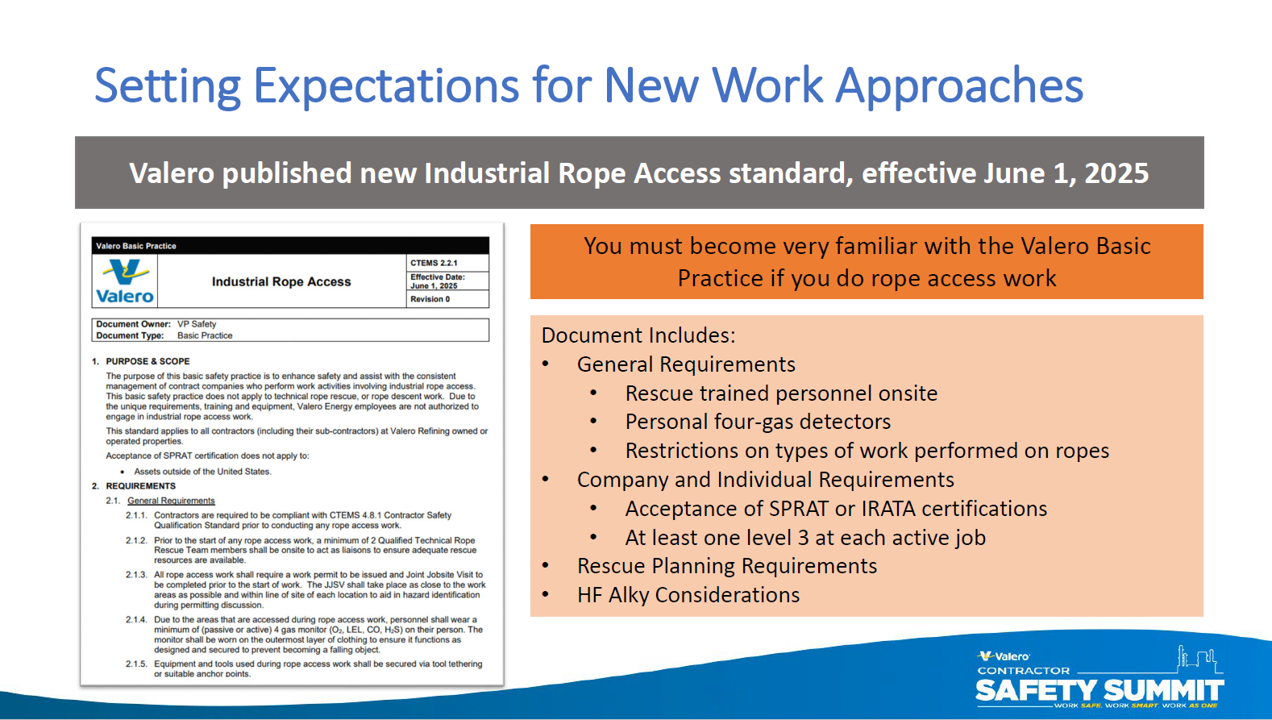

Slide 13
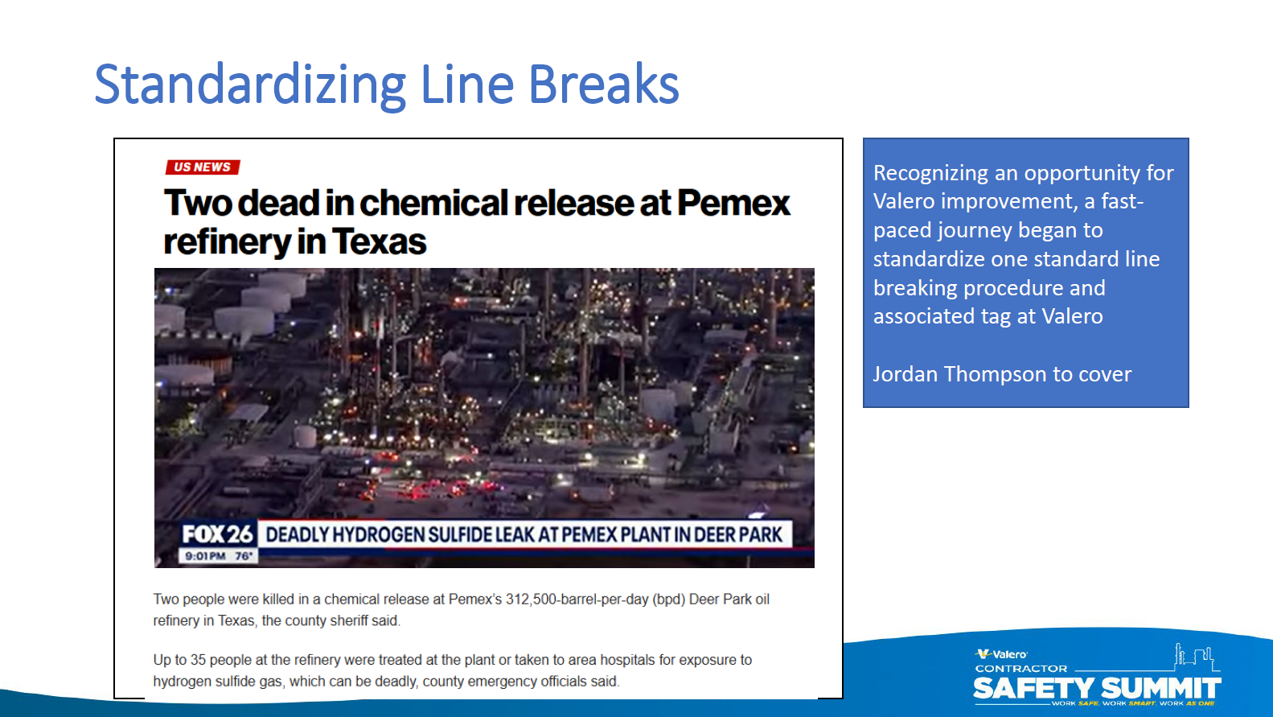


Slide 14
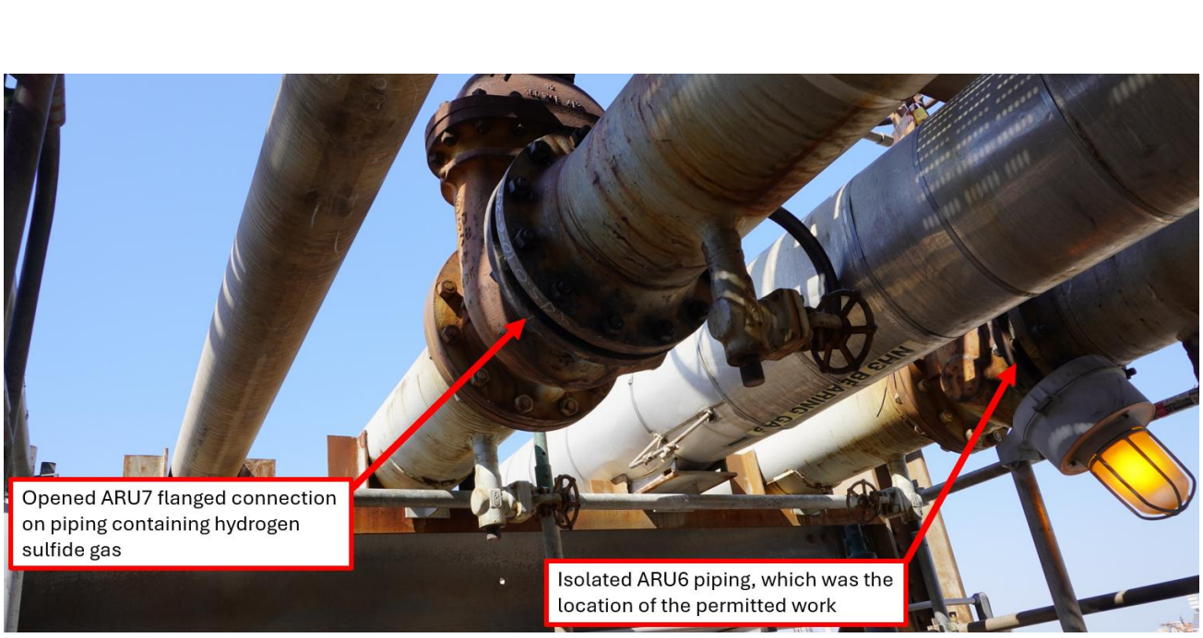

On October 2, 2024, Contract Employees (CE) began work at the PEMEX Deer Park Refinery for the scheduled maintenance activities that were part of the turnaround.
On October 8 and October 10, PEMEX Deer Park operations personnel requested assistance from CE workers and issued permits allowing CE workers to isolate piping segments in Amine Regeneration Unit 6 (ARU6), which is adjacent to the SRU involved in the turnaround.
The maintenance activities on process equipment in ARU6 were not part of the work CE was performing for the turnaround. Amine Regeneration Unit 7 (ARU7), which had piping segments adjacent to ARU6 (Figure 2), was operational. The adjacent ARU7 piping segment contained approximately 90 percent hydrogen sulfide gas at gauge pressure of approximately 15 pounds per square inch.

Slide 15
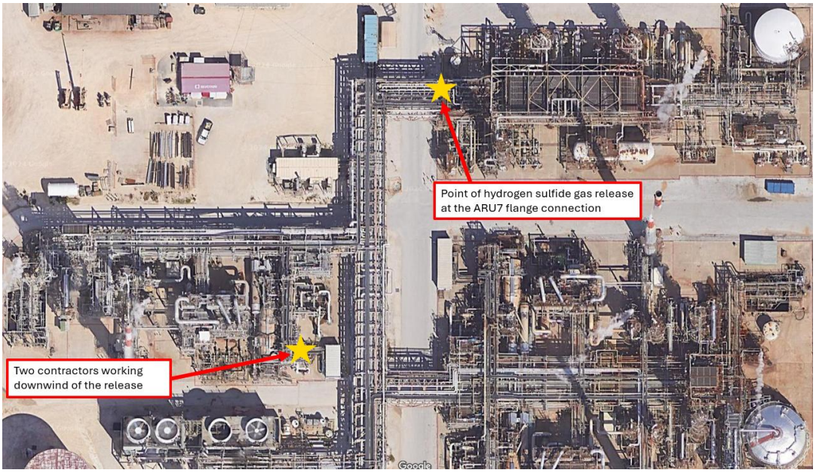

The CSB update states that on the day of the incident two contract workers at the refinery partially opened a flanged connection on piping containing hydrogen sulfide gas, which caused the release. One of these workers was fatally injured. The work was supposed to be done on a different, isolated piping segment located about five feet away from the flange that was opened. Two other contract workers from a separate company, who were working on equipment less than 250 feet away and downwind from the release, were also affected, with one fatally injured from the hydrogen sulfide exposure.

Slide 16
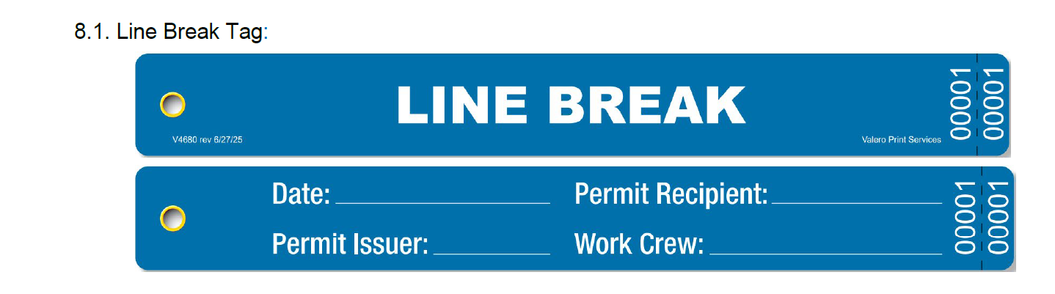

Slide 17
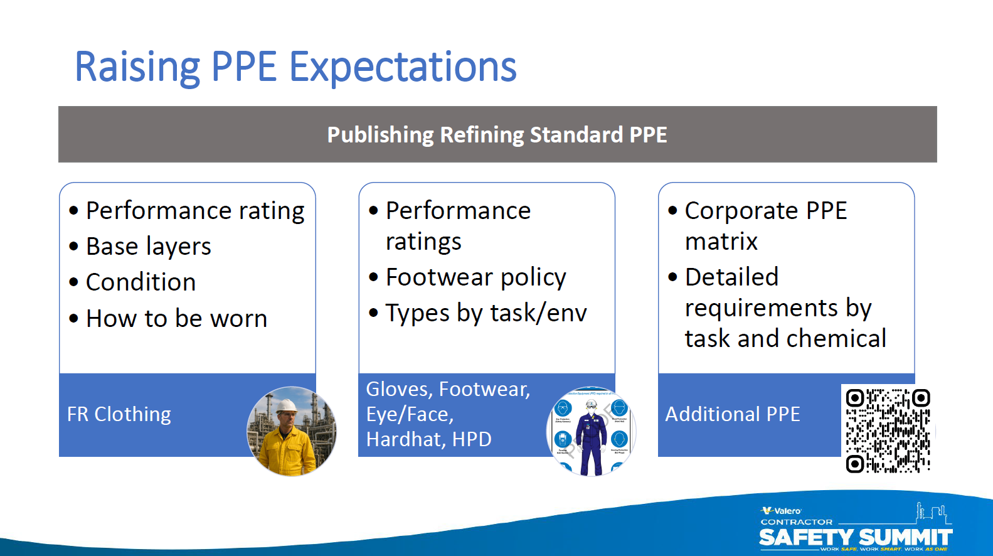

Slide 18


Slide 19

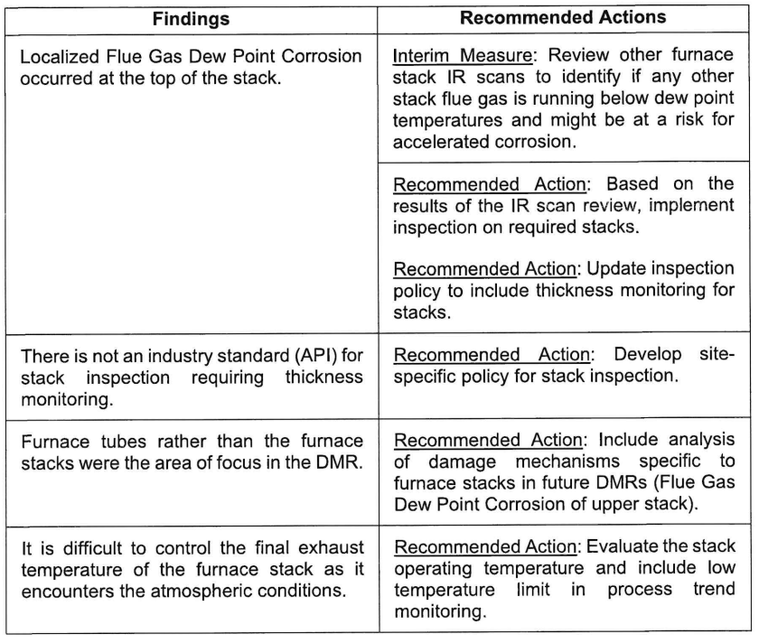
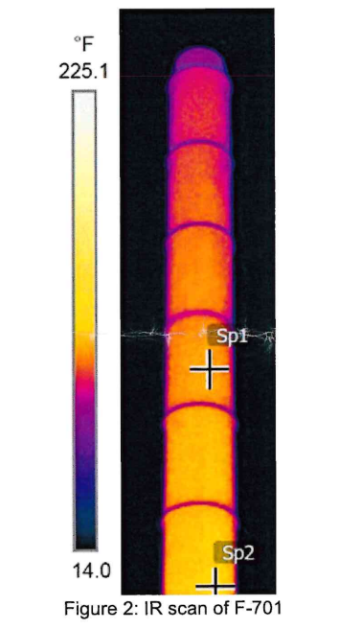

https://www.ci.benicia.ca.us/vertical/Sites/%7BF991A639-AAED-4E1A-9735-86EA195E2C8D%7D/uploads/2025-05-05_Valero_Fire_90_Day_Report.pdf

