Slide 1
Martinez Refinery
Sean Johnson
Engineering and Projects Manager

Slide 2
Agenda – Regen Head Replacement
Great collaboration by all involved
PBF
Shell Global Solutions
Nooter
Project Started 2018
  Welding difficulties observed during the TA in 2018 – time to go
  Shell design
  Unique Fabrication strategy – modular
  Build in shop – move to field for completion

Slide 3
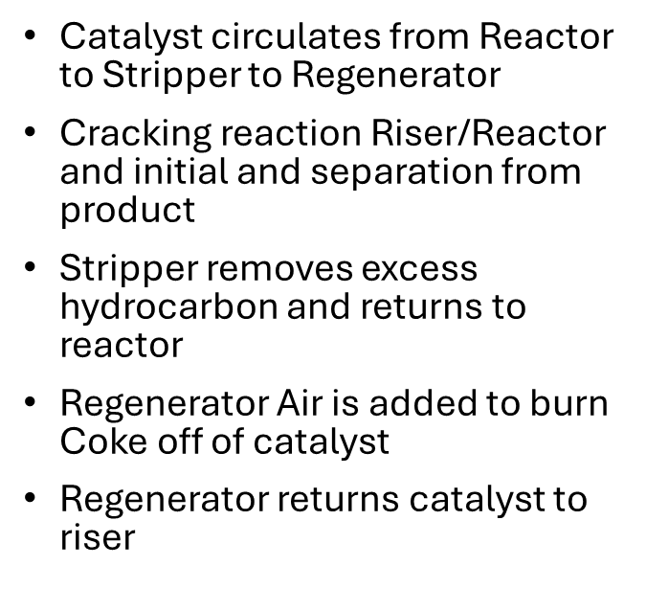
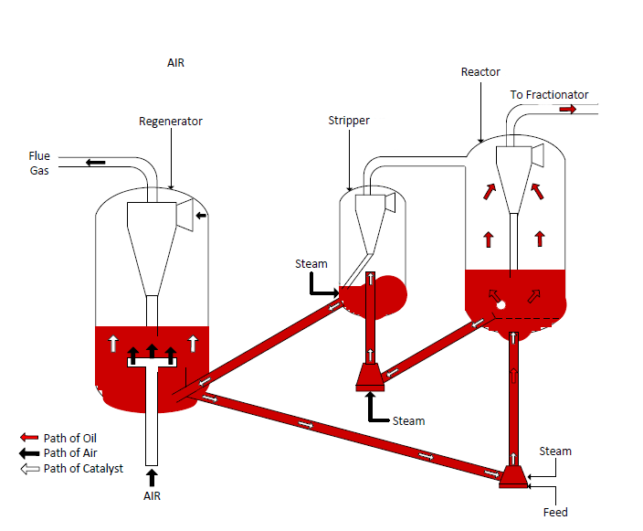
Cat Cracking Overview

Slide 4
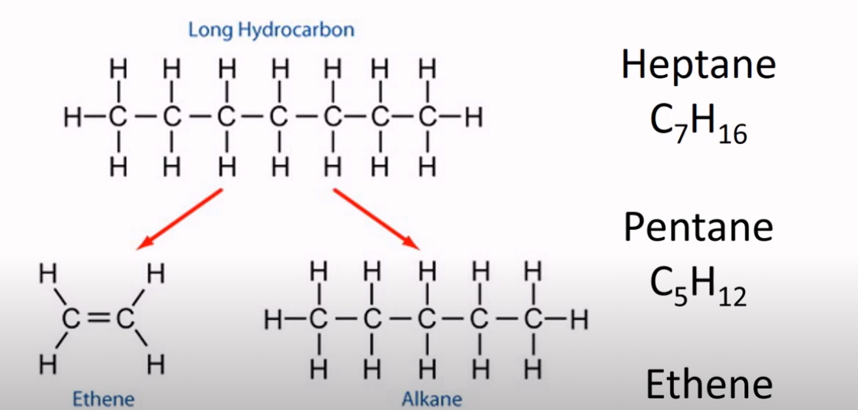
Cracking Reaction

Slide 5
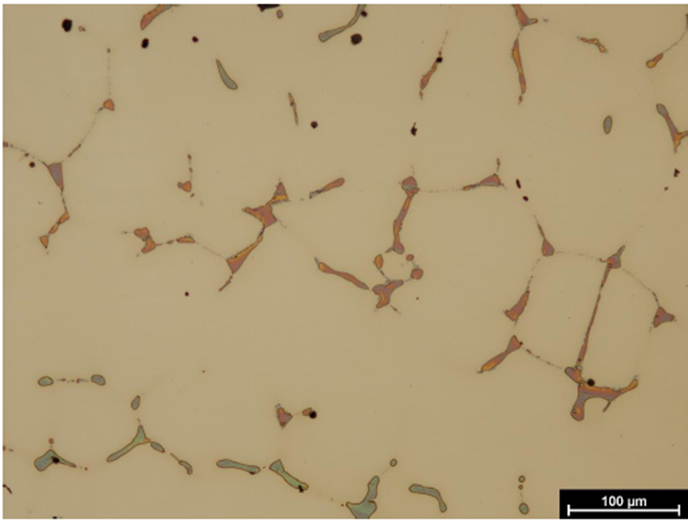
Sigma Phase Embrittlement
A second phase that forms in stainless steels above 1000 F
Embrittlement at low temperatures
Causes difficulties when welding (cracking)
Our cyclones were installed in 1989 and had 36 years of service

Slide 6
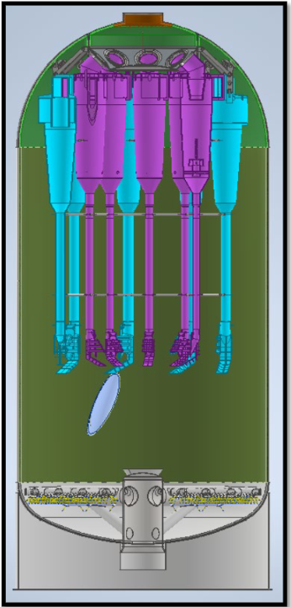
CCU Cyclone Regenerator Head
Replacement of Regenerator cyclones
  Internal solids separation equipment
  Removes catalyst from flue gas
  Unique construction strategy - Prove fit in shop in shop – build in field on jig stands
  Air grid was replaced along with cyclones

Slide 7
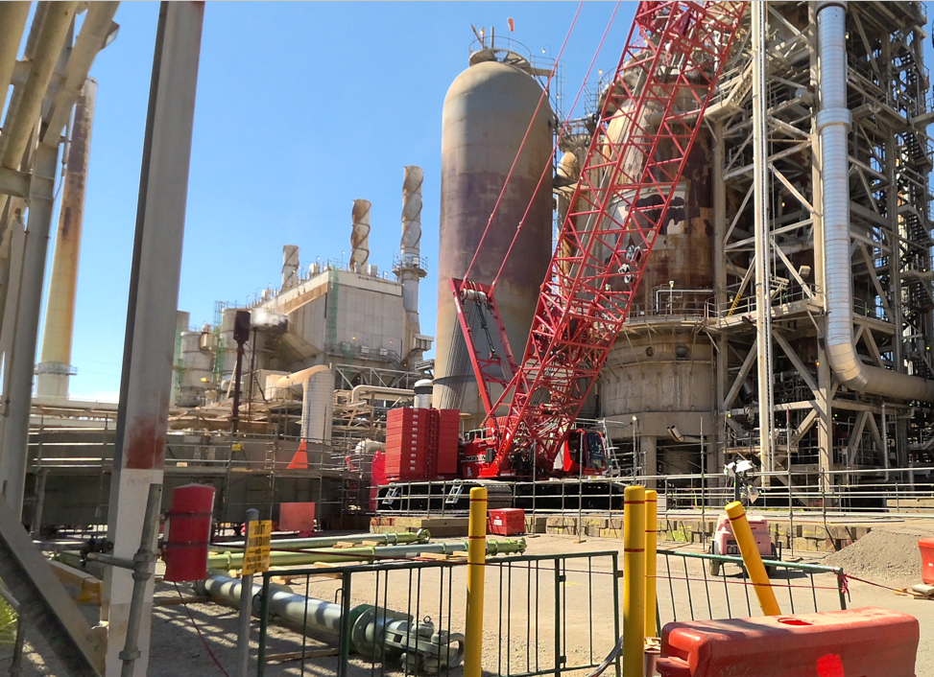
CCU Cyclone Regenerator Head
Notes:
PDC - Power Distribution Center

Slide 8
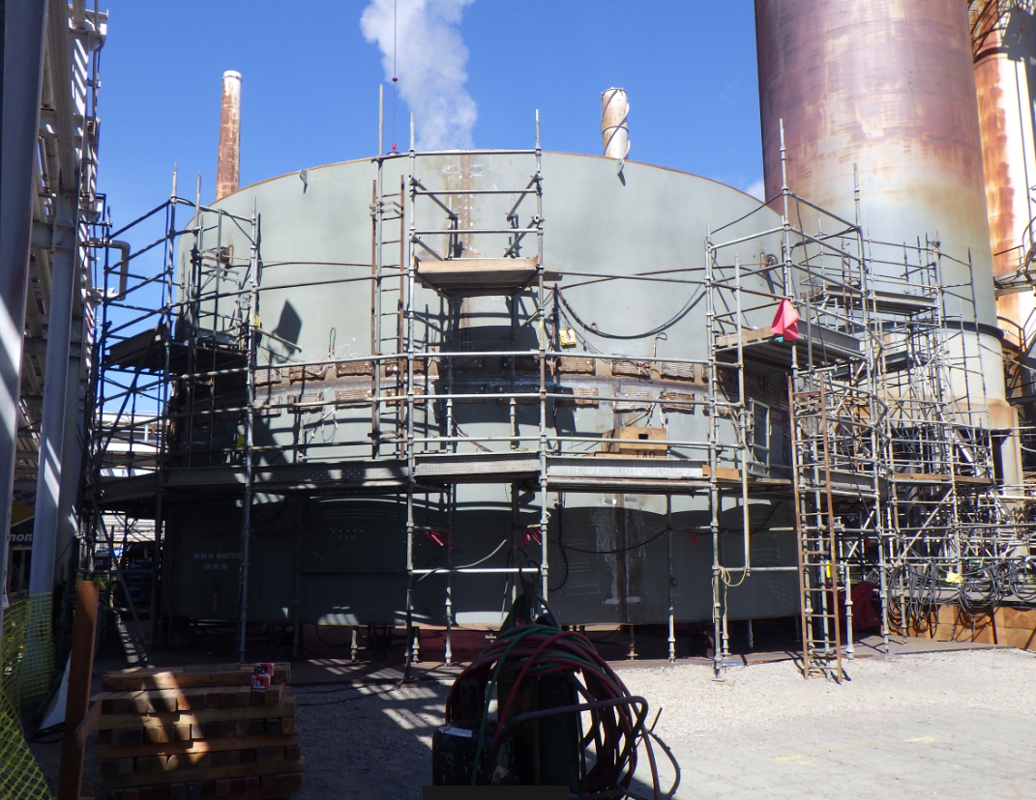
CCU Cyclone Regenerator Head
Notes:
PDC - Power Distribution Center

Slide 9
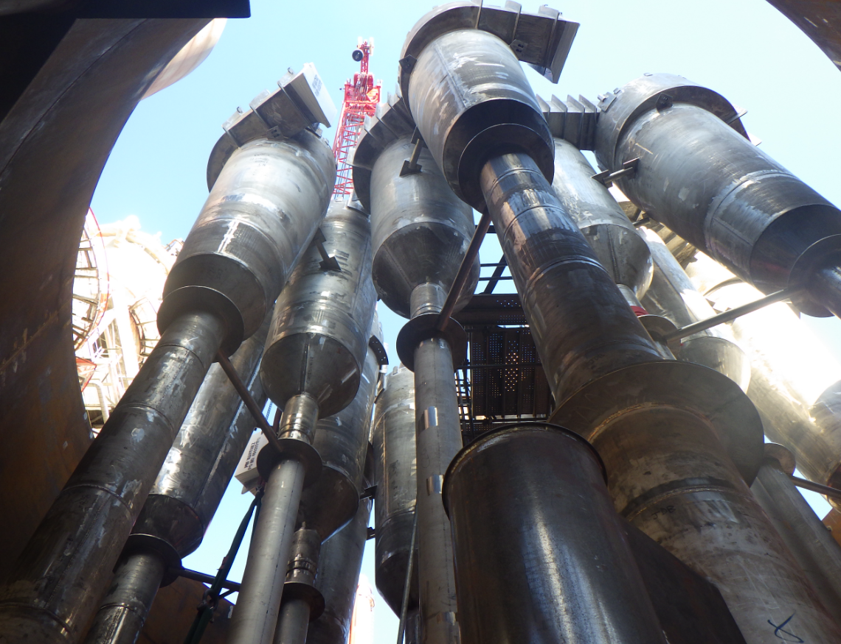
CCU Regenerator – Cyclones on Jig Stand
Notes:
PDC - Power Distribution Center

Slide 10
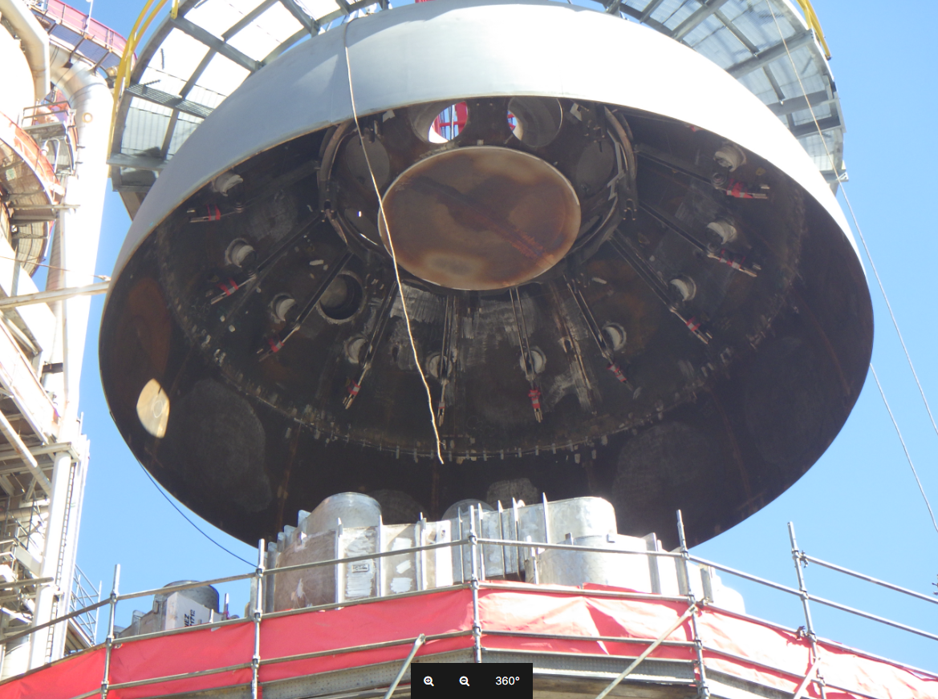
CCU Regenerator Construction
Remove old head – place in 2nd jig stand
Lift new head in place – weld circumferential seam
2 X 425-ton lift (850,000 pounds - about the same as a fully loaded Boeing 747)
Notes:
PDC - Power Distribution Center

Slide 11

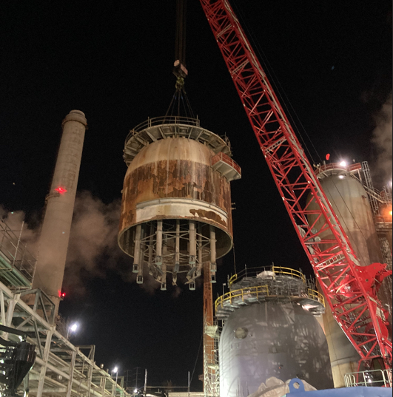
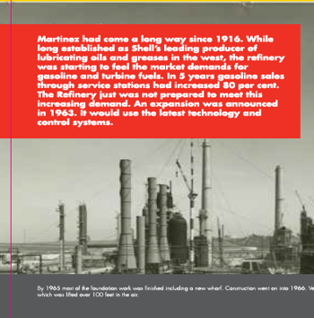
CONFIDENTIAL—PBF Energy Company, LLC

Slide 12
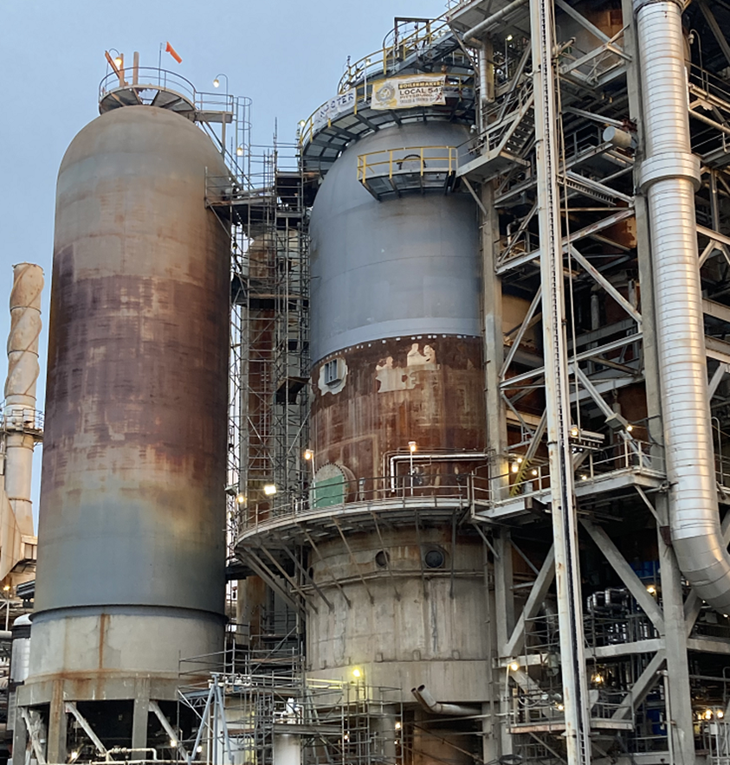
CONFIDENTIAL—PBF Energy Company, LLC

Slide 13


Questions or Comments?
13

