Slide 1
I-780 ASPHALT SPILL
9-6-2023

Slide 2
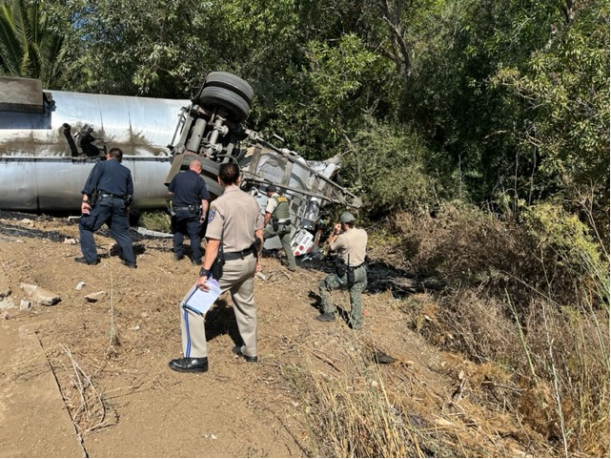
REAR TRAILER ABOVE TRUCK CAB & TRAILER

Slide 3
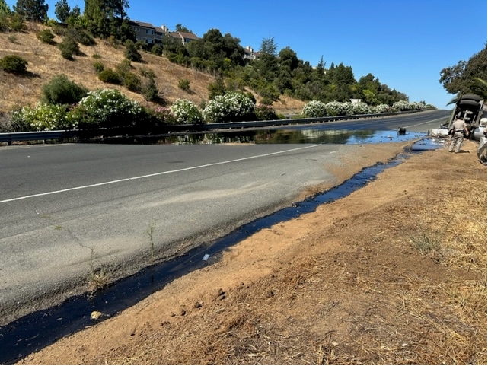
I-780 CLOSED FOR 14 HOURS

Slide 4
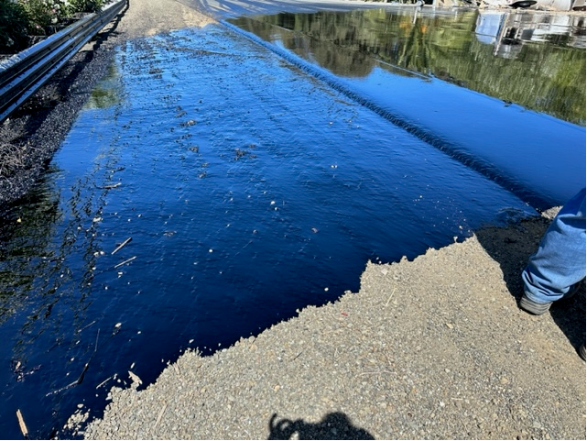
4000 GALLONS FROM SHOULDER TO MEDIAN

Slide 5
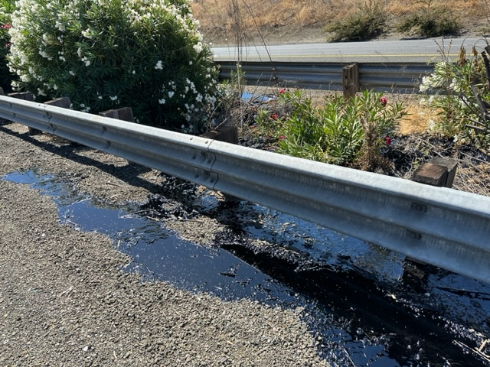
ASPHALT TO MEDIAN

Slide 6
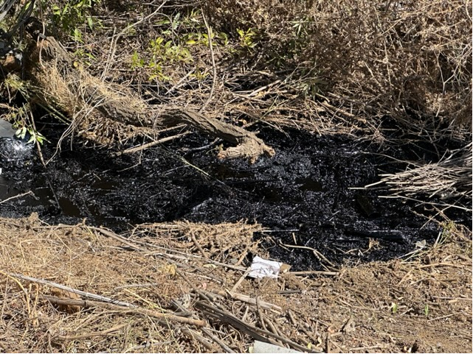
MOLTEN ASPHALT QUICKLY SOLIFIED

Slide 7
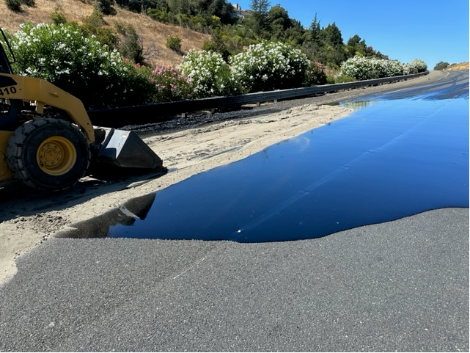
FRONT END LOADER SPREADING SAND

Slide 8
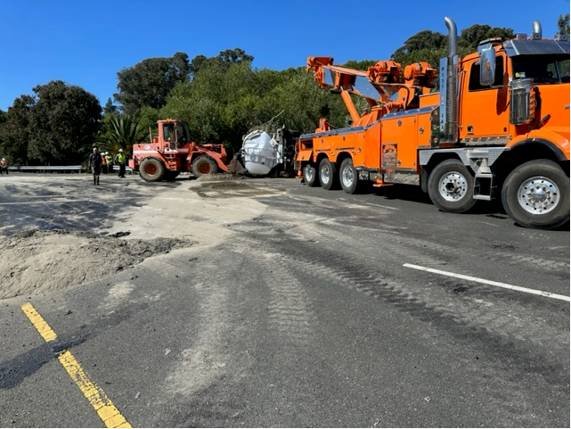
REAR TRAILER REMOVAL

Slide 9
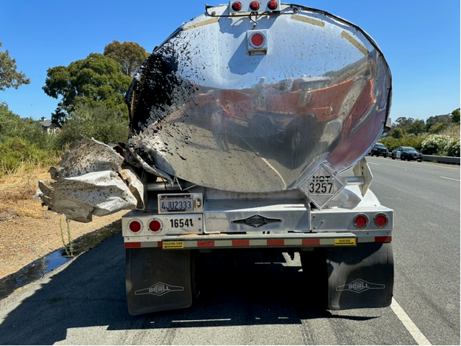
REAR TRAILER STATIONED SHOULDER

Slide 10
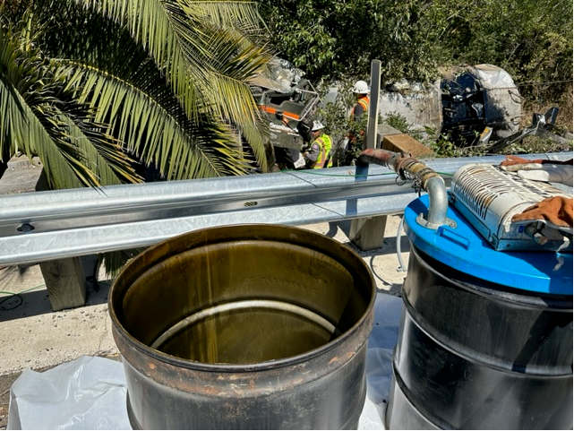
DIESEL REMOVED FROM SADDLE TANK

Slide 11
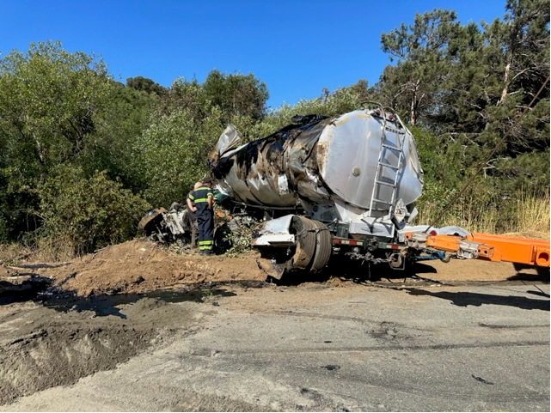
TRAILER AND CAB BEING REMOVED

