Slide 1
Heat Stress Prevention
Paul Modjesky
Manager Refinery Safety
Benicia, CA.

Slide 2

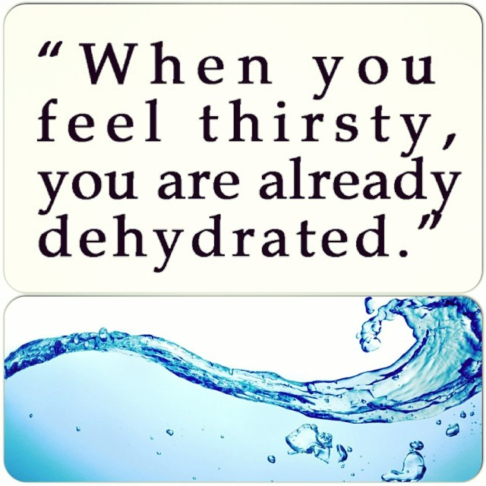
You don’t have in hot weather to get dehydrated.

Slide 3
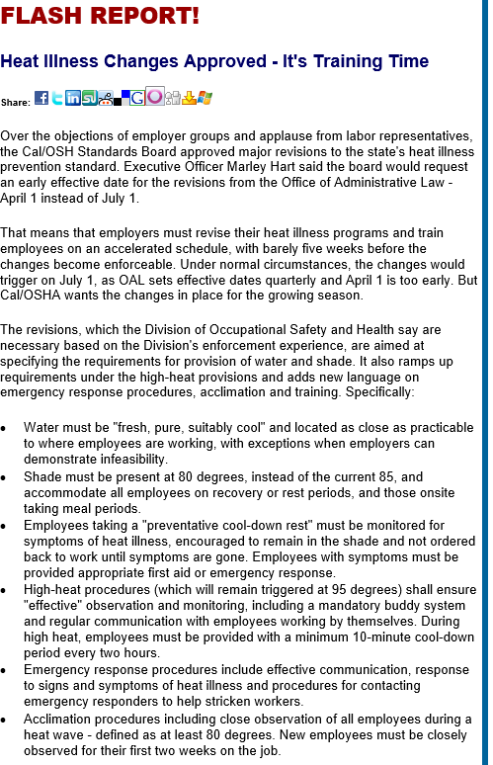






Cal/OSHA Heat Illness Prevention Plan
Title 8 CCR 3395
Heat Illness Prevention in Outdoor Places of Employment
New Standard 2005
Amended 2010
Amended 5/1/2015
  Access to clean water
  Shade must be present at 80 degrees F
  Preventative cool down rest
  High Heat procedures at 95 degrees F
  Emergency response procedures
  Monitoring of employees during heat waves

Slide 4
You don’t have in hot weather to get dehydrated.

Slide 5
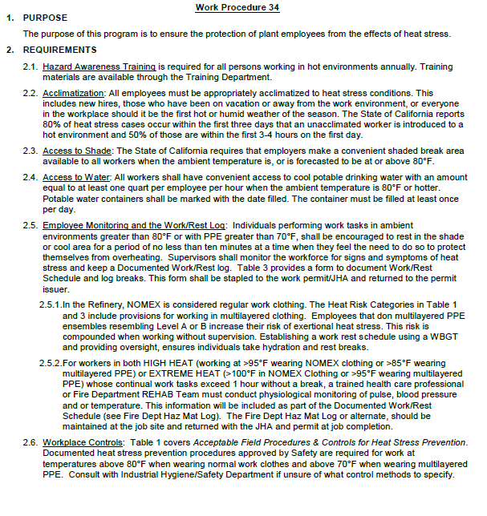
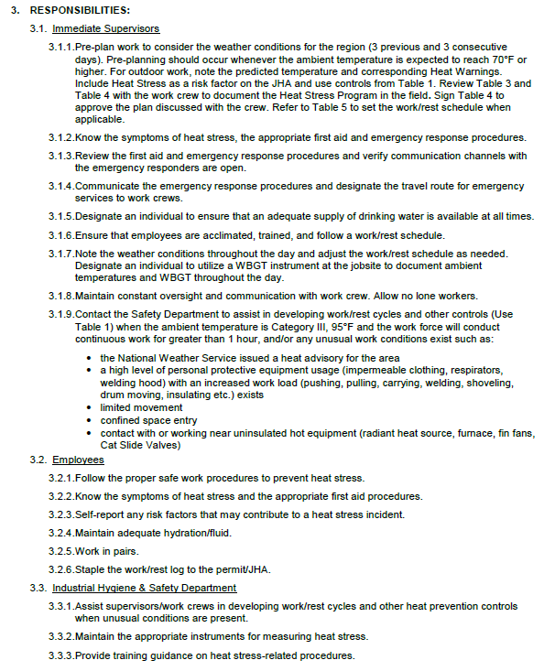

6-4-34 Heat Stress Prevention

Slide 6
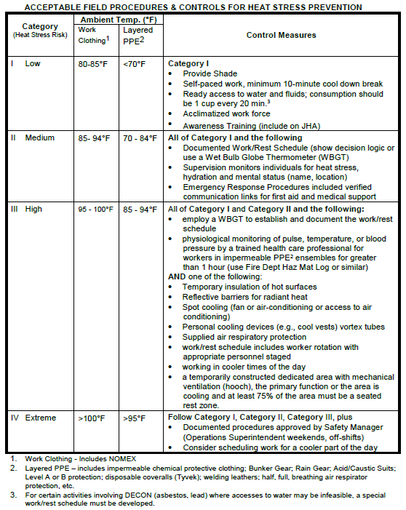
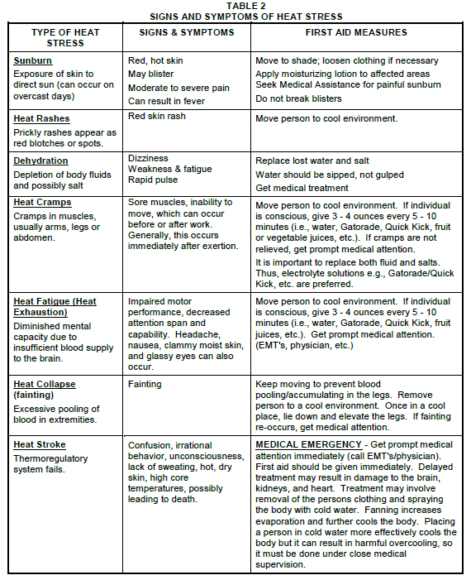
6-4-34 Heat Stress Prevention

Slide 7


What does a successful heat stress program look like?
Management Commitment
Employee Involvement
Work Site Analysis
Hazard Prevention and Control
Safety & Health Training

Slide 8
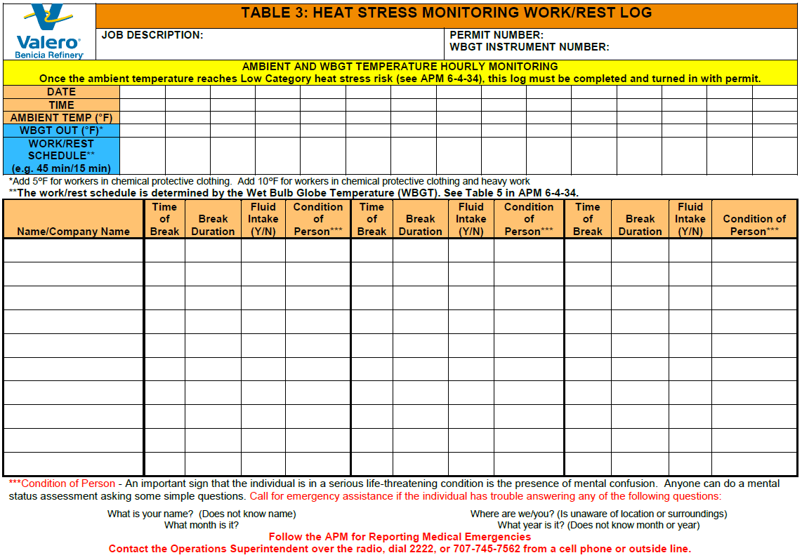
Employee Involvement

Slide 9
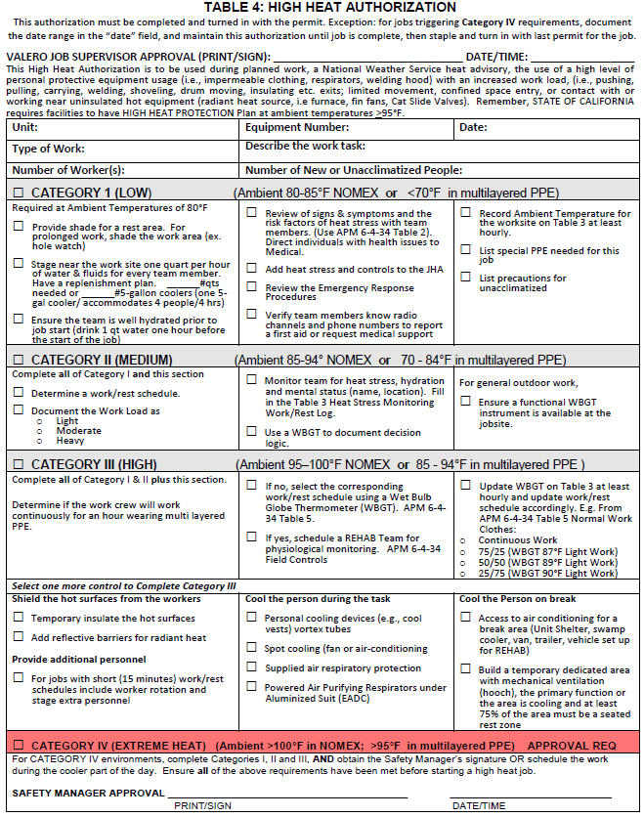
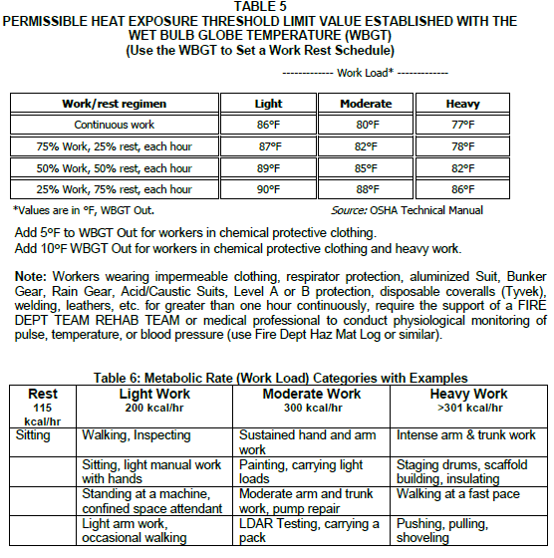
Hazard Prevention and Control

Slide 10
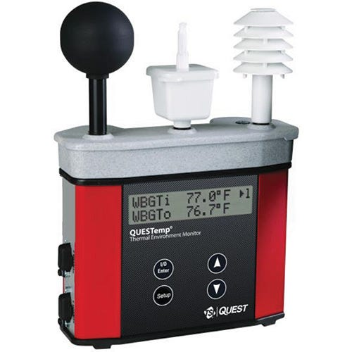
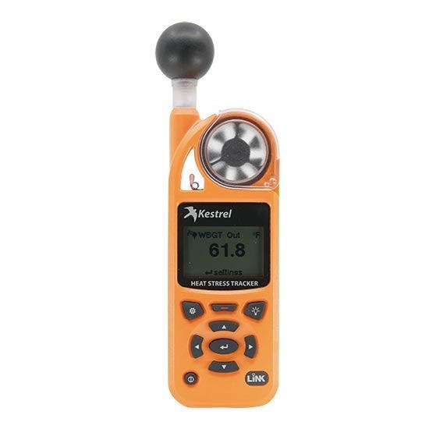
Wet Bulb Globe Thermometer (WBGT)
WBGT is a composite temperature used to estimate the effect of temperature, humidity, and radiant heat (usually sunlight) on humans
T_{w} = Natural Wet Bulb (evaporative cooling)
T_{g} = Black Globe Thermometer
( radiant heat)
T_{d} = Dry Bulb (ambient temperature )

Slide 11
Wet Bulb Globe Thermometer (WBGT)
The WBGT index was created following WWII when majority of troops landing in Africa fell out for lack of acclimatization. It was used extensively at training camps in the 1950’s for Marines and Soldiers to establish acclimation periods and optimize training time. Now, emergency response teams, collegiate, high school and sports teams are using WBGTs to protect their players from overheating during training evolutions.

Slide 12
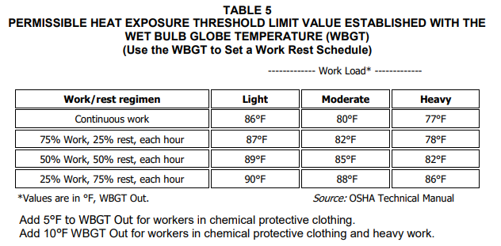
Management Commitment

Slide 13
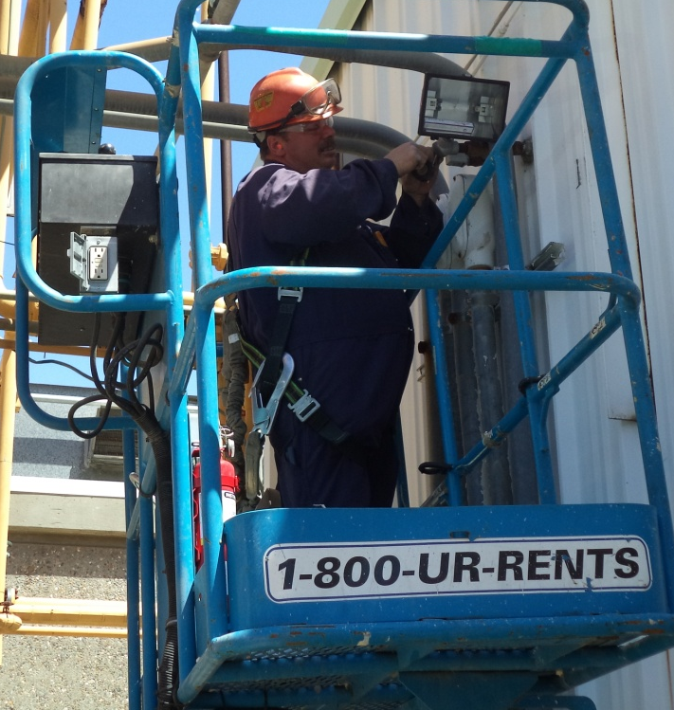
Total Body Heat Stress : Light Work Load
Solar radiation
Temperature
& Humidity
Convection
(air currents)
Evaporation & Humidity
Metabolic (internal)
Heat Production
Work/Rest Schedule
75/25%
Conduction
(contact with surfaces)
Notes:
TOTAL BODY HEAT STRESS IS BASED IN THE OVERALL HEAT REGULATION OF THE BODY:
(1) Convection - is heat transfer by moving a gas or liquid over the body, whether induced by thermal currents, body motion or natural movement of air (wind) or water.
(a) Heat loss - occurs when air temperature is below skin temperature.
(b) Heat gain - occurs when air temperature approaches or exceeds that of the body.
(2) Radiation – heat loss and gain.
(a) Heat loss - occurs when surrounding objects have lower surface temperature than the body.
(b) Heat gain - occurs when surrounding objects have higher surface temperature than body surface temperature. Temperature combinations of the solar, ground and surrounding objects may exist which result in body heat gain, even if the air temperature is below that of the body.
(3) Conduction – Conduction of heat to or from solid objects is usually minimal, since little contact surface is involved.
(a) Although minimal – heat loss occurs from boots to the ground when the surface ground’s temperature is lower than the boots.
(b) Although minimal – heat gain occurs from the ground to the boots usually occurs during hot weather.
(4) Evaporation - evaporation of water produces cooling – heat loss. The max heat loss from evaporation is a function of the rate of air motion over the skin and the water vapor pressure differences between the surrounding air and the wet skin.
(a) Sweating – sweat glands secrete fluid onto the skin surface permitting evaporative cooling when liquid is converted to water vapor.
(b) In hot environments, the amount of heat loss achievable via sweating is the major determinant of the body’s ability to maintain a normal body core temperature.

Slide 14
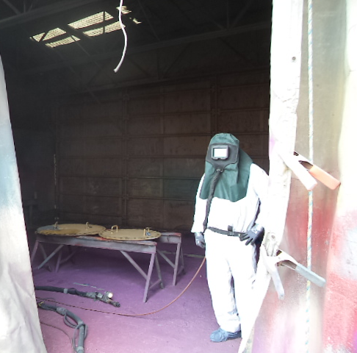
Total Body Heat Stress: Moderate Work Load
Solar radiation
Convection
(air currents)
Temperature
& Humidity
Evaporation & Humidity
Metabolic (internal)
Heat Production
Work/Rest Schedule
50/50%
Conduction
(contact with surfaces)

Slide 15
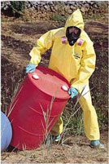
Total Body Heat Stress: Heavy Work Load
Solar radiation
Air Temperature
& Humidity
Convection
(air currents)
Evaporation & Humidity
Work/Rest Scheduled 25/75%
Metabolic (internal)
Heat Production
Conduction
(contact with surfaces)

Slide 16
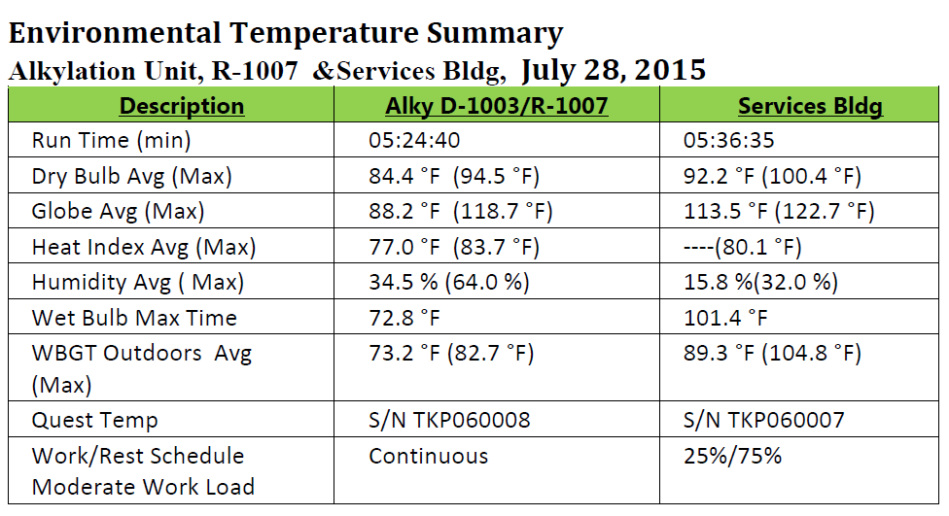
Case Study July 28,2015

Slide 17
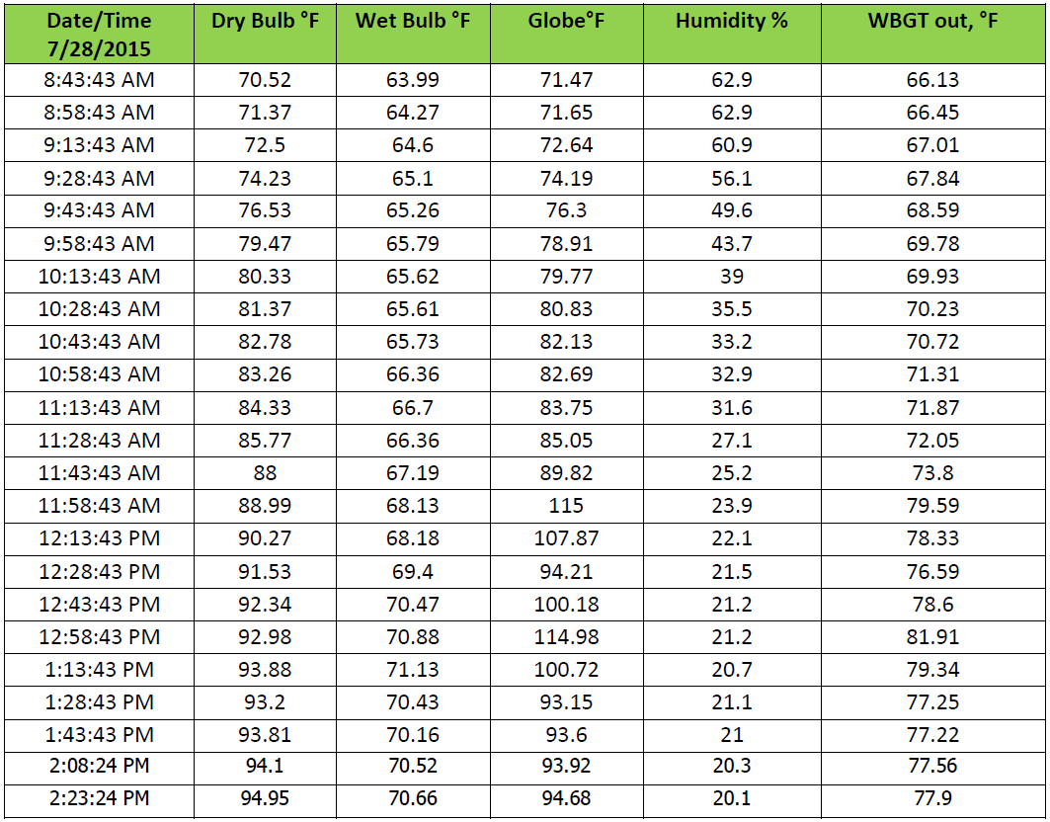
Case Study July 28,2015

Slide 18
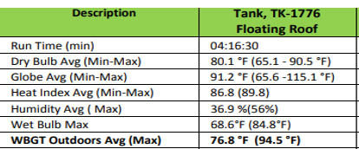
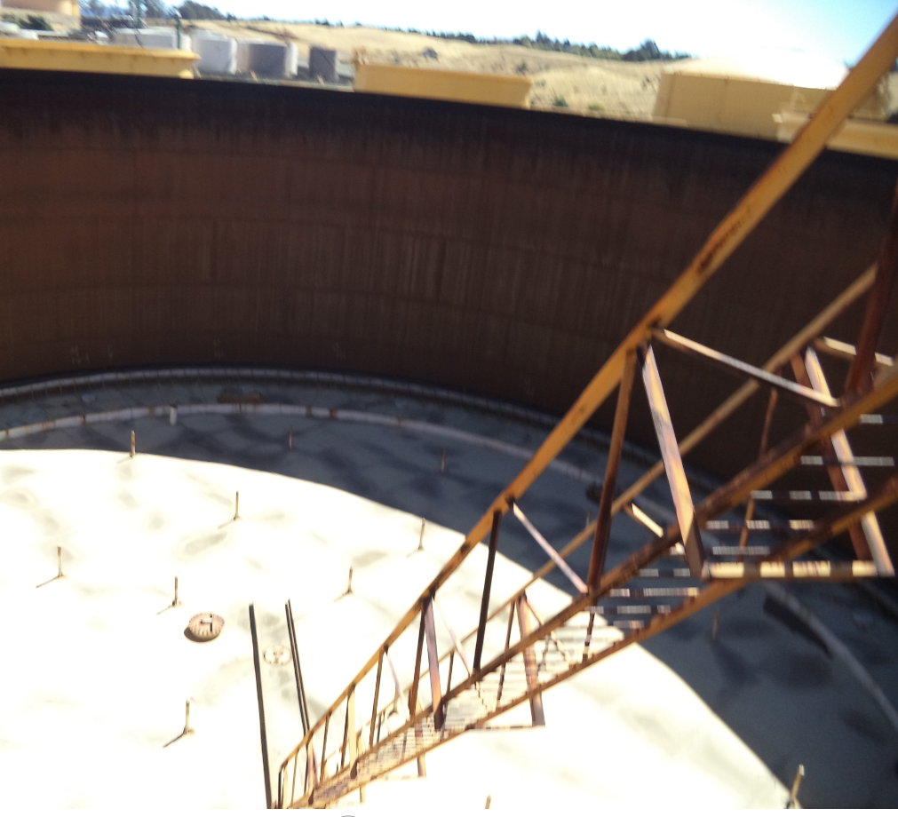
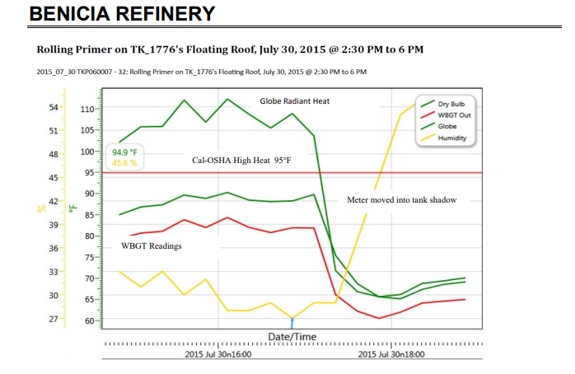

Slide 19
Summary
Alky’s job under D1003 when the ambient temperature at the Services BLDG was 92°F . The ambient temperature under the drum near R1007 was 84.4 °F with a WBGT of 72.8°F. Translation - a crew in layered PPE could perform continuous work and not be expected to have a heat stress episode.
OM Tank-1776. The temperature in the tank shadow was close to 24 degrees cooler than in the direct sun.

Slide 20
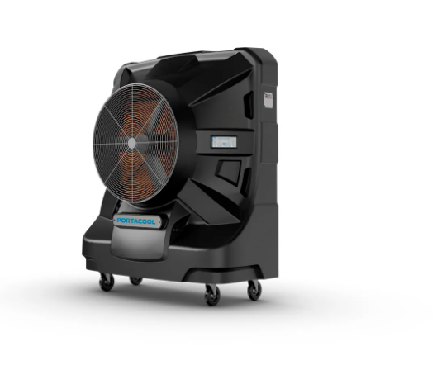
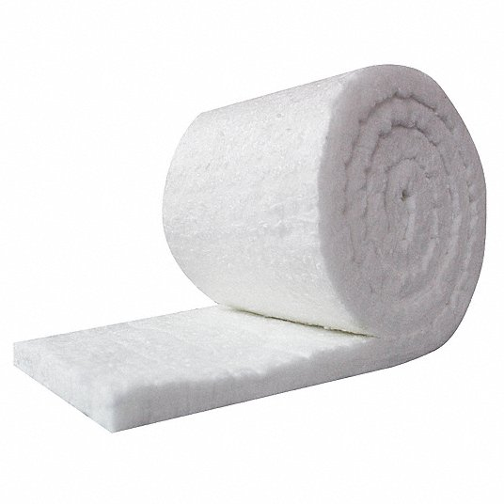
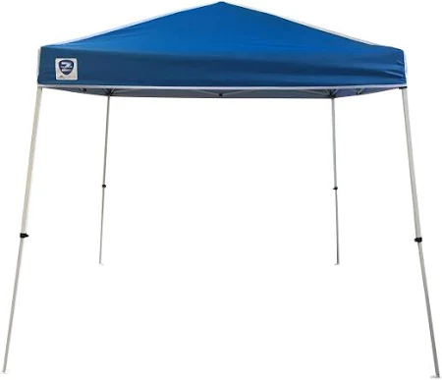
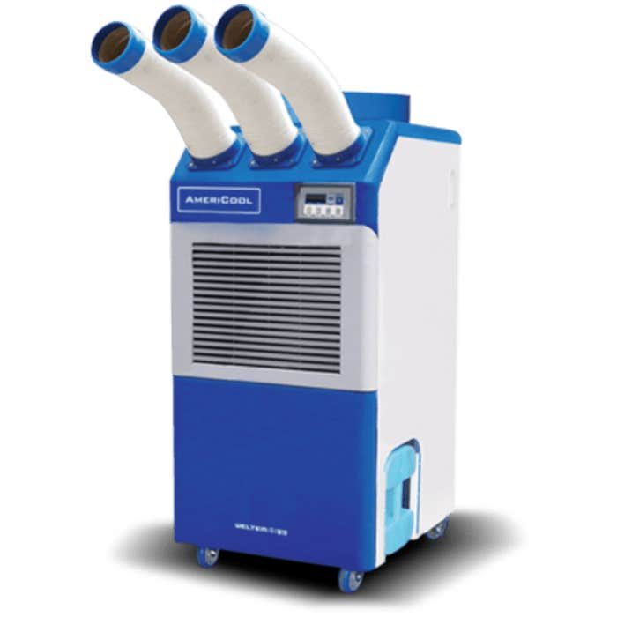
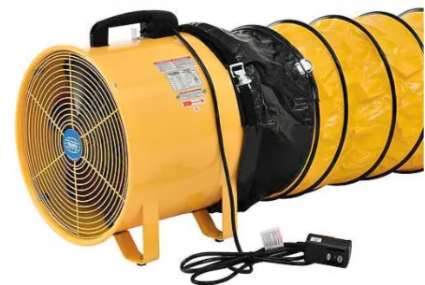
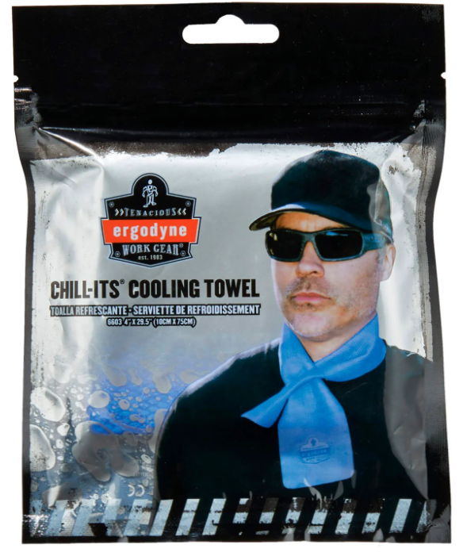
Examples of Mitigations

Slide 21


