Slide 1



AN OVERVIEW OF THE
COMMUNITY WARNING SYSTEM
2025
Notes:
The Community Warning System is THE Emergency Alert system for Contra Costa County Incident Commanders.

Slide 2


COMMUNITY WARNING SYSTEM
THE COMMUNITY WARNING SYSTEM EQUIPS AUTHORITIES WITH SPECIALIZED TOOLS TO DELIVER PROTECTIVE ACTIONS IN EMERGENCIES.
Notes:
2 pronged: All Hazards & Hazmat

Slide 3






COMMUNITY WARNING SYSTEM
FEDERAL NOTIFICATION TOOLS
WEA
WEA
EAS
EAS
NOAA RADIOS
CWS REGISTRATION
Voice, Text, Email
PUBLIC WEBSITE
NOAA RADIOS
SOCIAL MEDIA
Wireless Emergency Alert
Mobile Devices
Wireless Emergency Alert
Mobile Devices
Emergency Alert System
National Weather Service (NWS)
Emergency Alert System
National Weather Service (NWS)
CWSAlerts.com
Facebook/X
TV & Radio
@cococws

Slide 4
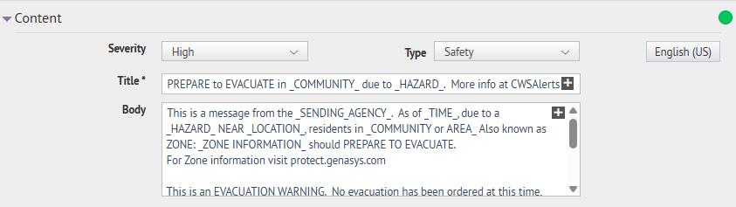
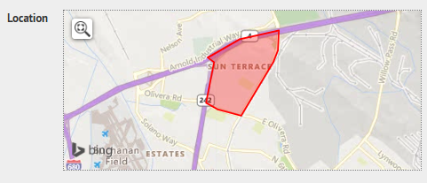

Slide 5
COMMUNITY WARNING SYSTEM
REGISTRATION BASED TOOLS
WEA
EAS
NOAA RADIOS
CWS REGISTRATION
Voice, Text, Email
PUBLIC WEBSITE
SOCIAL MEDIA
Wireless Emergency Alert
Mobile Devices
Emergency Alert System
National Weather Service (NWS)
CWSAlerts.com
Facebook/X
TV & Radio
@cococws

Slide 6
CWS IS USED WHEN
Imminent threat to human health or life,
&
immediate protective action is required.

Slide 7

CWS IS USED WHEN
EVACUATION WARNINGS/ORDERS
SHELTER-IN-PLACE/LOCKDOWN
Imminent threat to human health or life,
&
immediate protective action is required.
AT RISK MISSING PERSON

Slide 8
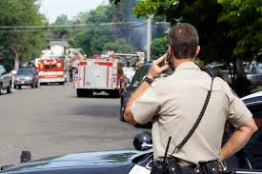
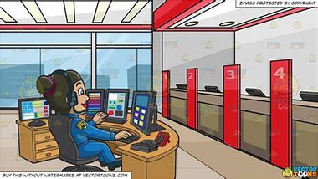
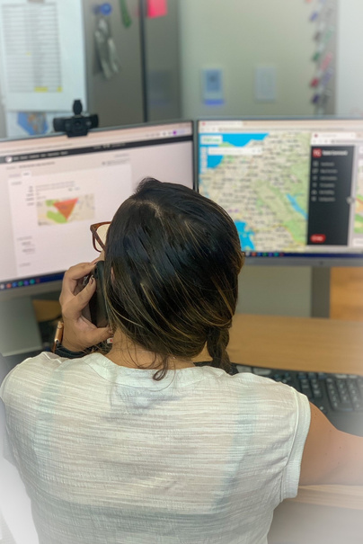

CWS ACTIVATION
INCIDENT COMMANDER REQUESTS CWS ACTIVATION THROUGH CCCSO DISPATCH
DISPATCH CONTACTS CWS DUTY OFFICER
CWS CALLS IC TO CONFIRM CRITICAL DETAILS FOR MESSAGE
CWS ALERTS THE PUBLIC

Slide 9
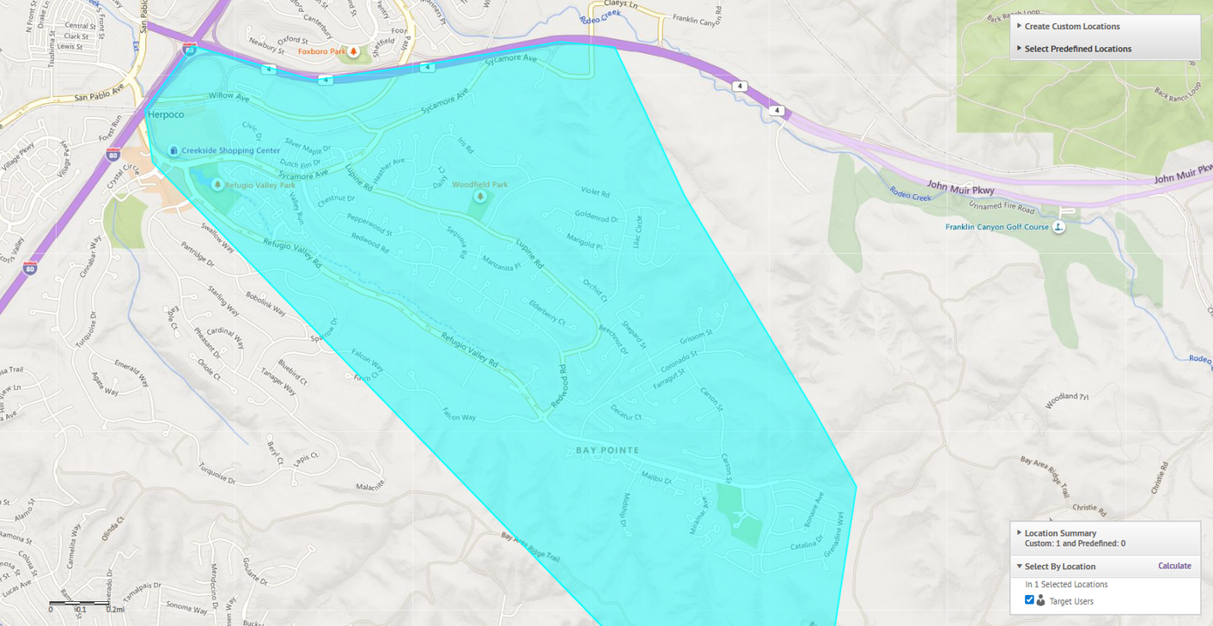
SENT VIA:
CCC Sheriff: EVACUATION WARNING in Hercules due to WILDFIRE. PREPARE by gathering your essential documents. BE READY to LEAVE when advised by local officials. If you require additional time to evacuate, you should leave now. More: CWSAlerts.com
WEA
EAS
TEXT
PHONE CALL
EMAIL
SOCIAL MEDIA
CWS WEBSITE

Slide 10

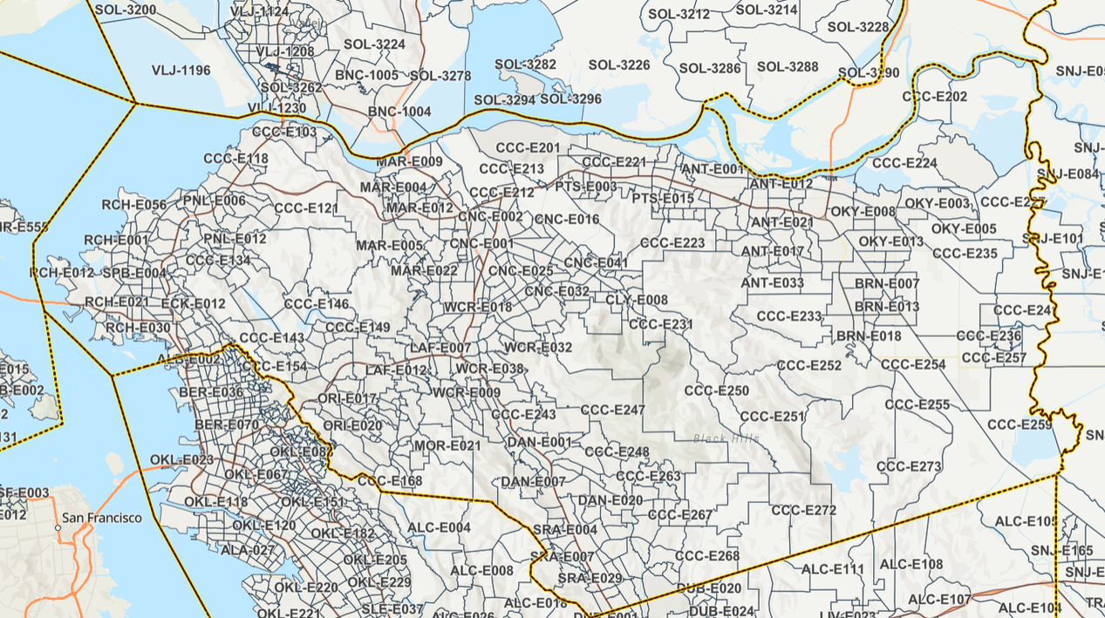
GENASYS - COMMON OPERATING PICTURE TOOL
EVACUATION ORDERS / WARNINGS
THE INCIDENT COMMANDER WILL PROVIDE LAW THE AREA TO EVACUATE VIA ADDRESSES OR ZONES
EVACUATIONS ARE A LAW ENFORCEMENT FUNCTION

Slide 11

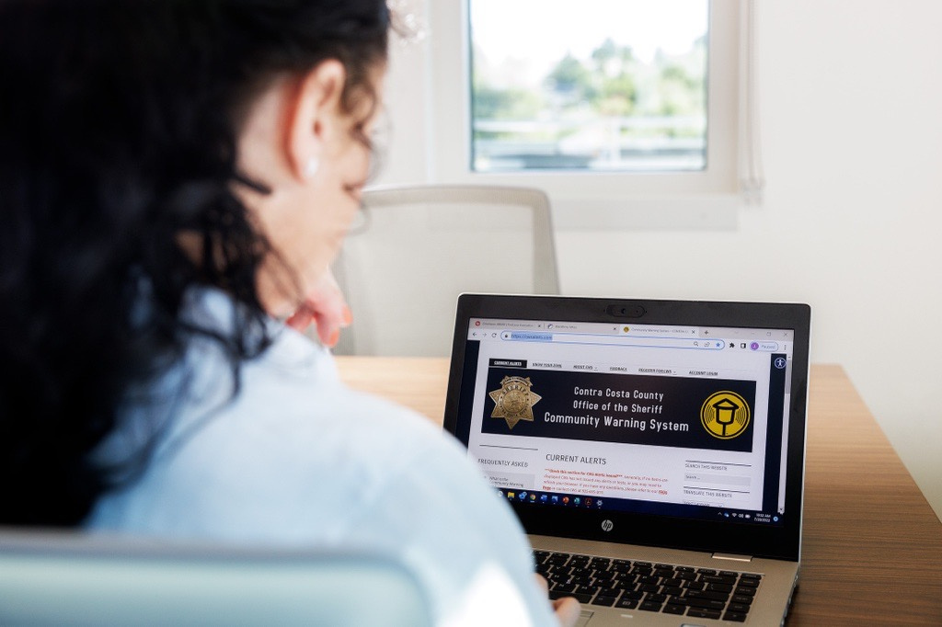



All Hazards Alerts
CONTACT SHERIFF’S OFFICE DISPATCH
REQUEST A CWS DUTY OFFICER CALLBACK
What is the Hazard?
What is the protective action?
Where is the area to be notified?

Slide 12
CCHHMP Notification Policy
LEVEL 0
LEVEL 1
LEVEL 2
LEVEL 3
Internal Notification
Community Awareness
Public Health Advisory
Protective Actions Issued
OFF-SITE IMPACT IS NOT EXPECTED
FLARING NOT INCLUDED IN ANY OTHER LEVEL
NOT EXPECTED TO CAUSE PUBLIC CONCERN
OFF-SITE HEALTH IMPACT IS NOT EXPECTED
ODOR OR AUDIBLE IMPACT
FLARING LASTING LONGER THAN 20 MINUTES
PLUMES VISIBLE OFF-SITE
OFF-SITE CONSEQUENCES EXPECTED
MAY IMPACT HEALTH OF SENSITIVE POPULATIONS
OFF-SITE CONSEQUENCES MAY IMPACT THE GENERAL PUBLIC’S HEALTH

Slide 13
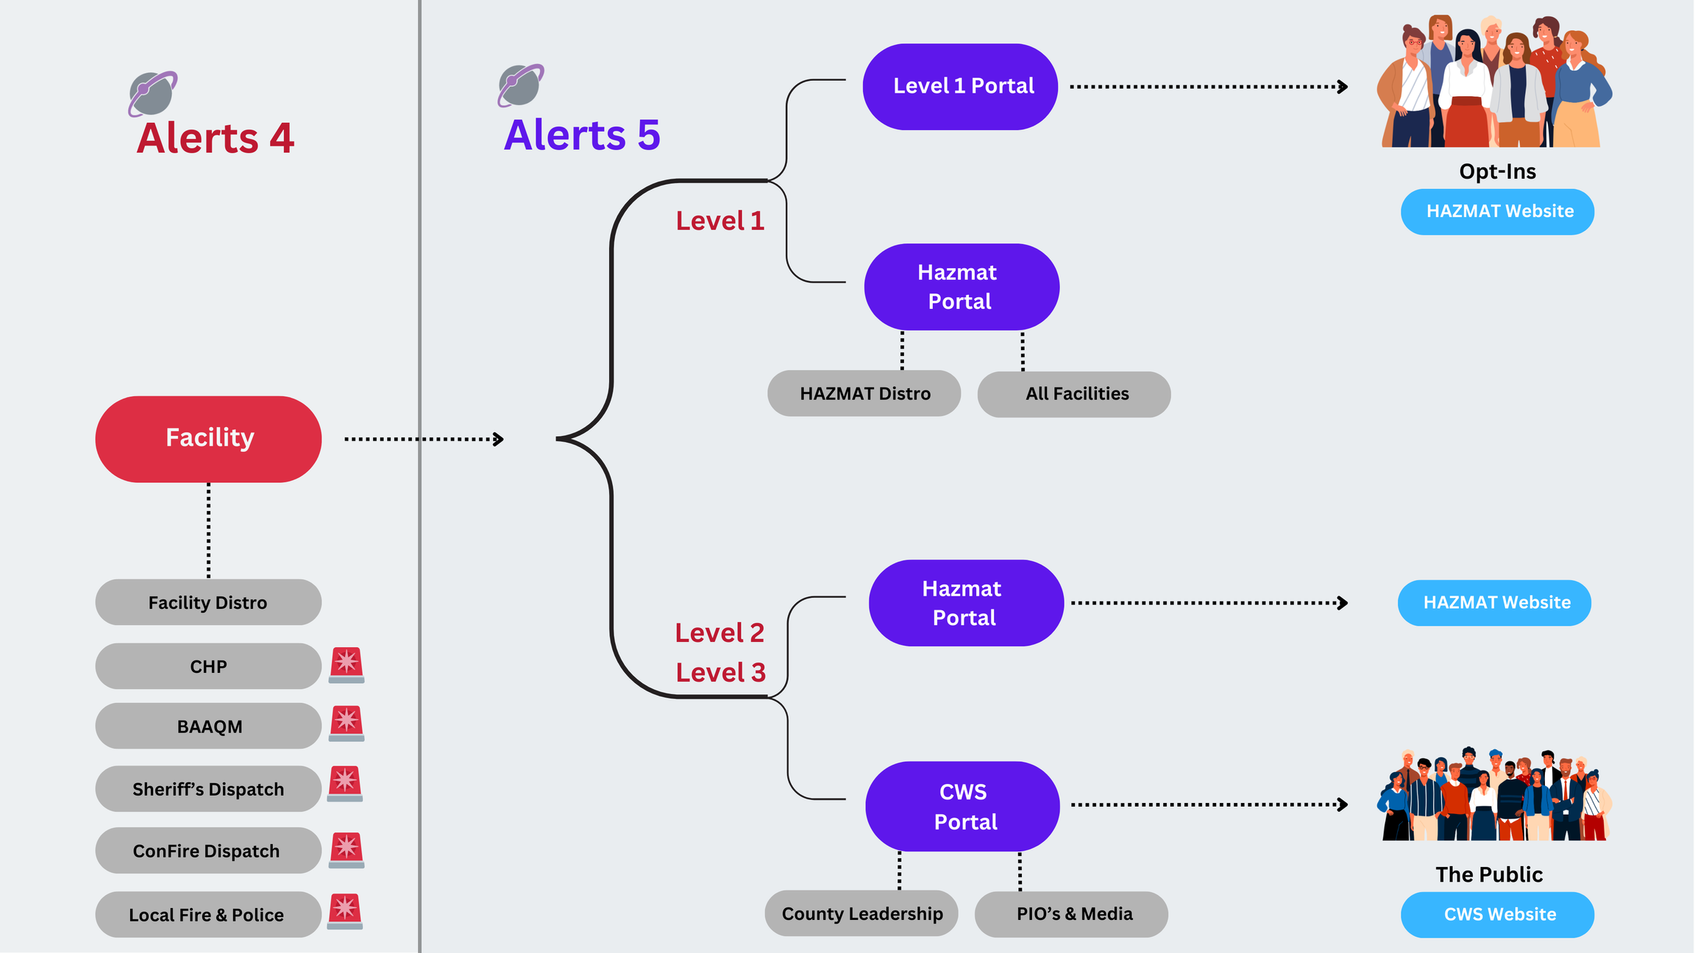

Slide 14
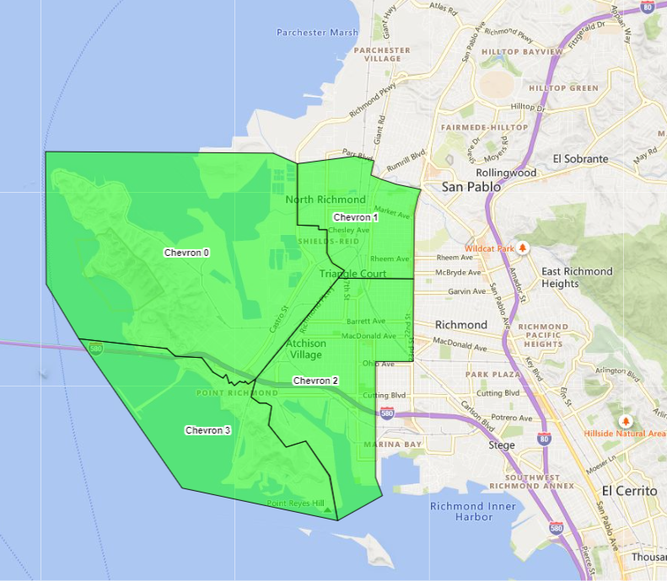
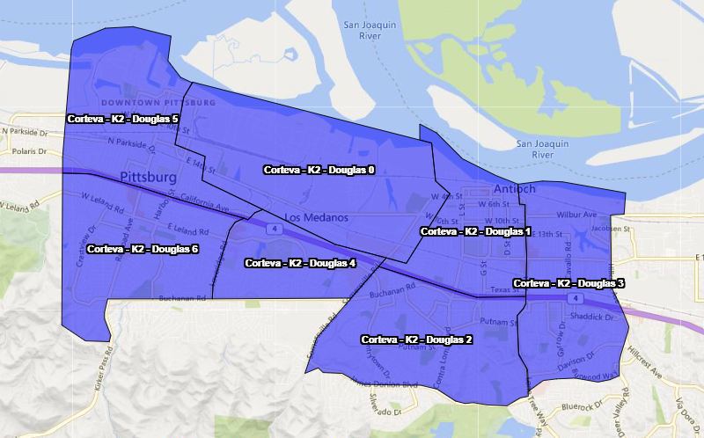

Slide 15
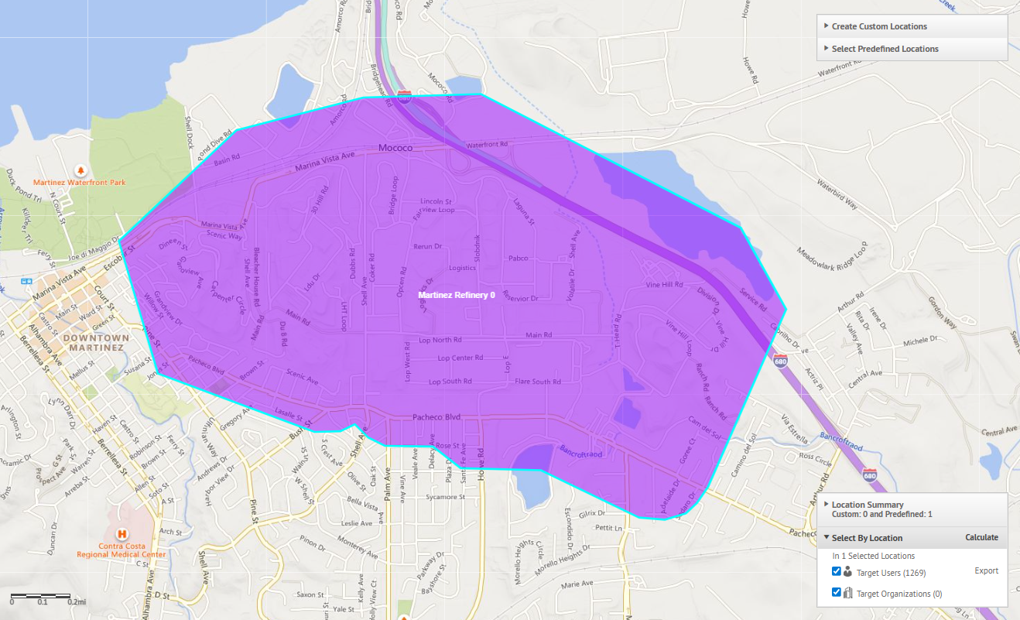
LEVEL 2:
This is a public health advisory for Martinez and Pacheco. An incident at the Martinez Refining Company could affect individuals with respiratory sensitivities. Most people will not be affected. Eye, skin, nose, or throat irritation may be possible for some people in the affected area. If people experience any irritation, advise them to go inside and rinse any irritated area of their body with water. Handle this as advisory information only. For more info go to CWSAlerts.com.
TEXT
EMAIL
SOCIAL MEDIA
CWS WEBSITE
HAZMAT WEBSITE

Slide 16
This is a message from Contra Costa Health Services. There is an emergency at the Martinez Refining Company. Residents in portions of Martinez, Pacheco, North Concord and Clyde should shelter in place. Please go inside, close all windows and doors, turn off all heaters, air conditioners and fans. If not using the fireplace, close fireplace dampers and vents, and cover cracks around doors and windows with tape or damp towels. Updated emergency information can be found on media news networks and by going to www.cwsalerts.com. Stay off the telephone unless you have a life-threatening emergency.
LEVEL 3:
SIRENS
WEA
EAS
NOAA RADIO
TEXT
PHONE CALL
EMAIL
SOCIAL MEDIA
CWS & HAZMAT WEBSITES

Slide 17
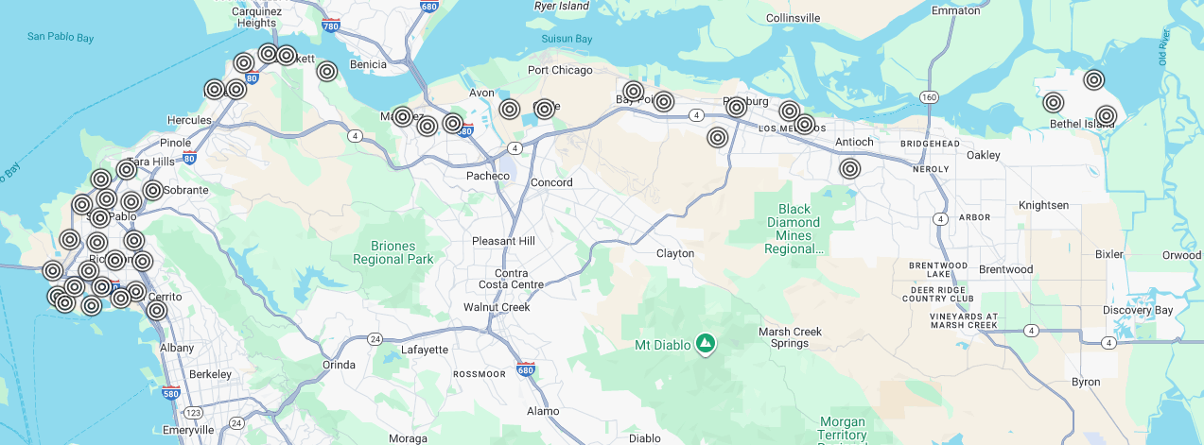

SIRENS
Notes:
Sirens must be manually resounded every 30 minutes

Slide 18


THANK YOU
Additional Questions
In-Person CWS Training
CWSstaff@so.cccounty.us
(925)655-0111

