Slide 1
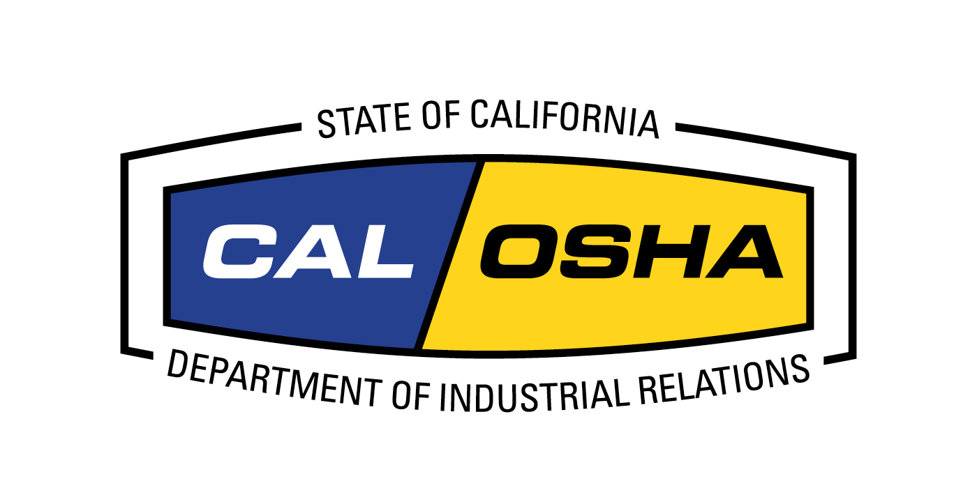
Applying California’s 2017 Refinery Safety Regulation, Section 5189.1, to Renewable Refineries.
Mike Wilson
Senior Safety Engineer
Cal/OSHA Research and Standards
mwilson@dir.ca.gov
The views expressed in this presentation do not necessarily reflect those of Cal/OSHA, DIR or the Labor and Workforce Development Agency.

Slide 2
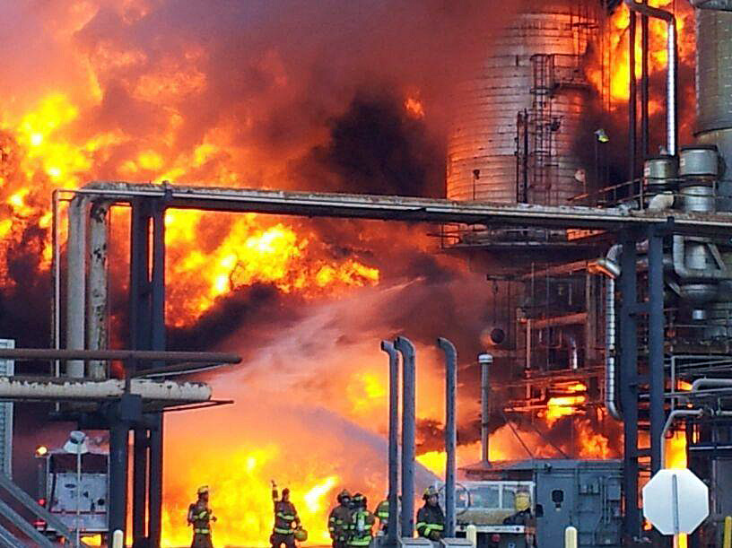

Slide 3
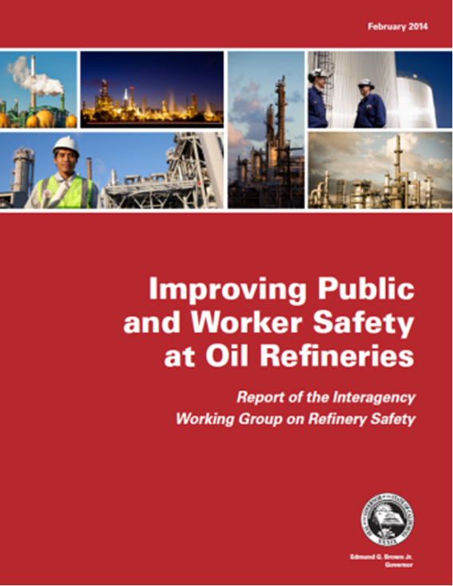
The following revisions to section 5189 should "be required as soon as possible” for the state’s petroleum refineries:”
Inherent safety, hierarchy of controls
Safety culture assessments
Damage mechanism reviews
Improved process hazard analysis (PHA)
Root cause analysis
Human factors analysis
Effects of organizational change
Layer of protection analysis

Slide 4
TIMELINE
August 2012: Richmond, Chevron fire
2013: Cal/OSHA, Cal/EPA and OES begin work on new refinery safety regulations.
2013-2016: Cal/OSHA convenes or participates in 26 meetings or hearings pertaining to refinery process safety.
2014-2016: Cal/OSHA convenes a labor-management PSM technical advisory committee to draft section 5189.1.

Slide 5
TIMELINE
August 2017
Standards Board approves section 5189.1, which takes effect in October.
October 2017
Cal/EPA implements a new Cal/ARP Program 4 regulation, enforced by county CUPAs, identical to section 5189.1.
December 2023
Section 5189.1 adopted by Washington State.

Slide 6
Section 5189.1 updated the 15 existing PSM elements in section 5189 and added nine new elements.
.

Slide 7
*A basic PHA is required in section 5189 from 1992.
Logic Model of Section 5189.1, California’s 2017 PSM Regulation

Slide 8
Hierarchy of Controls: U.S. EPA and OSHA 2015 Chemical Safety Alert. Required in section 5189.1.
Source: https://www.epa.gov/sites/production/files/2015 06/documents/alert_safer_tech_alts.pdf

Slide 9
AGENCY LEADERSHIP PERSPECTIVES
David Lanier, Secretary, Labor and Workforce Development Agency:
“California now leads the nation in protecting the safety and health of refinery workers and people in nearby communities.”
Mark Ghilarducci, director, Governor’s Office of Emergency Services (OES)
“These new regulations increase overall preparedness, provide greater accountability and implement a nation-leading approach to public safety and emergency prevention at refineries.”
Matthew Rodriquez, Secretary for Environmental Protection
“The goal of these regulations is to hold refineries accountable for the safety of workers and communities. Thanks to input from refinery workers, industry leaders and environmental and community organizations, we can better anticipate problems and prevent accidents that might pose serious risks to the public and environment.”

Slide 10
In response to Governor Newsom’s Executive Order N-79-20 (Sept 2020), the production of fuels formulated from renewable feedstocks (e.g. animal tallow, cooking fats, corn and soybean oil) is growing in California and is expected to become an increasing part of the state’s transportation fuels market.

Slide 11
Martinez Refinery Renewable Fuels Project, Final Environmental Impact Report, 2022.
“The processing activities under the proposed Project would be similar to activities that are currently being conducted at the Refinery with the primary change being a change in feedstock from fossil fuels (crude oil) to renewable sources (rendered fats and vegetable oils) for a transition from fossil fuel petroleum refining into a renewable fuels facility.”

Slide 12
Martinez Refinery Renewable Fuels Project, Final Environmental Impact Report, 2022.
“Explosion and fire risks could increase because byproducts of refining the new feeds pose new equipment damage hazards, and the extra hydrogen reacted with HEFA feeds would increase the frequency and magnitude of dangerous runaway reactions in high-pressure HEFA reactors.”
“Even with safeguards in place, recurrent catastrophic explosions and fires can occur.”
https://www.contracosta.ca.gov/DocumentCenter/View/74460/Martinez-Refinery-Renewable-Fuels-Project-FEIR

Slide 13
Interagency Refinery Task Force (13 agencies)
“The PSM and CalARP refinery regulations established a common framework for managers to invest in process safety and build their PSM programs over time, and they improved agency cooperation among CalEPA, CalOSHA, local CUPAs and U.S. EPA in training, inspections, and enforcement.”
“When refineries convert from petroleum to renewable fuel production, it is important that they continue to be covered by the PSM and CalARP regulations because the fuels they produce will continue to be flammable.”
January 2024

Slide 14
Interagency Refinery Task Force (13 agencies)
“…because the regulations specifically apply to petroleum refineries, not to renewables, it might be necessary for California to take special action to ensure these refineries continue to comply as they transition.”
January 2024

Slide 15
Section 5189.1. Process Safety Management for Petroleum Refineries.
(a) Scope and Purpose.
This section contains requirements for petroleum refineries to reduce the risk of major incidents and eliminate or minimize process safety hazards to which employees may be exposed.
(b) Application.
This section shall apply to processes within petroleum refineries. For petroleum refineries, this regulation supersedes California Code of Regulations (CCR) Title 8, Section 5189.

Slide 16
Use of Flash Point in Section 5189.1
5189.1 applies to highly hazardous materials used in processes, including flammable liquids with a flash point below 199.4 deg F.
Petroleum diesel: FP = 125 deg F
Renewable diesel: FP = 125 deg F
However, only petroleum diesel is covered; renewable petroleum is not, due to the scope of 5189.1.
Therefore, covering renewable diesel is consistent with the intent and all technical elements of 5189.1.

Slide 17
Conclusion
The drafters of section 5189.1 did not anticipate the emergence of a renewable refinery sector in California.
However, they recognized that—to protect worker safety and health—any substance with a flashpoint lower than 199.4 deg F that is used in a process must be covered by 5189.1.
For this reason, expanding the Scope and Application of section 5189.1 to include renewable refineries is consistent with the intent of section 5189.1 and all its technical elements.

