Slide 1
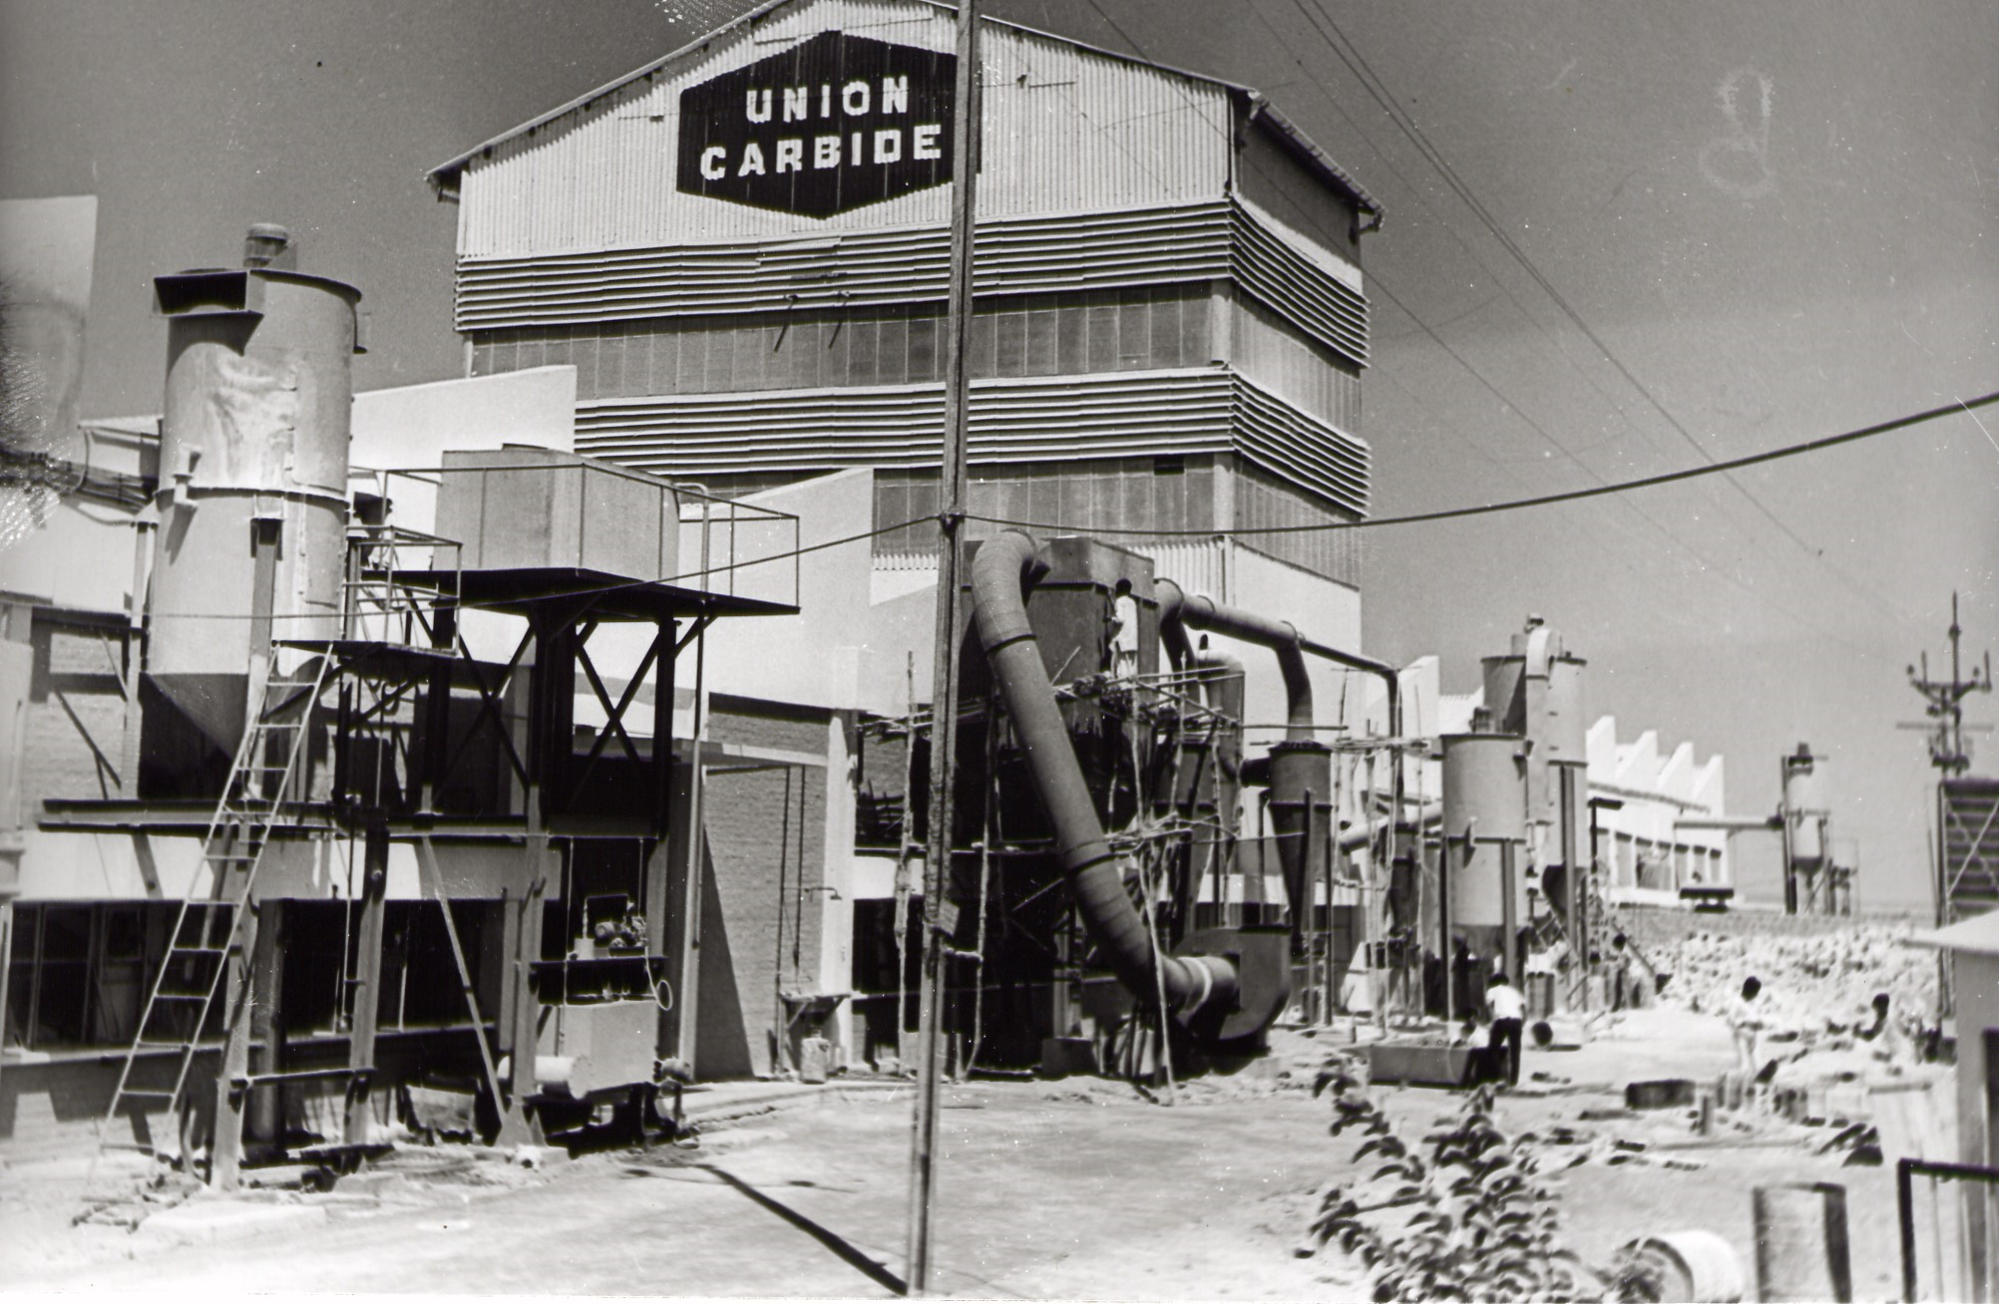
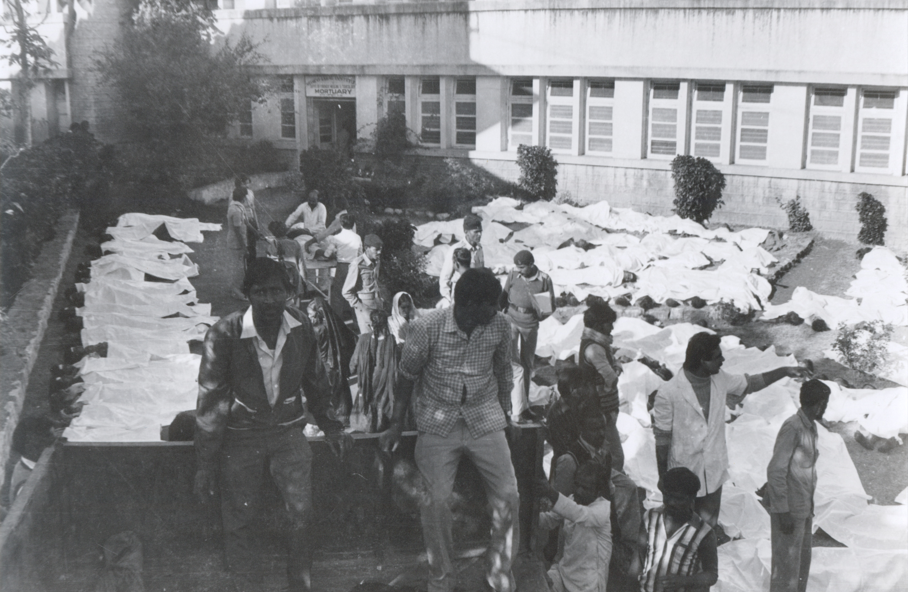
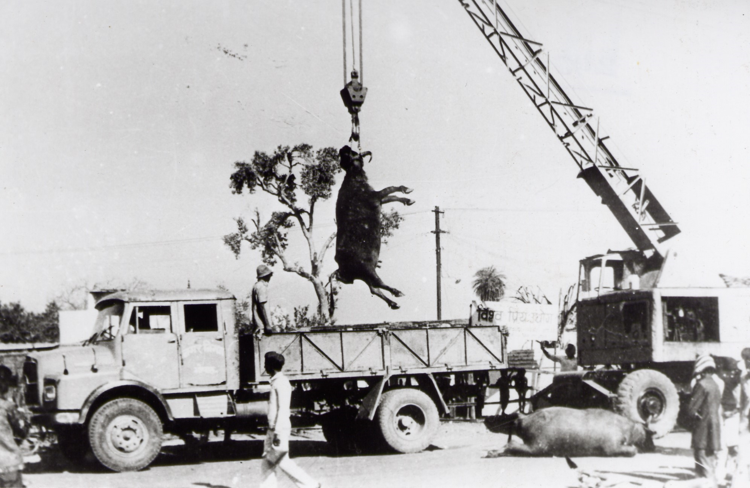
Photos by: Kamlesh Jamini (Jamini Photo Studio Bhopal)
The Bhopal Gas Tragedy
The 40th Memorial Review

Slide 2
Disclaimer
Mr. Bloch authored Rethinking Bhopal and the content of this presentation in his personal capacity. The views expressed are his own and do not represent the views of his employer.

Slide 3
Your Speaker
Kenneth
Bloch
processreliability@gmail.com
Process Safety Supervisor in Renewable Energy
BS Env Sci (Lamar University, 1988)
Author of Rethinking Bhopal (ISBN# 978-0128037782)
Started investigating industrial process incidents in 1986
Reliability, maintenance, process safety, and operations experience
Career goal: Solve one problem more than I created

Slide 4
Outline
The Bhopal Gas Tragedy 40th Memorial Review
The Incident
Three Major Sources
The Carbaryl (“Sevin”) Molecule
Causal Factor 1: Hazardous Chemistry
The MIC Process
Causal Factor 2: Material Selection
The Nitrogen Purge
Causal Factor 3: MIC Transfer Pump Failure
The Water Washing Procedure
Causal Factor 4: Tank E610 Vent Valve Failure
Cause and Effect
Restart Attempt
Takeaways

Slide 5
The Incident
On Dec. 3, 1984 a chemical plant in Bhopal India released 28 tons of toxic gas into the night sky
The poisonous cloud dispersed into the community
  Thousands of deaths
  Hundreds of thousands of injuries
  Widespread animal and ecological devastation
After 40 years, still history’s worst industrial disaster (why?)
On Feb 14, 1989, all legal claims (over 500,000) were dismissed in an out-of-court settlement
  No definitive account from Union Carbide Corporation (UCC) or Union Carbide India, Ltd (UCIL) into what happened
  Controversial cause theories (prevailing public opinion has filled the knowledge gap)

Slide 6
Three Major Sources
Union Carbide (UCC) Report, March 1985
Google: “Union Carbide Review of Methyl Isocyanate”
(Starts on Page 35)
Arthur Daniel Little (ADL) Report, May 1988
Research (CSIR) Report, December 1985
Council of Scientific & Industrial
TRANSPARENCY
Google: “Union Carbide Large Magnitude”
Google: “Varadarajan Bhopal Report”

Slide 7
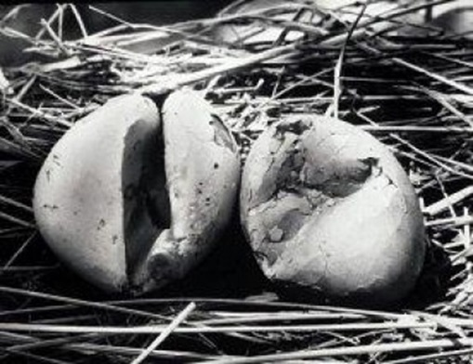
The Carbaryl (“Sevin”) Molecule
PROBLEM
What?
In 1958 the U.S. started phasing out DDT, the world’s most powerful weapon against crop losses (starvation) and vector diseases (malaria, typhus, zika, plague, etc.)
Why?
DDT was proven responsible for global ecological destruction.
D
D
T
ichloro
iphenyl
richloromethane

Slide 8
The Carbaryl (“Sevin”) Molecule
SOLUTION
Union Carbide invented and patented a safe alternative in 1958.
The new pesticide molecule was environmentally acceptable.
Can easily be broken-down by the metabolic process in mammals.
At least, if not more, effective than DDT.
Hugely popular and effective, worldwide.
Carbaryl

Slide 9
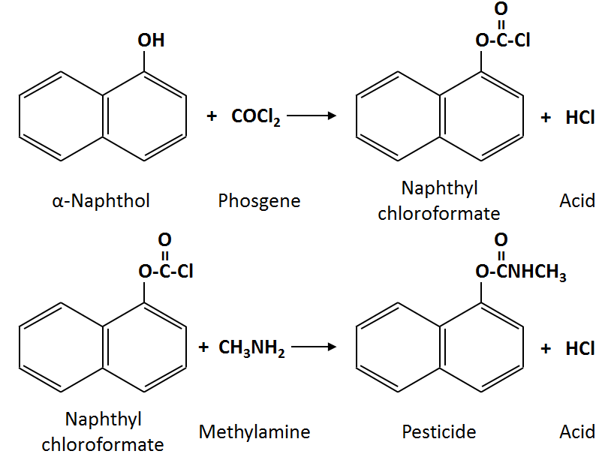
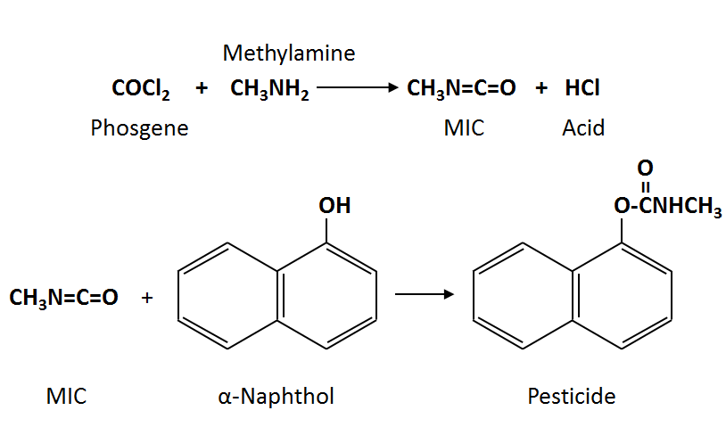
Hazardous Chemistry
CF1
2
The history of methyl isocyanate
Notes:
MIC was a very appealing intermediate product because of it’s high reactivity. It therefore required very little effort to react with the alpha-naphthol to generate the pesticide product. Furthermore, the efficiency was extraordinarily high. The second reaction produced no acid byproduct which made separation very easy. MIC was not only reactive, but it was also volatile and flammable. In chemical handling terms, these three properties were hazards that needed to be adequately and continuously controlled. We’ll examine how this was accomplished in our next section . . . <click>

Slide 10
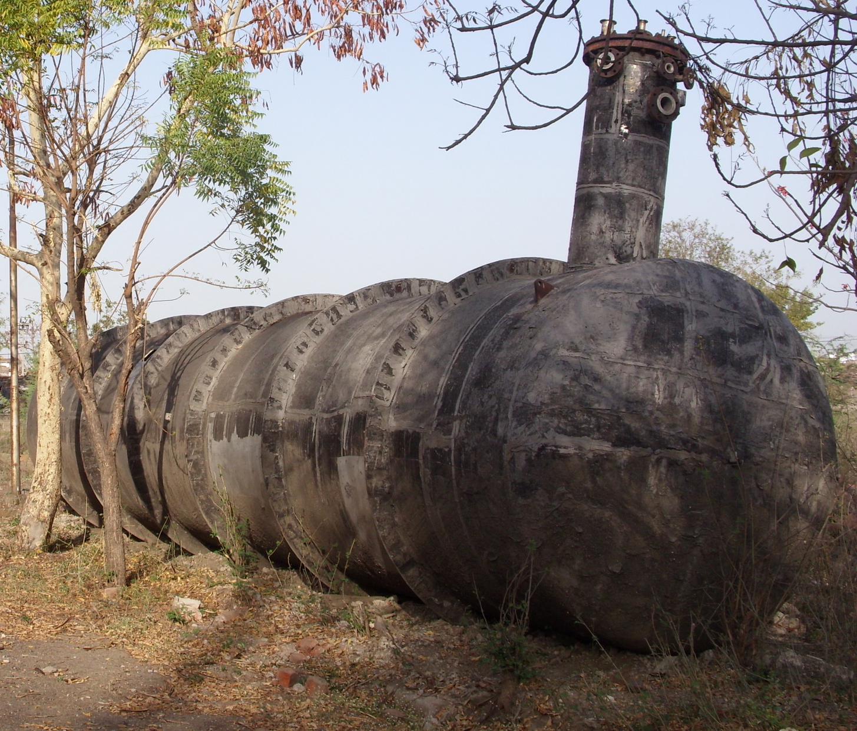
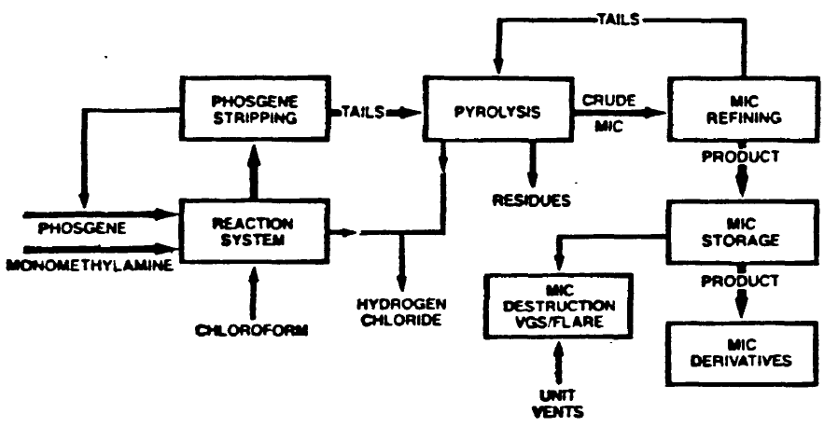
The MIC Process
“MIC Storage” Area
3x 15,000-gal Stainless Steel Tanks
Tank E610 – MIC Storage Tank
Tank E611 – MIC Storage Tank
Tank E619 – MIC Reject Tank
Notes:
Why this diagram animation? Even though you’ve made the intermediate, if something goes wrong in storage, you can’t use it to make pesticide. You’re “down!”

Slide 11
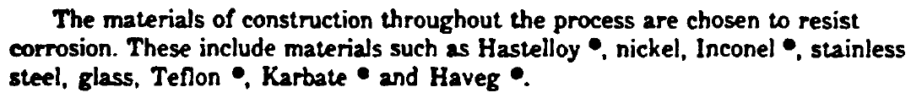
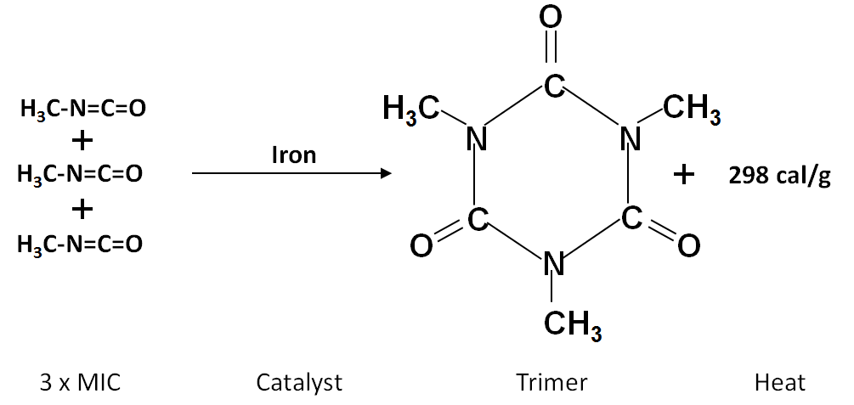
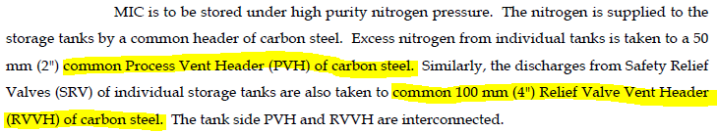
Material Selection
UCC Report:
Design specification
CF2
(Rust)
MIC design spec was stainless steel
Bhopal plant used carbon steel in vapor management system (pipes and valves)
Why?
CSIR Report:
Actual construction
Notes:
However, the high purity and reactivity caused a problem with with the intermediate’s behavior. Quite readily, it would react with itself exothermically to form a larger, tenacious product called “trimer.” Trimer had to be controlled because in the process it was notorious for clogging pipes and process equipment.

Slide 12
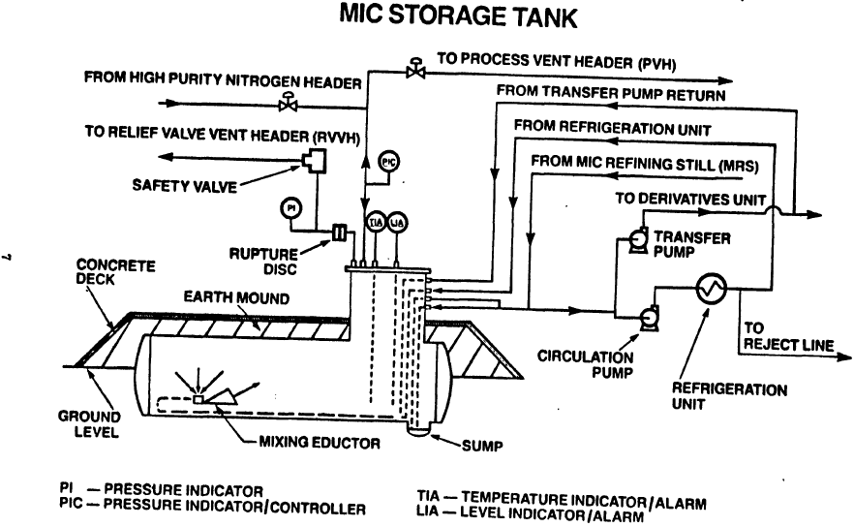

The Nitrogen Purge
AIR WOULD NOT ENTER THE IRON ATMOS HEADER
UCC Report:
THE VENT VALVE (CV) WAS ALWAYS OPEN
2 PSIG

Slide 13
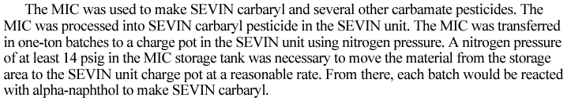
MIC Transfer Pump Failure
CF3
AIR STARTED ENTERING THE CARBON STEEL HEADER (RUST)
MIC-TRIMER DEPOSITS STARTED TO FORM, CHOKING LINES AND VALVES
THE VENT VALVE (CV) WAS CLOSED
THIS CONTROL VALVE WAS ALWAYS OPEN
2 PSIG
X
14 PSIG
BACK PRESSURE
BUSINESS CONTINUATION
BUSINESS INTERRUPTION
ADL Report:

Slide 14
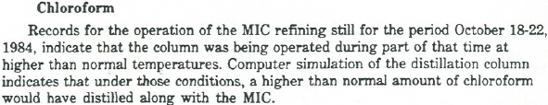
The Water Washing Procedure
FLUSH WITH WATER
UCC Report:
MIC-Trimer
Deposit
MIC
GAS
MIC-Trimer Buildup
High ∆P
LOW ∆P
PVH & RVVH Cross-Section
and ∆P Management
CLEAN,
CORRODED CS PIPE
FOULED,
CHOKED CS PIPE

Slide 15
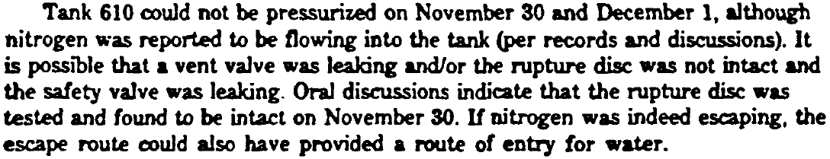
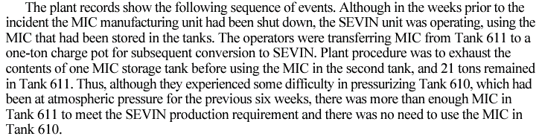
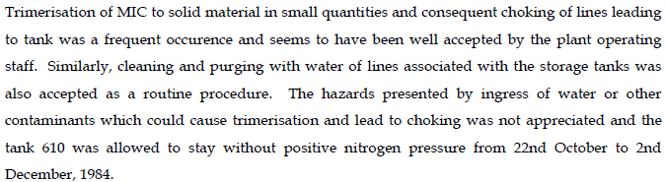
CF4
Tank E610 Vent
Valve Failure
UCC Report:
TRANSPARENCY
ADL Report:
CSIR Report:
Oct. 22-29
Oct. 29-Nov 5
Nov 5-12
Nov 12-19
Nov 19-26
Nov. 26-Dec. 3

Slide 16
Cause and Effect
X
THE FOULED VENT VALVE (CV) WAS LEAKING
THIS CONTROL VALVE WAS ALWAYS OPEN
2 PSIG
X
BUSINESS INTERRUPTION

Slide 17
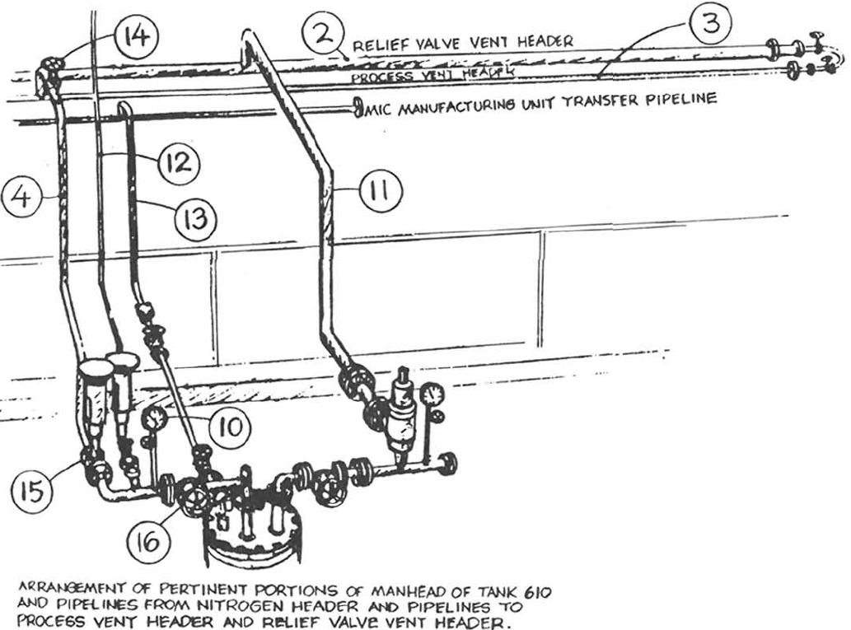
Restart Attempt
ADL Report (Figure 7):
#10: Tank Pressure Gauge
#15: Vent Valve
Acceptable Blind Flange
Location
#16: Common Valve
Notes:
Let’s write a ‘procedure’ based on what we would do under similar circumstances. What’s the easiest, fastest, least intrusive way to restore the vent valve (#15) to service?
Close the common valve (#16).
Remove the PI.
Attach a hose to the open threaded pressure tap.
Start water flow.

Slide 18
Takeaways
Design specs will save you from what you don’t know and can’t afford to learn from experience. Don’t deviate from them.
Workaround solutions can create bigger problems than the ones they are meant to solve. Don’t think you can get away with them.
“Human Error” can be a convenient scapegoat for underlying process design and chronic reliability issues that deserve the spotlight.
You have a limited amount of time to manage a problem before you must solve it.
Just because you isolate something doesn’t mean you don’t have to blind it.

Slide 19
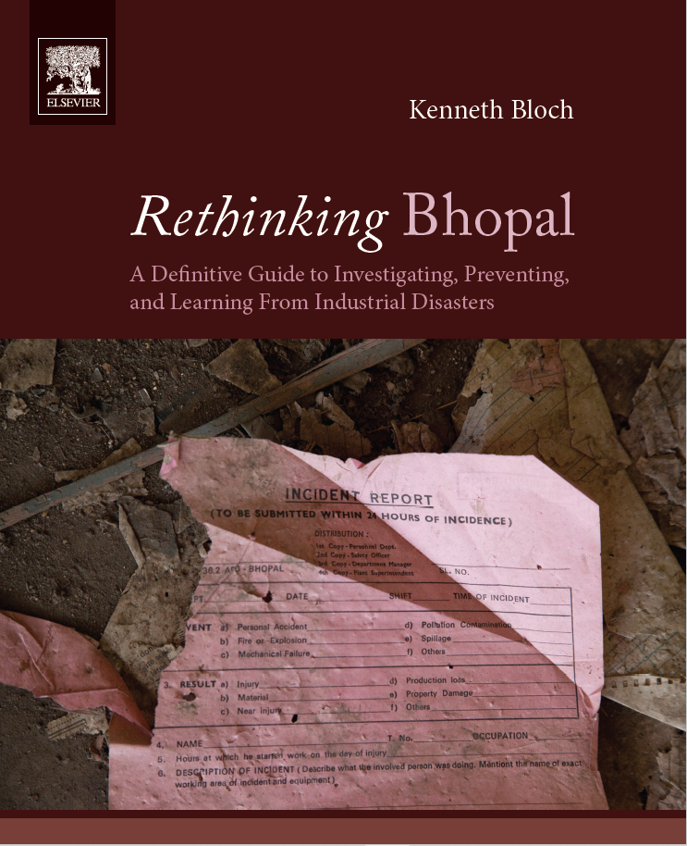
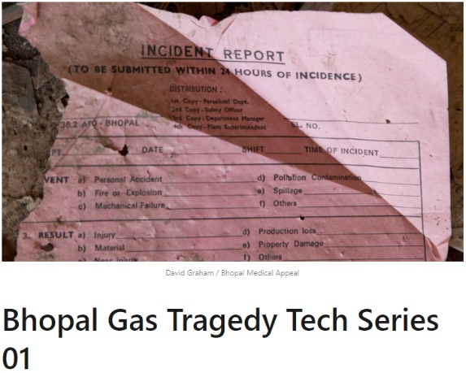
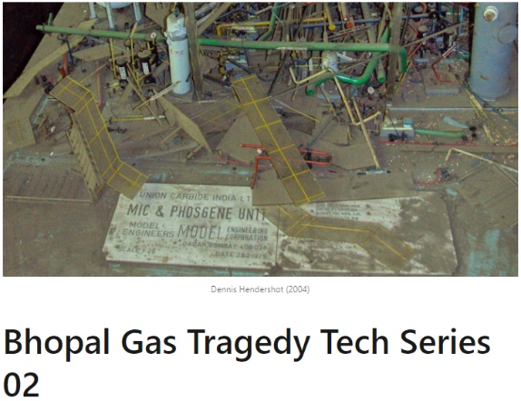
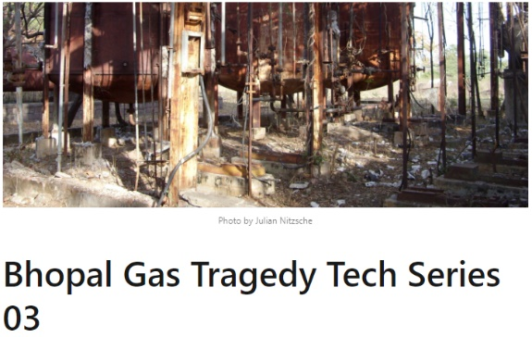
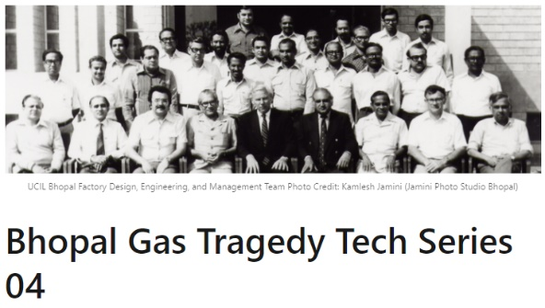
What now . . . ?
Get the book, Rethinking Bhopal
Connect with me on LinkedIn
All royalties go directly to The Process Safety Heritage Scholarship at Lamar University in Beaumont, TX.

