Slide 1
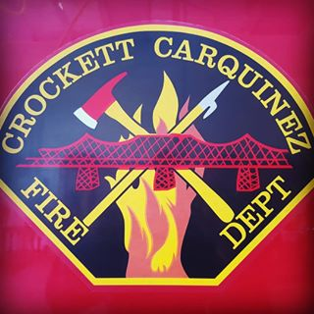
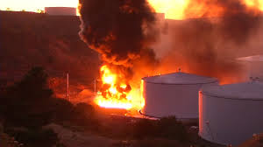
AAR for Incident on 10-15-19
Slides Prepared by Contra Costa Fire

Slide 2
Overview
Crockett-Carquinez Fire District, Rodeo-Hercules Fire District, and Contra Costa County Fire responded for a reported “Commercial Structure Fire” at 90 San Pablo Ave, Crockett
911 Callers heard explosion
Facility 911 call advises 200,000 Barrel Tank Just Exploded, evacuations in progress

Slide 3
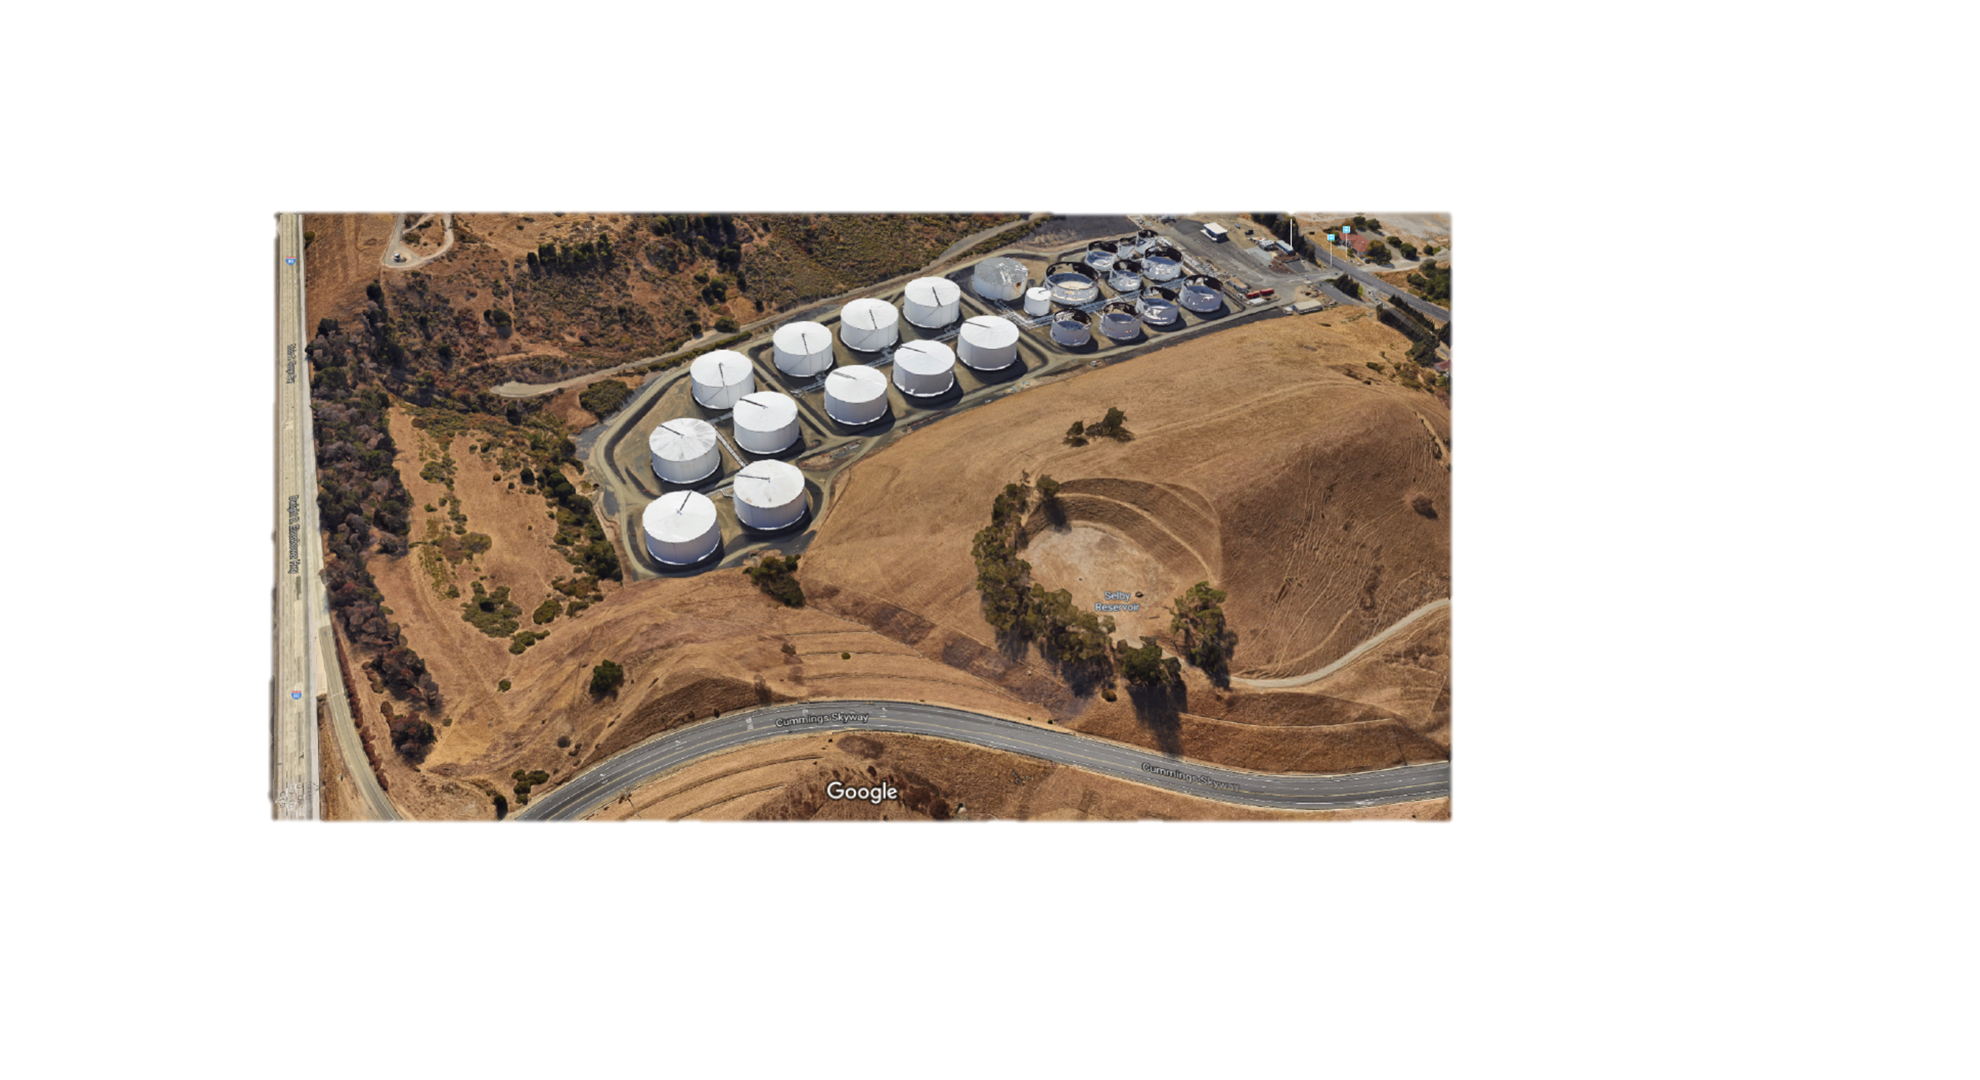
Photo of Facility – Pre 10/15/2019

Slide 4
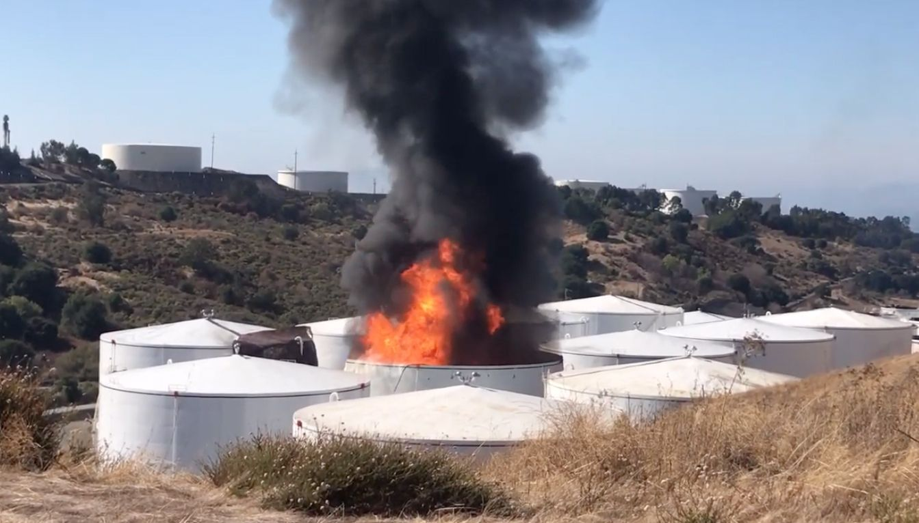
First Alarm Response
E175
Q176
E179
E178
E378
BC7
BC71

Slide 5
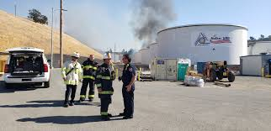
Additional Resources
E170
E169
E165
BS161
Sq70
T114
M69, M70, EMS7
BC1, BC4, BC2, TC-10, INV.20,
7500, 7800, 7801, EBIMT, CMD 84
1100, 1101, 1102, 1103, 1104, 1105

Slide 6
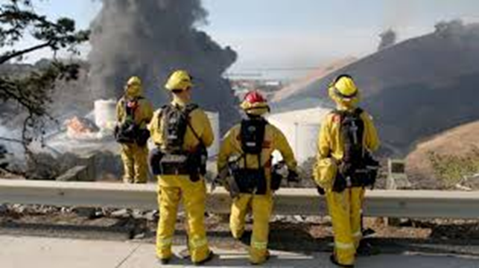
Vegetation Fire Response
E169
E313
CAL Fire (E1666, E1676)
E166/666
E168/668
East Bay Parks
Dozer 220
BC2, BC64
CAL Fire Air Attack

Slide 7
Responding Fire Agencies
Crockett Fire
Rodeo- Hercules Fire
Pinole Fire
Contra Costa County Fire
El Cerrito Fire
Richmond Fire
Moraga – Orinda Fire
CAL Fire
San Ramon Valley Fire
Berkeley Fire
East Bay Regional Parks Fire
Vallejo Fire
Phillips 66 Fire
Chevron Fire
Shell Fire
Valero Fire
Golden Eagle Fire
Corteva Fire

Slide 8
Assisting Agencies
Contra Costa County Sheriff
California Highway Patrol
Hercules Police
California Department of Fish and Wildlife
AMR
PMAO
CAL OSHA
Contra Costa Co. Health - HAZMAT
Contra Costa OES
California OES
National Weather Service
ATF
PG&E
Red Cross

Slide 9
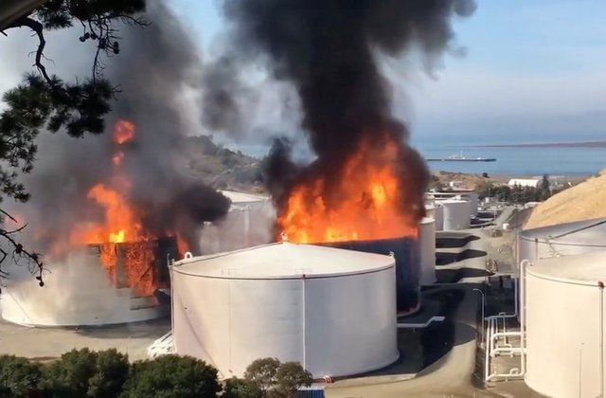
Discussions / Lessons Learned

