Slide 1
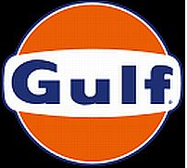
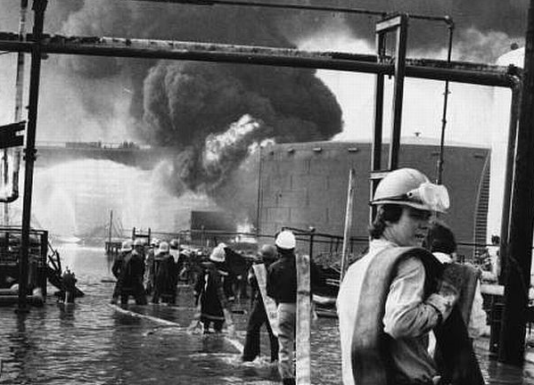
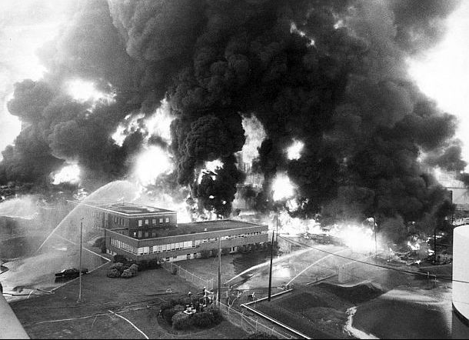
Refinery Fire in Philadelphia (1975)
Background
The 180,000 BPD Gulf Oil Philadelphia Refinery was one of the largest refineries in the country during the mid-1970s.
There were a total of 8 extra alarm fires in the prior 10 years of operation
Event
Oil tanker was filling storage tank with Venezuelan crude oil (additional 5% naptha) into tank 231
Tank overfill resulted in hydrocarbon vapors being pushed-out the tank vent; the gas cloud was ignited at the nearby Boiler House
Flash fire burned back to the tank; more liquid filled the dike, resulting in a large pool fire
Fire was nearly contained in a few hours with water and foam, but hydrocarbon/ water mixture was not adequately draining
Drainage pump power had be shut-off over concern of using the overhead power lines
Liquid flashed, while firefighters were standing in it. The firefighters couldn’t make it to the foam blanket
Fire spread and consumed fire trucks and foam pumpers
Consequences
8 fatalities and 14 injuries
Learnings
Ensure crude storage tank fills are closely monitored, especially for higher volatility feeds. Overfill mitigation is essential.
Ensure equipment that needs to function in the event of an emergency will be operational. Plan for the worst case scenario!
Promote a culture of learning from prior incidents and address any trends.
1
Boiler House Smokestack Crack
Link

