Slide 1
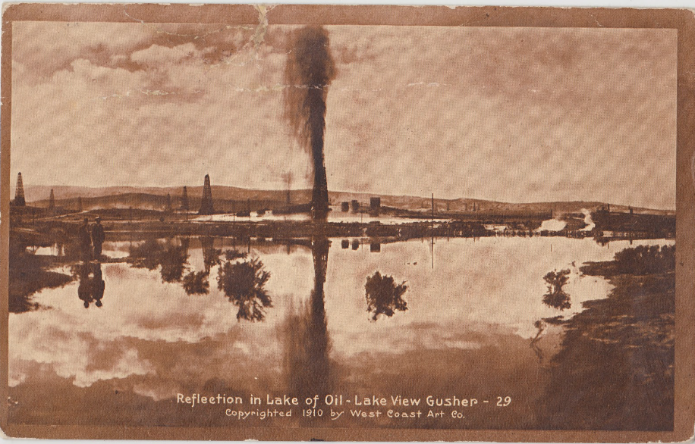
San Joaquin Valley Lakeview #1 Well (1910)
Early 1900’s Drilling Technology
Blunt piece of steel (~15 ft long) suspended from a cable run through a pulley
Wooden derrick
Cam Mechanism – moved up and down to get the steel object to chip at the downhole rock
Water was used to keep drill chips out of the way
A bailer was used for bulk chip removal (hollow pipe with a flapper)
The Event
Bailer was stuck in the well at >2,000 ft (indicative of higher pressure zone)
Operations Supervisor encouraged the driller to “unstick” the bailer using force.
Blowout!
The Outcome
Released ~9 million bbl of crude oil (~2x the quantity released by BP Machondo)
A lake of crude oil formed (up to 8 miles from the well)
“Such gushers were considered signs of success, and although feared, were actually relished. No one was particularly concerned about adverse environmental impacts in those days”
Reference
1

