Slide 1
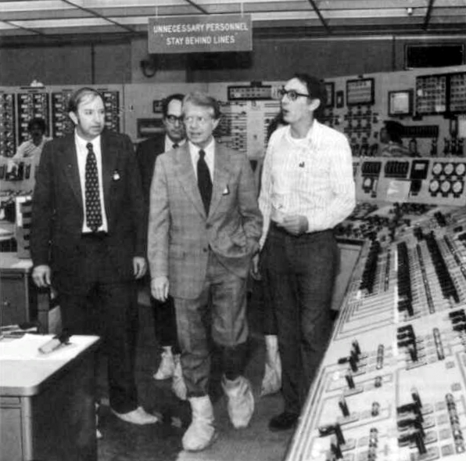
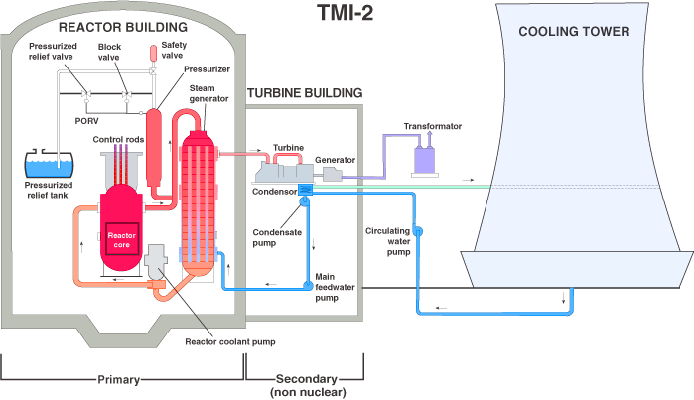
Three Mile Island Meltdown (1979)
Background
Three Mile Island nuclear power plant is located near Harrisburg, PA
The Pressurized Water Reactor (PWR) nuclear plant is currently owned by Excellon, but is scheduled to be shutdown in 2019
Event
Cooling circuit shutdown, allowing the primary coolant to overheat
TMI-2 Reactor shutdown immediately and the Relief Valve opened to reduce reactor pressure and temperature
Relief Valve was stuck in the open position and nearly all the water was released
Operators thought the Relief Valve was closed, due to no light indication in the control room- no light actually indicated that there was no power to solenoid valve!
New coolant entered the relief tank and operators responded by reducing the flow and overriding the automatic emergency system!
The remaining coolant turned to steam; fuel rods overheated, melting the protective layer
Consequences
Released a small amount of radioactive contaminant – not enough to harm people, animals, or crops
Decontamination of the TMI-2 reactor took 12 years and cost $973 million
Learnings
Ensure indications in the Control House are well understood. What triggers the indication? What is occurring in the plant?
Design, plan, and drill for smaller failures that may escalate.
Open Relief Valve
Link
Link

Slide 2
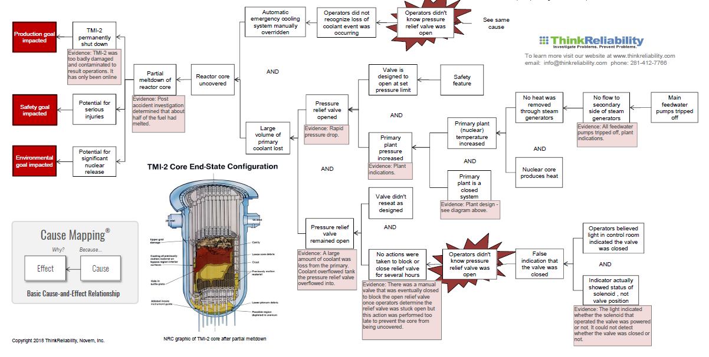
Three Mile Island Cause Map
Link

