Slide 1
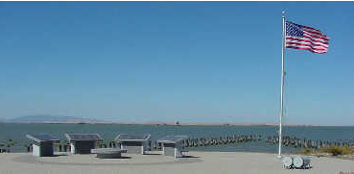
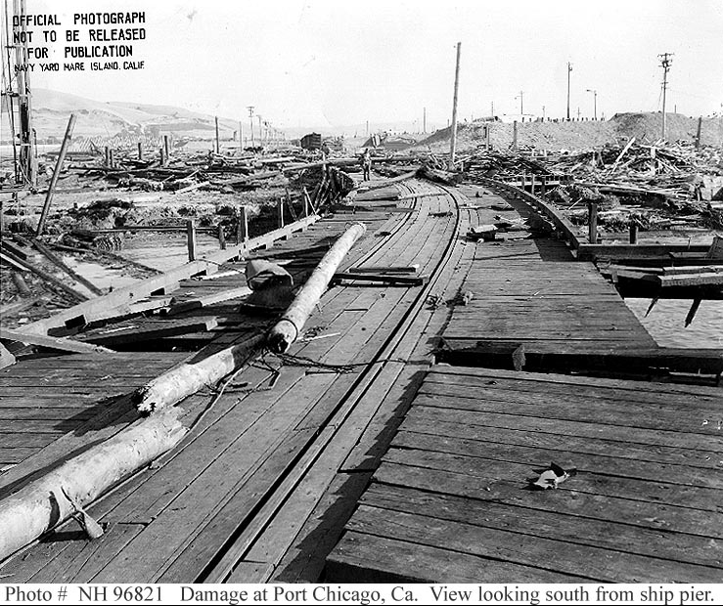
Port Chicago Explosion (1944)
Background
The town of Port Chicago was located in present-day Concord, CA on the Suisun Bay
The Concord Naval Weapons Station was built during WWII
Large quantities of bombs, shells, naval mines, torpedoes, and small arms ammunition were transported through the station
Leading-Up to the Event
Loading officers pushed the enlisted men to load the explosive cargos very quickly, initiating competition amongst crews
Workers were not trained in Safely handling the explosives
The loading winches experienced mechanical issues; the repair specialist witnessed a man accidentally drop a naval artillery shell, but there was no detonation
A Coast Guard explosives commander warned the Navy that conditions were unsafe and ripe for disaster. There was no follow-up.
Consequences
Large explosion occurred, which was thought to be triggered by a falling boom
320 fatalities and 390 injuries
Learnings
Always listen and address potentially unsafe conditions
Simplify and make the work process safer
Never compromise Safety in work competition
Link
Link

