Slide 1
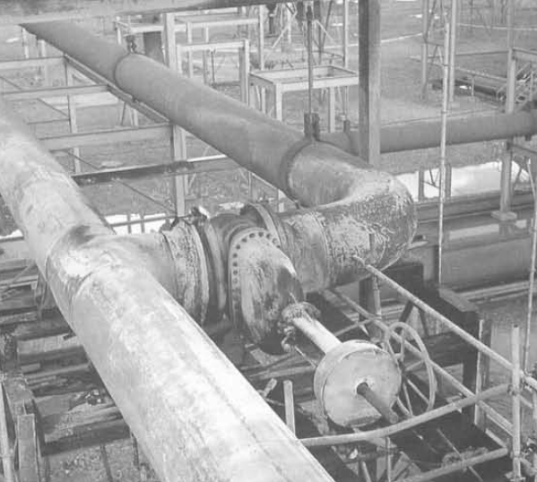
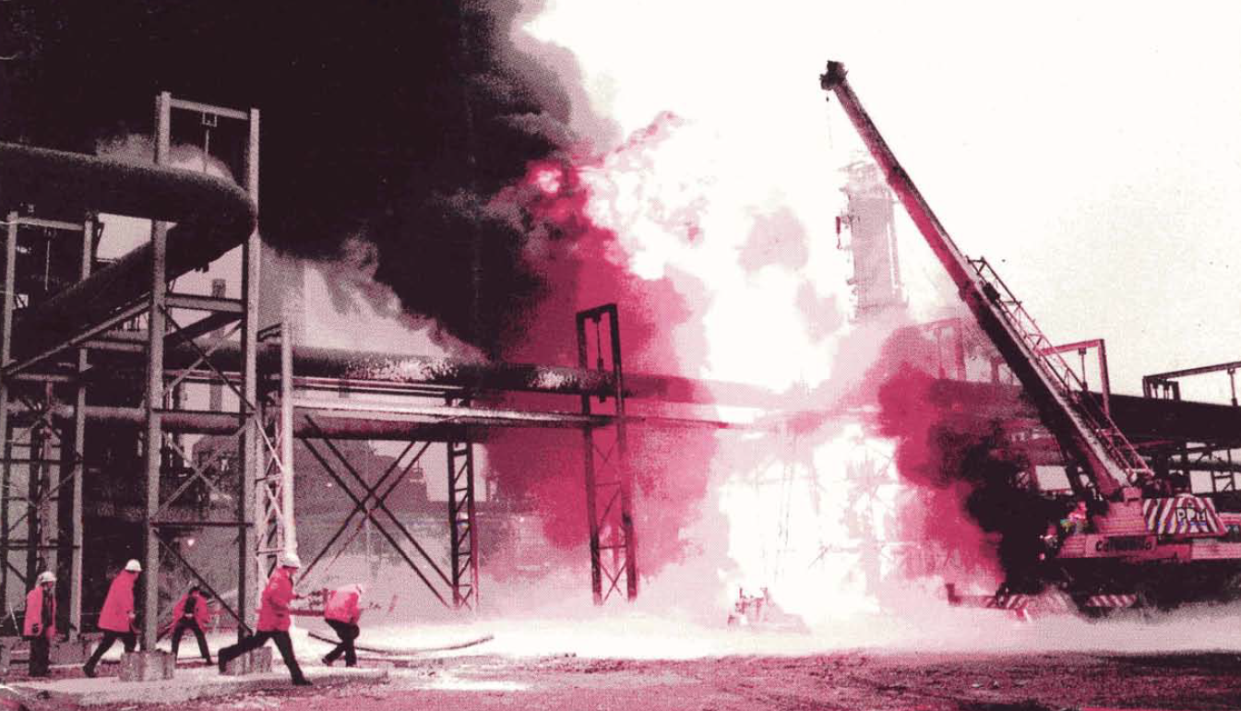
BP Grangemouth Flare Line Release (1987)
Background
The Grangemounth Refinery is a large refinery in the UK that has a throughput capacity of ~210 kBPD. The refinery is currently owned by Ineos.
The refinery flare system uses crossover valves to effectively isolate the three flares
Flare gas recovery losses were occurring and it was determined that crossover valve V17 was leaking-by
A decision was made to remove and overhaul V17
Event
Operations began isolating and blinding the section of the flare system with crossover valve V17- there was difficulty closing neighboring valve V10
The job was performed under fresh air and a water curtain was applied
An existing scaffold was used despite restricted egress
Visual checks were preformed on the isolation valves; system pressure was also checked at KO drum #1 and found to be 0 psig
When the flange bolts were loosened, liquid and gas came out– Stop Work Authority
Crossover Valve V17
Link
When the last bolt was removed, the crane lifted the valve and “gallons and gallons of liquid were coming from the pipe under pressure” onto the platform and the ground below
Consequences
A pool fire ensured, resulting in 2 fatalities and 2 serious injuries
Fire burned for hours due to difficulty in putting it out safely
Learnings
Never assume full closure for isolation valves. Sludge and scale can prevent closure.
Plan work so that egress can occur quickly and safely
Conduct a team review in the event of Stop Work Authority before continuing work

Slide 2
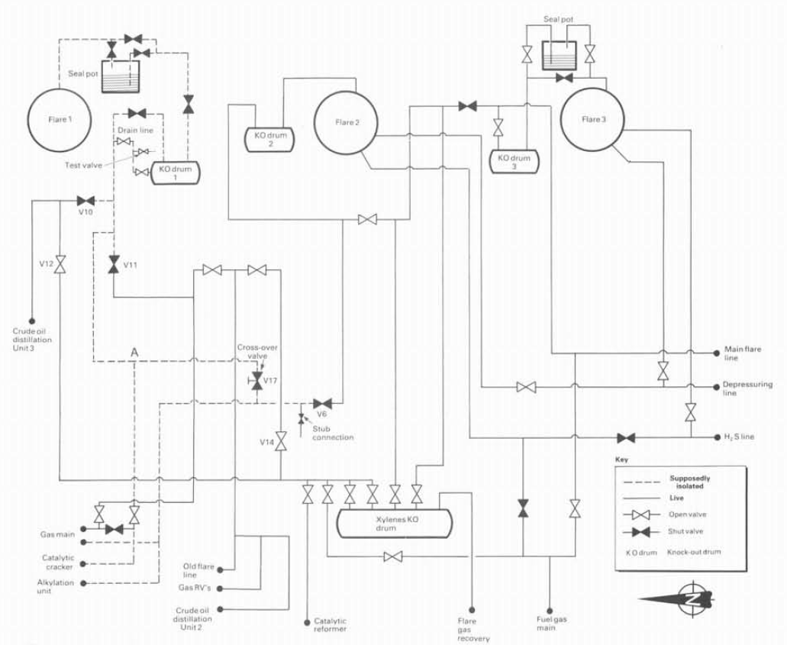
BP Grangemouth Flare Line Release (1987)
Valve not fully closed
Pressure gauge
Valve to be removed
Liquid accumulation
Link

