Slide 1
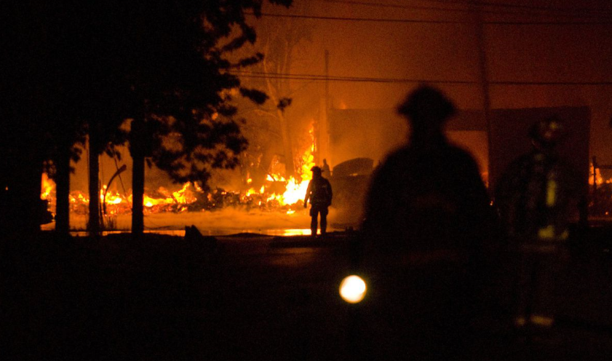
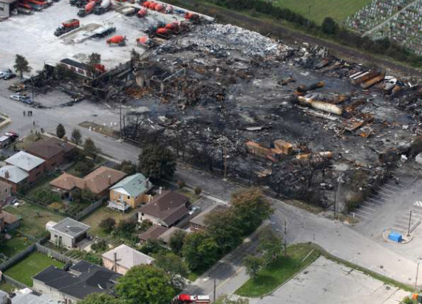
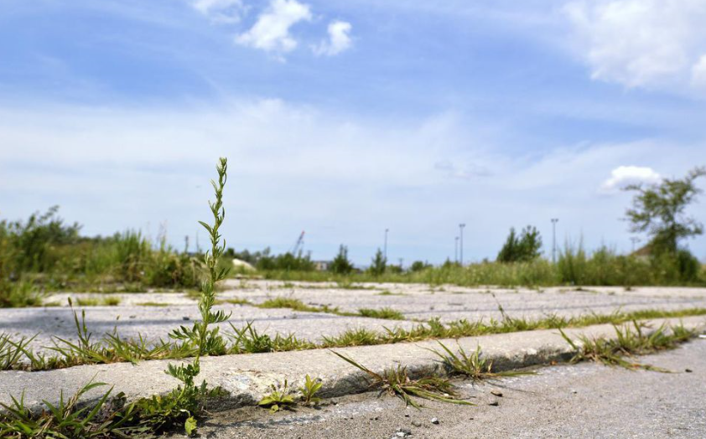

Sunrise Propane Explosion (2008)
Background
Sunrise Propane sold propane, helium, and acetylene for home uses in residential Toronto
The facility had been warned by Ontario’s Technical Standards and Safety Authority (TSSA) for its lack of Safety by not stopping truck-to-truck propane transfers in 2006
The TSSA allowed Sunrise to continue the illegal transfers while Sunrise was building a new tank on their property
Event
An illegal tank-to-tank transfer took place in the early morning hours the day of the incident
There was a hose leak after the transfer was completed
A Sunrise employee saw the vapor cloud at the site of the truck transfer and fled. He warned another employee, who decided to run into the cloud and was fatally injured
Consequences
2 fatalities and 12,000 residents evacuated
The Ontario TSSA shutdown all 7 operations a few days after the event due to inadequate workforce training
Sunrise left the clean-up to the City of Toronto
Learnings
Commitment to Process Safety is essential!
Always fully comply with all Safety Regulations
Hose integrity is very important!
Link
August 2008
August 2018
Link
Link

