Slide 1
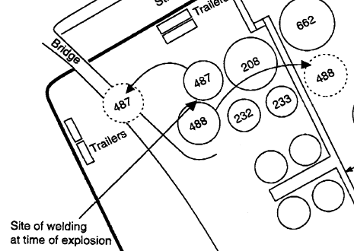
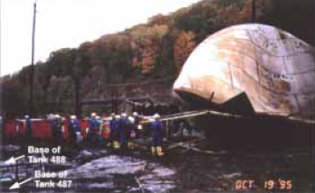
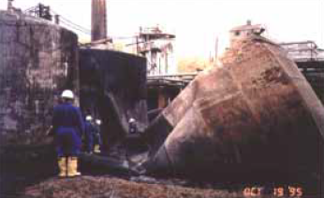
Pennzoil Refinery Tank Explosion (1995)
Background
The Pennzoil- Quaker State Refinery operated for >100 years until it was shutdown in 2001
Tanks 487 and 488 were for waste water treatment and were not connected to other tanks. The tanks shared a dike with neighboring tanks.
Event
A hot work permit was granted to begin welding on a service stairway between tank 487 and 488 after the gas test indicated absence of combustible vapors- good for 7:40 AM – 3:30 PM
One welder and one fire watch began the welding repair
At ~10 AM the welders returned to work and had to jump start the welding machine; a follow-up gas test was not conducted
At ~10:15 AM, a “whooshing” sound and a low boom were heard as flames engulfed tank 487
An explosion in tank 488 occurred less than a minute later
Consequences
5 fatalities and 2 serious injuries
13 liquid storage tanks were damaged and contractor trailers were demolished
Learnings
Ensure that potential vapor release sources from tanks are controlled. Gas testing is an important activity for ensuring job Safety.
Ignition sources should be minimized and controlled
487
488
Link

Slide 2
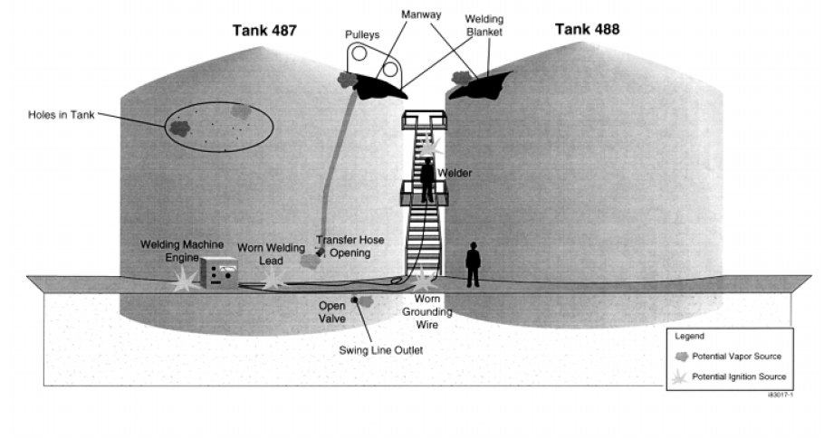
Pennzoil Refinery Tank Explosion (1995)
Potential Sources of Ignition:
Welding Rod or Sparks
Welding Machine
Electrical Arcing from Welding or Grounding Cables
Potential Sources of Vapor:
Escape from Open Manway – manway could not be vapor tight when transfer hose was in-place
Escape from Swingline – swingline entered the vapor space inside the tank and the swingline valve was open outside of the tank
Escape from Transfer Hose – the 3 inch transfer hose was open
Escape from Holes in Tank – holes up to ¼” diameter were found in tank 487 after the event
Link

