Slide 1
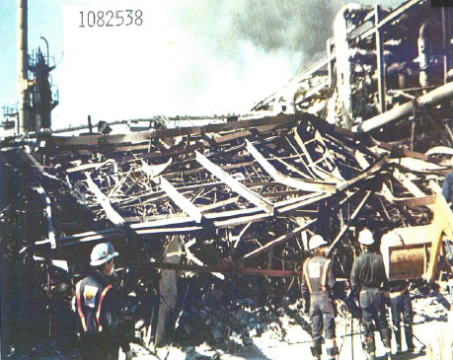
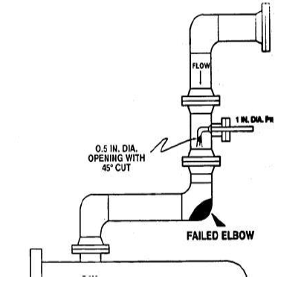
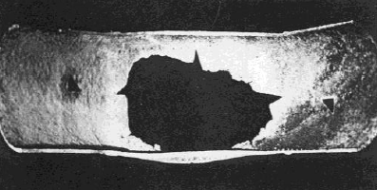
Shell Norco Explosion (1988)
Background
The ~250,000 BPD Shell Norco Refinery is located near New Orleans, LA
The refinery has been in operation since 1916 and was purchased by Shell in 1929
Event
A large propane release occurred from the depropanizer overhead line on the Catalytic Cracking Unit (CCU)
Release was ignited within ~40 seconds, resulting in a strong explosion
Consequences
7 fatalities and ~50 injuries (personnel and public)
Explosion destroyed the CCU and other units, disabled site firewater, steam, communication, and the emergency alert systems
Investigation
Pipe failure occurred 44” below an ammonia-water injection point that was installed 5 years earlier to prevent corrosion due to H2S, CO2 and cyanides
Incomplete dispersion of the corrosion inhibitor resulted in a acidic zone at the outside edges of the spray cone
UT measurements at the center of the elbow did not detect the localized corrosion “groove”
Learnings
Identify and address cases where there is potential for localized corrosion
Ensure any areas with potential for localized corrosion are thoroughly inspected
Control ignition sources in the plant
Failed 8” Elbow
Reference & AFPM
Notes:
A reactor trip occurred during hydrocracker start-up, which was thought to be spurious
No over-temperature condition found
Control system was verified to be working

