Slide 1
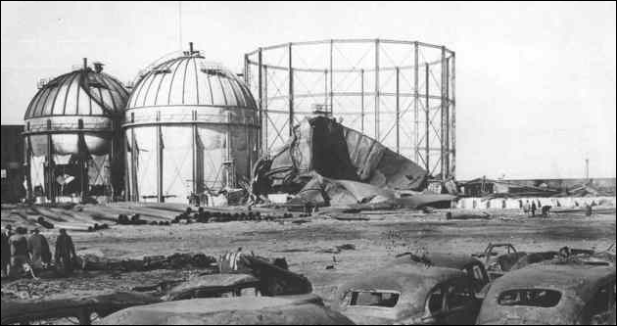
East Ohio Gas LNG Incident (1944)
Circumstances Before Release:
LNG peak shaving facility located in the center of Cleveland’s east side in an urban neighborhood
Built 3 spherical LNG tanks to alleviate supply problems associated with the war effort (1941)
Built cylindrical LNG tank on low budget (wartime economics) to alleviate further shortages (1943)
Cylindrical design saves steel (less supports)
Low Ni (3.5%) steel alloy was used
Rock wool insulation was more readily available and less expensive compared to cork
Cylindrical tank bottom cracked upon first pour of LNG due to uneven cooling
“Frosting” observed with cylindrical tank – possibly due to:
Settling of the rock wool insulation
Relatively uninsulated spots between the inner and outer shells
East Ohio Gas Company LNG Tanks
1
50,000 ft³
cork insulation
2
50,000 ft³
cork insulation
3
50,000 ft³
cork insulation
4
100,000 ft³
rock wool insulation
Source
Source

Slide 2
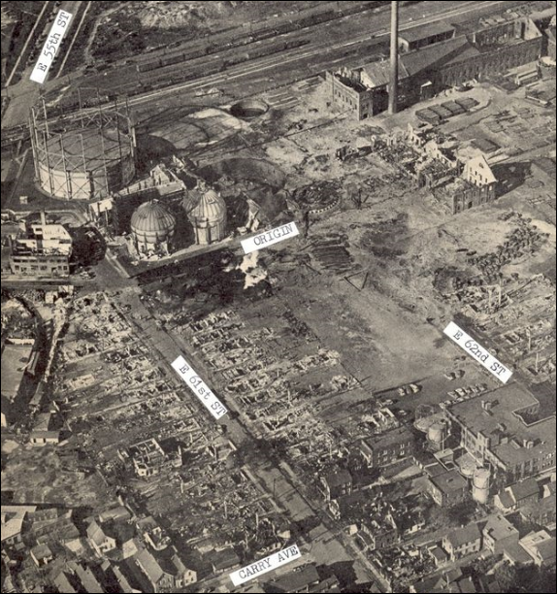
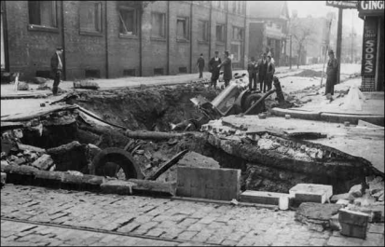
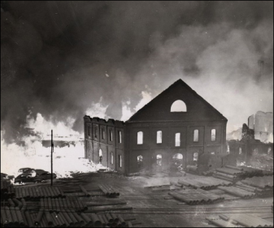
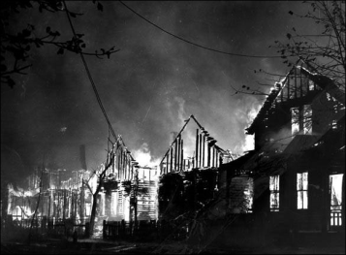
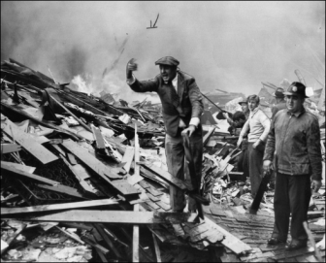
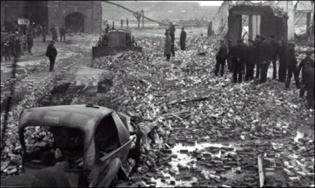
East Ohio Gas LNG Incident (1944)
LNG Release Event:
Laboratory workers spotted white vapor leaking from the LNG tank (2:30 PM 10/20/44)
10 minutes later – “violent explosion from sewer”
Flames as high as 2,500 ft in the air
Everything within a half mile was completely destroyed
Gas was trapped in the sewer systems and exploded
Consequences:
130 fatalities, 225 injuries
Destroyed plant and city
Industry Learnings:
Improved metallurgy and insulation for LNG tanks
Closed sewer systems; urban areas away from facilities
Source
Source

