Slide 1
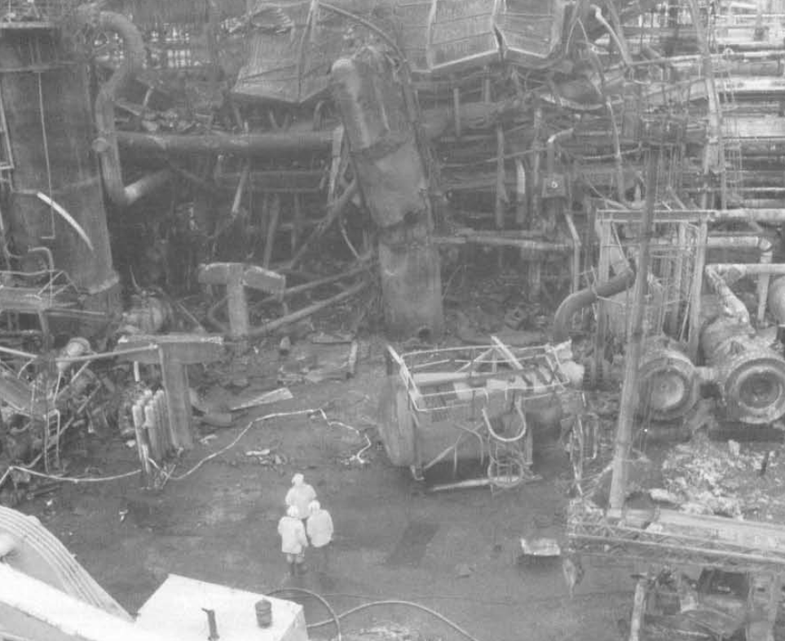

BP Grangemouth Hydrocracker Explosion (1987)
Background
The Grangemounth Refinery has been operating since 1924
BP sold the refinery to Ineos in 2005; throughput is ~210,000 BPD
Event
A reactor trip occurred during hydrocracker start-up, which was thought to be spurious
Hydrocracker Unit was placed in “stand-by” mode with no fresh feed
Manual, air-controlled HP separator control valve opened 3 times – HP gas broke through to the LP separator
  HP separator LL level trip was previously disconnected
  Operations did not trust the HP separator level float; offset was not read correctly on chart recorder
LP separator violently exploded
Consequences
1 fatality, 8 operators escaped through the rear exit of a brick control room that was destroyed
Learnings
Safety systems need to be adequate and “trustworthy”
Fully investigate and address spurious alarms
Relief valves need to be sized for the worst case scenario
Link
Am I Trustworthy?
Link

Slide 2
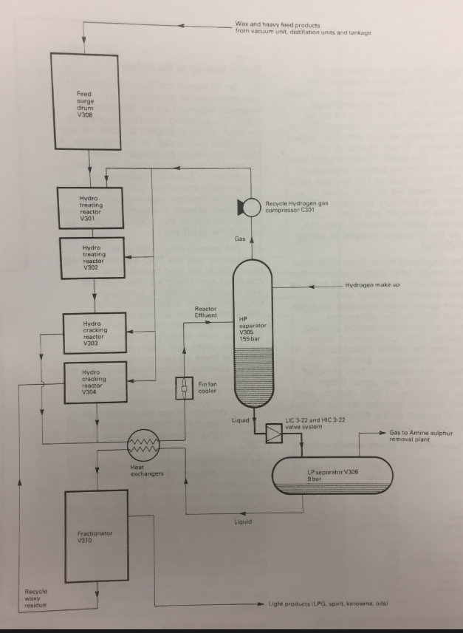
BP Grangemouth (1987)
Pre-Conditions:
Audit Finding not addressed-
1975 audit item identified the potential for gas breakthrough from the HP to the LP separator. Recommended improvements for HP Separator (V-305):
  Retain LL indication
  Duplicate level for level instruments
Valve between the HP and LP separators was placed in manual as its solenoid was disconnected
Operations remembered a previous gas breakthrough incident from 2 years prior that was not reported
~2,200 psig
Gas breakthrough location
~130 psig
PRV not designed for HP gas breakthrough
Link

