Slide 1
Understanding RAGAGEP for refineries
What is and is not a Ragagep

Slide 2
RAGAGEP
Say what you do and do what you say
Background and Interpretations

Slide 3
Definition of a RAGAGEP (Fed/OSHA 2015 memo)
RAGAGEP Background
Recognized and Generally Accepted Good Engineering Practices (RAGAGEP)
The term is referenced four times in the PSM Standard:
    Paragraph (d)(3)(ii) requires employers to document that process equipment complies with RAGAGEP;
    Paragraph (d)(3)(iii) addresses situations where the design codes, standards, or practices used in the design and construction of existing equipment are no longer in general use. In such cases, the employer must determine and document that the equipment is designed, maintained, inspected, tested, and operating in a safe manner.
    Paragraph (j)(4)(ii) requires that testing and inspecting procedures of process equipment to comply with RAGAGEP.
    Paragraph (j)(4)(iii): Inspection and test frequency follows manufacturer's recommendations and good engineering practice, and more frequently if indicated by operating experience.

Slide 4
Definition of a RAGAGEP (Fed/OSHA)
May 11, 2016 - OSHA publishes a revised memo defining Recognized and Generally Accepted Good Engineering Practices (RAGAGEP) for the first time.
4 categories of acceptable RAGAGEP:
  (1) Published and widely adopted codes (e.g., NFPA 70 National Electric codes);
  (2) Published consensus documents (e.g., ASME B31.3 Process Piping Code);
  (3) Published non-consensus documents (e.g., the Chlorine Institute’s (CI) “pamphlets” that depart from ANSI’s due process requirements for rulemaking and specifically focus on chlorine and sodium hypochlorite (bleach) safety); and
  (4) “Appropriate” internal standards set by the employer (Not in 5189.1)

Slide 5
Definition of a RAGAGEP (Fed/OSHA)
Shall vs. Should in Published Codes/Standards
Shall
  OSHA considers “shall” requirements to be “a mandatory minimum requirement.”
  OSHA will presume a violation if an employer deviates from either a “shall” or “shall not” requirement in the applicable RAGAGEP.
Should
  “Should” requirements are the “acceptable and preferred approach.”
  OSHA presumes that employer compliance with the recommended approach is acceptable.
  If an employer does not follow a “should” requirement, the compliance officer will do an evaluation to decide if the alternative practice is as protective as the “should” provision in the code or standard.
    Compliance officer will examine documents (e.g., PHAs and MOCs) to determine if the employer’s approach is as protective as the published RAGAGEP and is a good engineering practice.

Slide 6
Definition of a RAGAGEP (Fed/OSHA)
Internal Standards
Employers’ internal standards must either meet or exceed the protective requirements of published RAGAGEP where such RAGAGEP exist. (2015)
If an employer develops and follows internal procedures, the CSHO should assess whether the internal procedures represent RAGAGEP. Like all employers complying with the PSM standard, an employer using internal procedures as RAGAGEP has an obligation under 1910.119(d)(3)(ii) to document that its equipment complies with recognized and generally accepted good engineering practices. (Revised 2016)

Slide 7
Definition of a RAGAGEP (Fed/OSHA)
Internal Standards
  Reasons an employer might choose to follow internal standards can include:
    Translating the requirements of published RAGAGEP into detailed corporate or facility implementation programs and/or procedures.
    Setting design, maintenance, inspection, and testing requirements for unique equipment for which no other RAGAGEP exists.
    Supplementing or augmenting RAGAGEP selected by the employer that only partially or inadequately address the employer's equipment.
    Controlling hazards more effectively than the available codes and consensus and/or non-consensus documents when deemed necessary by the employer's PSM program.
    Addressing hazards when the codes and consensus and/or non-consensus documents used for existing equipment are outdated and no longer describe good engineering practice.

Slide 8
Definition of Ragagep:
    Title 8 5189.1 for Refineries - Definition of Recognized and Generally Accepted Good Engineering Practices:
      Engineering, operation or maintenance activities established in codes, standards, technical reports or recommended practices, and published by recognized and generally accepted organizations such as the American National Standards Institute (ANSI), American Petroleum Institute (API), American Society of Heating, Refrigeration and Air Conditioning Engineers (ASHRAE), American Society of Mechanical Engineers (ASME), American Society of Testing and Materials (ASTM), National Fire Protection Association (NFPA), and Instrument Society of America (ISA). RAGAGEP does not include standards, guidelines or practices developed for internal use by the employer.

Slide 9
RAGAGEP Used In: 5189.1(d)(7)(8)(9)
(7) The employer shall document that process equipment complies with RAGAGEP, where RAGAGEP has been established for that process equipment, or with more protective internal practices that ensure safe operation.
(8) If the employer installs new process equipment for which no RAGAGEP exists, the employer shall document that this equipment is designed, constructed, installed, maintained, inspected, tested and operating in a safe manner.
(9) If existing process equipment was designed and constructed in accordance with codes, standards or practices that are no longer in general use, the employer shall document that the process equipment is designed, installed, maintained, inspected, tested and operating in a safe manner for its intended purpose.

Slide 10
RAGAGEP Used In 5189.1- (j)(2)(A)(B) and (3)(A)
(2) Inspection and testing.
  (A) Inspections and tests shall be performed on process equipment using procedures that meet or exceed RAGAGEP.
  (B) The frequency of inspections and tests shall be consistent with: (1) the applicable manufacturer's recommendations, (2) RAGAGEP or (3) internal practices that are more protective than (1) or (2). Inspections and tests shall be conducted more frequently if necessary, based on the operating experience with the process equipment.
(3) Equipment deficiencies.
  (A) The employer shall correct deficiencies to ensure safe operation of process equipment. Repair methodologies shall be consistent with RAGAGEP or more protective internal practices.

Slide 11
RAGAGEP Used In 5189.1- (4) Quality assurance.
(B) If the employer installs new process equipment or has existing process equipment for which no RAGAGEP exists, the employer shall document and ensure that this equipment is designed, constructed, installed, maintained, inspected, tested and operating in a safe manner.

Slide 12
RAGAGEP applies
As used in the PSM standard, RAGAGEP apply to process equipment design and maintenance; inspection and test practices; and inspection and test frequencies. Examples:
  API 510 Pressure Vessel Codes
  API 537 Flare System
  API 570 Pipe Inspection Code
What it does NOT apply to is:
  API/RP 755 Fatigue Risk Management Systems for Personnel in the Refining and Petrochemical Industries
  API Environmental Health & Safety Mission and Guiding Principles
  Most CCPS Books

Slide 13
Cal/OSHA Use of the Word “Should” in Ragagep
Use of the term "should" or similar language in RAGAGEP denotes a recommendation that reflects an acceptable and preferred practice. If a "should" provision in the employer's selected RAGAGEP is applicable to the covered process or particular situation, the CSHO will presume that the employer’s compliance with the recommended practice is acceptable.
If an employer selects RAGAGEP that contains "should" provisions, but does not follow them, the CSHO will evaluate whether the employer's approach reflects recognized and generally accepted good engineering practices and whether the employer documented that its equipment complies with RAGAGEP. An employer does not need to document deviations from a "should" statement provided it documents that its equipment complies with RAGAGEP.

Slide 14
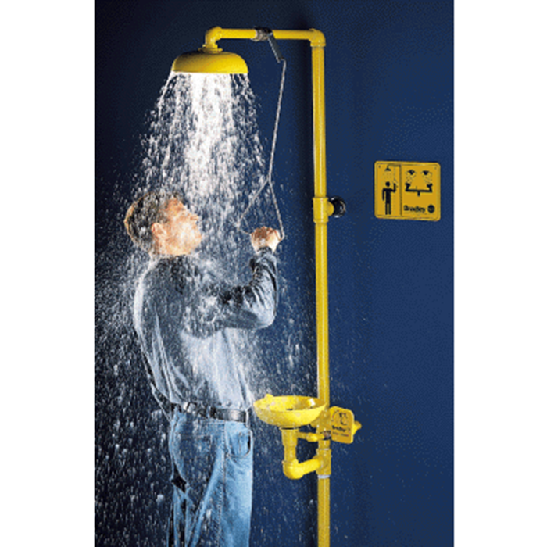
SAFETY SHOWERS IN ammonia refrigeration ENGINE ROOMS, WHAT'S EVERYONE GETTING ALL WET ABOUT?

Slide 15
T8 §5162. EMERGENCY EYEWASH AND SHOWER EQUIPMENT.
(a) Plumbed or self-contained eyewash or eye/facewash equipment which meets the requirements of sections 5, 7,or 9 of ANSI Z358.1-1981, Emergency Eyewash and Shower Equipment. incorporated ...reference, shall be provided at all work areas ...,during routine operations or foreseeable emergencies, the eyes of an employee may come into contact with a substance which can cause corrosion, severe irritation or permanent tissue damage or which is toxic by absorption. Water hoses, sink faucets, or showers are not acceptable eyewash facilities. Personal eyewash units or drench hoses which meet the requirements of section 6 or 8 of ANSI Z358.1-1981

Slide 16
T8 §5162. EMERGENCY EYEWASH AND SHOWER EQUIPMENT.
(c) Location. Emergency eyewash facilities and deluge showers shall be in accessible locations that require no more than 10 seconds for the injured person to reach. If both an eyewash and shower are needed, they shall be located so that both can be used at the same time by one person. The area of the eyewash and shower equipment shall be maintained free of items which obstruct their use.

Slide 17
THINGS TO THINK ABOUT ...
What is an obstruction?
What is accessible location ?
How far can you walk in 10 seconds?
Is anhydrous ammonia a "strong acid."?
Catastrophic Release?

Slide 18
THINGS TO THINK ABOUT ...
Catastrophic Release?
  2010 Tulare ammonia safety day; out of 800 representing ammonia refrigeration facilities, two have seen a catastrophic release of anhydrous ammonia. Everybody in the last 3 years have seen a "minor" release.

Slide 19
IiAR 2 §6.3 .1.4
Eye-wash & Shower Station
  Shall be located outside the exit door and another recommended inside machinery/engine room
Is there a conflict?

Slide 20
Let's Discuss ...
Enforcement (by Cal/OSHA)
  T8 §5162 vs. lIAR 2 §6.3.1.4

Slide 21
Lastly, a Brain Teaser for our next meeting
MOC (n)(3) Prior to implementing a major change, the employer shall review or conduct a DMR pursuant to subsection (k) and perform an HCA pursuant to subsection (l). The findings of the DMR and recommendations of the HCA shall be included in the MOC documentation.
Major Change. Any of the following:
  Introduction of a new process, new process equipment, or new highly hazardous material;
  Any operational change outside of established safe operating limits; or,
  Any alteration that introduces a new process safety hazard or worsens an existing process safety hazard.
Process Equipment. Equipment, including pressure vessels, rotating equipment, piping, instrumentation, process control, or appurtenance related to a process.

Slide 22
Questions

