Slide 1
LOP Flare Pilot Outage Shell Martinez Refinery 7/6/18
Nathan Hanna
Operations Support Engineer
Austin Schipper
Reliability Engineer
Tim Sloper
Senior Operator

Slide 2
Agenda
Event Description
Impacts of the Event
Root Causes
Recommendations
Question and Answer Session

Slide 3
July 6th, 2018 Event Description
00:57 AM – The (Light Oil Processing) LOP instrument air header pressure dropped from 109 psig to 76 psig due to a failure of a mechanical linkage between two valves on an instrument air dryer.
01:03 AM – The dip in instrument air header pressure caused a flaring event that extinguished the LOP flare pilots by carrying water from the flare lines to the flare tip.
03:10 AM – An unrelated unit upset caused a second flaring event and a release of unburned flare gas from the LOP Flare while the flare pilots were still extinguished.
Notes:
The flare is a safety device that is designed to combust excess gas at the refinery. During normal operation, the flare is always lit

Slide 4
Impact from the Event
Release of uncombusted flare gas from the LOP flare.
A Community Warning System (CWS) level 2 was called as a precaution
No impact to people or assets.
Required agency notifications were made.
Ground Level Monitors located on the facility fence-line showed no detection of H₂S or SO₂ above background levels.
Community sampling did not detect any offsite readings.
Notes:
2) A Community Warning System Level 1 was called for the 1AM flaring event and the level 2 was called for the release of unburned flare gas.
3) No impact to people or assets internal or external to the site.
4) Required agency notifications were made during the event to the county, local law enforcement, and Cal OSHA.
5) Elevated H2S or SO2 levels would be an indication of potentially hazardous materials.
6) Shell sent teams with portable gas detectors into the surrounding community to sample for noise and toxic materials, such as H2S, SO2, and combustible hydrocarbons.

Slide 5
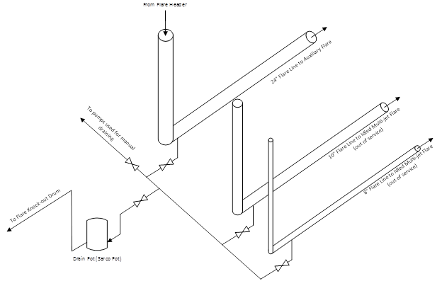
Root Cause #1 – Flare Line Drain System

Slide 6
Root Cause #1 – Flare Line Drain System
The elevated flare is used to combust flare gas in a controlled manner when unit upsets occur in the refinery.
Flare gases are transported to the flare tip using a 24” line that is sloped to drain liquid back to a collection manifold.
Steam is always injected into the flare during normal operation to keep the flare tip hot and condenses into the 24” flare line.
The flare header collection manifold drain pot continually pumps liquid out of the collection manifold.
Operations also drains the collection manifold on a weekly basis using one of three pumps which were connected to the manifold.
Two other lines are connected to the collection manifold, an 8” line and a 10” line, which are blinded upstream and downstream of the collection manifold.

Slide 7
Root Cause #1 – Flare Line Drain System
Evidence from the investigation indicated that there was a significant accumulation of water in the flare line prior to the incident.
The water in the 24” flare line came from steam condensing at the flare tip and flowing back into the flare line towards the collection manifold
The flare header drain pot (Sarco pot) was ineffective at removing the water.
The weekly draining by operations did not successfully remove all the water.
Vapor that caused the pump to speed up came from the 10” and 8” lines
Notes:
1) Typically the water is removed by the drain pot and weekly pump outs.
4) The operator would believe that the 24” line was properly drained based on the speeds of the pump.

Slide 8
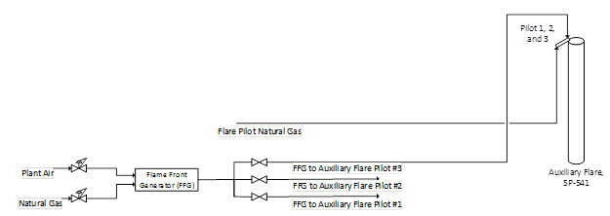
Root Cause #2 – Flare Pilot Relighting System
The pilots are initially lit or re-lit with a flame front generator lighting system
This system fills a ¾” pipe between a remote ignition station and the flare pilot burner with a combustible air and fuel mixture.
When the pipe is fully primed with a combustible mixture the mixture is ignited and the flame travels from the lighting station to the pilot burner to ignite it.
Notes:
1) The flare pilots are always lit, similar to a water heater in your house.

Slide 9
Root Cause #2 – Flare Pilot Relighting System
After the flaring event at 1:03 AM, the flare pilots were unable to be relit even though operations had started trying to relight the pilots immediately after the event.
It was quickly discovered that the flame was unable to travel from the ignitor panel to the flare pilots.
The piping from the ignitor panel to the pilots was plugged with a combination of corrosion product and water.
This caused a delay in the relighting of the pilots and the pilots to remained unlit during the second flaring event at 3:10 AM.
Notes:
3) The build up of corrosion product, such as rust, and water from the 1AM flaring event.
4) The flare pilots were relit after the 3AM flaring event.

Slide 10
Recommendations
A total of 13 recommendations were identified by the investigation team, including:
Evaluate the current functioning of the flare line drain pot. If the drain pot is not functioning as expected, troubleshoot the issue and ensure the drain pot is repaired.
Evaluate the carbon steel portions of the flame front generator lines.
Identify flare pilot system and pilot ignition system for all flare systems as Safety Critical Equipment (HEMP). Ensure the critical activities to maintain the equipment in good condition are identified and implemented.
Learnings from this event were incorporated into the procedures and the unit Process Hazard Analysis (PHA).
Notes:
This recommendations has been completed and repairs were made.
A project to upgrade significant portions of flame front generator lines to stainless steel, and determine whether the rest of the line needs to be upgraded to stainless steel.
HEMP is a Shell internal program to manage Safety Critical Equipment.
PHAs are a systematic approach to evaluate initiating events and barriers to prevent potentially dangerous scenarios.

Slide 11
Questions and Answers

